Slide 1
Lecture13: Processing
Copyright (c) Pearson 2013.
All rights reserved.

Slide 2
Processing
Processing started by Ben Fry and Casey Reas while both were graduate students at MIT Media Lab in 2001.
Processing is Java.
Designed for visual artists with limited programming experience who want to create art without knowing complicated Java syntax.
In its current version, hundred of libraries have been written for computer vision, data visualization, music composition, networking, 3D drawings and programming electronics.

Slide 3
Structure of a Sketch
A sketch or program in processing only needs two method: setup and draw. All methods in Processing are non-static. setup() is similar to a constructor, it initializes variables. draw() is similar to the main method.
//declare variables on top
//setup() similar to constructors; initialize variables, runs ONCE.
void setup()
{…}
//draw is a loop that runs
//automatically 60 frames per second.
//used for animation.
void draw()
{…}

Slide 4
File System
When a sketch is saved, Processing will create new folder whose name matches the name of the sketch(without the .pde extension). For example, if I save the sketch below as Main.pde, then Main.pde is in a folder called Main.
void setup()
{…}
void draw()
{…}

Slide 5
Example
int x,y; //declare global variables
//initialize them in setup().
void setup(){
x=5;
y=10;
}
// modify and update them in draw().
void draw()
{
x+=1; //x increases by 1, 60 times per second.
}

Slide 6
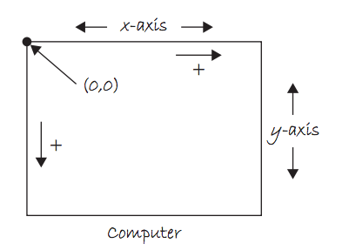
Coordinate System

Slide 7
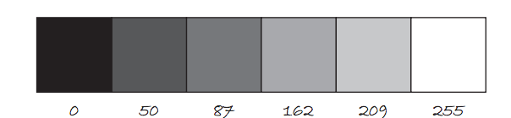
Color
Color is defined by a range of numbers.
In grayscale, 0 is black, 255 is white and any color in between is a shade of gray ranging from black to white.

Slide 8
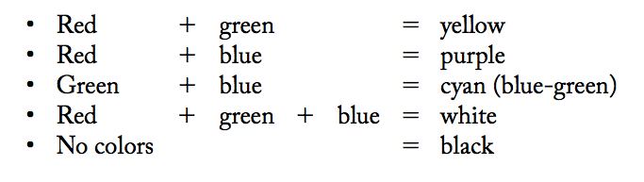
Color
RGB Color is determined by three parameters. Each parameter is in the range 0-255. The first indicates the degree of red(R), the second the degree of green(G) and the last the degree of blue(B).

Slide 9
Some Methods
size(int width, int height): Set the size of the window. This should go in setup(). width and height are reserved words referring to the size of the screen.
background(int range): range can be any integer from 0=black to 255=white. This should go in draw().
background(int r, int g, int b): Background with RGB values. This should go in draw().

Slide 10
Some Methods
fill(int r, int g, int b):By calling fill before a shape will set the color of the shape.
line(int x1, int y1, int x2, int y2):
ellipse(int x, int y, int width, int height): center of ellipse is (x,y); width and height are the lengths of the axes.
rect(int x, int y, int width, int height): position is top left corner by default.

Slide 11
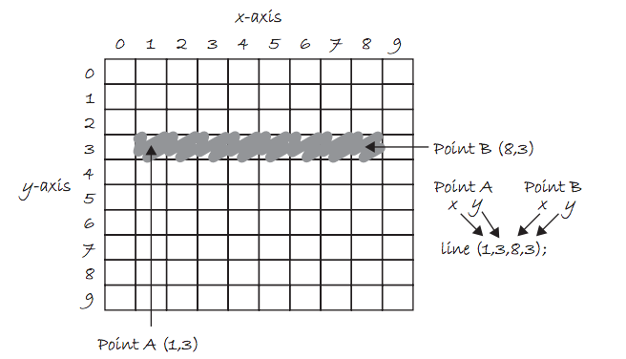
Draw a Line

Slide 12
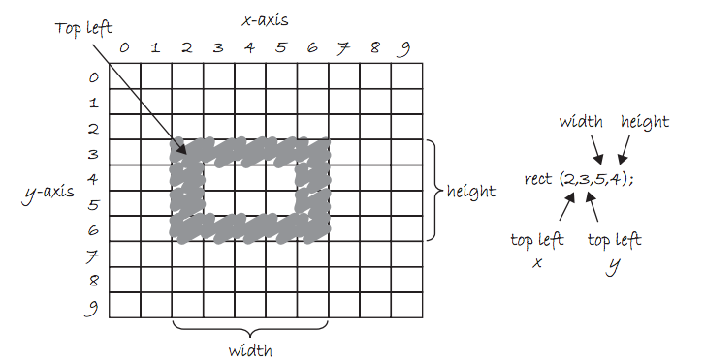
Draw a Rectangle

Slide 13
Example 1
int x,y;
void setup(){
size(800,600); //800 pixels by 600 pixels
x=width/2; //width=800, height=600
y=height/2; }
void draw(){
background(255);//white background
fill(255,0,0);//red fill
ellipse(x,y,80,80);//red-filled circle radius 40
//continued on the next slide…

Slide 14
Example 1 Continued..
fill(0,255,0);//green fill
ellipse(x,y,80,80);//green-filled circle radius 40
fill(0,0,255); //blue fill
//blue filled rectangle at (40,50) width=60,height=70
rect(40,50,60,70);
}

Slide 15
Example 2:Make it move.
int x, y, xspeed=5;
void setup(){
size(600,400);
x = width/2;
y = height/2;}
// make a red circle moves horizontally
// across the screen
void draw(){
background(255);//white background
fill(255,0,0); //fill red
ellipse(x,y,80,80);
x += xspeed;//moves 5*60=300 pixels per sec.
}

Slide 16
Processing (keyPressed)
The draw() loop runs continuously until it is interrupted by an event, for example, a keyboard or mouse event.
If a key is pressed, draw() temporarily halts, Processing then jump execution to the keyPressed() function, runs the function’s code then return control to the draw() loop. The key that is pressed is store in the key variable.(or keyCode if it is a special character, e.g. UP, DOWN, LEFT, RIGHT).

Slide 17
Processing (keyPressed)
void setup(){…}
void draw(){…}
void keyPressed(){
if(key==‘a’){//for letter keys
//code to run if ‘a’ is pressed.
}
if(keyCode==UP) {//for arrow keys: UP,DOWN, LEFT, RIGHT
//code to run if UP is pressed.
}
}

Slide 18
Processing: Mouse Events
Processing keeps track of the position of the mouse at any given time through the variables mouseX, mouseY.
Similar to keyPressed, which responds to keyboard inputs, mouseClicked is a function that can be implemented to respond to the mouse being clicked.

Slide 19
What does it do?
int blue=0;
void setup(){
size(600,600);
}
void draw(){
background(255);
fill(255,0,blue);
ellipse(mouseX,mouseY,100,100);
}
void mouseClicked(){
if (blue==0)
blue=255;
else
blue=0;
}

Slide 20
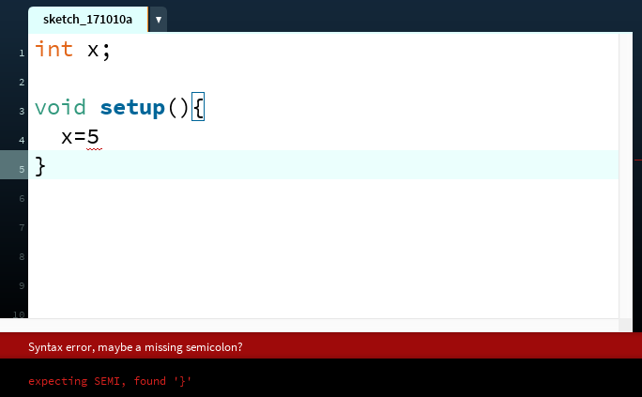
The Console
The console refers to the box at the bottom of Processing. It is generally used to print error messages in the code.
Notes:
ask them, how might the computer store "hi" using binary digits? (some kind of mapping; ASCII)

Slide 21
The Console
  Messages can be printed on the console(for error-checking purposes, etc..) by using the command println() or print().
  println(4); // 4
  println(4+3/2); // 5
  println(“Hello, world”);
Notes:
ask them, how might the computer store "hi" using binary digits? (some kind of mapping; ASCII)

Slide 22
float vs double
float: 32-bit data type representing real numbers to about 7 decimal places.(Not on AP Exam)
double: 64-bit data type representing real numbers to about 16 decimal places.
Since Processing is graphics intensive, it is recommended that floats are used instead of doubles. In fact, float is the default type for decimal numbers in Processing. All of the built-in math functions in Processing returns floats. The math functions from the standard Math library in Java returns doubles.
//sqrt() is Processing’s version of Math.sqrt(). Both available in Processing
double a = Math.sqrt(9); // a = 3.0 but is a double
float b = sqrt(9); // b = 3.0 but is a float

Slide 23
Download Processing
Download Processing in your computer at home!
Your computer is probably a 64-bit computer if it’s fairly recently. Use the 64-bit version.
http://www.processing.org

Slide 24
Things to Try
Lab 1: Make the ball move horizontally back and forth in the middle of the screen, bouncing each time it hits the left or right side of the screen.
Modify your code so that it is moving in a diagonal direction and bouncing when it hits any side of the screen.

Slide 25
Things to Try
Lab 2: Draw a rectangle at the center of the screen. Let the user move the ball up, down, left, right using the keyboard arrow keys. You need the following method in your code.
//if a key is pressed, the draw() loop is temporarily interrupted
//to execute this method; once done, it returns to the draw loop.
void keyPressed(){
// depends on which key is pressed, a specific action is performed.
if(key==‘a’){} //for letter keys
if(keyCode==UP) {} //for arrow keys: UP,DOWN, LEFT, RIGHT
}

Slide 26
Things to Try
Lab 3: Use mouseX and mouseY to write a program that draw a red ball which follows your mouse.

Slide 27
Things to Try
(Optional) Lab 4: Combine the previous two labs(Labs 1 and 2) to do a Pong game. Make two paddles(rectangles) on each side of the screen and let the user control the two paddles. The ball bounces if it hits a paddle or a top/bottom sides of the screen.

