Slide 1
Lecture 17: Inheritance
Building Java Programs: A Back to Basics Approach
by Stuart Reges and Marty Stepp
Copyright (c) Pearson 2013.
All rights reserved.

Slide 2
The software crisis
software engineering: The practice of developing, designing, documenting, testing large computer programs.
Large-scale projects face many issues:
  getting many programmers to work together
  getting code finished on time
  avoiding redundant code
  finding and fixing bugs
  maintaining, improving, and reusing existing code
code reuse: The practice of writing program code once and using it in many contexts.

Slide 3
Law firm employee analogy
common rules: hours, vacation, benefits, regulations ...
  all employees attend a common orientation to learn general company rules
  each employee receives a 20-page manual of common rules
each subdivision also has specific rules:
  employee receives a smaller (1-3 page) manual of these rules
  smaller manual adds some new rules and also changes some rules from the large manual

Slide 4
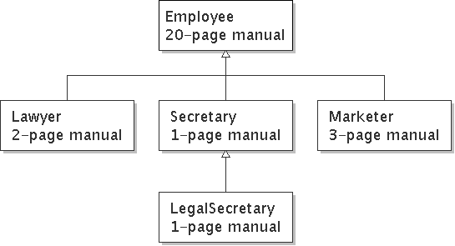
Law firm employee analogy
each subdivision also has specific rules:
  employee receives a smaller (1-3 page) manual of these rules
  smaller manual adds some new rules and also changes some rules from the large manual

Slide 5
Separating behavior
Why not just have a 22 page Lawyer manual, a 21-page Secretary manual, a 23-page Marketer manual, etc.?
Some advantages of the separate manuals:
  maintenance: Only one update if a common rule changes.
  locality: Quick discovery of all rules specific to lawyers.
Some key ideas from this example:
  General rules are useful (the 20-page manual).
  Specific rules that may override general ones are also useful.

Slide 6
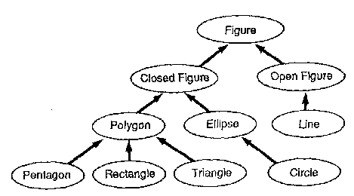
Is-a relationships, hierarchies
is-a relationship: A hierarchical connection where one category can be treated as a specialized version of another.
  every marketer is an employee
  every legal secretary is a secretary
inheritance hierarchy: A set of classes connected by is-a relationships that can share common code.

Slide 7
Employee regulations
Consider the following employee regulations:
  Employees work 40 hours / week.
  Employees make $40,000 per year, except legal secretaries who make $5,000 extra per year ($45,000 total), and marketers who make $10,000 extra per year ($50,000 total).
  Employees have 2 weeks of paid vacation leave per year, except lawyers who get an extra week (a total of 3).
  Employees should use a yellow form to apply for leave, except for lawyers who use a pink form.
Each type of employee has some unique behavior:
  Lawyers know how to sue.
  Marketers know how to advertise.
  Secretaries know how to take dictation.
  Legal secretaries know how to prepare legal documents.

Slide 8
An Employee class
// A class to represent employees in general (20-page manual).
public class Employee {
public int getHours() {
return 40; // works 40 hours / week
}
public double getSalary() {
return 40000.0; // $40,000.00 / year
}
public int getVacationDays() {
return 10; // 2 weeks' paid vacation
}
public String getVacationForm() {
return "yellow"; // use the yellow form
}
}
  Implement class Secretary, based on the previous employee regulations. (Secretaries can take dictation.)

Slide 9
Secretary class
Notice the redundancy.
public class Secretary {
public int getHours() {
return 40; // works 40 hours / week
}
public double getSalary() {
return 40000.0; // $40,000.00 / year
}
public int getVacationDays() {
return 10; // 2 weeks' paid vacation
}
public String getVacationForm() {
return "yellow"; // use the yellow form
}
public void takeDictation(String text) {
System.out.println("Taking dictation of text: " + text);
}
}

Slide 10
Desire for code-sharing
takeDictation is the only unique behavior in Secretary.
We'd like to be able to say:
// A class to represent secretaries.
public class Secretary {
copy all the contents from the Employee class;
public void takeDictation(String text) {
System.out.println("Taking dictation of text: " + text);
}
}

Slide 11
Inheritance
inheritance: A way to form new classes based on existing classes, taking on their attributes/behavior.
  a way to group related classes
  a way to share code between two or more classes
One class can extend another, absorbing its data/behavior.
  superclass: The parent class that is being extended.
  subclass: The child class that extends the superclass and inherits its behavior.
    Subclass gets a copy of every field and method from superclass

Slide 12
Inheritance syntax
  public class name extends superclass {
  Example:
  public class Secretary extends Employee {
  ...
  }
By extending Employee, each Secretary object now:
  receives a getHours, getSalary, getVacationDays, and getVacationForm method automatically
  can be treated as an Employee by client code (seen later)

Slide 13
Improved Secretary code
// A class to represent secretaries.
public class Secretary extends Employee {
public void takeDictation(String text) {
System.out.println("Taking dictation of text: " + text);
}
}
Now we only write the parts unique to each type.
  Secretary inherits getHours, getSalary, getVacationDays, and getVacationForm methods from Employee.
  Secretary adds the takeDictation method.

Slide 14
Implementing Lawyer
Consider the following lawyer regulations:
  Lawyers who get an extra week of paid vacation (a total of 3).
  Lawyers use a pink form when applying for vacation leave.
  Lawyers have some unique behavior: they know how to sue.
Problem: We want lawyers to inherit most behavior from employee, but we want to replace parts with new behavior.

Slide 15
Overriding methods
override: To write a new version of a method in a subclass that replaces the superclass's version.
  No special syntax required to override a superclass method.
  Just write a new version of it in the subclass.
  public class Lawyer extends Employee {
  // overrides getVacationForm method in Employee class
  public String getVacationForm() {
  return "pink";
  }
  ...
  }
  Have we done this before? Answer:toString()
  Exercise: Complete the Lawyer class.
    (3 weeks vacation, pink vacation form, can sue)

Slide 16
Lawyer class
// A class to represent lawyers.
public class Lawyer extends Employee {
// overrides getVacationForm from Employee class
public String getVacationForm() {
return "pink";
}
// overrides getVacationDays from Employee class
public int getVacationDays() {
return 15; // 3 weeks vacation
}
public void sue() {
System.out.println("I'll see you in court!");
}
}
  Exercise: Complete the Marketer class. Marketers make $10,000 extra ($50,000 total) and know how to advertise.

Slide 17
Marketer class
// A class to represent marketers.
public class Marketer extends Employee {
public void advertise() {
System.out.println("Act now while supplies last!");
}
public double getSalary() {
return 50000.0; // $50,000.00 / year
}
}

Slide 18
Levels of inheritance
Multiple levels of inheritance in a hierarchy are allowed.
  Example: A legal secretary is the same as a regular secretary but makes more money ($45,000) and can file legal briefs.
  public class LegalSecretary extends Secretary {
  ...
  }
  Exercise: Complete the LegalSecretary class.

Slide 19
LegalSecretary class
// A class to represent legal secretaries.
public class LegalSecretary extends Secretary {
public void fileLegalBriefs() {
System.out.println("I could file all day!");
}
public double getSalary() {
return 45000.0; // $45,000.00 / year
}
}

Slide 20
Example
public static void main(String[] args) {
Employee a=new Employee();
Employee b=new Marketer();//a marketer is-an employee
Employee c=new LegalSecretary(); //a legal secretary is an employee
Lawyer d=new Lawyer();
Lawyer e=new Employee(); // compile error
//not every employee is a lawyer.
LegalSecretary f=new Secretary(); //compile error
double salary= a.getSalary(); //40000
int salary2= b.getSalary(); //50000, use overwritten version
int salary3= c.getSalary(); //45000, use overwritten version
a.sue(); //error, no sue method for Employee a
b.advertise();// error, even though b is a Marketer.
//b is an Employee reference. (need to cast, later lecture)
d.sue();
}

Slide 21
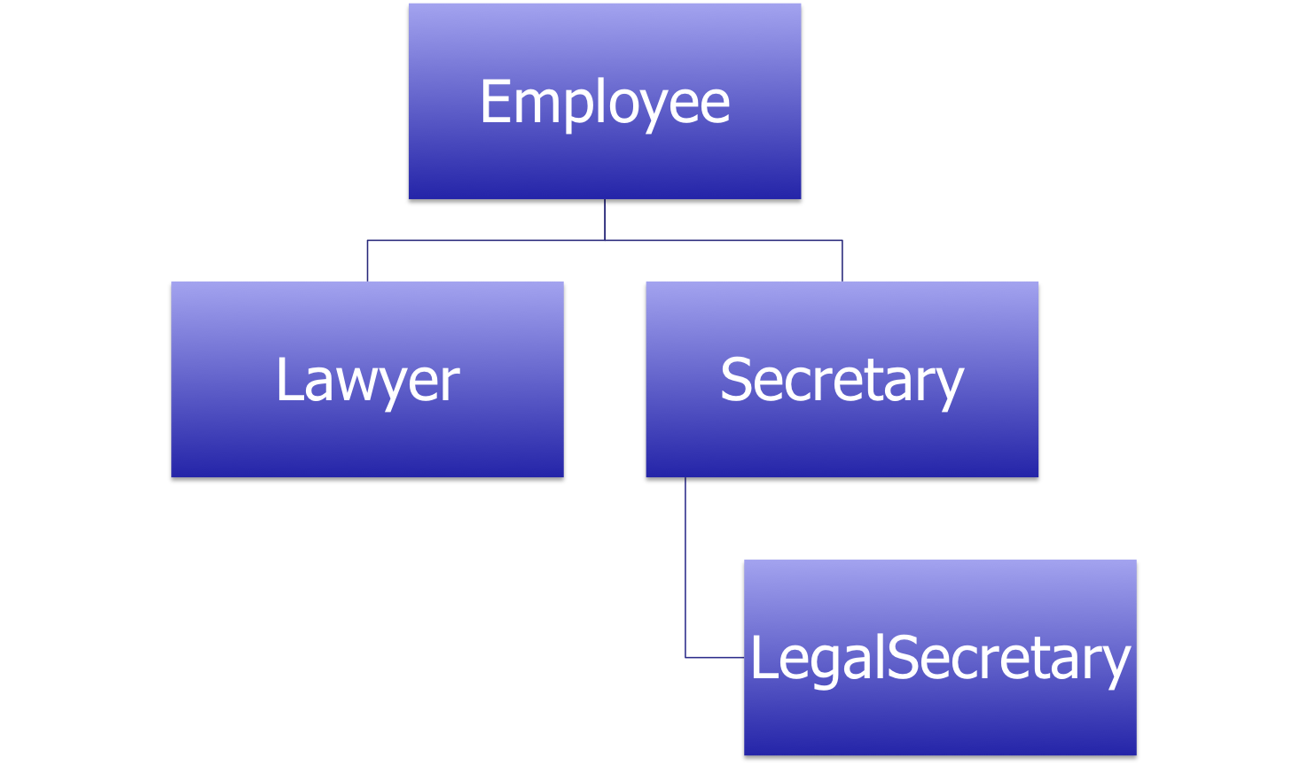
UML Diagram of Classes

Slide 22
Lab 1
Write the superclass Student and subclass GradStudent.
The Student class has a private string name and public integer id. It has no constructors.
Student has getName(), setName (String n),printWelcome() PUBLIC methods. printWelcome() prints “Welcome”.

Slide 23
Lab 1
Write the subclass GradStudent.
The GradStudent class has a private string dissertationTopic. It has no constructors.
GradStudent has getTopic(), setTopic (String t),printWelcome() public methods. printWelcome() overrides the same method from the superclass Student and prints “Welcome to Graduate School”.

Slide 24
Lab 1(continued)
Write the driver class to create a Student and a GradStudent and prints out their names and welcome messages. Print out private variables to see the error messages.

