Slide 1

Lecture 3: Hardware (Part 2)
AP Computer Science Principles
Adapted from Harvard’s CS50 curriculum.

Slide 2
Logical Gates

Slide 3
Encoding Data
Computer logic attempts to solve two problems: encoding data and processing data.
In the previous lecture, we talked about encoding data such as text and images using ASCII and various UTF encodings.
We’ll talk about how a computer process data, e.g., display text, show image or play a video.

Slide 4
Processing Data
Encoding data is mapping the data such as text to a sequence of bits.
Processing data is mapping an input sequence of bits to some output sequence of bits. These mappings can be as basic as math operations or as complicated as applying a filter to an image.
All processing operations can be broken down into simple operations called boolean functions.

Slide 5



Boolean Function
A boolean function is a function that takes an m-sequence binary input and maps it into an n-sequence binary output.
Any boolean function can be decomposed further into one of seven basic boolean functions: OR, XOR(Exclusive-OR), NOR, XNOR, AND, NAND, and NOT.

Slide 6
Computer Logic

Slide 7
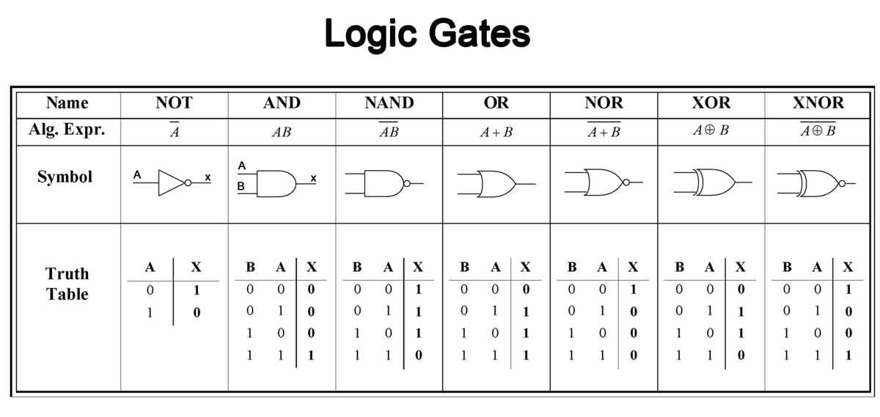
Computer Logic

Slide 8
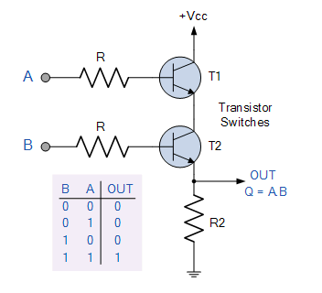
Computer Logic

Slide 9
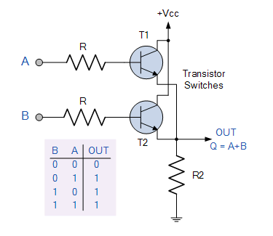
Computer Logic

Slide 10
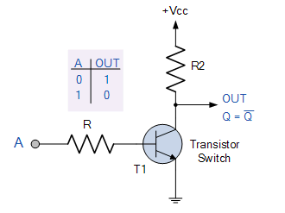
Computer Logic

Slide 11
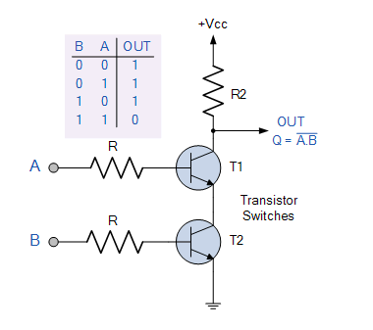
Computer Logic

Slide 12
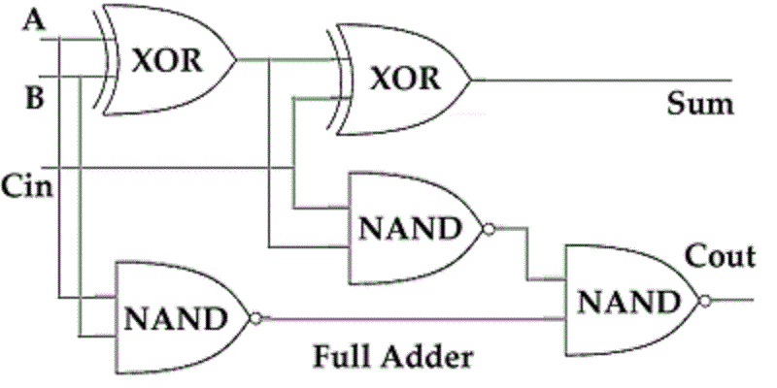
Computer Logic

Slide 13
CPU

Slide 14
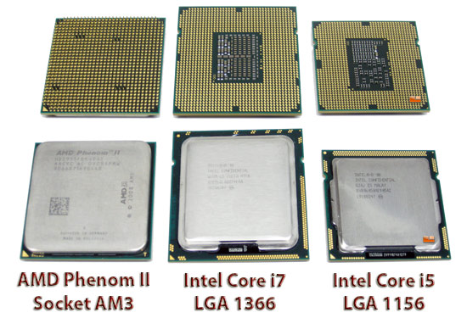
CPU

Slide 15
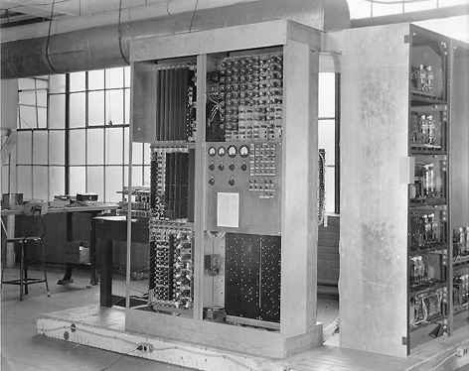
EDVAC
One of the first computers
capable of executing stored
instructions was EDVAC
(Electronic Discrete
Variable Automatic Computer),
developed in the mid-1940s for
the United States Army by the
University of Pennsylvania.
Weighing almost 9 tons and covering about 500 square feet, EDVAC could add two numbers together in about 850 microseconds.

Slide 16
Processes
The CPU's main job is to handle the execution of processes, which is a single instance of a program being executed. An operating system will typically allow you to view the current processes that are executing on your machine.
So, processes have a set of instructions that tell your CPU how the program actually works.

Slide 17
Task Manager
On Windows, you can press the infamous Ctrl-Alt-Delete to open up the task manager, while on Mac OS X, you can open a program called the Activity Manager, shown below..
If your computer starts to slow down, applications like the Task Manager on Windows and Activity Manager on Mac can be useful for identifying which currently-running process is the culprit (as a result of greedy memory or CPU usage).
These applications also allow you to kill processes that are hanging or no longer responding, which should shut down a stalled program.

Slide 18
CPU Instructions
However, a CPU doesn't understand English sentences like "open Google Chrome”. In reality, the instructions that can be understood by a CPU are much more primitive.
What we would consider a simple task (like reading an email) actually requires a huge number of CPU instructions to complete because each individual instruction is so simple and low-level.

Slide 19
CPU Instructions
So, the CPU will typically be given a sequence of these small instructions that when run in some predetermined order create some larger functionality like reading an email.
For example, reading an email requires your computer to download the email, display its contents, remember that the message has been read, etc.

Slide 20
CPU Instructions
Then, the task of displaying an email can be broken down even further, as it requires figuring out what font to use, what color the text should be drawn in, and actually displaying something on your screen.
Even then, these instructions are still at a much, much higher level than the instructions understood by a CPU; in many cases, a CPU instruction is a task that can't be broken down much further.

Slide 21
CPU Instructions
Instead, more realistic CPU instructions could include "add two numbers together," "flip the fourth bit in this 4-byte number," or "determine if these two numbers are equal."
Doesn't get much simpler than that! But, Tetris is in fact really just a very long sequence of instructions like these.

Slide 22
CPU Instruction Set
The list of all the different types of instructions that can be understood by a CPU is called its instruction set. Not all CPUs are alike, which means a CPU manufactured by AMD may understand a different set of instructions than a CPU made by Intel does.
The instructions in a CPU's instruction set can be broken up into three main groups: data, arithmetic, and control flow.(See the video The Making of a Chip, on the last slide).

Slide 23
Data
Data handling instructions involve retrieving or storing data in the computer's memory.
For example, saving a document in Microsoft Word requires a sequence of instructions that involves creating or updating a Word document that you can access later.

Slide 24
Arithmetic
Arithmetic instructions are just what they sound like: it's very common for the CPU to perform mathematical operations. The CPU can add, subtract, multiply, and divide, as well as compare numbers and perform operations on the individual bits of a number.

Slide 25
Control Flow
Control flow instructions help the CPU decide what to do next. A sequence of instructions may contain a built-in fork in the road; based on your computer's current conditions, the CPU might decide to skip over a few instructions or repeat some instructions.
Much more on this topic a bit later, but for now, just remember that some instructions can affect the order in which other instructions are executed!

Slide 26
Operation Code
Each of these instructions is represented with a unique number called an opcode, which is short for "operation code". Any additional data used by an opcode are called operands.
For example, if an arithmetic instruction tells the CPU to add two numbers, the CPU is going to need to know what numbers to add. Since both opcodes and operands are represented with numbers, all of the instructions passed to a CPU can be expressed in binary.
In that sense, then, everything your computer does really does boil down to the zeroes and ones we saw earlier.

Slide 27
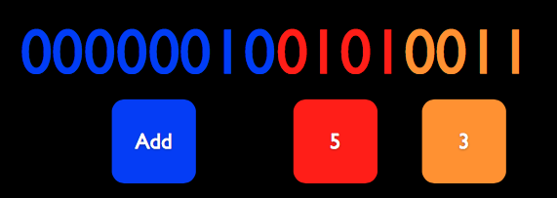
Decode An Operation Code
Add 5+3

Slide 28
Pipeline
Let's take a look at how the CPU actually goes about executing these instructions. One of the main goals of a CPU is to be as fast as possible. To do so, the CPU runs each instruction through a pipeline, which is just like a factory assembly line.
The task of building a car can be completed in a sequence of phases, where the assembly line will typically have a number of separate machines dedicated to performing a single task like securing a wheel or attaching the engine.

Slide 29
Fetch and Decode
Fetch. The first thing the CPU needs to do is... figure out what to do! Recall that our CPU will be executing some sequence of tasks. So, the fetch phase of the pipeline is responsible for determining the instruction that actually needs to be executed next.
Decode. Remember, our CPU's instructions are actually given as opcodes and operands that are represented using zeros and ones. The decode phase of the pipeline is responsible for figuring out what those zeroes and ones actually mean. After this phase is complete, the CPU knows exactly what it needs to do to execute the instruction.

Slide 30
Execute and Writeback
Execute. The execute phase does just that: runs the requested computation. Here's where your CPU will perform an arithmetic operation, grab something from memory, etc.
Writeback. Our fourth and final stage is where we store the result of the computation. Instead, the writeback phase will write the result to memory somewhere, often in a special location on the CPU itself, so the result of the instruction can be used later.

Slide 31

Fetch

Slide 32
Decode
Add 5+3

Slide 33
Execute
5+3=8

Slide 34
Writeback
Save the value 8 in memory!

Slide 35
Cycle
Each instruction that we want the CPU to run will have to go through all four of these phases. Because the CPU is constantly running instructions, putting new things through the CPU pipeline is a cyclic process.
Visually, running four instructions through our pipeline looks something like the below, where each block in the diagram represents a single CPU cycle.

Slide 36
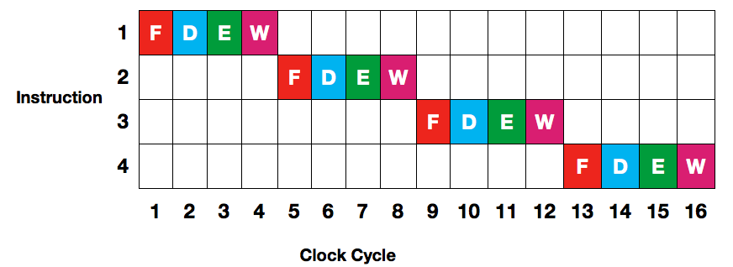
Pipeline

Slide 37
Parallelism
Because different parts of the CPU handle different parts of the pipeline, we can be more efficient through multi-tasking, or parallelism.
Rather than waiting for the rest of the pipeline to finish an instruction, the CPU can start fetching the next instruction before the current one completes! That way, the CPU is wasting a lot less time. Our new, more efficient pipeline now looks something like this:

Slide 38
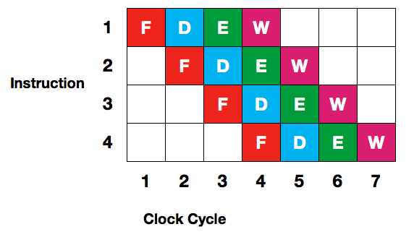
Parallelism
Seven cycles instead of 16 cycles! So, we were able to make our CPU significantly faster by taking advantage of the fact that we can execute different stages of the pipeline in parallel, or at the same time.

Slide 39
Cores
While shopping for a new computer, you may have seen advertisements for dual-core or quad-core CPUs on new machines. In general, multi-core processors combine multiple CPUs into one. So, at any given time, a multi-core will be executing multiple pipelines at once.

Slide 40
Cores
A dual-core CPU has two cores, which is just like having two CPUs on your machine. Similarly, a quad-core CPU has four cores. However, adding more cores to your CPU won't necessarily make all software perform better.
For example, Intel i3 has two cores, i5 and i7 has four cores.
In fact, many computer programs were written before multi-core processors were commonly found in consumer computers. If these programs were written with only a single core in mind, then the existence of other cores won't really help if they're just sitting there doing nothing.

Slide 41
A Parallel Problem
Suppose you have a piggy bank full of change and you’d like to count the change.
Let’s say you have enlisted the help of 4 friends. How do you friends speed up the process? What is the parallel and serial component of your solution? (Count in parallel and add in serial.)
Suppose now you have a lot of friends to help. The count in parallel and add in serial solution runs into a problem, what is it? (For example, if you have as many friends as coins, the time it takes is the same as if you have no friends to help!)

Slide 42
Clock Speed
There isn't one silver bullet when it comes to comparing the performance of two CPUs. A CPU's clock speed, nowadays measured in gigahertz (GHz), describes the rate at which the CPU executes instructions.
A gigahertz is a billion computations per second. Specifically, the clock speed measures how many cycles the CPU can complete in one second.

Slide 43
Moore’s Law
A higher clock speed means that the CPU can execute more instructions in a single second, so a CPU with a higher clock speed will perform faster than an identical CPU with a lower clock speed.
The clock speed of CPUs has been rising over the past several decades largely due to a trend known as Moore's Law, which states that processing power will double every 18 months. Specifically, it states that the number of transistors that can be fit into a chip of a fixed size can be doubled every 18 months.

Slide 44
Clock Speed
However, other factors also influence the overall performance of a CPU, so simply comparing the clock speeds of two CPUs won't necessarily tell you which is faster.
As we've seen, parallelism is an important contributor to the performance of modern processors. So, processors with two or four cores may have better performance than their single-core equivalents. The instruction set of a CPU can also affect its performance.

Slide 45
Megahertz Myth
For example, if one processor can complete a task using one instruction that takes another processor five instructions, then naturally, it may be able to complete certain tasks faster even if it has a slower clock speed.
Finally, the size of a CPU's pipeline can affect its performance, as explained in the video below(See last slide). In this 2001 MacWorld keynote, Apple coined the term "Megahertz Myth" to describe the issues surrounding the comparison of two CPUs using only clock speed.

Slide 46
Memory

Slide 47
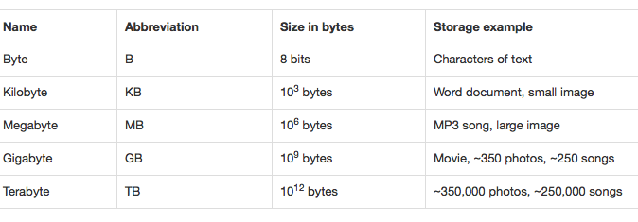
Bytes

Slide 48
Registers
Turns out that a few different types of memory are actually found directly on the CPU. The smallest and fastest memory on the CPU is found in registers. Registers hold extremely small amounts of data: on the order of several bytes.
Earlier, when we said that a CPU could add two numbers together, we took for granted where those numbers would be coming from and where the answer would go.

Slide 49
Registers
This is where registers come in! While the CPU is in the process of adding two numbers together, both numbers are stored in registers, and once the CPU has computed the answer, the result is also stored in a register.
Registers are also used to keep track of things like the instruction that is currently being decoded or executed as well as what instruction should be put into the pipeline next.

Slide 50
Registers
Since registers are so small, there's not much more that could even fit in a CPU register. But, in order for the CPU to quickly perform its addition, accessing register data must be extremely fast, so we have a bit of a trade-off between the size of the memory and the speed of the memory
In fact, we'll see this trade-off become a trend throughout this section! The number of registers on a CPU can vary, with some CPUs having just 16 registers and others having as many as 256 registers.

Slide 51
RAM
Okay, but a few registers that can't hold much more than a 32-bit number don't seem sufficient for playing a several megabyte song or watching a several gigabyte movie.
In order to efficiently handle tasks like these, we'll need some short-term memory with a larger capacity. That's where RAM, or Random-Access Memory, comes in. RAM is a block of memory that can be used by currently-running process to store data.

Slide 52
RAM
For example, a web browser might need to store what website you're currently browsing, and your email client might need to store all of the emails in your inbox. So, the more RAM you have, the more space you have available for processes to store information.
Because all of the currently-running processes on your computer will probably need to utilize RAM for short-term storage, having more RAM in your computer will allow you to run more programs at the same time efficiently.

Slide 53
RAM
A laptop on today's market will likely have between four and eight gigabytes of RAM, so we're talking much more space than something like a CPU register. In fact, when you see any language that refers to the amount of "memory" in a computer, there's a very good chance it's referring to RAM, since RAM is the main source of short-term memory in your computer.

Slide 54
RAM
Your laptop probably contains at least a couple of sticks of RAM. The CPU has the ability to read values from RAM (i.e., access already-stored data) and write values to RAM (i.e., store new data).
We can think about RAM as a really long street with lots of houses. Each house has an address, which is simply a unique whole number starting from zero, that is used to identify it. Each one of these houses can store exactly one byte (remember, 8 bits!) of data.

Slide 55
RAM
So, the total number of houses available to your computer depends on the total size of the available RAM. With 2 GB of RAM, for example, your computer will have about two billion houses, and with 4 GB of RAM, your computer will have about four billion houses.
When the CPU needs to read or write information from RAM, it will do so using a memory address. For example, let's say the following represents a portion of RAM.

Slide 56
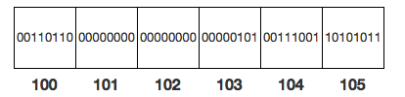
Let's say that a 32-bit (aka 4-byte) number has been broken up into chunks and stored at the addresses 101-104. Putting these four blocks of memory together, we can see that the number stored at the address 101 in RAM is 00000000000000000000010100111001, or 1337.

Slide 57
RAM
We call this way of representing numbers in RAM, in which the bytes are read from left to right, big-endian. Here, the most significant byte is stored at a lower address than the least significant byte.
It's actually not uncommon for computers to store bytes in the opposite order, with more significant bytes stored at higher addresses in memory. This is called little-endian.

Slide 58
RAM
In the above example, if we were instead using a little-endian representation and read the same memory addresses (101-104) again, we would instead get the number 00111001000001010000000000000000, or 956,628,992. Whether data is stored using a big-endian or little-endian representation is up to the CPU!

Slide 59
RAM
The "Random-Access" part of RAM refers to the fact that accessing any address in RAM takes the same amount of time. It's no faster, for example, to access the information stored at the address 0 than it is to access the information stored at the address 1048576. As we'll see shortly, this isn't the case with all types of memory.

Slide 60
Cache

Slide 61
Cache
However, accessing data stored in RAM is significantly slower than accessing data stored in a CPU register. In fact, the CPU can typically complete a cycle much faster than it can read a value from RAM, so the CPU could waste cycles while waiting for a value to be read from RAM.
In order to increase efficiency and waste less time, the CPU also utilizes a layer of storage called the processor cache. Not only is the cache physically located closer to the CPU, but data stored on the cache can be accessed more quickly than data stored in RAM.

Slide 62
Cache
In many cases, the CPU will need to use some value from RAM more than once, just like you might listen to a song on repeat.
Rather than going all the way to RAM multiple times to grab a frequently-accessed value, the CPU might instead place it on the cache after getting the value once from RAM, where it can be fetched much more quickly in the future.
Now, the next time we need that value, we can take a much shorter trip to the cache to get it, rather than going all the way to RAM.

Slide 63
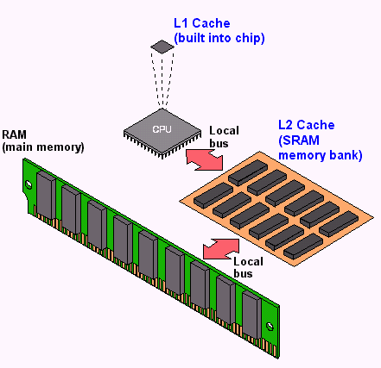

Slide 64
Cache
Processor caches are able to hold significantly less data than RAM. As shown in the above diagram, computers typically have several levels of caches, each having different sizes and speeds.
The L1 cache is the smallest, fastest, and closest to the CPU, and the L1 cache typically comprises several (e.g., 32 or 64) kilobytes in size. Next up is the L2 cache, which is typically a bit farther away from the CPU and slower to access, but usually holds up to several megabytes (e.g., 4 or 8) of data.

Slide 65
Cache
Finally, the L3 cache is even slower, but can hold even more data. Not all CPUs have all three levels of caches—some CPUs don't utilize an L1 cache, while others don't have an L3 cache. All that being said, accessing data in the CPU cache is still much faster than accessing data from RAM.

Slide 66
HDD
You computer's hard drive is its primary form of long-term storage. Unlike RAM, which holds only a few gigabytes, you'll find that modern hard drives often hold 500, 750, or 1000+ GB. Hard disks, or HDDs, are typically 3.5" in size in desktop computers and 2.5" in size on laptops.
As shown below, a typical hard disk consists of several circular platters that don't look all that dissimilar from CDs. Each platter is coated in a thin layer of magnetic material that is used to encode information. A positive magnetic charge could represent a 1, and a negative magnetic charge could represent a 0.

Slide 67
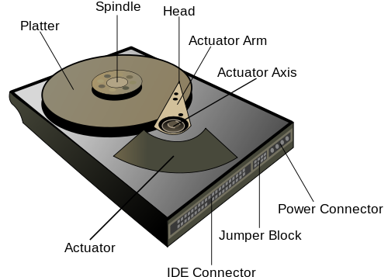
HDD

Slide 68
HDD
So that the platters aren't scratched or damaged, the read-write heads don't actually touch the platters, but are instead perched precariously above them. The heads are attached to an actuator arm, which allows the heads to move closer to the platters' centers or edges.
Meanwhile, a separate motor on the spindle rotates the platters at speeds between 4,000 and 15,000 rotations per minute (RPM), with consumer disks typically rotating at 7,200 RPM.
As a reference, tires on a car going 100 mph spins at less than 2000 RPM! (See Inside a HDD video on last slide)

Slide 69
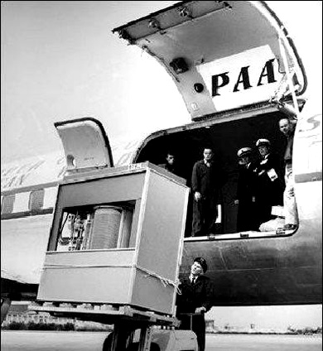
HDD
A hard disk from 1956.
Yes, the entire box. Its
capacity?
5 mb.

Slide 70
HDD
Instead, each platter in the hard disk is divided into many concentric rings called tracks, along which slots for bits are stored.
Each track is further subdivided into sectors, each of which holds a small, fixed amount of data, typically several hundreds of bytes.
A group of adjacent sectors is known as a cluster. So, a single file will actually occupy multiple sectors on your hard disk, and your computer is responsible for remembering where files are stored and how much space they consume.

Slide 71
HDD
Your computer can do so using a special file on the hard disk called the master file table, which is essentially a mapping of paths to files to platters, tracks, and sectors.
That way, a request to a file using its path (as we do when we open a Word document, for example), can be translated to a physical location on the hard disk.
So, when we want to open a file, we can look up its physical location on the hard disk (e.g., its platter, track, and sectors) using the master file table, and then the hard disk can move components like the read-write head appropriately.

Slide 72
SSD
However, hard disk drives are starting to become decreasingly common in consumer computers. Instead, many new machines utilize SSDs, or solid-state drives, as their primary form of storage.
Most SSDs store data using NAND flash memory, which is also used by USB flash drives (aka "thumb drives") and camera memory cards. Flash memory stores data using a large grid of cells, each composed of two transistors, or small electrical components that can allow or block the flow of current.
Flash memory is non-volatile, it does not require power to store data, unlike RAM.

Slide 73
SSD
We're still using binary to represent data, and in this case, a 1 is represented by the flow of current, and a 0 is represented by the blockage of current.
Current flows freely on a blank portion of an SSD drive, which represents a series of 1s. When a write operation is performed, some of those 1s will be flipped to 0s by sending a precise voltage to the control gate, one of the two transistors in a cell. This voltage will transfer electrons to the floating gate, the other transistor in each cell, which gives cells a positive charge and blocks the flow of current.

Slide 74
SSD
Reading data, then, is as simple as sending current through a series of cells and determining where flow was blocked, which represents a series of 0s and 1s. (See HDD vs SDD video last on the slide)

Slide 75
Filesystem
How exactly your files are accessed and stored depends on how it is formatted, which determines which filesystem it uses. Many Windows PCs have hard drives that utilize the proprierary NTFS filesystem, while USB thumb drives may be formatted using FAT32, an older filesystem. exFat is the newer version of FAT32.
While operating systems may support multiple filesystems, you may sometimes encounter a device that your computer can't read from or write to. For example, some versions of OS X can read files from an NTFS drive, but can't write any new data. exFat is a good option if you want read and write capability for both Windows and Mac.

Slide 76
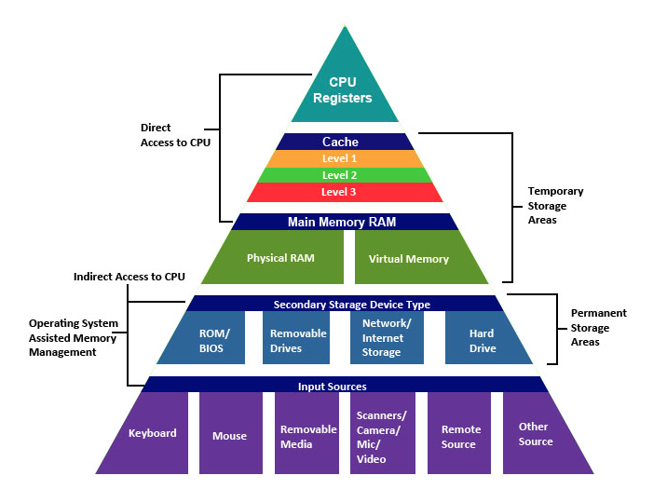

Slide 77
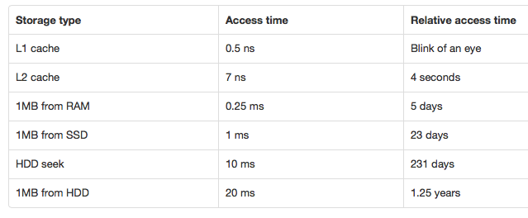
How long to retrieve 1MB?

Slide 78
Homework
Read and reread these lecture notes.
Do the problem set.
Megahertz Myth: https://www.youtube.com/watch?v=tPBtXUUeFK0
Inside a HDD: https://www.youtube.com/watch?v=kdmLvl1n82U
SSD vs HDD: https://www.youtube.com/watch?v=j84eEjP-RL4
The Making of a Chip: https://www.youtube.com/watch?v=UvluuAIiA50

Slide 79
References
This lecture is a summary of a lecture from an OpenCourseWare course below.
Computer Science E-1 at Harvard Extension School
Understanding Computers and the Internet
by Tommy MacWilliam
https://www.youtube.com/watch?v=pbJ_U9O5nmo

