Slide 1
Introduction to Processing
The Basics(Python Version)

Slide 2
Processing
Processing started by Ben Fry and Casey Reas while both were graduate students at MIT Media Lab in 2001.
The original language for Processing is Java. We will use the Python version.
Designed for visual artists with limited programming experience who want to create art without knowing complicated Java syntax.
In its current version, hundred of libraries have been written for computer vision, data visualization, music composition, networking, 3D drawings and programming electronics.

Slide 3
Processing
Processing was created originally for the Java language. For this reason, the interface to Processing's Python version is not very "Pythonic".
I wrote some code to hide some of this interface and make it flow better with Python. Download the zip file that contains this code on our course website here.
Once you unzip the contents and open it with Processing. There should be three files:
processing_py.pyde(DO NOT MODIFY THIS FILE)
game.py(write all of your code here)
There is also a data folder where you should put all of your images for your game.

Slide 4
game.py
All of your code should go here in game.py.
You will need to implement(provide code for) two methods/functions:
1) def __init__(self): Declare and initialize all your game/application variables.
2) def on_draw(self): Called automatically 60 times a second to draw and update all objects. Write code to draw and update all objects here.

Slide 5
Sketch
First declare and initialize all variables in __init__
class Window:
def __init__(self):
""" Initialize all variables here. """
def on_draw(self):
""" Called automatically 60 times a second to draw/update
objects.
"""
__init__ only runs ONCE.
on_draw runs automatically 60 times a second
to draw and update all images

Slide 6
Creating Variables
When declaring/initializing a global variable that is used
throughout the game, use self and the dot notation.
class Window:
def __init__(self):
""" Initialize all variables here. """
self.x = 10
y = 5
def on_draw(self):
""" Called automatically 60 times a second to draw/update objects."""
print(self.x) # valid!
print(y) # error! y does not exist here!
The y variable here does not have the “self.” prefix.
Consequently, it only exists locally here in init.

Slide 7
Updating Variables
What values are printed on the console in the following program?
class Window:
def __init__(self):
""" Initialize all variables here. """
self.x = 10
def on_draw(self):
""" Called automatically 60 times a second to draw/update all objects."""
print(self.x)
self.x += 5
Answer: Prints:
10 in the first frame
15 in the second frame
20 in the third frame
etc…

Slide 8
Animation
Animation only takes five lines of code!
class Window:
def __init__(self):
""" Initialize all variables here. """
self.x = WIDTH/2
self.y = HEIGHT/2
def on_draw(self):
""" Called automatically 60 times/second to draw/update objects."""
# fill(red, green, blue)
fill(255, 0, 0)
ellipse(self.x, self.y, 300, 300)
self.x += 5
draw red circle at (self.x, self.y)
diameter = 300 pixels
(update) move circle 5 pixels to the right
Repeat 60 times a second!

Slide 9
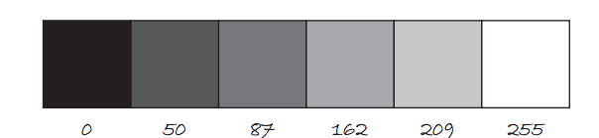
Color
Color is defined by a range of numbers.
In grayscale, 0 is black, 255 is white and any color in between is a shade of gray ranging from black to white.

Slide 10
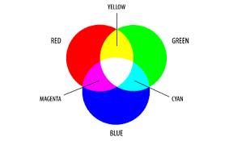
Color
RGB Color is determined by three parameters. Each parameter is in the range 0-255. The first indicates the degree of red(R), the second the degree of green(G) and the last the degree of blue(B).

Slide 11
Some Methods for Drawing Shapes
fill(r, g, b):By calling fill BEFORE a shape will set the color of the shape. Call it again before drawing another shape to change color.
line(x1, y1, x2, y2):draw line through (x1, y1) and (x2, y2).
ellipse(x, y, width, height):center of ellipse is (x, y); width and height are the lengths of the axes.
rect(x, y, width, height:center of the rectangle is (x,y)

Slide 12
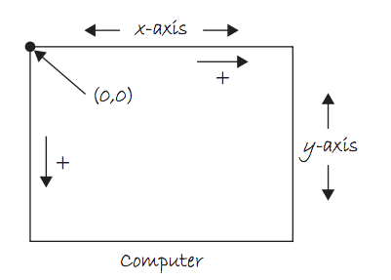
The Coordinate System

Slide 13
Sprites
A sprite is an image(.png or .jpg) that represent a character or object in a game.
In arcade.py, I have written a simple custom class: the Sprite class. It allows us to easily draw, scale and animate sprites. We may create several Sprite instances or objects.
This reusability feature is important especially when we need to create many objects(for example enemies) with similar data and behaviors.

Slide 14

The Sprite Class
Sprite(filename, scale=1.0)
center_x center_y angle width height change_x change_y change_angle alpha
draw() move()
The Sprite class’ constructor allows us
to create a Sprite object. It has many
parameters to help us initialize a Sprite
object for our game.
Usually, we specify only the image
filename and scaling and set the other
attributes as needed.
player = Sprite(“player.png”, 0.5)
width
height

Slide 15
The Sprite Class
Sprite(filename, scale=1.0)
center_x center_y angle width height change_x change_y change_angle alpha
draw() move()
Properties: Every sprite has properties or
variables that contains information
about the sprite. A sprite has variables
for its position, or velocity. These can be
modified or updated.
Functions or Methods:
Every sprite has useful has functionalities.
For example, a sprite can move, or draw itself.
width
height

Slide 16
Sprite Example 1
class Window:
def __init__(self):
""" Initialize all variables here. """
self.player = Sprite(“tank.png”)
self.player.scale = 2.0
self.player.center_x = 100
self.player.center_y = 200
def on_draw(self):
""" Called automatically 60 times a second to draw all objects."""
self.player.draw()
self.player.move()
A tank sprite is drawn on the screen but is not moving.
These four lines are equivalent to:
self.player = Sprite(“tank.png”, 2.0, 100, 200)

Slide 17
Sprite Example 2: Moving the tank
A tank sprite is drawn on the screen but is moving 5 pixels per frame to the right.
class Window:
def __init__(self):
""" Initialize all variables here. """
self.player = Sprite(“tank.png”, 2.0, 100, 200)
self.player.change_x = 5
def on_draw(self):
""" Called automatically 60 times a second to draw all objects."""
self.player.draw()
self.player.move()

Slide 18
Adding Text
The text(str, x, y) function draws text on the screen.You can set the text size and color by using textSize(s) and fill(r, g, b) before drawing the text.
textSize(32);
fill(255, 0, 0);
text("Hello, World!", 100, 200);

Slide 19
The Console
Messages can be printed on the console(for error-checking purposes, etc..) by using the command print().
print(4);
print(4 + 3/2);
print(“Hello, world”);

Slide 20
Download Processing
Download Processing!
http://www.processing.org

