Slide 1

Algorithms

Slide 2
Algorithms
An algorithm is a finite set of instructions that accomplish a specific task.
Every algorithm can be constructed using combinations of sequencing, selection, and iteration.
Sequencing is the application of each step of an algorithm in the order in which the code statements are given. (for example, following a baking recipe requires that steps are taken in a certain order)
Iteration is a repeating portion of an algorithm. Iteration repeats a specified number of times or until a given condition is met.
Selection determines which parts of an algorithm are executed based on a condition being true or false.
We will discuss some important algorithms in this lecture.

Slide 3
Sequential search
Linear search or sequential search algorithms check each element of a list, in order, until the desired value is found or all elements in the list have been checked. Implement sequential search using list which returns the index of the target or -1 if it is not found.
def sequential_search(lst, target):
for i in range(len(lst)):
if lst[i] == target:
return i
return -1
a = sequential_search([3,0,5,1], 0) # a = 1
print(a) # 1

Slide 4
Sequential search
Linear search or sequential search algorithms check each element of a list, in order, until the desired value is found or all elements in the list have been checked. Implement sequential search using list which returns the index of the target or -1 if it is not found.
def sequential_search(lst, target):
for i in range(len(lst)):
if lst[i] == target:
return i
return -1
a = sequential_search([3,0,5,1], 0) # a = 1
print(a) # 1
numbers = [4, 2, 3, 7 -12, 3, 56, 34]
print(sequential_search(numbers, 3)) # 2

Slide 5
Sequential search
Linear search or sequential search algorithms check each element of a list, in order, until the desired value is found or all elements in the list have been checked. Implement sequential search using list which returns the index of the target or -1 if it is not found.
def sequential_search(lst, target):
for i in range(len(lst)):
if lst[i] == target:
return i
return -1
a = sequential_search([3,0,5,1], 0) # a = 1
print(a) # 1
numbers = [4, 2, 3, 7 -12, 3, 56, 34]
print(sequential_search(numbers, 3)) # 2
print(sequential_search(numbers, 100)) # -1

Slide 6

Binary Search
Note that the array below is sorted. How can we take advantage of this?
The binary search algorithm starts at the middle of a sorted data set of numbers and eliminates half of the data; this process repeats until the desired value is found or all elements have been eliminated.
Look at the middle of the array. If the target is found, we are done. Otherwise, If the target is greater than that value, we can eliminate the left half of the array. And If the target is less than the value, eliminate the right half.
Repeat with left or right half of the array accordingly.

Slide 7
Binary Search
Low
Mid
High

Slide 9
Binary Search
Implement binary search. Data must be in sorted order to use the binary search algorithm.
def binary_search(sorted_lst, target):
min, max = 0, len(sorted_lst)-1
while min <= max:
mid = (min + max)//2
if sorted_lst[mid] < target:
min = mid + 1
elif sorted_lst[mid] > target:
max = mid – 1
elif sorted_lst[mid] == target:
return mid
return -1

Slide 10
Sorting(not on AP)
sorting: Rearranging the values in an array or collection into a specific order (usually into their "natural ordering").
one of the fundamental problems in computer science
sorts products on Amazon based on ratings or price
sorts contacts on phone in alphabetical order
can be solved in many ways:
there are many sorting algorithms
some are faster/slower than others
some use more/less memory than others
some work better with specific kinds of data
some can utilize multiple computers / processors, ...

Slide 11
Sorting(not on AP)

Slide 12
Sorting(not on AP)

Slide 13
Sorting(not on AP)

Slide 14
Algorithmic Efficiency
A problem is a general description of a task that can (or cannot) be solved algorithmically.
An instance of a problem also includes specific input. For example, sorting is a problem; sorting the list (2,3,1,7) is an instance of the problem.
A decision problem is a problem with a yes/no answer (e.g., is there a path from A to B?).
An optimization problem is a problem with the goal of finding the “best” solution among many (e.g., what is the shortest path from A to B?).

Slide 15
Algorithmic Efficiency
Efficiency is an estimation of the amount of computational resources used by an algorithm.
Efficiency is typically expressed as a function of the size of the input(e.g the size of the list). Can either be worst-case complexity or average-case complexity.
An algorithm’s efficiency can be informally measured by determining the number of times a statement or group of statements executes.
Different correct algorithms for the same problem can have different efficiencies. For example, a sorting algorithm that requires more computations is slower than a different sorting algorithm that requires less.

Slide 16
Example 1 of Algorithmic Efficiency
def sum(lst):
s = 0
for x in lst:
s += x
s += 1
return s
Let's define efficiency as the number of times a math operation statement is executed. Let the size of lst be n. What is the efficiency of the function sum as a function of n?
Answer: 2n

Slide 17
Example 2 of Algorithmic Efficiency
def sum(lst):
s = 0
for x in lst:
s += x
s += 1
for x in lst:
s -= 1
return s
Let's define efficiency as the number of times a math operation statement is executed. Let the size of lst be n. What is the efficiency of the function sum as a function of n?
Answer: 3n

Slide 18
Example 3 of Algorithmic Efficiency
def sum(lst):
s = 0
for x in lst:
for y in lst:
s += y
return s
Let's define efficiency as the number of times a math operation statement is executed. Let the size of lst be n. What is the efficiency of the function sum as a function of n?
Answer: n*n = n^2

Slide 19
Efficiency for Searching
Suppose we have a list of size n.
1) In the worst-case scenario, what is the number of comparisons needed to find the target using sequential or linear search?
Answer: n
2) In the worst-case scenario, what is the number of comparisons needed to find the target using binary search(when applied to a sorted list)?
Answer: Approximately log_2(n).
Note: The AP exam only requires that you know binary search is generally faster than linear search when applied to a sorted list but not how much faster.

Slide 20
Exponential Complexity Problems
Algorithms with a polynomial efficiency(constant, linear, square, cube, etc.) are said to run in a reasonable amount of time. They can be executed quickly on a modern processor.
However, there exists important and practical problems for which there exists no known polynomial time algorithm. Algorithms with exponential or factorial efficiencies are examples of algorithms that run in an unreasonable amount of time.
For example, given a set of integers, find a subset that sums to zero. A brute-force algorithm would try every possible subset. But there are 2^n different subsets. This is an example of an exponential time algorithm. If n is large, even the fastest computers would take too long.

Slide 21
Heuristic
Some problems cannot be solved in a reasonable amount of time because there is no efficient algorithm for solving them. In these cases, approximate solutions are sought.
A heuristic is an approach to a problem that produces a solution that is not guaranteed to be optimal but may be used when techniques that are guaranteed to always find an optimal solution are impractical.
For example, ﻿a file-organizing algorithm(sorting a folder based on file types e.g. pdf, docs, jpegs) determines the content of a file based on a certain number of bytes in the beginning of the file. This is an approximate solution since only a few bytes are examined. But it is more practical and faster to run than examining every byte of every file.

Slide 22
Computational Complexity for Sorting(not on AP exam)
Suppose we have a list of size n.
1) What is the approximate number of comparisons needed for selection sort?
Answer: The implementation of this algorithm uses 2 nested loops, with each loops running n times. Thus, approximately n*n = n^2.
2) What is the approximate number of comparisons needed for insertion sort?
Answer: Similar to selection sort, the code uses 2 nested loops, with each loops running n times. Thus, approximately n*n = n^2.
3) What is the number of comparisons needed for mergesort?
Answer: Approximately n*log(n). (slower than linear search(n) but faster than both selection and insertion sort(n^2).

Slide 23
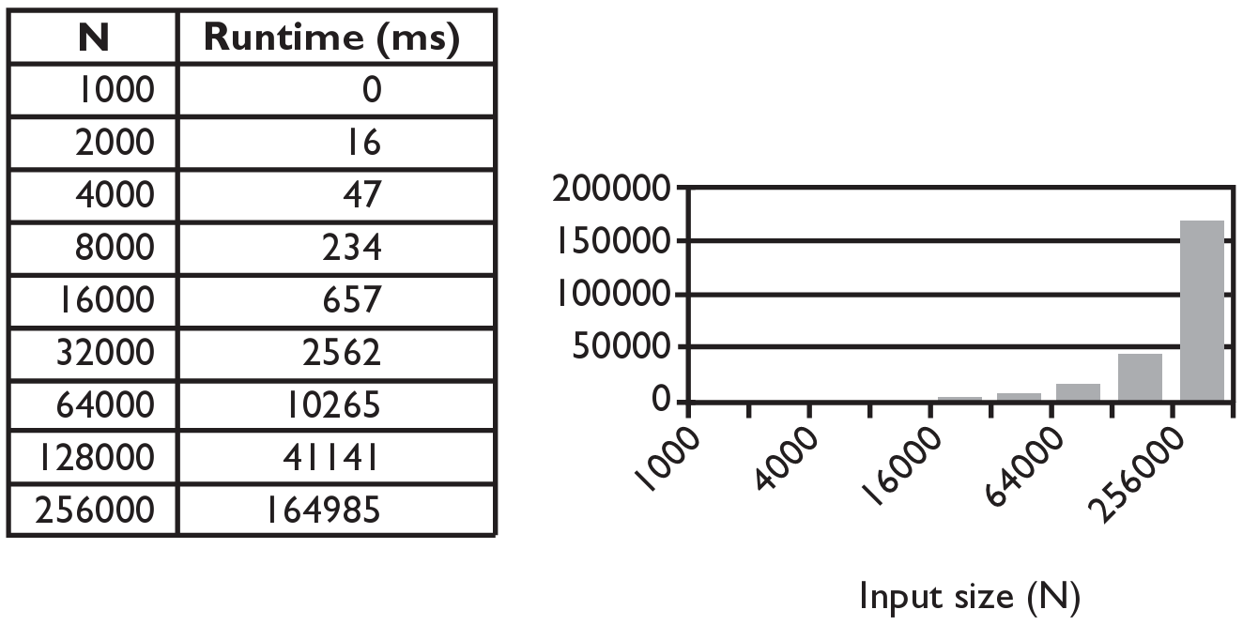
Selection sort runtime(not on AP exam)

Slide 24
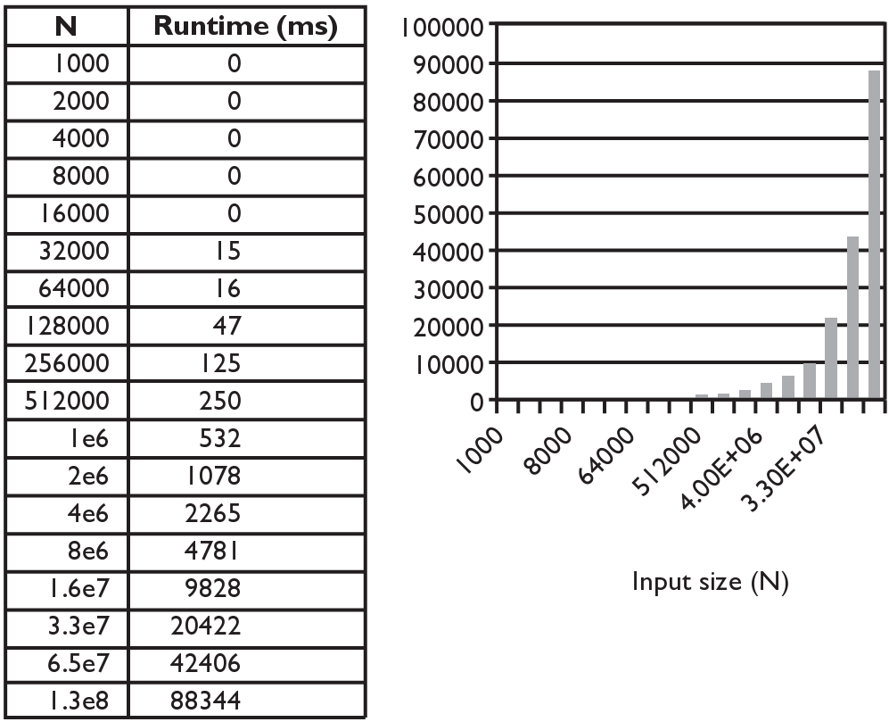
Merge sort runtime(not on AP exam)
For a list of length 256000 items, selection sort takes
about 2.75 minutes but mergesort takes 1/10 of a second.

Slide 25
Exponential Complexity Problems
Algorithms with a polynomial efficiency(constant, linear, square, cube, etc.) are said to run in a reasonable amount of time. They can be executed quickly on a modern processor.
However, there exists important and practical problems for which there exists no known polynomial time algorithm. Algorithms with exponential or factorial efficiencies are examples of algorithms that run in an unreasonable amount of time.
For example, given a set of integers, find a subset that sums to zero. A brute-force algorithm would try every possible subset. But there are 2^n different subsets. This is an example of an exponential time algorithm. If n is large, even the fastest computers would take too long.

Slide 26
Decidability
A decidable problem is a decision problem for which an algorithm can be written to produce a correct output for all inputs.
E.g. Is the number even?
An undecidable problem is one for which no algorithm can be constructed that is always capable of providing a correct yes-or-no answer.
An undecidable problem may have some instances that have an algorithmic solution, but there is no algorithmic solution that could solve all instances of the problem.
Alan Turing, considered by many to be the father of computer science, proved that there exists undecidable problems. An example he posed is the Halting Problem.

Slide 27
The Halting Problem(optional)
Can you write a program that takes the source code of another program and some input and returns whether the program will terminate(not go into an infinite loop) with the given input?
def halting(function, input):
# returns whether the function terminates with
# given input.
# Is there an implementation of this function?

Slide 28
Example(optional)
IF the halting function can be implemented, it will give the following outputs for the sum function(sum 1 to 10 with step size= increment).
def sum(increment):
x = 1
while x <= 10:
x += increment
return x
print(halting(sum, 1)) # True
print(halting(sum, -1)) # False (infinite loop)
Alan Turing proved that such a function(halting) does not exist(cannot be
implemented). Alan Turing is portrayed by the incredible Benedict Cumberbatch in
the movie "The Imitation Game".

Slide 29
Simulation
Computer simulation is the process of mathematical modelling, performed on a computer, which is designed to predict the behaviour of, or the outcome of, a real-world or physical system.
Simulations often mimic real-world events with the purpose of drawing inferences, allowing investigation of a phenomenon without the constraints of the real world.
Simulations are most useful when real-world events are impractical for experiments (e.g., too big, too small, too fast, too slow, too expensive, or too dangerous).
For example, instead of letting an untrained pilot fly an actual plane, the pilot can learn by using a flight simulator.

Slide 30
Simulation
The process of developing an abstract simulation involves removing specific details or simplifying functionality.
Simulations can contain bias derived from the choices of real-world elements that were included or excluded.
Simulations facilitate the formulation and refinement of hypotheses related to the objects or phenomena under consideration.
Random number generators can be used to simulate the variability that exists in the real world.

Slide 31
Algorithms to know for AP Exam
You should know how to implement(write the code for) the following algorithms. The AP exam may give you the code for an algorithm and ask you to find the error or explain what it does.
Finding an item in a list(sequential search).
Given a list and an item, return whether(True or False) the item is in the list
Give a list an an item, return the index of the item in the list(-1 if not found).
Compute the sum or average of a list of numbers.
Find the minimum or maximum value of a list of numbers.

