Slide 1
Introduction
AP Computer Science A

Slide 2
Materials
Computer at home with internet.
3-holed punch binder. All worksheets, quizzes and tests are stored in this binder. Divide your binder(e.g. using a blank page) into three sections: Classwork, Tests and Worksheets. You must have your binder in class each day. The classwork section should have a set of blank pieces of paper.
No official textbook. All lecture notes will be posted on Google Classroom and available on my website:
https://longbaonguyen.github.io/courses/apcsa/apjava.html

Slide 3
Grading
Your grade for each term will consists of:
3 tests.
Lab assignments.
Completed worksheets
Binder check
The homework policy can be found in your syllabus.

Slide 4
Google Classroom
Go to Google Classroom with your bps login and enter the code bbdwna to join the class.
All lecture notes and assignments, including worksheets, will be posted on Google Classroom. You will need to login with your BPS email.

Slide 5
Compilers
There are many free Java IDE(Integrated Development Environment) available, but in the lab, we will be using a cloud-based compiler repl.it.
  Go to https://www.repl.it. and create an account. You can alternatively sign in using your Google account. I highly recommend signing in using Google.
  To join click on one of the link below based on your section:
  Section 1: https://repl.it/classroom/invite/eGTv9TN
  Section 2: https://repl.it/classroom/invite/eEyFYnV
  Section 3: https://repl.it/classroom/invite/eEzIXXY

Slide 6
AP Classroom College Board
For the first time this year, the College Board has created a classroom site for each student.
The site contains practice problems, progress checks for each of the unit of study.
Go to: myap.collegeboard.org
Join the class by section:
Section 1: YR33VN
Section 2: KG3NJK
Section 3: 7K4ZMR

Slide 7
Registering and Paying for AP Exams
This is the first year where the College Board require the ordering and registration of exams to be done early Fall rather than Spring.
In addition, all AP students MUST register and pay for their AP exams using the BLS AP Form that has been used in previous years.
This form will be on SIS as well.
Students must complete this registration by October 1 because the exams need to be ordered this fall. See Mr.Kennelly for more info.

Slide 8
Homework
Login to Google Classroom and join the class.
Get a 3-holed punched binder.
Get access to repl.it and join the class by section.
Get access to College Board’s classroom by entering the correct code.

Slide 9
Overview of Computer Science
(will not be tested)

Slide 10
What is computer science?
Computer Science
  The study of theoretical foundations of information and computation and their implementation and application in computer systems. -- Wikipedia
  Many subfields
    Graphics, Computer Vision
    Artificial Intelligence
    Scientific Computing
    Robotics
    Databases, Data Mining
    Computational Linguistics, Natural Language Processing ...
Computer Engineering
  Overlap with CS and EE; emphasizes hardware

Slide 11

What is programming?
program: A set of instructions
to be carried out by a computer.
program execution: The act of
carrying out the instructions
contained in a program.
programming language: A systematic set of rules used to describe computations in a format that is editable by humans.

Slide 12
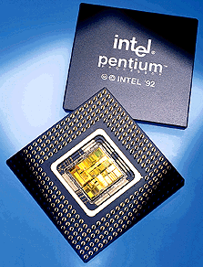
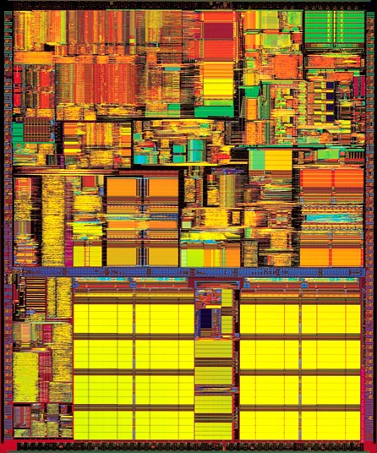
Processors
Computers are fast
  Pentium 4 chip from 2001 can perform approximately 1,700,000,000(1.7 Ghz) computations per second
  made up of 42,000,000 transistors (a switch that is on or off)
Computers are dumb
  They can only carry out a very limited set of instructions
    on the order of 100 or so depending on the computer's processor
    machine language instructions, aka instruction set architecture (ISA)
    Add, Branch, Jump, Get Data, Get Instruction, Store

Slide 13
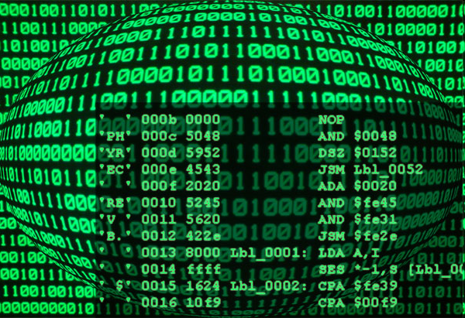
Neumann’s Idea
John von Neumann - co-author of paper in 1946 with Arthur W. Burks and Hermann H. Goldstine,
  "Preliminary Discussion of the Logical Design of an Electronic Computing Instrument"
One of the key points
  program commands and data stored as sequences of bits in the computer's memory
A program:
1110001100000000
0101011011100000
0110100001000000
0000100000001000
0001011011000100
0001001001100001
0110100001000000

Slide 14
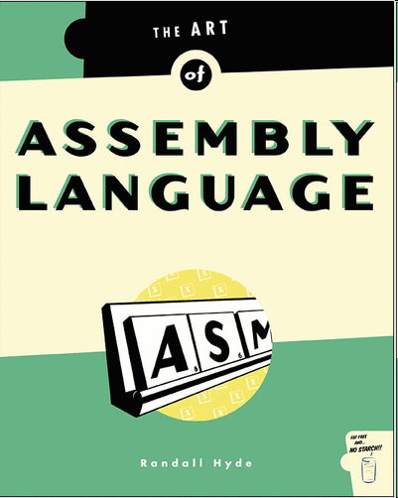
Low Level Programming
Programming with Strings of bits (1s or 0s) is not the easiest thing in the world.
Assembly language
  mnemonics for machine language instructions
  .ORIG x3001
  LD R1, x3100
  AND R3, R3 #0
  LD R4, R1
  BRn x3008
  ADD R3, R3, R4
  ADD R1, R1, #1
  LD R4, R1
  BRnzp x3003

Slide 15
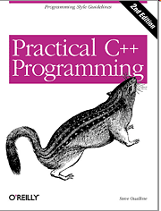
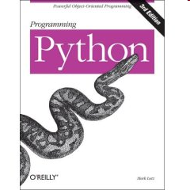
High Level Programming
Assembly language, still not so easy, and lots of commands to accomplish things
High Level Computer Languages provide the ability to accomplish a lot with fewer commands than machine or assembly language in a way that is hopefully easier to understand:
  int sum = 0;
  int count = 1;
  while(count <= 100){
  sum += count;
  count += 1;
  }

Slide 16
Programming Languages
There are hundreds of high level computer languages. Java, C++, C, Basic, Fortran, Cobol, Lisp, Perl, Prolog, Eiffel, Python
The capabilities of the languages vary widely, but they all need a way to do
  declarative statements
  conditional statements
  iterative or repetitive statements
A compiler is a program that converts commands in high level languages to machine language instructions

Slide 17
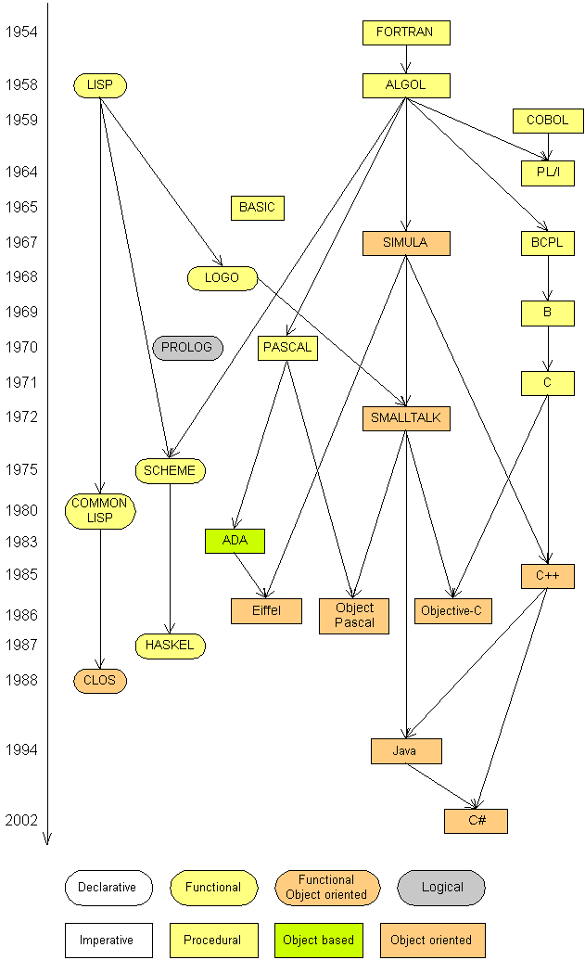
Programming languages
Some influential ones:
  FORTRAN
    science / engineering
  COBOL
    business data
  LISP
    logic and AI
  BASIC
    a simple language

Slide 18
Some modern languages
procedural languages: programs are a series of commands
  Pascal (1970): designed for education
  C (1972): low-level operating systems and device drivers
functional programming: functions map inputs to outputs
  Lisp (1958) / Scheme (1975), ML (1973), Haskell (1990)
object-oriented languages: programs use interacting "objects"
  Smalltalk (1980): first major object-oriented language
  C++ (1985): "object-oriented" improvements to C
    successful in industry; used to build major OSes such as Windows
  Java (1995): designed for embedded systems, web apps/servers
    Runs on many platforms (Windows, Mac, Linux, cell phones...)
    The language taught in this textbook

Slide 19

A Picture is Worth…
The output of the compiler is .class file
The Interpreter's are sometimes referred to as the Java Virtual Machines

Slide 20
Compile/run a program
Write it.
  code or source code: The set of instructions in a program.
Compile it.
  compile: Translate a program from one language to another.
  byte code: The Java compiler converts your code into a format named byte code that runs on many computer types.
  interpreter: A converts one instruction or line of code from one language to another and then executes that instruction
  When java programs are run the bytecode produced by the compiler is fed to an interpreter that converts it to machine code for a particular CPU.

Slide 21



Compile/run a program
3. Run (execute) it.
  output: The messages printed to the user by a program.
source code
byte code
compile
output
run

