Slide 1

Lecture 14: Strings and Recursion
AP Computer Science Principles

Slide 2
Strings

Slide 3
Strings
string: An object storing a sequence of text characters.
  String is not a primitive type. String is an object type.
  String name = "text";
  String name2 = new String(“text”);
  String name3 = expression;
  Examples:
  String name = ”Mike";
  String name2 = new String(“John”);
  int x = 3;
  int y = 5;
  String point = "(" + x + ", " + y + ")";
  // (3, 5)

Slide 4
Indexes
Characters of a string are numbered with 0-based indexes:
  String name = ”J. Smith";
  First character's index : 0
  Last character's index : 1 less than the string's length
  The individual characters are values of type char
index | 0 | 1 | 2 | 3 | 4 | 5 | 6 | 7
character | J | . |  | S | m | i | t | h

Slide 5
String methods
These methods are called using the dot notation
Method name | Description
indexOf(str) | Returns index where the start of the given string appears in this string (-1 if not found)
length() | Returns number of characters in this string
substring(index1, index2) or substring(index1) | Returns the characters in this string from index1 (inclusive) to index2 (exclusive); if index2 is omitted, grabs till end of string
toLowerCase() | Returns a new string with all lowercase letters
toUpperCase() | Returns a new string with all uppercase letters

Slide 6
String method examples
  // index 0123456789012345678
  String s1 = ”programming in java";
  println(s1.length());
  // 19
  println(s1.indexOf(“i")); // 8
  println(s1.indexOf(“gram")); // 3
  println(s1.indexOf(“hi")); // -1
  println(s1.substring(7, 10));
  // ”min"
  println(s1.substring(12));
  // ”in java”
  println(s1.substring(2,3));
  // ”o”
  println(s1.substring(2,2));
  // ””, empty string
  String s2 = s1.substring(10, 17);
  // ”g in ja”
  println(s2.toUpperCase());
  // ”G IN JA”, s2 is still “g in ja”

Slide 7
String method examples
Given the following string:
  // index 0123456789012345678901
  String book = "Building Java Programs";
  How would you extract the word "Java" ?
  String word = book.substring(9,13);

Slide 8
Modifying strings
Methods like substring and toLowerCase build and return a new string, rather than modifying the current string.
  String is immutable; once created, its value cannot be changed.
  String s = "lil bow wow";
  s = “snoop dog”;
  //”lil bow wow” is discarded and a new String
  // object “snoop dog” is created.
  s.toUpperCase();
  println(s);
  // snoop dog, s is not changed

Slide 9
Modifying strings
To modify a variable's value, you must reassign it:
  String s = "lil bow wow";
  s = s.toUpperCase();
  println(s);
  // LIL BOW WOW

Slide 10
String test methods
  String a = “hello”, b = “HELLO”;
  println(a.equals(b)); // false
  println(a.equalsIgnoreCase(b)); // true
Method | Description
equals(str) | whether two strings contain the same characters
equalsIgnoreCase(str) | whether two strings contain the same characters, ignoring upper vs. lower case

Slide 11
Comparing strings
Avoid using == to compare objects, including Strings.
  == compares objects by references , so it often gives false even when two Strings have the same letters. Use equals instead.
  String a = “hi”; //String literal
  String b = “hi”;
  String c = new String(“hi”);
  println(a == b);
  //true, to save on memory, a and b reference the
  // same String
  println(a == c); //false, a and c reference
  // different Strings.
  println(a.equals(c));
  //true, a and c have the same values.

Slide 12
Substring Methods
  The following methods are useful. Learn how to
  use them properly!
  length()
  indexOf(String a)
  substring(int index)
  substring(int index1, int index2)
  equals(String a)
  k

Slide 13
Substring Methods
  String school = “Hogwarts: School for Pigs”;
  String headmaster = “Brad Pig”; //
  String teacher = “Kevin Bacon”;
  String gf = “Piggy Azalea”;
  String fav = “Hamlet”;
  String favCharsinStarWars = “Ham Solo and Chewbacon”;

Slide 14
Recursion

Slide 15
Recursion
recursion: The definition of an operation in terms of itself.
  Solving a problem using recursion depends on solving
  smaller occurrences of the same problem.
recursive programming: Writing methods that call themselves to solve problems recursively.
  An equally powerful substitute for iteration (loops)
  Particularly well-suited to solving certain types of problems

Slide 16
Why learn recursion?
"cultural experience" - A different way of thinking of problems
Can solve some kinds of problems better than iteration
Leads to elegant, simplistic, short code (when used well)
Many programming languages ("functional" languages such as Scheme, ML, and Haskell) use recursion exclusively (no loops)

Slide 17
Recursion and cases
Every recursive algorithm involves at least 2 cases:
  base case: A simple occurrence that can be answered directly.
  recursive case: A more complex occurrence of the problem that cannot be directly answered, but can instead be described in terms of smaller occurrences of the same problem.
  Some recursive algorithms have more than one base or recursive case, but all have at least one of each.
  A crucial part of recursive programming is identifying these cases.

Slide 18
Example
You are lined up in front of your favorite store for Black Friday deals. The line is long and wraps around the building so that you cannot see the front of the line. How do you figure out your position without getting out of line?
Answer: Ask the person in front of you.
Base case: If a customer is at the front of the line and someone asks him for his position, he’ll “return” 1.
Recursive case: If a customer is at position n and someone asks him for his position, he’ll ask the person in front of him.
Note: The recursive case reduces an n problem to an n-1 problem.

Slide 19
Recursion in Java
Consider the following iterative version method to print a line of * characters:
  void printStars(int n) {
  for (int i = 0; i < n; i++) {
  print("*");
  }
  println(); // end the line of output
  }
Write a recursive version of this method (that calls itself).
  Solve the problem without using any loops.
  Hint: Your solution should print just one star at a time.

Slide 20
"Recursion Zen"
The real, even simpler, base case is an n of 0, not 1:
  void printStars(int n) {
  if (n == 0) {
  // base case; just end the line of output
  println();
  return; // ends execution of method early
  } else {
  // recursive case; print one more star
  print("*");
  printStars(n - 1);
  }
  }
  Note: In a void method, the empty ”return” statement can be used
  to ends the execution of a method early. This is sometimes useful
  in recursive methods.

Slide 21
Exercise
Write a recursive method pow accepts an integer base and exponent and returns the base raised to that exponent.
  Example: pow(3, 4) returns 81
  Solve the problem recursively and without using loops.

Slide 22
pow solution
  // Returns base ^ exponent.
  // Precondition: exponent >= 0
  int pow(int base, int exponent) {
  if (exponent == 0) {
  // base case; any number to 0th power is 1
  return 1;
  } else {
  // recursive case: x^y = x * x^(y-1)
  return base * pow(base, exponent - 1);
  }
  }

Slide 23
Recursive tracing
Consider the following recursive method:
  int mystery(int n) {
  if (n < 10) {
  return n;
  } else {
  int a = n / 10;
  int b = n % 10;
  return mystery(a + b);
  }
  }
  What is the result of the following call?
    mystery(648)

Slide 24
A recursive trace
mystery(648):
  int a = 648 / 10; // 64
  int b = 648 % 10; // 8
  return mystery(a + b); // mystery(72)
    mystery(72):
    int a = 72 / 10; // 7
    int b = 72 % 10; // 2
    return mystery(a + b); // mystery(9)
      mystery(9):
      return 9;

Slide 25
Recursive tracing 2
Consider the following recursive method:
  int mystery(int n) {
  if (n < 10) {
  return (10 * n) + n;
  } else {
  int a = mystery(n / 10);
  int b = mystery(n % 10);
  return (100 * a) + b;
  }
  }
  What is the result of the following call?
    mystery(348)

Slide 26
A recursive trace 2
mystery(348)
  int a = mystery(34);
    int a = mystery(3);
      return (10 * 3) + 3; // a=33
    int b = mystery(4);
      return (10 * 4) + 4; // b=44
    return (100 * 33) + 44; // a=3344
  int b = mystery(8);
    return (10 * 8) + 8; // b=88
  return (100 * 3344) + 88; // 334488
  What is this method really doing?

Slide 27
Lab 1: Codingbat
Do the following on codingbat.
In String-1, do:
makeOutWord
firstHalf
theEnd
frontAgain
In String-2, do:
countHi
repeatEnd
catDog

Slide 28
Lab 2: Fractal Circles
  Use Processing to write the recursive method to print out a
  recursive pattern of circles of decreasing radii.
void setup(){
circle(width/2, width/4, 10);
}
void circle(int x, int radius, int depth)
{…}
  The call circle(width/2, width/4, 10) should produce the
  image on the following slide. Use noFill() before drawing
  the circle to make it transparent.

Slide 29
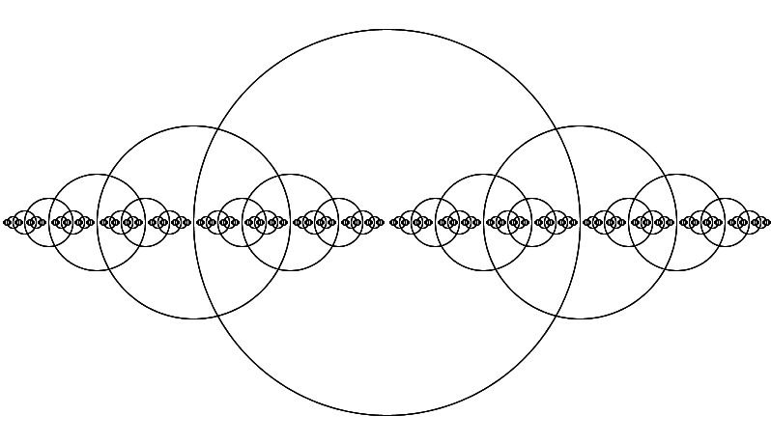
Lab 2

Slide 30
Lab 3: Sierpinski Triangle(Optional)
  Use Processing to write the recursive method to the Sierpinski triangle.
void setup(){
fractralTriangle(width/2,0,0,height,width,height,10);
}
void fractalTriangle(int x1, int y1, int x2, int y2, int x3, int y3, int n)
{…}

Slide 31
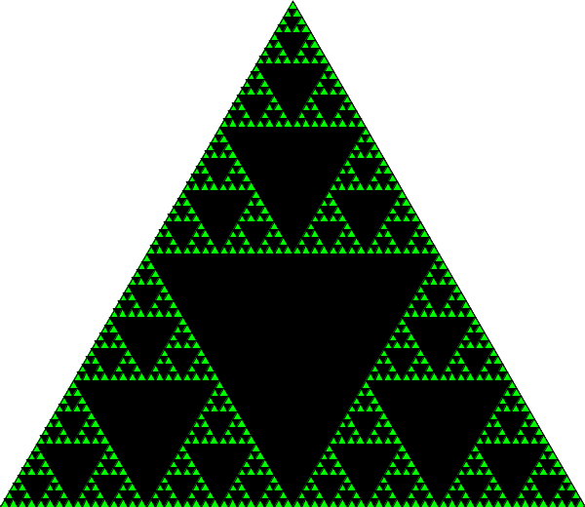
Lab 3 Optional

Slide 32
Homework
Read and reread these lecture notes.
Complete the lab.

Slide 33
References
Part of this lecture is taken from the following book.
Stuart Reges and Marty Stepp. Building Java Programs: A Back to Basics Approach. Pearson Education. 2008.

