Slide 1

Lecture 2: Binary and Encoding
AP Computer Science Principles

Slide 2
Number Systems

Slide 3
Boole
In 1854, British mathematician George Boole published a landmark paper detailing an algebraic system of logic that would become known as Boolean algebra. In programming, a boolean data type takes on two possible values: true or false and is named after him.
His logical calculus was to become instrumental in the design of digital electronic circuitry.

Slide 4
Model K
In November 1937, George Stibitz, then working at Bell Labs, completed a relay-based computer he dubbed the "Model K" (for “Kitchen", where he had assembled it), which calculated using binary addition. Bell Labs thus authorized a full research program in late 1938 with Stibitz at the helm

Slide 5
Complex Number Computer
Their Complex Number Computer, completed January 8, 1940, was able to calculate complex numbers. In a demonstration to the American Mathematical Society conference at Dartmouth College on September 11, 1940, Stibitz was able to send the Complex Number Calculator remote commands over telephone lines by a teletype. It was the first computing machine ever used remotely over a phone line.

Slide 6
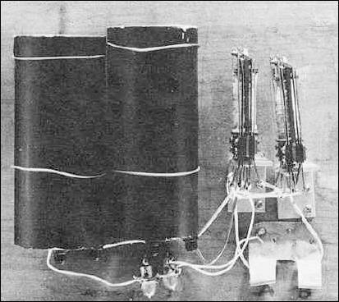
Model K
Model K The first Relay Based Computer to use Binary Numbers (1937)

Slide 7
Base 10 (Decimal numbers)
Why base 10?
We happened to use the current counting system, because we happened to have ten fingers.
Base 10(Decimal) uses 10 digits {0,1,2,3…,9}.
Base 2(Binary) uses 2 digits {0,1}.

Slide 8
Base 10 (Decimal numbers)
What does 157 mean?
  157 = 1 x 100 + 5 x 10 + 7 x 1
= 1 x 10² + 5 x 10¹ + 7 x 10⁰

Slide 9
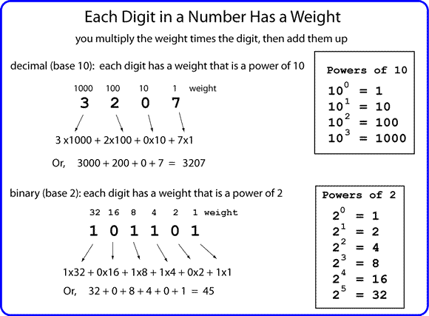

Slide 10
Base 2 (Binary)
Base 10
157
157 = 1 x 100 + 5 x 10 + 7 x 1
= 1 x 10² + 5 x 10¹ + 7 x 10⁰
Base 2
1011 = 1 x 2³ + 0 x 2² + 1 x 2¹ + 1 x 2⁰
1011 = 1 x 8 + 0 x 4 + 1 x 2 + 1 x 1 =11 in Base 10

Slide 11
Bits and Bytes
1 bit is a single bit of information, a 1 or 0
  Only two possible values
1 byte is 8 bits, an 8 bit word
  256 possible values from 0-255 base 10 or 00000000 to 11111111 base 2
10100110 is a single byte

Slide 12
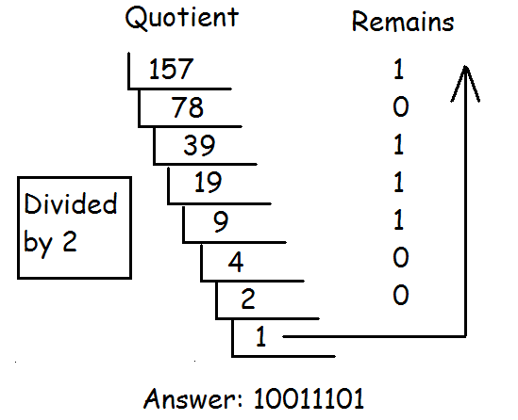
Decimal to Binary

Slide 13
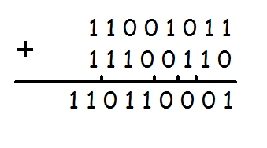
Adding Binary
0+0=0
1+0=1
1+1=10

Slide 14
People
There are 10 types of people in the world; those who understand binary and those who don’t.
There are 10 types of people in the world; those who understand binary and those who have friends.

Slide 15
Hexadecimal
Binary code is too long in representation. Hexadecimal is much shorter.
Converting a binary number to a Hex number is relatively easy
  Every 4 bit can convert to a Hex
Problem: we are short of numbers
  A-10 B-11 C-12 D-13 E-14 F-15

Slide 16
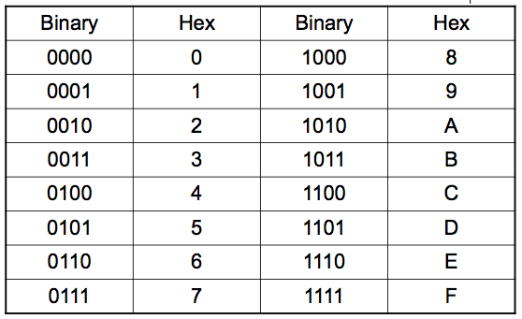
Hexadecimal

Slide 17
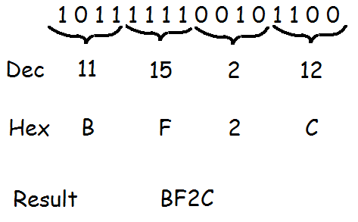
Binary to Hex

Slide 18
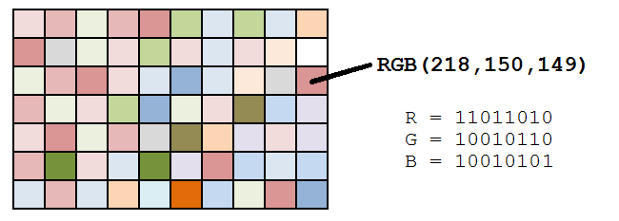
Encoding Data in Binary

Slide 19
Counting
Let’s count in Base 10.
0,1,2,3,4,5,6,7,8,9,__,___,…,18,19,__,__.
Answer: 10,11,20,21. Impressive!
Let’s count in Base 5.
0,1,2,3,4,__,__,__,__,__,___.
Answer:10,11,12,13,14,20.
Let’s keep going!
40,41,42,43,44,___,___,___.
Answer:100,101,102.

Slide 20






Quick Quiz
What’s the answer in base 8?
What’s the answer in base 5?
What’s the answer in base 12?

Slide 21
Character Encoding

Slide 22

Encoding
A computer cannot store “letters” or “pictures”. It can only work with bits(0 or 1).
To represent anything other than bits, we need to rules that will allow us to convert a sequence of bits into letters or pictures. This set of rules is called an encoding scheme, or encoding for short. For example,

Slide 23
ASCII
ASCII(American Standard Code for Information Exchange) is an encoding scheme that specifies the mapping between bits and characters. There are 128 characters in the scheme. There are 95 readable characters and 33 values for nonprintable characters like space, tab, and backspace and so on.
The readable characters include a-z, A-Z, 0-9 and punctuation.
ASCII uses all possible combinations of 7 bits(0000000 to 1111111, 2^7=128).

Slide 24
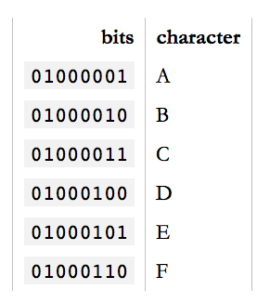
ASCII Sample
In ASCII, 65 represents A, 66 represents B and so on. The numbers are called code points.
To encode something in ASCII,
follow the table from right to left,
substituting letters for bits.
To decode a string of bits into
human readable characters, follow
the table from left to right, substituting
bits for letters.

Slide 25
Excusez-Moi?
95 characters can covers English but what about French? Or how do you represent Swedish letters é, ß, ü, ä, ö or å in ASCII?
"But look at it," the Europeans said, "in a common computer with 8 bits to the byte, ASCII is wasting an entire bit which is always set to 0! We can use that bit to squeeze a whole 'nother 128 values into that table!" And so they did.
The extended ASCII table has 256 values. All 8 bits were used.

Slide 26
Excusez-Moi?
But even so, there are more than 128 ways to stroke, slice, slash and dot a vowel. Not all variations of letters and squiggles used in all European languages can be represented in the same table with a maximum of 256 values.
Not to mention Chinese. Or Japanese. Both contains thousands of characters. There are many encodings that try to address this. For example, BIG-5 covers all traditional Chinese characters.

Slide 27
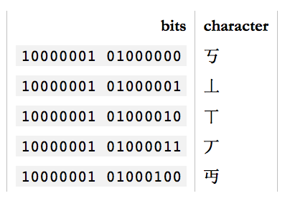
GB18030 Encoding
And GB18030 covers both traditional and simplified Chinese as well as a large part of the latin characters.
GB18030 uses two bytes
(16 bits) to encode. This
can encode 65,536
distinct values.
But in the end, GB18030 is
yet another specialized
encoding among many.

Slide 28
Unicode
Finally, in 1991, Unicode was created to unify all encoding standards. It defines a table of 1,114,112 code points that can be used for all sorts of letters and symbols. That's plenty to encode all European, Middle-Eastern, Far-Eastern, Southern, Northern, Western, pre-historian and future characters mankind knows about.

Slide 29
Unicode
Using Unicode, you can write a document containing virtually any language using any character you can type into a computer. This was either impossible or very very hard to get right before Unicode came along. There's even an unofficial section of Klingon in Unicode.

Slide 30
Unicode
So, how many bits does Unicode use to encode all these characters? None. Because Unicode is not an encoding.
Unicode first and foremost defines a table of code points for characters. That's a fancy way of saying "65 stands for A, 66 stands for B and 9,731 stands for ☃”.

Slide 31
UTF-32
To represent 1,114,112 different values, two bytes aren't enough. Three bytes are, but three bytes are often awkward to work with, so four bytes would be the comfortable minimum.
UTF-32(Unicode Transformation Format) is such an encoding that encodes all Unicode code points using 32 bits. That is, four bytes per character.

Slide 32
UTF-32
UTF-32 very simple, but often wastes a lot of space. For example, if A is always encoded as 00000000 00000000 00000000 01000001 and B as 00000000 00000000 00000000 01000010 and so on, documents would bloat to 4x its necessary size.
UTF-16 and UTF-8 are variable-length encodings. If a character can be represented using a single byte (because its code point is a very small number), UTF-8 will encode it with a single byte. If it requires two bytes, it will use two bytes and so on. UTF-16 is in the middle, using at least two bytes, growing to up to four bytes as necessary.

Slide 33
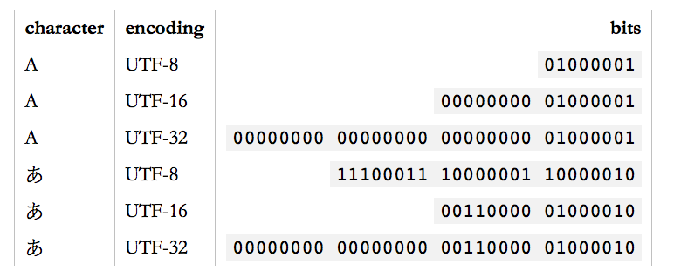
Unicode
Unicode is a large table mapping characters to numbers and the different UTF encodings specify how these numbers are encoded as bits.

Slide 34
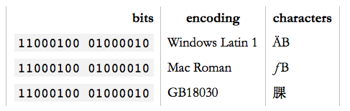
UTF-32
Any character can be encoded in many different bit sequences and any particular bit sequence can represent many different characters, depending on which encoding is used to read or write them. The reason is simply because different encodings use different numbers of bits per characters and different values to represent different characters.

Slide 35
Garbled Text?
You open a text file and it looks like:
ÉGÉìÉRÅ[ÉfÉBÉìÉOÇÕìÔÇµÇ≠Ç»Ç¢
Reason: Your text editor, browser, word processor or whatever else that's trying to read the document is assuming the wrong encoding.
In Safari or Firefox, you can change the text encoding. (Chrome only supports this through an extension.) For Safari, under “View”, select “Text Encoding” and “Japanese Shift JS” to see the correct text:
エンコーディングは難しくない

Slide 36
UTF-8
UTF-8 is the standard encoding for all email and webpages(HTML5).
The ingenious thing about UTF-8 is that it's binary compatible with ASCII, which is the de-facto baseline for all encodings.
All characters available in the ASCII encoding only take up a single byte in UTF-8 and they're the exact same bytes as are used in ASCII. In other words, ASCII maps 1:1 unto UTF-8. Any character not in ASCII takes up two or more bytes in UTF-8.

Slide 37
Homework
Read and reread these lecture notes.
Do the problem set.

Slide 38
References
1) What Every Programmer Absolutely, Positively Needs To Know About Encodings And Character Sets To Work With Text, by David Zentgraf. http://kunststube.net/encoding/
2) Part of this lecture is taken from a lecture from an OpenCourseWare course below.
Computer Science E-1 at Harvard Extension School
Understanding Computers and the Internet
by Tommy MacWilliam
https://www.youtube.com/watch?v=Q2mOfJSG7rc

