Slide 1

Lecture 5: Basic Java Syntax
AP Computer Science Principles

Slide 2
Data Types and Operations

Slide 3
Data types
type: A category or set of data values.
  Constrains the operations that can be performed on data
  Many languages ask the programmer to specify types
  Examples: integer, real number, string
Internally, computers store everything as 1s and 0s
  104 → 01101000
  "hi" → 01101000110101
Notes:
ask them, how might the computer store "hi" using binary digits? (some kind of mapping; ASCII)

Slide 4
Java's primitive types
primitive types: 8 simple types for numbers, text, etc.
  Java also has object types, which we'll talk about later.
  Name Description Examples
  int integers(up to 2³¹ - 1) 42, -3, 0, 9263
  float real numbers (up to 10³⁸) 3.1, -0.25, 9.4e3
  boolean logical values true, false
Notes:
We're basically going to manipulate letters and numbers.
We make the integer / real number distinction in English as well. We don't ask, "How many do you weigh?" or, "How much sisters do you have?"
Part of the int/double split is related to how a computer processor crunches numbers. A CPU does integer computations and a Floating Point Unit (FPU) does real number computations.
Why does Java separate int and double? Why not use one combined type called number?

Slide 5
Arithmetic operators
operator: Combines multiple values or expressions.
  + addition
  - subtraction (or negation)
  * multiplication
  / division
  % modulus (a.k.a. remainder)

Slide 6
Integer division with /
When we divide integers, the quotient is also an integer.
  14 / 4 is 3, not 3.5
3 4 52
4 ) 14 10 ) 45 27 ) 1425
12 40 135
2 5 75
54
21
More examples:
  32 / 5 is 6
  84 / 10 is 8
  156 / 100 is 1
  Dividing by 0 causes an error when your program runs.

Slide 7
Integer remainder with %
The % operator computes the remainder from integer division.
  14 % 4 is 2
  218 % 5 is 3
  3 43
  4 ) 14 5 ) 218
  12 20
  2 18
  15
  3
Applications of % operator:
  Obtain last digit of a number: 230857 % 10 is 7
  Obtain last 4 digits: 658236489 % 10000 is 6489
  See whether a number is odd: 7 % 2 is 1, 42 % 2 is 0
What is the result?
45 % 6
2 % 2
8 % 20
11 % 0
Notes:
What is 8 % 20? It's 8, but students often say 0.

Slide 8
Precedence
precedence: Order in which operators are evaluated.
  Generally operators evaluate left-to-right for operators with the same level of precedence. For example, + and -.
  1 - 2 - 3 is (1 - 2) - 3 which is -4
  But * / % have a higher level of precedence than + -
  1 + 3 * 4 is 13
  6 + 8 / 2 * 3
  6 + 4 * 3
  6 + 12 is 18
  Parentheses can force a certain order of evaluation:
  (1 + 3) * 4 is 16
  Spacing does not affect order of evaluation
  1+3 * 4-2 is 11

Slide 9
Precedence examples
1 * 2 + 3 * 5 % 4
\_/
|
2 + 3 * 5 % 4
\_/
|
2 + 15 % 4
\___/
|
2 + 3
\________/
|
5
1 + 8 % 3 * 2 - 9
\_/
|
1 + 2 * 2 - 9
\___/
|
1 + 4 - 9
\______/
|
5 - 9
\_________/
|
-4
Notes:
Ask the students what 15 / 4 and 2 / 3 are, since the answers are non-obvious.

Slide 10
Precedence questions
What values result from the following expressions?
  9 / 5
  695 % 20
  7 + 6 * 5
  7 * 6 + 5
  248 % 100 / 5
  6 * 3 - 9 / 4
  (5 - 7) * 4
  6 + (18 % (17 - 12))
Notes:
(I don't usually go through these in lecture; I tell them they are extra problems they can work on later)
Answers:
1
15
37
47
9
16
-8
9

Slide 11
Real numbers (type float)
Examples: 6.022 , -42.0 , 2.143
  Placing .0 or . after an integer makes it a float.
The operators + - * / % () all still work with float.
  / produces an exact answer: 15.0 / 2.0 is 7.5
  Precedence is the same: () before * / % before + -
Notes:
Point out that it's odd for 42.0 to be considered a real number, but it is.

Slide 12
Real number example
2.0 * 2.4 + 2.25 * 4.0 / 2.0
\___/
|
4.8 + 2.25 * 4.0 / 2.0
\___/
|
4.8 + 9.0 / 2.0
\_____/
|
4.8 + 4.5
\____________/
|
9.3

Slide 13
Mixing types
When int and float are mixed, the result is a float.
  4.2 * 3 is 12.6
The conversion is per-operator, affecting only its operands.
  7 / 3 * 1.2 + 3 / 2
  \_/
  |
  2 * 1.2 + 3 / 2
  \___/
  |
  2.4 + 3 / 2
  \_/
  |
  2.4 + 1
  \________/
  |
  3.4
  3 / 2 is 1 above, not 1.5.
2.0 + 10 / 3 * 2.5 - 6 / 4.0
\___/
|
2.0 + 3 * 2.5 - 6 / 4.0
\_____/
|
2.0 + 7.5 - 6 / 4.0
\_/
|
2.0 + 7.5 - 1.5
\_________/
|
9.5 - 1.5
\______________/
|
8.0
Notes:
I don't usually go through the expression on the right; I just show it very quickly and move on.

Slide 14
Strings
string: A sequence of characters to be printed.
  Starts and ends with a " quote " character.
  Examples:
  "hello"
  "This is a string. It's very long!"
Restrictions:
  May not span multiple lines.
  "This is not
  a legal String."
  May not contain a " character.
  "This is not a "legal" String either."

Slide 15
String concatenation
string concatenation: Using + between a string and another value to make a longer string.
  "hello" + 42
  1 + "abc" + 2
  "abc" + 1 + 2
  1 + 2 + "abc”
  "abc" + 9 * 3
  "1" + 1
  ("abc”+(2+3))+4*5
Use + to combine a string and an expression's value together.
  println("Grade: " + (95.1 + 71.9) / 2));
  Output:
  Grade: 83.5
“hello42”
“1abc2”
“abc12”
“3abc”
“abc27”
“11”
“abc520”

Slide 16
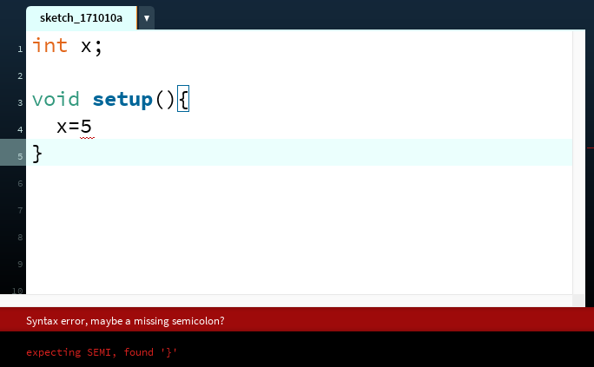
The Console
The console refers to the box at the bottom of Processing. It is generally used to print error messages in the code.
Notes:
ask them, how might the computer store "hi" using binary digits? (some kind of mapping; ASCII)

Slide 17
The Console
  Messages can be printed on the console(for error-checking purposes, etc..) by using the command println().
  println(4); // 4
  println(4+3/2); // 5
  println(“Hello, world”); // Hello, world(no quotation in output)
Notes:
ask them, how might the computer store "hi" using binary digits? (some kind of mapping; ASCII)

Slide 18
Variables

Slide 19
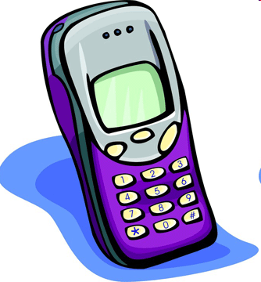
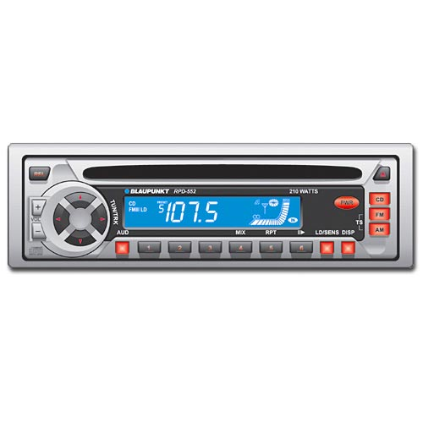
Variables
variable: A piece of the computer's memory that is given a name and type, and can store a value.
  Like preset stations on a car stereo, or cell phone speed dial:
  Steps for using a variable:
    Declare it - state its name and type
    Initialize it - store a value into it
    Use it - print it or use it as part of an expression
Notes:
a variable is also like the MS / MR buttons on a calculator
variables must be declared before they are used, just like methods

Slide 20
Declaration
variable declaration: Sets aside memory for storing a value.
  Variables must be declared before they can be used.
Syntax:
  type name;
    The name is an identifier.
  int x;
  float myGPA;
x
myGPA

Slide 21
Assignment
assignment: Stores a value into a variable.
  The value can be an expression; the variable stores its result.
Syntax:
  name = expression;
  int x;
  x = 3;
  float myGPA;
  myGPA = 1.0 + 2.25;
x | 3
myGPA | 3.25

Slide 22
Using variables
Once given a value, a variable can be used in expressions:
  int x;
  x = 3;
  println("x is " + x); // x is 3
  println(5 * x - 1); // 14
You can assign a value more than once:
  int x;
  x = 3;
  println(x + " here"); // 3 here
  x = 4 + 7;
  println("now x is " + x); // now x is 11
x | 3
x | 11

Slide 23
Declaration/initialization
A variable can be declared/initialized in one statement.
Syntax:
  type name = value;
  float myGPA = 3.95;
  int x = (11 % 3) + 12;
myGPA | 3.95
x | 14

Slide 24
Assignment and algebra
Assignment uses = , but it is not an algebraic equation.
  =means, "store the value at right in variable at left"
    The right side expression is evaluated first,
    and then its result is stored in the variable at left.
What happens here?
  int x = 3;
  x = x + 2; // ???
x | 3
x | 5
Notes:
x = x + 2; increases the value stored in variable x by two.

Slide 25
Assignment and types
A variable can only store a value of its own type.
  int x = 2.5; // ERROR: incompatible types
An int value can be stored in a float variable.
  The value is converted into the equivalent real number.
  float myGPA = 4;
  float avg = 11 / 2;
    Why does avg store 5.0
    and not 5.5 ?
myGPA | 4.0
avg | 5.0

Slide 26
Compiler errors
Order matters.
  int x;
  7=x; // ERROR: should be x=7;
A variable can't be used until it is assigned a value.
  int x;
  println(x); // ERROR: x has no value
You may not declare the same variable twice.
  int x;
  int x; // ERROR: x already exists
  int x = 3;
  int x = 5; // ERROR: x already exists
    How can this code be fixed? (remove the second int)

Slide 27
Declaring Strings
  A string can be stored in a variable with type String. String is not one of
  the 8 primitive types; it is an object type.
  String x = “Hello!”; // declare and initialize x
  x = x + “ Mike!”; // “Hello! Mike!”
  x = x + 2 * 4 + 5; //“Hello! Mike!85”
  println(x);
  // Hello! Mike!85
  println(“x”);
  // x

Slide 28
Declaring Strings
  String beans;
  beans = “Programming”;
  String cheese = “in”;
  String quartet;
  println(quartet); //error, quartet not initialized
  quartet = beans + cheese + “Java”;
  println(quartet); //ProgramminginJava
  println(beans + “ ” + cheese + “ ” + “Java”);
  //Programming in Java

Slide 29
Printing a variable's value
Use + to print a string and a variable's value on one line.
  float grade = (95.1 + 71.9 + 82.6) / 3.0;
  println("Your grade was " + grade);
  int students = 11 + 17 + 4 + 19 + 14;
  println("There are " + students +
  " students in the course.");
  Output:
  Your grade was 83.2
  There are 65 students in the course.

Slide 30
Comments
comment: A note written in source code by the programmer to describe or clarify the code.
  Comments are not executed when your program runs.
Syntax:
// comment text, on one line
or,
/* comment text; may span multiple lines */
Examples:
  // This is a one-line comment.
  /* This is a very long
  multi-line
  comment. */

Slide 31
Declaring a method
  A method is a sequence of related statements performing a specific task.
  Declaring a method is giving a method a name so that it can be executed.
void name() {
statement;
statement;
...
statement;
}
Example:
void printWarning() {
  println(“This product causes cancer in humans.”);
}

Slide 32
Calling a method
Executes the method's code
Syntax:
  name();
  You can call the same method many times if you like.
Example:
  printWarning();
  Output:
  This product causes cancer in humans.

Slide 33
Control flow
When a method is called, the program's execution...
  "jumps" into that method, executing its statements, then
  "jumps" back to the point where the method was called.

Slide 34
Methods calling methods
  void setup() {
  message1();
  message2();
  println("Done with setup.");
  }
  void message1() {
  println("This is message1.");
  }
  void message2() {
  println("This is message2.");
  message1();
  println("Done with message2.");
  }

Slide 35
Control flow
When a method is called, the program's execution...
  "jumps" into that method, executing its statements, then
  "jumps" back to the point where the method was called.
void setup() {
message1();
message2();
println("Done with main.");
}
...
}
void message1() {
println("This is message1.");
}
void message2() {
println("This is message2.");
message1();
println("Done with message2.");
}
void message1() {
println("This is message1.");
}

Slide 36
Methods calling methods
  void setup() {
  message1();
  message2();
  println("Done with setup.");
  }
  void message1() {
  println("This is message1.");
  }
  void message2() {
  println("This is message2.");
  message1();
  println("Done with message2.");
  }
Output:
  This is message1.
  This is message2.
  This is message1.
  Done with message2.
  Done with setup.

Slide 37
When to use methods
Place statements into method if:
  The statements are related structurally, and/or
  The statements are repeated.
You should not create methods for:
  Unrelated or weakly related statements.
  (Consider splitting them into two smaller methods.)

Slide 38
Lab 1: Decomposing Time
  Given an integer that represent the number of seconds. Decompose it into the number hours, minutes and seconds.
  For example,
  int seconds=3728;
  int hr,min,sec;
  //your code here
  println(hr + “:” + min + “:” + sec);
  Should have output: 1:2:8

Slide 39
Lab 2: GMT
  Write a program that display the current Greenwich Mean Time(GMT) in the format hour:minute:second, for example, 5:43:25.
  The method System.currentTimeMillis() returns the current time in milliseconds since midnight of January 1, 1970(GMT).
  A template GMT.pde has been created for you. Modify the template so that the current time is displayed on the screen.

Slide 40
Lab 2: GMT
  The method text(str,x,y) will display the the String str at given (x,y) position. You can set the font size with textSize(size).
  The following display “Hello” at (200,300).
  textSize(32);
  text(“Hello”,200,300);

Slide 41
Lab 3: GMT
  Modify the previous lab so that the time display on the screen updates in real time.
  Hint: By default draw() runs 60 times a second and frameCount is a reserved variable that keep track of the current frame; at the end of the first draw iteration, frameCount is 1, at the end of the second, it is 2 etc…

Slide 42
Lab 4: GMT (AM/PM)
  Add a textstring above the clock display to read “GMT Time”.
  Also, modify the previous lab so that the time display on the screen incorporates an “AM” or “PM”.
  For example, 14:25:16 would now be 2:25:16 PM.
  Modify it again to add in “leading zeroes” if the minute or second component of time is less than 10.
  For example 14:3:5 would now be 2:03:05 PM.

Slide 43
Homework
Read and reread these lecture notes.
Complete the problem set.
Complete the three labs.

Slide 44
References
Part of this lecture is taken from the following book.
1) Stuart Reges and Marty Stepp. Building Java Programs: A Back to Basics Approach. Pearson Education. 2008.

