Slide 1

Algorithms

Slide 2
Algorithms
An algorithm is a finite set of instructions that accomplish a specific task.
Every algorithm can be constructed using combinations of sequencing, selection, and iteration.
Sequencing is the application of each step of an algorithm in the order in which the code statements are given.
Iteration is a repeating portion of an algorithm. Iteration repeats a specified number of times or until a given condition is met.
Selection determines which parts of an algorithm are executed based on a condition being true or false.
We will discuss some important algorithms in this lecture.

Slide 3
Sequential search
Linear search or sequential search algorithms check each element of a list, in order, until the desired value is found or all elements in the list have been checked. Implement sequential search using list which returns the index of the target or -1 if it is not found.
def sequential_search(lst, target):
for i in range(len(lst)):
if lst[i] == target:
return i
return -1
a = sequential_search([3,0,5,1], 0) # a = 1
print(a) # 1

Slide 4
Sequential search
Linear search or sequential search algorithms check each element of a list, in order, until the desired value is found or all elements in the list have been checked. Implement sequential search using list which returns the index of the target or -1 if it is not found.
def sequential_search(lst, target):
for i in range(len(lst)):
if lst[i] == target:
return i
return -1
a = sequential_search([3,0,5,1], 0) # a = 1
print(a) # 1
numbers = [4, 2, 3, 7 -12, 3, 56, 34]
print(sequential_search(numbers, 3)) # 2

Slide 5
Sequential search
Linear search or sequential search algorithms check each element of a list, in order, until the desired value is found or all elements in the list have been checked. Implement sequential search using list which returns the index of the target or -1 if it is not found.
def sequential_search(lst, target):
for i in range(len(lst)):
if lst[i] == target:
return i
return -1
a = sequential_search([3,0,5,1], 0) # a = 1
print(a) # 1
numbers = [4, 2, 3, 7 -12, 3, 56, 34]
print(sequential_search(numbers, 3)) # 2
print(sequential_search(numbers, 100)) # -1

Slide 6

Binary Search
Note that the array below is sorted. How can we take advantage of this?
The binary search algorithm starts at the middle of a sorted data set of numbers and eliminates half of the data; this process repeats until the desired value is found or all elements have been eliminated.
Look at the middle of the array. If the target is found, we are done. Otherwise, If the target is greater than that value, we can eliminate the left half of the array. And If the target is less than the value, eliminate the right half.
Repeat with left or right half of the array accordingly.

Slide 8
Binary Search
Implement binary search. Data must be in sorted order to use the binary search algorithm.
def binary_search(sorted_lst, target):
min, max = 0, len(sorted_list)-1
while min <= max:
mid = (min + max)//2
if sorted_lst[mid] < target:
min = mid + 1
elif sorted_lst[mid] > target:
max = mid – 1
elif sorted_lst[mid] == target:
return mid
return -1

Slide 9
Sorting(not on AP)
sorting: Rearranging the values in an array or collection into a specific order (usually into their "natural ordering").
one of the fundamental problems in computer science
sorts products on Amazon based on ratings or price
sorts contacts on phone in alphabetical order
can be solved in many ways:
there are many sorting algorithms
some are faster/slower than others
some use more/less memory than others
some work better with specific kinds of data
some can utilize multiple computers / processors, ...

Slide 10
Sorting(not on AP)

Slide 11
Sorting(not on AP)

Slide 12
Sorting(not on AP)

Slide 13
Algorithmic Efficiency
A problem is a general description of a task that can (or cannot) be solved algorithmically.
An instance of a problem also includes specific input. For example, sorting is a problem; sorting the list (2,3,1,7) is an instance of the problem.
A decision problem is a problem with a yes/no answer (e.g., is there a path from A to B?).
An optimization problem is a problem with the goal of finding the “best” solution among many (e.g., what is the shortest path from A to B?).

Slide 14
Algorithmic Efficiency
Efficiency is an estimation of the amount of computational resources used by an algorithm.
Efficiency is typically expressed as a function of the size of the input(e.g the size of the list). Can either be worst-case complexity or average-case complexity.
An algorithm’s efficiency can be informally measured by determining the number of times a statement or group of statements executes.
Different correct algorithms for the same problem can have different efficiencies.

Slide 15
Algorithmic Efficiency
Some problems cannot be solved in a reasonable amount of time because there is no efficient algorithm for solving them. In these cases, approximate solutions are sought.
A heuristic is an approach to a problem that produces a solution that is not guaranteed to be optimal but may be used when techniques that are guaranteed to always find an optimal solution are impractical.
For example, ﻿a file-organizing algorithm(sorting a folder based on file types e.g. pdf, docs, jpegs) determines the content of a file based on a certain number of bytes in the beginning of the file. This is an approximate solution since only a few bytes are examined. But it is more practical and faster to run than examining every byte of every file.

Slide 16
Example 1 of Algorithmic Efficiency
def sum(lst):
s = 0
for x in lst:
s += x
s += 1
return s
Let's define efficiency as the number of times a math operation statement is executed. Let the size of lst be n. What is the efficiency of the function sum as a function of n?
Answer: 2n

Slide 17
Example 2 of Algorithmic Efficiency
def sum(lst):
s = 0
for x in lst:
s += x
s += 1
for x in lst:
s -= 1
return s
Let's define efficiency as the number of times a math operation statement is executed. Let the size of lst be n. What is the efficiency of the function sum as a function of n?
Answer: 3n

Slide 18
Example 3 of Algorithmic Efficiency
def sum(lst):
s = 0
for x in lst:
for y in lst:
s += y
return s
Let's define efficiency as the number of times a math operation statement is executed. Let the size of lst be n. What is the efficiency of the function sum as a function of n?
Answer: n*n = n^2

Slide 19
Efficiency for Searching
Suppose we have a list of size n.
1) In the worst-case scenario, what is the number of comparisons needed to find the target using sequential or linear search?
Answer: n
2) In the worst-case scenario, what is the number of comparisons needed to find the target using binary search(when applied to a sorted list)?
Answer: Approximately log_2(n).
Note: The AP exam only requires that you know binary search is generally faster than linear search when applied to a sorted list but not how much faster.

Slide 20
Computational Complexity for Sorting(not on AP exam)
Suppose we have a list of size n.
1) What is the approximate number of comparisons needed for selection sort?
Answer: The implementation of this algorithm uses 2 nested loops, with each loops running n times. Thus, approximately n*n = n^2.
2) What is the approximate number of comparisons needed for insertion sort?
Answer: Similar to selection sort, the code uses 2 nested loops, with each loops running n times. Thus, approximately n*n = n^2.
3) What is the number of comparisons needed for mergesort?
Answer: Approximately n*log(n). (slower than linear search(n) but faster than both selection and insertion sort(n^2).

Slide 21
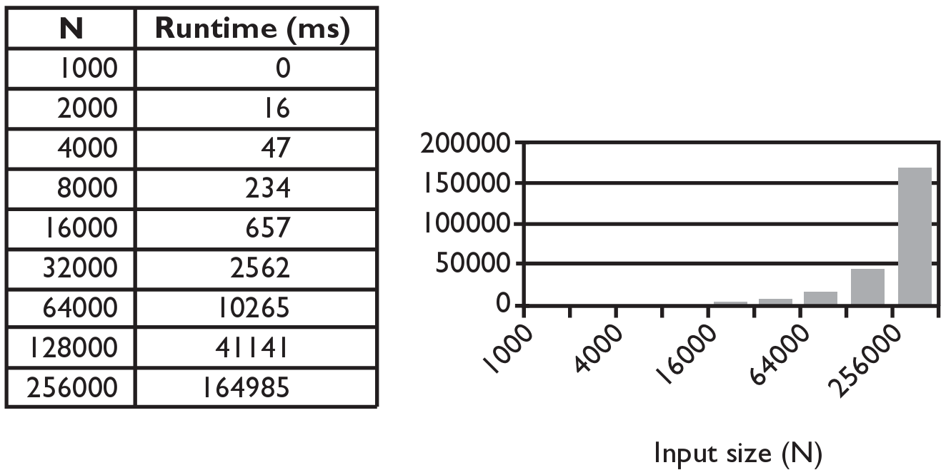
Selection sort runtime(not on AP exam)

Slide 22
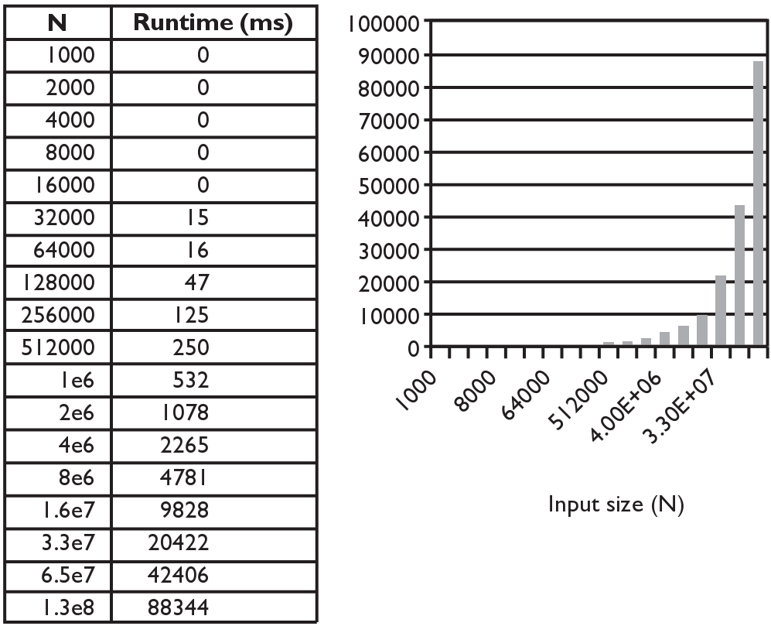
Merge sort runtime(not on AP exam)
For a list of length 256000 items, selection sort takes
about 2.75 minutes but mergesort takes 1/10 of a second.

Slide 23
Exponential Complexity Problems
Algorithms with a polynomial efficiency(constant, linear, square, cube, etc.) are said to run in a reasonable amount of time. They can be executed quickly on a modern processor.
However, there exists important and practical problems for which there exists no known polynomial time algorithm. Algorithms with exponential or factorial efficiencies are examples of algorithms that run in an unreasonable amount of time.
For example, given a set of integers, find a subset that sums to zero. A brute-force algorithm would try every possible subset. But there are 2^n different subsets. This is an example of an exponential time algorithm. If n is large, even the fastest computers would take too long.

Slide 24
Top-Down Design
Top-down design is the name given to breaking a problem down into smaller and more manageable parts(also known as decomposition).
If any of these subproblems is not easier to solve, we further divide the subproblem into smaller parts. The subdivision of a computer program into separate subprograms is called modularity.
We repeat the subdividing process until all small parts are not dividable. Then, we can use a few lines of code to solve every trivial problem. In the end, we put all these little pieces together as a solution to the original problem.
This approach makes it easy to think about the problem, code the solution, read the code, and identify bugs.

Slide 25
Abstraction
Abstraction is the process of reducing complexity by focusing on the main idea.
By hiding details irrelevant to the question at hand and bringing together related and useful details, abstraction reduces complexity and allows one to focus on the idea.
One common type of abstraction is procedural abstraction, which provides a name for a procedure(function) and allows it to be used only knowing what it does, not how it does it.
import random
print(random.randrange(10)) # random number from 0 - 9
We don't need to know how the randrange() function is implemented to be able use it.

Slide 26
Index of Two Smallest Values
Given a list of numbers, find the indices of the two smallest numbers in the list.
We'll implement two algorithms to solve the above problem. We'll use top-down design by first using pseudocode and break down problems into smaller and smaller parts until the pseudocode is easily translated into Python code.
We'll use both built-in functions(min, sorted) and list methods(index, remove,insert) to abstract away some of the smaller tasks in the problem(procedure abstraction).

Slide 27
Index of Two Smallest Values
Given a list of numbers, find the indices of the two smallest numbers in the list.
Jumping right into coding this problem without planning will be tricky.
Let's think carefully how we would solve this by writing out the pseudocode.
def two_smallest(lst):
# Find the index of the minimum item in lst
# Remove that item from the list
# Find the index of the new minimum item in the list
# Put the smallest item back in the list
# If necessary, adjust the second index
# Return the two indices

Slide 28
def two_smallest(lst):
# Find the index of the minimum item in lst
smallest = min(lst)
min1 = lst.index(smallest)
# Remove that item from the list
lst.remove(smallest)
# Find the index of the new minimum item in the list
next_smallest = min(lst)
min2 = lst.index(next_smallest)
# Put the smallest item back in the list
lst.insert(min1, smallest)
# If necessary, adjust the second index
if min1 <= min2:
min2 += 1
# Return the two indices
return (min1, min2)

Slide 29
Here's another algorithm to find the indices of the two smallest numbers.
def two_smallest(lst):
# Sort a copy of lst
sorted_list = sorted(lst)
# Get the two smallest numbers
small1 = sorted_list[0]
small2 = sorted_list[1]
# Find their indices in the original list lst
index1 = lst.index(small1)
index2 = lst.index(small2)
# Return the two indices
return index1, index2

Slide 30
Decidability
A decidable problem is a decision problem for which an algorithm can be written to produce a correct output for all inputs.
E.g. Is the number even?
An undecidable problem is one for which no algorithm can be constructed that is always capable of providing a correct yes-or-no answer.
An undecidable problem may have some instances that have an algorithmic solution, but there is no algorithmic solution that could solve all instances of the problem.
Alan Turing, considered by many to be the father of computer science, proved that there exists undecidable problems. An example he posed is the Halting Problem.

Slide 31
The Halting Problem
Can you write a program that takes the source code of another program and some input and returns whether the program will terminate(not go into an infinite loop) with the given input?
def halting(function, input):
# returns whether the function terminates with
# given input.
# Is there an implementation of this function?

Slide 32
Example
IF the halting function can be implemented, it will give the following outputs for the sum function(sum 1 to 10 with step size= increment).
def sum(increment):
x = 1
while x <= 10:
x += increment
return x
print(halting(sum, 1)) # True
print(halting(sum, -1)) # False (infinite loop)
Alan Turing proved that such a function(halting) does not exist(cannot be
implemented). Alan Turing is portrayed by the incredible Benedict Cumberbatch in
the movie "The Imitation Game".

Slide 33
Algorithms to know for AP Exam
You should know how to implement(write the code for) the following algorithms. The AP exam may give you the code for an algorithm and ask you to find the error or explain what it does.
Finding an item in a list(sequential search).
Given a list and an item, return whether(True or False) the item is in the list
Give a list an an item, return the index of the item in the list(-1 if not found).
Compute the sum or average of a list of numbers.
Find the minimum or maximum value of a list of numbers.

