Slide 1
Introduction to Python
Basic Syntax
Operations and Variables

Slide 2
Topics
Operations
Arithmetic
Comparison
Boolean
Variables
Assignments and Augmented Assignments
User input

Slide 3
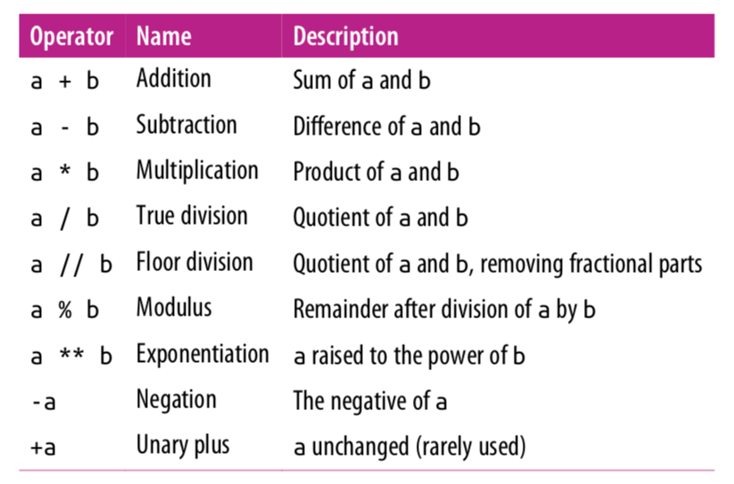
Arithmetic Operations

Slide 4
Mixing Types
Any expression that two floats produce a float.
In[1]: 17.0 – 10.0
Out [1]: 7.0
When an expression’s operands are an int and a float, Python automatically converts the int to a float.
In[2]: 17.0 – 10
Out [1]: 7.0
In[3]: 17 – 10.0
Out [1]: 7.0

Slide 5
True Division vs Floor Division
The operator / is true division and the operator // returns floor division(round down after true divide).
In[1]: 23 // 7
Out [1]: 3
In[2]: 3 // 9
Out [2]: 0
In[2]: -4 // 3
Out [2]: -2
In[3]: 6 / 5
Out [3]: 1.2

Slide 6
Remainder with %
The % operator computes the remainder from floor division.
14 % 4 is 2
218 % 5 is 3 3 43 4 ) 14 5 ) 218 12 20 2 18 15 3
Applications of % operator:
Obtain last digit of a number: 230857 % 10 is 7
Obtain last 4 digits: 658236489 % 10000 is 6489
See whether a number is odd: 7 % 2 is 1, 42 % 2 is 0
Notes:
6
What is 8 % 20? It's 8, but students often say 0.

Slide 7
Modulo Operator
The operator % returns the modulus which is the remainder after floor division.
In[1]: 18 % 5
Out [1]: 3
In[2]: 3 % 9
Out [2]: 3
In[2]: 125 % 10
Out [2]: 5
In[3]: -17 % 10
Out [3]: 3
In[3]: 17 % -10
Out [3]: -3
Note: This is different than Java, which gives the remainder after integer division. But the two are the same for positive operands.

Slide 8
Why floor/modulo division is useful
Floor division allows us to extract the integer part of the division while the modulo operator extracts the remainder part of the division. Consider the question:
How many weeks and days are there in 25 days?
Answer: 3 weeks plus 4 days.
In[1]: 25 // 7 # extracting number of weeks
Out [1]: 3
In[1]: 25 % 7 # extracting number of days
Out [1]: 4

Slide 9
Why the modulo operator is useful
If today is a Tuesday, which day is 43 days from today?
Answer: 43 divided by 7 is 6 with a remainder of 1. Thus it will be Wednesday.
In[1]: 43 % 7
Out [1]: 1
Even/odd: A number x is even if x % 2 == 0 and odd if
x % 2 !=0

Slide 10
Expressions
Find the exact change for 137 cents using quarters, dimes, nickels and cents. Use the least number of coins.
How many quarters? 137 / 25 = 5 quarters (Floor Division!)
What’s leftover? 137 % 25 = 12 cents
How many dimes? 12 / 10 = 1 dime
What’s leftover? 12 % 10 = 2 cents
How many nickels? 2 / 5 = 0 nickels.
What’s leftover? 2 % 5 = 2 cents.
How many pennies? 2 / 1 = 2 pennies
What’s leftover? 2 % 1= 0 cents. Done!

Slide 11
Extracting Digits
Given a three-digit integer. Extract its the ones, tens and hundreds digits.
For example, if the integer is 352. Its ones digit is the 2, its tens digit is the 5 and
its hundreds digit is the 3.
number = 352
print("ones:", number % 10)
number = number // 10
print(number)
print("tens:", number % 10)
number = number // 10
print(number)
Note: Modulo 10 (% 10) extracts the last digit. Floor division (// 10) discards the
last digit. Later in another lecture, we will see how to generalize this to
any number of digits.
# ones: 2
# number = 35 (discards last digit)
# 35
# tens: 5
# number = 3 (discards last digit)
# 3

Slide 12
Extracting Digits
Alternatively:
number = 352
ones = number % 10
tens = (number // 10) % 10
hundreds = number // 100
print("ones:", ones, "tens", tens, "hundreds:", hundreds)
Output:
ones: 2 tens: 5, hundreds: 3
Note: You will need the last couple of slides for Replit Classroom labs 2.x.

Slide 13
Exponentiation and Negation
In[1]: 2 ** 3
Out[3]: 8
Negation is a unary operator. It applies to only one operand. Other operations such as +, -, *, /, //, % are binary operators, they apply to two operands.
In[2]: -5
Out [3]: -5
In[3]: --5
Out[3]: 5

Slide 14
Operator Precedence
Precedence | Operator | Operation
highest | ** | exponentiation
 | - | negation
 | *, /, //, % | multiplication, division, floor division, modulus
lowest | +, - | adding, subtraction
Operators on the same row are applied left to right. Exponentiation, however, is
applied right to left. Expressions in parenthesis are evaluated first(PEMDAS).

Slide 15
Operator Precedence
In[1]: -2 ** 4
Out[3]: -16
In[2]: 7 – 4 * 5 % (1 + 2)
Out [3]: 5
7 - 4 * 5 % (1 + 2)
7 – 4 * 5 % 3
7 – 20 % 3
7 – 2
5

Slide 16
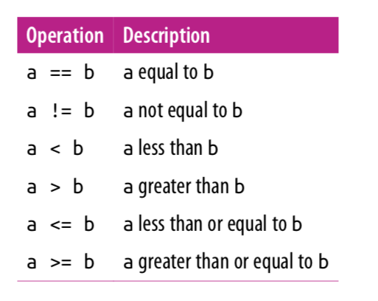
Comparison Operators
Note that = is for assignment and
== is for equals.
These operators return either True or
False.

Slide 17
Comparison Operators
In[1]: 10 == 5
Out[1]: False
In[2]: 3 <= 7
Out[2]: True
In[3]: 3 != 7
Out[3]: True

Slide 18
Boolean Operations
Python provides operators to combine the values using the standard concepts of “and”, “or”, and “not”.
These operators are expressed using the words and, or, and not:
Or above is "inclusive or".
X | Y | X or Y
True | True | True
True | False | True
False | True | True
False | False | False
X | Y | X and Y
True | True | True
True | False | False
False | True | False
False | False | False
X | not X
True | False
False | True

Slide 19
Boolean Operations
In[1]: x = 4
(x < 6) and (x > 2)
Out[1]: True
In[2]: (x > 10) or (x % 2 == 0)
Out[2]: True
In[3]: not (x < 6) Out[3]: False

Slide 20
Operator Precedence
Precedence | Operator | Operation
highest | ** | exponentiation
 | - | negation
 | *, /, //, % | multiplication, division, floor division, modulus
 | +, - | adding, subtraction
 | ==,!=,<,>,<=,>= | comparisons
 | not | logical not
 | and | logical and
 | or | logical or
lowest | = | assignment

Slide 21
Boolean Operations
Math operators have the highest precedence. Then comparison operators are followed by logical operators. The assignment operator is evaluated last.
In[1]: result = 3 + 2 * 4 < 14 or 3 == 5
result
Out[1]: True

Slide 22
Variables
We can use variables to refer to values that can be used later.
You can create a new variable by given it a value.
In[1]: x = 4
x
Out[1]: 4
Variable names can use letters, digits, and the underscore symbol (but they can’t start with a digit).

Slide 23
= is not equality
Unlike in math, = is not equality in Python. It is an assignment: assign the expression on the right side of = to the variable on the left.
In[1]: x = 4
x = x + 1 # in math, this has no solutions!
x
Out[1]: 5
Assignment is not symmetric.
In[1]: x = 4 # correct!
10 = y # error!

Slide 24
Augmented Assignment
An augmented assignment combines an assignment statement with an operator to make the statement more concise.
Shorthand Equivalent version
variable += value; variable = variable + value;
variable -= value; variable = variable - value;
variable *= value; variable = variable * value;
variable /= value; variable = variable / value;
variable %= value; variable = variable % value;
In[1]: x = 4
x += 1 # equivalent to x = x + 1
x
Out[1]: 5

Slide 25
Augmented Assignment
In[1]: x = 3
x *= 2 + 5
x
Out[1]: 21
In[1]: number = 5
number *= number
number
Out[1]: 25

Slide 26
Input
Programs may use the input function to obtain information from the user.
print('Please enter some text:')
x = input()
print('Text entered:', x)
print('Type:', type(x))
Please enter some text:
hello
Text entered: hello
Type: <class 'str'>

Slide 27
Input
Since user input almost always requires a message to the user about the expected input, the input function optionally accepts a string that it prints just before the program stops to wait for the user to respond.
x = input('Please enter an integer value: ')
y = input('Please enter another integer value: ')
num1 = int(x)
num2 = int(y)
print(num1, '+', num2, '=', num1 + num2)
Please enter an integer value: 4
Please enter another integer value: 5
4 + 5 = 9

Slide 28
Input
Or even more succinctly.
num1 = int(input(‘Please enter an integer value: ’))
num2 = int(input('Please enter another integer value: ‘))
print(num1, '+', num2, '=', num1 + num2)
Please enter an integer value: 4
Please enter another integer value: 5
4 + 5 = 9

Slide 29
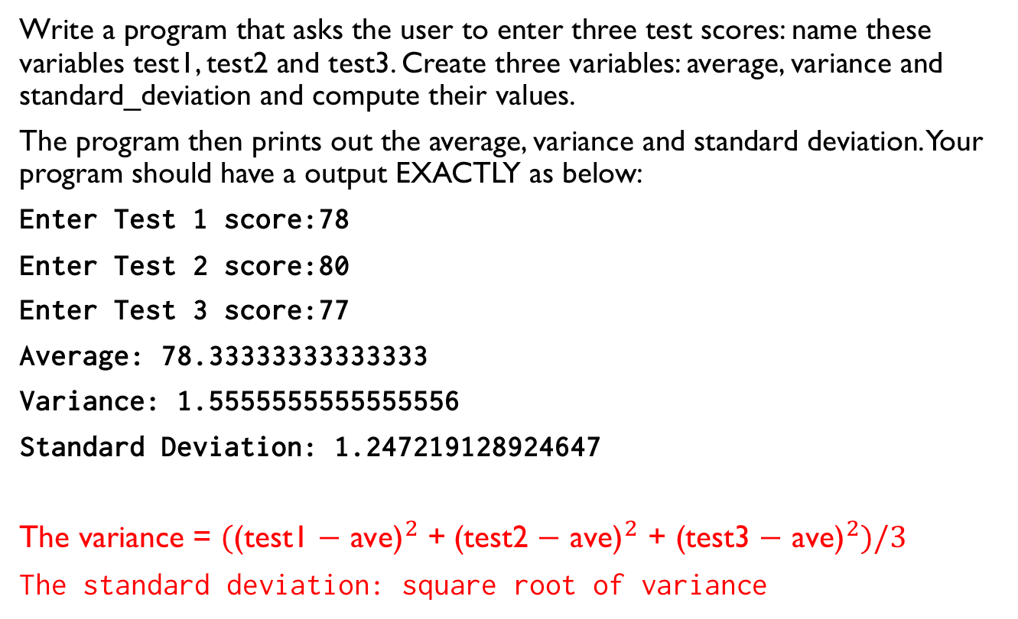
Lab
Write a program that asks the user to enter three test scores: name these variables test1, test2 and test3. Create three variables: average, variance and standard_deviation and compute their values.
The program then prints out the average, variance and standard deviation. Your program should have a output EXACTLY as below:
Enter Test 1 score:78
Enter Test 2 score:80
Enter Test 3 score:77
Average: 78.33333333333333
Variance: 1.5555555555555556
Standard Deviation: 1.247219128924647
The variance = ${\text{(}\text{(}\text{test}\text{1 − }\text{ave}\text{)}}^{2}$ +${\text{(}\text{test}\text{2 − }\text{ave}\text{)}}^{2}\text{ +} {\text{(}\text{test}\text{3}\text{ − }\text{ave}\text{)}}^{2})/3$
The standard deviation: square root of variance

Slide 30
References
Vanderplas, Jake, A Whirlwind Tour of Python, O’reilly Media.
This book is completely free and can be downloaded online at O’reilly’s site.

