Slide 1
Introduction to Processing
Top-Down Games

Slide 2
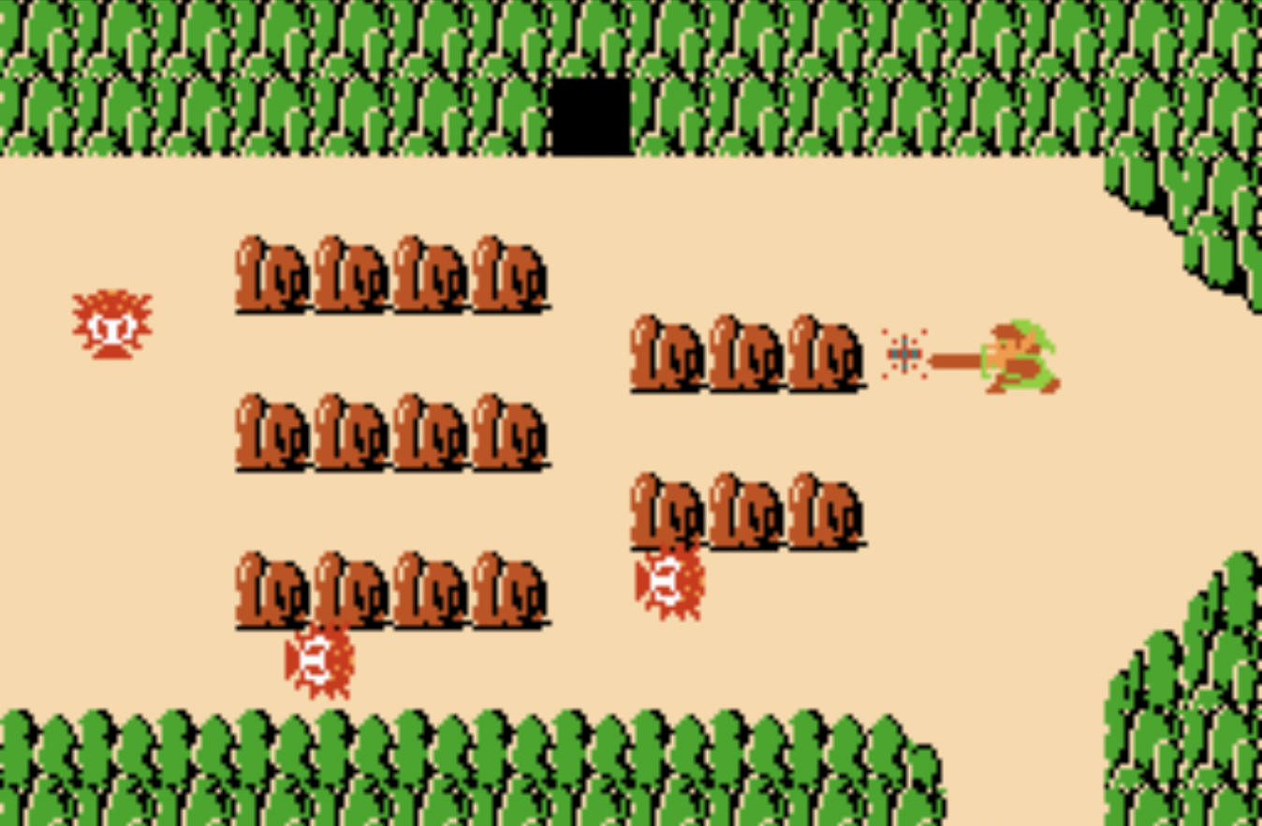
Top-Down Games
Top-down games, also sometimes referred to as bird's-eye view games, refers to games where the camera angle that shows players and the areas around them is directly above.

Slide 3
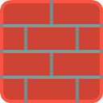

Top-Down Games
Top-down games, also sometimes referred to as bird's-eye view games, refers to games where the camera angle that shows players and the areas around them is directly above.

Slide 4
Collision Detection
Assume that we already implemented the two collision detection methods below:
def check_for_collision(sprite1, sprite2):
# returns whether sprite1 and sprite2 intersects
def check_for_collision_list(sprite, sprite_list):
#returns list of sprites in sprite_list which
#intersects with sprite.

Slide 5
Velocity
Velocity of an object is the rate of change of its position. It is a vector and can be decomposed into a x-component and a y-component.
A Sprite object has attributes change_x and change_y for its velocity.
Origin (0,0)
In our games, velocity is
measured in pixels per frame.
(center_x, center_y)
Y
change_x
center_x = center_x + change_x
center_y = center_y + change_y
change_y
X

Slide 6
Resolving Top-Down Collisions
Instead of moving in both the x and y directions and then try to resolve collisions, it is easier to
1) move in x direction, check for and resolve collision
2) then move in the y direction and then check for and resolve collision again.
center_x += change_x
center_y += change_y

Slide 7
Resolving Top-Down Collisions
# move in horizontal direction
center_x += change_x
# resolve collisions
# move in vertical direction
center_y += change_y
# resolve collisions

Slide 8
Horizontal Direction
move in horizontal direction

Slide 9
Horizontal Direction
move in horizontal direction
compute list of all platforms which collide with player
if list not empty:
if player is moving right:

Slide 10
Horizontal Direction
move in horizontal direction
compute list of all platforms which collide with player
if list not empty:
if player is moving right:
set right side of player = left side of a
collided platform

Slide 11
Horizontal Direction
move in horizontal direction
compute list of all platforms which collide with player
if list not empty:
if player is moving right:
set right side of player = left side of a
collided platform
if player is moving left:

Slide 12
Horizontal Direction
move in horizontal direction
compute list of all platforms which collide with player
if list not empty:
if player is moving right:
set right side of player = left side of a
collided platform
if player is moving left:

Slide 13
Horizontal Direction
move in horizontal direction
compute list of all platforms which collide with player
if list not empty:
if player is moving right:
set right side of player = left side of a
collided platform
if player is moving left:
set left side of player = right side of a
collided platform

Slide 14
Vertical Direction
Similarly for the vertical direction:
move in vertical direction
compute list of all platforms which collide with player
if list not empty:
if player is moving up:
set top side of player = bottom side of a
collided platform
if player is moving down:
set bottom side of player = top side of a
collided platform

