Slide 1
Lecture 24: Recursion
Building Java Programs: A Back to Basics Approach
by Stuart Reges and Marty Stepp
Copyright (c) Pearson 2013. All rights reserved.

Slide 2
Recursion
recursion: The definition of an operation in terms of itself.
Solving a problem using recursion depends on solving smaller occurrences of the same problem.
recursive programming: Writing methods that call themselves to solve problems recursively.
An equally powerful substitute for iteration (loops)
Particularly well-suited to solving certain types of problems

Slide 3
Why learn recursion?
"cultural experience" - A different way of thinking of problems
Can solve some kinds of problems better than iteration
Leads to elegant, simplistic, short code (when used well)
Many programming languages ("functional" languages such as Scheme, ML, and Haskell) use recursion exclusively (no loops)

Slide 4
Recursion and cases
Every recursive algorithm involves at least 2 cases:
base case: A simple occurrence that can be answered directly.
recursive case: A more complex occurrence of the problem that cannot be directly answered, but can instead be described in terms of smaller occurrences of the same problem.
Some recursive algorithms have more than one base or recursive case, but all have at least one of each.
A crucial part of recursive programming is identifying these cases.

Slide 5
Example
You are lined up in front of your favorite store for Black Friday deals. The line is long and wraps around the building so that you cannot see the front of the line. How do you figure out your position without getting out of line?
Answer: Ask the person in front of you.
Base case: If a customer is at the front of the line and someone asks him for his position, he’ll “return” 1.
Recursive case: If a customer is at position n and someone asks him for his position, he’ll ask the person in front of him.
Note: The recursive case reduces an n problem to an n-1 problem.

Slide 6
Recursion in Java
Consider the following method to print a line of * characters:
// Prints a line containing the given number of stars.
// Precondition: n >= 0
public static void printStars(int n) {
for (int i = 0; i < n; i++) {
System.out.print("*");
}
System.out.println(); // end the line of output
}
Write a recursive version of this method (that calls itself).
Solve the problem without using any loops.
Hint: Your solution should print just one star at a time.

Slide 7
"Recursion Zen"
The real, even simpler, base case is an n of 0, not 1:
public static void printStars(int n) {
if (n == 0) {
// base case; just end the line of output
System.out.println();
} else {
// recursive case; print one more star
System.out.print("*");
printStars(n - 1);
}
}
Recursion Zen: The art of properly identifying the best set of cases for a recursive algorithm and expressing them elegantly.

Slide 8
Exercise
Write a recursive method pow accepts an integer base and exponent and returns the base raised to that exponent.
Example: pow(3, 4) returns 81
Solve the problem recursively and without using loops.

Slide 9
pow solution
// Returns base ^ exponent.
// Precondition: exponent >= 0
public static int pow(int base, int exponent) {
if (exponent == 0) {
// base case; any number to 0th power is 1
return 1;
} else {
// recursive case: x^y = x * x^(y-1)
return base * pow(base, exponent - 1);
}
}

Slide 10
Recursive tracing
Consider the following recursive method:
public static int mystery(int n) {
if (n < 10) {
return n;
} else {
int a = n / 10;
int b = n % 10;
return mystery(a + b);
}
}
What is the result of the following call?
mystery(648)

Slide 11
A recursive trace
mystery(648):
int a = 648 / 10; // 64
int b = 648 % 10; // 8
return mystery(a + b); // mystery(72)
mystery(72):
int a = 72 / 10; // 7
int b = 72 % 10; // 2
return mystery(a + b); // mystery(9)
mystery(9):
return 9;

Slide 12
Recursive tracing 2
Consider the following recursive method:
public static int mystery(int n) {
if (n < 10) {
return (10 * n) + n;
} else {
int a = mystery(n / 10);
int b = mystery(n % 10);
return (100 * a) + b;
}
}
What is the result of the following call?
mystery(348)

Slide 13
A recursive trace 2
mystery(348)
int a = mystery(34);
int a = mystery(3);
return (10 * 3) + 3; // 33
int b = mystery(4);
return (10 * 4) + 4; // 44
return (100 * 33) + 44; // 3344
int b = mystery(8);
return (10 * 8) + 8; // 88
return (100 * 3344) + 88; // 334488
What is this method really doing?

Slide 14
Exercise
Write a recursive method isPalindrome accepts a String and returns true if it reads the same forwards as backwards.
isPalindrome("madam") → true
isPalindrome("racecar") → true
isPalindrome("step on no pets") → true
isPalindrome("able was I ere I saw elba") → true
isPalindrome("Java") → false
isPalindrome("rotater") → false
isPalindrome("byebye") → false
isPalindrome("notion") → false

Slide 15
Exercise solution
// Returns true if the given string reads the same
// forwards as backwards.
// Trivially true for empty or 1-letter strings.
public static boolean isPalindrome(String s) {
if (s.length() < 2) {
return true; // base case
} else {
String first = s.substring(0,1);
String last = s.substring(s.length() - 1);
if (!first.equals(last)) {
return false;
} // recursive case
String middle = s.substring(1, s.length() - 1);
return isPalindrome(middle);
}
}

Slide 16
Exercise solution 2
// Returns true if the given string reads the same
// forwards as backwards.
// Trivially true for empty or 1-letter strings.
public static boolean isPalindrome(String s) {
if (s.length() < 2) {
return true; // base case
}
else {
return s.substring(0,1).equals(s.substring(s.length()-1))
&& isPalindrome(s.substring(1, s.length() - 1));
}
}

Slide 17
Types of Recursion Problems
Types of recursion tracing problems. The reference numbers refer to the problems on the Recursion Worksheet.
Easy pattern, do it in your head problem.(#1,7,8)
Order matters. (#4,5)
(Do something + call) vs (call + do something)
One return all the way back. (#6)
Return + additional math before subsequent returning (#1,3)
(Trickiest)Multiple recursive calls at the same level/page. (#9, 10)

Slide 18
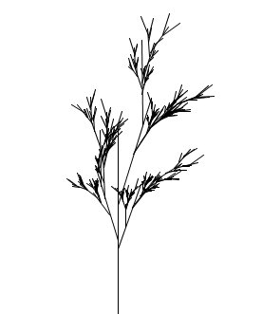
Recursive Plant
This plant is drawn in processing using recursion. Can you figure out how?

Slide 19
Lab 1: Fractal Circles
Use Processing to write the recursive method to print out a recursive
pattern of circles of decreasing radii.
void circle(int x, int radius, int depth)
{…}
The call circle(width/2, width/4, 10) should produce the image on
the following slide. Use noFill() before drawing the circle to make
it transparent.

Slide 20
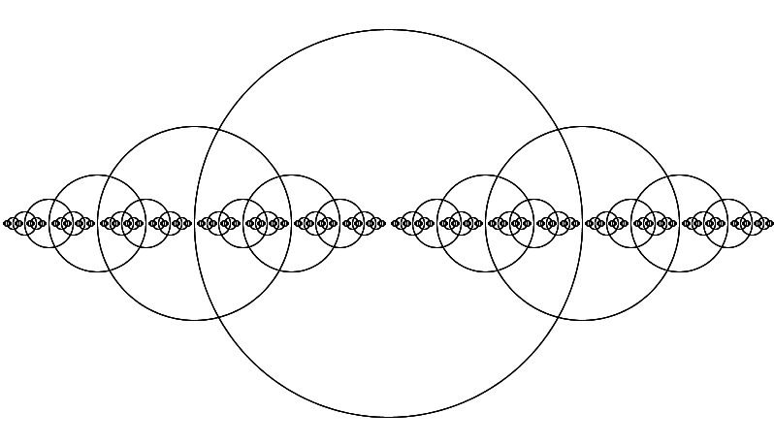
Lab 1

Slide 21
Lab 2: Sierpinski Triangle
Use Processing to write the recursive method to the Sierpinski triangle.
void fractalTriangle(int x1, int y1, int x2, int y2, int x3, int y3, int n)
{…}
Note: Trigonometric functions in Processing by default take radians as the unit of angle measure. To convert degrees to radians use the radians(float degree) method.

Slide 22
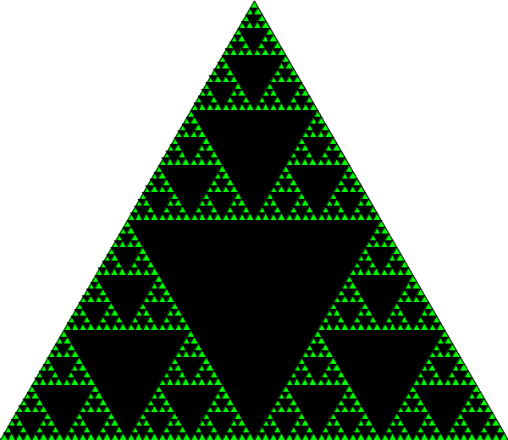
Lab 2

