Slide 1

Understanding Data
Number Systems and Text Encoding

Slide 2
Base 10 (Decimal numbers)
Why base 10?
We happened to use the current counting system, because we happened to have ten fingers.
Base 10(Decimal) uses 10 digits {0,1,2,3…,9}.
Base 2(Binary) uses 2 digits {0,1}.
Base 8(Octal) uses 8 digits {0,1,2,3,4,5,6,7}

Slide 3
Base 10 (Decimal numbers)
Each digit has a weight corresponding to a power of 10. Multiply each digit with its weight and then sum.
What does 157 mean?
157 = 1 x 100 + 5 x 10 + 7 x 1
= 1 x 10² + 5 x 10¹ + 7 x 10⁰

Slide 4
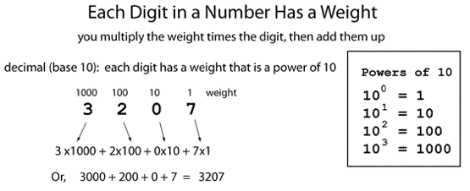
Base 10 (Decimal)

Slide 5
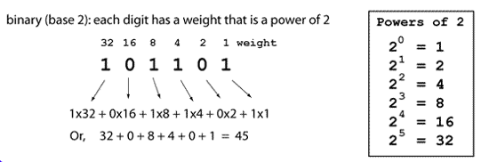
Base 2 (Binary)

Slide 6
Base 2 (Binary)
Base 2
1011 = 1 x 2³ + 0 x 2² + 1 x 2¹ + 1 x 2⁰
1011 = 1 x 8 + 0 x 4 + 1 x 2 + 1 x 1 =11 in Base 10

Slide 7
Bits and Bytes
1 bit is a single bit of information, a 1 or 0(Only two possible values)
1 byte is 8 bits, an 8 bit word
256 possible values from 0-255 base 10
or 00000000 to 11111111 base 2
For example, 10100110 is a single byte

Slide 8
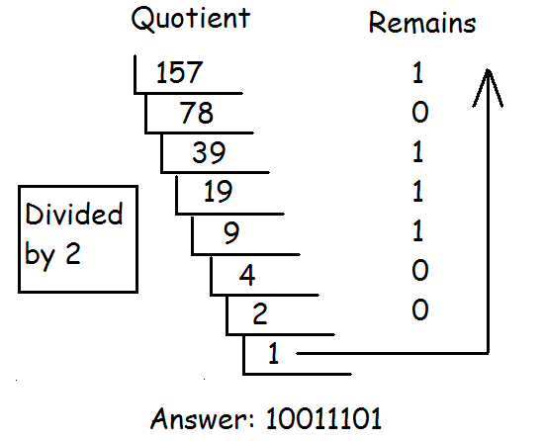
Decimal to Binary
Repeatedly modulo 2 and the divide by 2. Stop at 0. The remainder list read top to bottom are the digits from left to right.

Slide 9
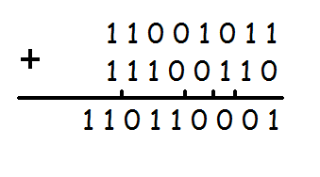
Adding Binary
Add from right to left as usual. Follow the three rules below and remember to carry.
0 + 0 = 0
1 + 0 = 1
1 + 1 = 10
Example:

Slide 10
People
There are 10 types of people in the world; those who understand binary and those who don’t.
There are 10 types of people in the world; those who understand binary and those who have friends.

Slide 11
Hexadecimal
Binary code is too long in representation. Hexadecimal is much shorter. Hexadecimal uses 16 digits
Problem: we are short of numbers.
A-10 B-11 C-12 D-13 E-14 F-15
Hexadecimal digits: {0,1,2,3,4…,9,A,B,C,D,E,F}
Converting a binary number to a Hex number is relatively easy. Every 4 bit can convert to a Hex.

Slide 12
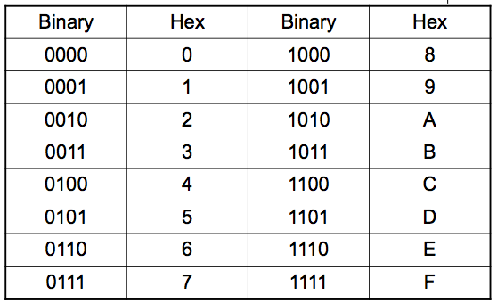
Hexadecimal

Slide 13
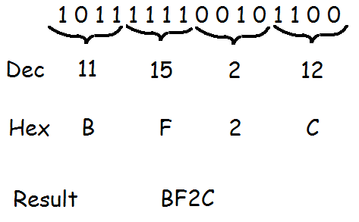
Binary to Hex

Slide 14
Counting
Let’s count in Base 10.
0,1,2,3,4,5,6,7,8,9,__,___,…,18,19,__,__.
Answer: 10,11…..,20,21. Good job!
Let’s count in Base 5.
0,1,2,3,4,__,__,__,__,__,___.
Answer:10,11,12,13,14,20.
Let’s keep going!
40,41,42,43,44,___,___,___.
Answer:100,101,102.

Slide 15






Quick Quiz
What’s the answer in base 8?
What’s the answer in base 5?
What’s the answer in base 12?

Slide 16
Character Encoding

Slide 17

Encoding
A computer cannot store “letters” or “pictures”. It can only work with bits(0 or 1).
To represent anything other than bits, we need to rules that will allow us to convert a sequence of bits into letters or pictures. This set of rules is called an encoding scheme, or encoding for short. For example,

Slide 18
ASCII
ASCII(American Standard Code for Information Exchange) is an encoding scheme that specifies the mapping between bits and characters. There are 128 characters in the scheme. There are 95 readable characters and 33 values for nonprintable characters like space, tab, and backspace and so on.
The readable characters include a-z, A-Z, 0-9 and punctuation.
ASCII uses all possible combinations of 7 bits(0000000 to 1111111, 2^7=128).

Slide 19
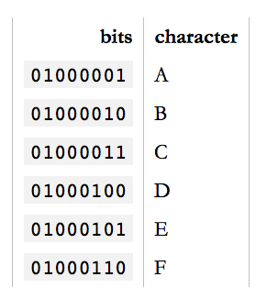
ASCII Sample
In ASCII, 65 represents A, 66 represents B and so on. The numbers are called code points.
To encode something in ASCII,
follow the table from right to left,
substituting letters for bits.
To decode a string of bits into
human readable characters, follow
the table from left to right, substituting
bits for letters.
encode
decode

Slide 20
Other letters?
95 characters can covers English but what about French? Or how do you represent Swedish letters é, ß, ü, ä, ö or å in ASCII?
"But look at it," the Europeans said, "in a common computer with 8 bits to the byte, ASCII is wasting an entire bit which is always set to 0! We can use that bit to squeeze a whole 'nother 128 values into that table!" And so they did.
The extended ASCII table has 256 values. All 8 bits were used.

Slide 21
Other letters
But even so, there are more than 128 ways to stroke, slice, slash and dot a vowel. Not all variations of letters and squiggles used in all European languages can be represented in the same table with a maximum of 256 values.
Not to mention Chinese. Or Japanese. Both contains thousands of characters. There are many encodings that try to address this. For example, BIG-5 covers all traditional Chinese characters.

Slide 22
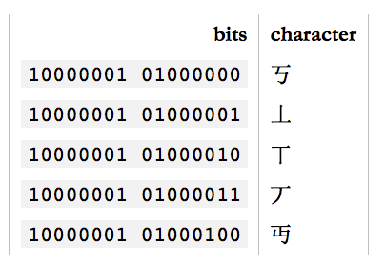
GB18030 Encoding
And GB18030 covers both traditional and simplified Chinese as well as a large part of the latin characters.
GB18030 uses two bytes
(16 bits) to encode. This
can encode 65,536
distinct values.
But in the end, GB18030 is
yet another specialized
encoding among many.

Slide 23
Encoding/Decoding Documents
In an editor such as Word document, you can specify the language encoding.
Special software can help you type
special characters.
When you save the document, the
editor saves the character as 0’s
And 1’s as specified by the encoding.
When you reopen the document, the encoding setting will allow the editor to decode the 0’s and 1’s back to correct characters.

Slide 24
Unicode
There are many encoding schemes for all sorts of applications. We need a standardized encoding.
Finally, in 1991, Unicode was created to unify all encoding standards. It defines a table of 1,114,112 code points that can be used for all sorts of letters and symbols. That's plenty to encode all European, Middle-Eastern, Far-Eastern, Southern, Northern, Western, pre-historian and future characters mankind knows about.

Slide 25
Unicode
Using Unicode, you can write a document containing virtually any language using any character you can type into a computer. This was either impossible or very very hard to get right before Unicode came along. There's even an unofficial section of Klingon in Unicode.

Slide 26
Unicode
So, how many bits does Unicode use to encode all these characters? None. Because Unicode is not an encoding.
Unicode first and foremost defines a table of code points for characters. That's a fancy way of saying "65 stands for A, 66 stands for B and 9,731 stands for ☃”.

Slide 27
UTF-32
To represent 1,114,112 different values, two bytes aren't enough. Three bytes are, but three bytes are often awkward to work with, so four bytes would be the comfortable minimum.
UTF-32(Unicode Transformation Format) is such an encoding that encodes all Unicode code points using 32 bits. That is, four bytes per character.

Slide 28
UTF-32
UTF-32 very simple, but often wastes a lot of space. For example, if A is always encoded as 00000000 00000000 00000000 01000001 and B as 00000000 00000000 00000000 01000010 and so on, documents would bloat to 4x its necessary size.
UTF-16 and UTF-8 are variable-length encodings. If a character can be represented using a single byte (because its code point is a very small number), UTF-8 will encode it with a single byte. If it requires two bytes, it will use two bytes and so on. UTF-16 is in the middle, using at least two bytes, growing to up to four bytes as necessary.

Slide 29
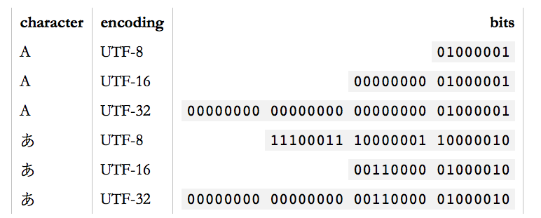
Unicode
Unicode is a large table mapping characters to numbers and the different UTF encodings specify how these numbers are encoded as bits.

Slide 30
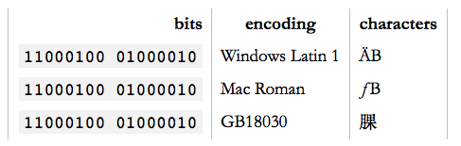
Encoding
Any character can be encoded in many different bit sequences and any particular bit sequence can represent many different characters, depending on which encoding is used to read or write them.
The reason is simply because different encodings use different numbers of bits per characters and different values to represent different characters.

Slide 31
Garbled Text?
You open a text file and it looks like:
ÉGÉìÉRÅ[ÉfÉBÉìÉOÇÕìÔÇµÇ≠Ç»Ç¢
Reason: Your text editor, browser, word processor or whatever else that's trying to read the document is assuming the wrong encoding.
In Safari or Firefox, you can change the text encoding. (Chrome only supports this through an extension.) For Safari, under “View”, select “Text Encoding” and “Japanese Shift JS” to see the correct text:
エンコーディングは難しくない

Slide 32
UTF-8
UTF-8 is the standard encoding for all email and webpages(HTML5).
The ingenious thing about UTF-8 is that it's binary compatible with ASCII, which is the de-facto baseline for all encodings.
All characters available in the ASCII encoding only take up a single byte in UTF-8 and they're the exact same bytes as are used in ASCII. In other words, ASCII maps 1:1 unto UTF-8. Any character not in ASCII takes up two or more bytes in UTF-8.
We will explore more on text encoding with Python in the next lecture.

Slide 33
Homework
Read and reread these lecture notes.
Do the problem set.

Slide 34
References
1) What Every Programmer Absolutely, Positively Needs To Know About Encodings And Character Sets To Work With Text, by David Zentgraf. http://kunststube.net/encoding/
2) Part of this lecture is taken from a lecture from an OpenCourseWare course below.
Computer Science E-1 at Harvard Extension School
Understanding Computers and the Internet
by Tommy MacWilliam.

