Slide 1
Introduction to Python
Direct Loops: For Loops

Slide 2
Topics
For Loops
Break vs. Continue
Nested Loops

Slide 3
For Loops
In general, a loop allows a sequence of instructions to execute repeatedly until some condition is met.
Python’s for loop iterates over items of a sequence(e.g. a list, string or tuple) and process them with some code.
for x in sequence: block
In[1]: for x in [2,3,5,7]: print(x, end=“ ”) # print all on same line
2 3 5 7
This is a list. More on lists in a later lecture.

Slide 4
For Loops
In[1]: for x in [2,3,5,7]: print(x)
2
3
5
7

Slide 5
range(stop)
A simple use of a for loop runs some code a specified number of times using the range() function.
range(stop): returns sequence of numbers from 0 (default) up to but not including stop. Increment by 1 (default).
In[1]: for i in range(10):
print(i, end=" ")
0 1 2 3 4 5 6 7 8 9

Slide 6
range(start, stop)
range(start, stop): from start up to but not including stop. Increment by 1(default).
In[2]: for i in range(2, 8):
print(i, end=' ‘)
2 3 4 5 6 7

Slide 7
range(start, stop, step)
range(start, stop, step): from start up to but not including stop, increment by step.
In[3]: for i in range(1, 10, 2):
print(i, end=' ')
1 3 5 7 9
If step is negative, a list can be traversed backwards.
In[4]: for i in range(10, 2, -1):
print(i, end=' ')
10 9 8 7 6 5 4 3

Slide 8
continue vs. break
The continue statement is used to skip the current iteration and move to the next iteration whereas the break statement is used to exit a for loop.
In [1]: for n in range(10): if n % 2 == 0:
continue
print(n, end=‘ ’)
1 3 5 7 9

Slide 9
continue vs. break
The continue statement is used to skip the current iteration and move to the next iteration whereas the break statement is used to exit a loop.
In [2]: for n in range(5): if n == 3:
break
print(n, end=‘ ’)
0 1 2

Slide 10
Definite Loop
The for loop is an example of a definite loop. We can determine ahead of time the number of times the loop repeats. Later, we will talk about indefinite loop, a loop where we cannot predict the number of times it repeats.
In [1]: for i in range(5): print("*", end="")
*****
The loop above prints five *'s. We can determine this from the for loop statement.

Slide 11
Summing and Counting
There are two common tasks that uses for loops.
1) Summing
2) Counting

Slide 12
Summing Values
Write a segment of code that solve the problem
1 + 2 + 3 + … + 98 + 99 + 100.
In [1]: sum = 0
for i in range(1, 101): sum += i

Slide 13
Writing a function to sum
Now write a function that accepts a non-negative integer input n and returns the sum of integers from 1 to n(including).
In [1]: def sum(n):
sum = 0
for i in range(1, n+1): sum += i
return sum
In [2]: print(sum(5)) # 1+2+3+4+5=15
15

Slide 14
Conditional Summing
Write a segment of code that compute the sum of all numbers from 1 to 100 that are multiples of 3.
In [1]: sum = 0
for i in range(0, 101, 3): sum += i
Or equivalently, we can use a conditional to select the numbers to add:
In [2]: sum = 0
for i in range(1, 101): if i % 3 == 0:
sum += i
Better to use if conditional for filtering.
In general, using the step size above
might not always work.

Slide 15
Conditional Summing Example
Write a segment of code that compute the sum of all numbers from 1 to 100. However:
if a number is a multiple of 3, double it before adding,
if a number is a multiple of 5, triple it before adding,
If a number is a multiple of both, quadruple it before adding.
otherwise, just add the number.

Slide 16
Conditional Summing Solution?
Is the following a correct solution?
sum = 0
for i in range(1, 101):
if i % 3 == 0:
sum += 2 * i
elif i % 5 == 0:
sum += 3 * i
elif i % 3 == 0 and i % 5 == 0:
sum += 4 * i
else:
sum += i
No! Why not?

Slide 17
Conditional Summing Solution
The following is correct.
sum = 0
for i in range(1, 101):
if i % 3 == 0 and i % 5 == 0:
sum += 4 * i
elif i % 3 == 0:
sum += 2 * i
elif i % 5 == 0 :
sum += 3 * i
else:
sum += i

Slide 18
Counting
Write a function that accepts an integer n and returns the number of factors of n.
In [1]: def count_factors(n):
count = 0
for i in range(1, n+1): if n % i == 0: # i is a factor of n
count += 1
return count
In [2]: print(count_factors(10))
4 # 4 factors of 10={1,2,5,10}

Slide 19
Nested Loops
A nested loop is a loop inside of another loop.
In[1]: for i in range(1, 4):
for j in range(1, 5):
print(i * j, end=‘ ’)
print()
1 2 3 4
2 4 6 8
3 6 9 12

Slide 20
Nested Loops Example 1
In[1]: for i in range(1, 6):
for j in range(1, i+1):
print(j, end=‘ ’)
print()
1
1 2
1 2 3
1 2 3 4
1 2 3 4 5

Slide 21
Nested Loops Example 2
In[2]: for i in range(1, 6):
for j in range(6, i, -1):
print(j, end=‘ ’)
print()
6 5 4 3 2
6 5 4 3
6 5 4
6 5
6

Slide 22
For Loop in Movies and TV-Shows
Movies:
Groundhog Day(1993); Bill Murray.
Looper(2010); Bruce Willis and Joseph Gordon-Levitt, Emily Blunt.
Edge of Tomorrow(2014); Tom Cruise, Emily Blunt.
Happy Death Day(2017).
TV-Show:
Russian Doll(Netflix, Emmy-Nominated)

Slide 23
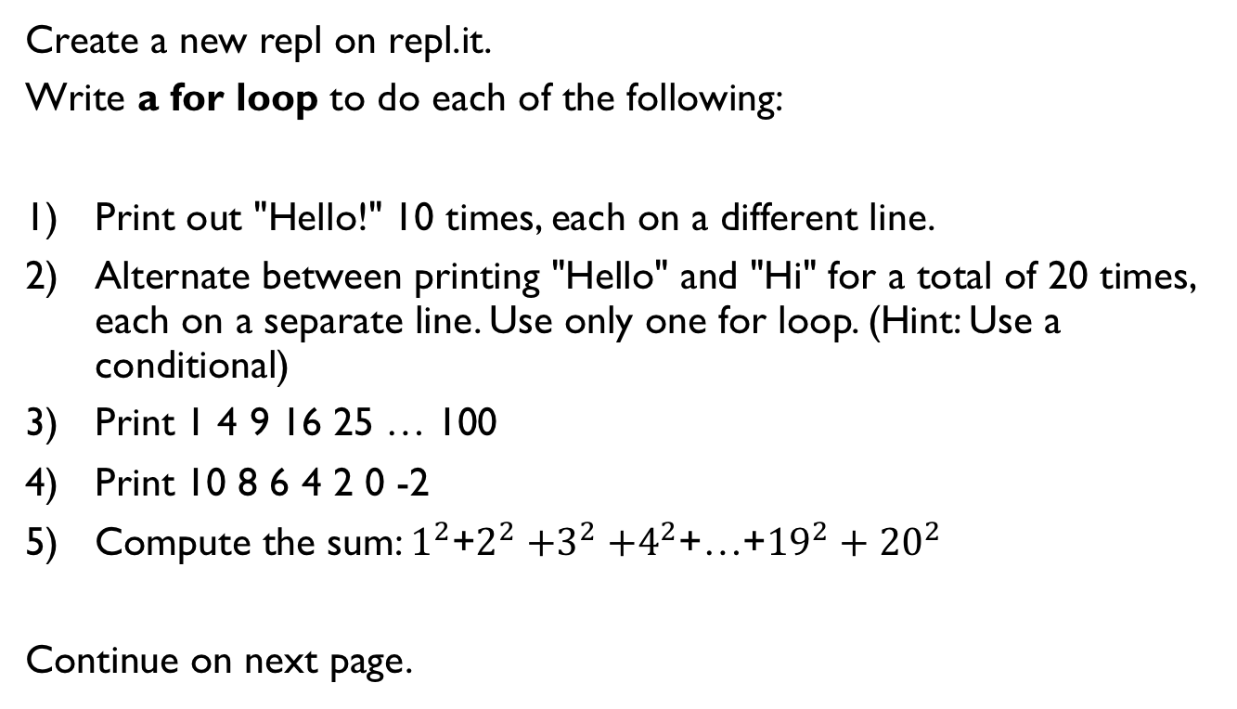
Lab 1
Create a new repl on repl.it.
Write a for loop to do each of the following:
Print out "Hello!" 10 times, each on a different line.
Alternate between printing "Hello" and "Hi" for a total of 20 times, each on a separate line. Use only one for loop. (Hint: Use a conditional)
Print 1 4 9 16 25 … 100
Print 10 8 6 4 2 0 -2
Compute the sum: $1^{2}$+$2^{2}{+3}^{2}+4^{2}$+…+${19}^{2}+{20}^{2}$
Continue on next page.

Slide 24
Lab 2
Create a new repl.
1) Rewrite the function count_factors as explained in a previous slide.
2) A number n is prime if its only factors are 1 and n. Write the function is_prime which accepts an integer n and returns whether it is prime. Note that 1 is not prime. You must call the function count_factors in your implementation of is_prime.
is_prime(13) returns true
is_prime(1245) returns false
3) Write the function num_primes which accepts an integer n and and returns the number of primes up to and including n. You must call the function is_prime in your implementation.
num_prime(11) returns 5 since 2, 3, 5, 7, 11 are the 5 prime numbers less than or equal to 11.
Write the main function and calls the three above functions with different input and make sure that your functions work as expected.

Slide 25
Lab 3
Write a nested for loop to do each of the following:
Print out 10 lines, each line containing 5 "Hello" separated by spaces.
2) ******
******
******
3) Print
*
**
***
****
*****

Slide 26
References
Vanderplas, Jake, A Whirlwind Tour of Python, O’reilly Media.

