Slide 1
Introduction to Processing
The Basics(Python Version)

Slide 2
Processing
Processing started by Ben Fry and Casey Reas while both were graduate students at MIT Media Lab in 2001.
The original language for Processing is Java. We will use the Python version.
Designed for visual artists with limited programming experience who want to create art without knowing complicated Java syntax.
In its current version, hundred of libraries have been written for computer vision, data visualization, music composition, networking, 3D drawings and programming electronics.

Slide 3
Processing
Processing was created originally for the Java language. For this reason, the interface to Processing's Python version is not very "Pythonic".
I wrote some code to hide some of this interface and make it flow better with Python. In addition, I added some code to make writing games and working with images easier.(see arcade.py) Download the zip file that contains this code on our course website here.
Once you unzip the contents and open it with Processing. There should be three files:
processing_py.pyde(DO NOT MODIFY THIS FILE)
arcade.py(DO NOT MODIFY THIS FILE)
game.py(write all of your code here)
There is also a data folder where you should put all of your images for your game.

Slide 4
game.py
All of your code should go here.
You will need to implement(provide code for) three methods/functions:
1) def __init__(self): Declare and initialize all your game/application variables.
2) def on_draw(self): Called automatically 60 times a second to draw objects. Write code to draw all objects here.
3) def on_update(self): Called automatically 60 times a second to update our objects. Write code to update all objects here(for animation).

Slide 5
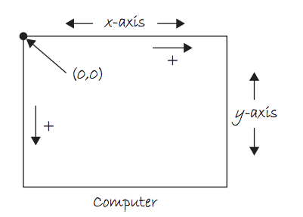
The Coordinate System

Slide 6
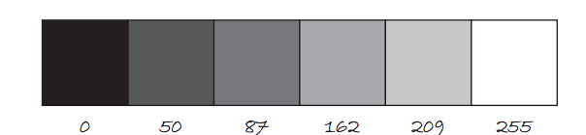
Color
Color is defined by a range of numbers.
In grayscale, 0 is black, 255 is white and any color in between is a shade of gray ranging from black to white.

Slide 7
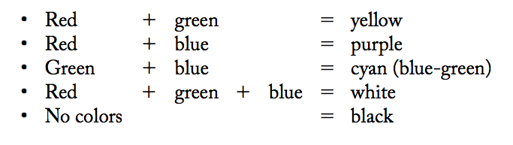
Color
RGB Color is determined by three parameters. Each parameter is in the range 0-255. The first indicates the degree of red(R), the second the degree of green(G) and the last the degree of blue(B).

Slide 8
Some Methods
fill(r, g, b):By calling fill BEFORE a shape will set the color of the shape. Call it again before drawing another shape to change color.
line(x1, y1, x2, y2):draw line through (x1, y1) and (x2, y2).
ellipse(x, y, width, height):center of ellipse is (x, y); width and height are the lengths of the axes.
rect(x, y, width, height:center of the rectangle is (x,y)

Slide 9
Adding Text
The text(str, x, y) function draws text on the screen.You can set the text size and color by using textSize(s) and fill(r, g, b) before drawing the text.
textSize(32);
fill(255, 0, 0);
text("Hello, World!", 100, 200);

Slide 10
The Console
Messages can be printed on the console(for error-checking purposes, etc..) by using the command println().
println(4);
println(4 + 3/2);
println(“Hello, world”);

Slide 11
game.py
A method/function that is not implemented yet still need code in the body.
We use the pass statement to construct a body that does nothing
so that the interpreter does not throw an error.
class Window:
def __init__(self):
""" Declare/initialize all variables here."""
pass
def on_draw(self):
""" Called automatically 60 times a second to draw all objects.
# draw red circle at (20, 25) diameter = 300 pixels
fill(255, 0, 0)
ellipse(20, 25, 300, 300)
def on_update(self):
pass

Slide 12
Animation
Animation only takes five lines of code!
class Window:
def __init__(self):
""" Declare/initialize all variables here."""
self.x = WIDTH/2
self.y = HEIGHT/2
def on_draw(self):
""" Called automatically 60 times a second to draw all objects.
# draw red circle at (20, 25) diameter = 300 pixels
fill(255, 0, 0)
ellipse(self.x, self.y, 300, 300)
def on_update(self):
self.x += 5
When declaring/initializing a global variable that is used
throughout the game, use self and the dot notation.
WIDTH and HEIGHT are width/height of the window.

Slide 13
on_key_press
The on_update() and on_draw() loops run continuously until they are interrupted by an event, for example, a keyboard or mouse event.
If a key is pressed, on_update() and on_draw() temporarily halt, Processing then jump execution to the on_key_press() function, runs the function’s code then return control to the on_update and on_draw loops.
The key that is pressed is store in the key variable.
Similarly, if a key is released, on_key_release() is called.
Notes:
13

Slide 14
Processing: Mouse Events
Processing keeps track of the position of the mouse at any given time through the variables mouseX, mouseY.
Similar to on_key_press, which responds to keyboard inputs, on_mouse_press is a function that can be implemented to respond to the mouse being pressed. Similarly for on_key_release.
def on_mouse_press(self, x, y, button): x, y location of the mouse; button: LEFT, RIGHT, CENTER
def on_mouse_release(self, x, y, button): x, y location of the mouse; button: LEFT, RIGHT, CENTER
Notes:
14

Slide 15
mouseX, mouseY
mouseX and mouseY are variables that keep track of the position of the mouse.
What does the following simple program do?
class Window:
def __init__(self):
""" Declare/initialize all variables here."""
pass
def on_draw(self):
""" Called automatically 60 times a second to draw all objects.
# draw red circle at (20, 25) diameter = 300 pixels
fill(255, 0, 0)
ellipse(mouseX, mouseY, 100, 100)
def on_update(self):
pass

Slide 16
Download Processing
Download Processing!
Your computer is probably a 64-bit computer if it’s fairly recent.
http://www.processing.org

