Slide 1
Unit 4: Data Collections Introduction to Arrays
Adapted from:
1) Building Java Programs: A Back to Basics Approach
by Stuart Reges and Marty Stepp
2) Runestone CSAwesome Curriculum
https://longbaonguyen.github.io

Slide 2

Can we solve this problem?
Consider the following program (input underlined):
How many days' temperatures? 7
Day 1's high temp: 45
Day 2's high temp: 44
Day 3's high temp: 39
Day 4's high temp: 48
Day 5's high temp: 37
Day 6's high temp: 46
Day 7's high temp: 53
You entered: [45, 44, 39, 48, 37, 46, 53]
Average temp = 44.6
4 days were above average.
Do we want to store these in separate integer variables?
What if the user want to enter 1000 temperatures? (temp1, temp2,..temp1000?)

Slide 3
Arrays
array: object that stores many values of the same type.
value: One value in an array.
index: A 0-based integer to access an element from an array.
index | 0 | 1 | 2 | 3 | 4 | 5 | 6 | 7 | 8 | 9
value | 12 | 49 | -2 | 26 | 5 | 17 | -6 | 84 | 72 | 3
index 0
value is 12
index 4
value is 5
index 9
value is 3

Slide 4
Array declaration
type[] name = new type[length];
Example:
int[] numbers = new int[10];
Note: The size of an array is established at the time of creation and cannot be changed. Array type can be primitive such as int and boolean or object reference type such as String or Point.
index | 0 | 1 | 2 | 3 | 4 | 5 | 6 | 7 | 8 | 9
value | 0 | 0 | 0 | 0 | 0 | 0 | 0 | 0 | 0 | 0

Slide 5
Array declaration, cont.
The length can be any integer expression.
int x = 2 * 3 + 1;
int[] data = new int[x % 5 + 2];
Each element initially gets a "zero-equivalent" value.
Type | Default value
int | 0
double | 0.0
boolean | false
String or other object | null (means, "no object")

Slide 6
Accessing elements
name[index] // access
name[index] = value; // modify
Example:
int[] numbers = new int[10];
numbers[0] = 27;
numbers[3] = -6;
System.out.println(numbers[0]);
if (numbers[3] < 0) {
System.out.println("Element 3 is negative.");
}
index | 0 | 1 | 2 | 3 | 4 | 5 | 6 | 7 | 8 | 9
value | 27 | 0 | 0 | -6 | 0 | 0 | 0 | 0 | 0 | 0
index | 0 | 1 | 2 | 3 | 4 | 5 | 6 | 7 | 8 | 9
value | 0 | 0 | 0 | 0 | 0 | 0 | 0 | 0 | 0 | 0

Slide 7
Arrays of other types
double[] results = new double[5];
results[2] = 3.4;
results[4] = -0.5;
boolean[] tests = new boolean[6];
tests[3] = true;
index | 0 | 1 | 2 | 3 | 4
value | 0.0 | 0.0 | 3.4 | 0.0 | -0.5
index | 0 | 1 | 2 | 3 | 4 | 5
value | false | false | false | true | false | false

Slide 8
Arrays of other types
String[] words = new String[5];
words[1] = "hi";
words[3] = "hello";
index | 0 | 1 | 2 | 3 | 4
value | null | "hi" | null | "hello" | null

Slide 9
Arrays of other types
Point[] pts = new Point[5];
pts[1] = new Point(2, 3);
pts[4] = new Point();
Note that each element of the pts array store the reference
to a Point object.
index | 0 | 1 | 2 | 3 | 4
value | null |  | null | null
Point
x = 2
y = 3
Point
x = 0
y = 0

Slide 10
Out-of-bounds
Legal indexes: between 0 and the array's length - 1.
Reading or writing any index outside this range will throw an ArrayIndexOutOfBoundsException.
Example:
int[] data = new int[10];
System.out.println(data[0]); // okay
System.out.println(data[9]); // okay
System.out.println(data[-1]); // exception
System.out.println(data[10]); // exception
index | 0 | 1 | 2 | 3 | 4 | 5 | 6 | 7 | 8 | 9
value | 0 | 0 | 0 | 0 | 0 | 0 | 0 | 0 | 0 | 0

Slide 11
Accessing array elements
int[] numbers = new int[8];
numbers[1] = 3;
numbers[4] = 99;
numbers[6] = 2;
int x = numbers[1];
numbers[x] = 42;
numbers[numbers[6]] = 11; // use numbers[6] as index
x
x | 3
index | 0 | 1 | 2 | 3 | 4 | 5 | 6 | 7
value
index | 0 | 1 | 2 | 3 | 4 | 5 | 6 | 7
value | 0 | 3 | 11 | 42 | 99 | 0 | 2 | 0
numbers

Slide 12
Arrays and for loops
It is common to use for loops to access array elements. This is called traversing the array.
for (int i = 0; i < 8; i++) {
System.out.print(numbers[i] + " ");
}
System.out.println(); // output: 0 3 11 42 99 0 2 0
Sometimes we assign each element a value in a loop.
for (int i = 0; i < 8; i++) {
numbers[i] = 2 * i;
}
index | 0 | 1 | 2 | 3 | 4 | 5 | 6 | 7
value | 0 | 2 | 4 | 6 | 8 | 10 | 12 | 14

Slide 13
The length field
An array's length field stores its number of elements.
name.length
for (int i = 0; i < numbers.length; i++) {
System.out.print(numbers[i] + " ");
}
// output: 0 2 4 6 8 10 12 14
It does not use parentheses like a String's .length().
What expressions refer to:
The last element of any array?
The middle element?
numbers.length - 1
numbers.length/2, if length is even, this element is the first element of the second half of the array.

Slide 14
Arrays and while loops
While loop can also be used to traverse the array. The following compute the sum of an array using a while loop and a for loop. Note the difference. In both cases, this requires the elements of the array to be accessed by the indices(i).
While Loop:
int sum = 0;
int i = 0;
while(i < numbers.length){
sum += numbers[i];
i++;
}
For Loop:
int sum = 0;
for(int i = 0; i < numbers.length; i++){
sum += numbers[i];
}
Typically, traversing an array
is best done with a for loop.

Slide 15
Quick array initialization
Arrays can be used created quickly using initializer lists.
type[] name = {value, value, … value};
Example:
int[] numbers = {12, 49, -2, 26, 5, 17, -6};
Useful when you know what the array's elements will be
The compiler figures out the size by counting the values
index | 0 | 1 | 2 | 3 | 4 | 5 | 6
value | 12 | 49 | -2 | 26 | 5 | 17 | -6

Slide 16
"Array mystery" problem
What element values are stored in the following array?
int[] a = {1, 7, 5, 6, 4, 14, 11};
for (int i = 0; i < a.length - 1; i++) {
if (a[i] > a[i + 1]) {
a[i + 1] = a[i + 1] * 2;
}
}
index | 0 | 1 | 2 | 3 | 4 | 5 | 6
value
index | 0 | 1 | 2 | 3 | 4 | 5 | 6
value | 1 | 7 | 10 | 12 | 8 | 14 | 22

Slide 17
Limitations of arrays
You cannot resize an existing array:
int[] a = new int[4];
a.length = 10; // error
You cannot compare arrays with == or equals:
int[] a1 = {42, -7, 1, 15};
int[] a2 = {42, -7, 1, 15};
if (a1 == a2) { ... } // false!
if (a1.equals(a2)) { ... } // false!
An array does not know how to print itself:
int[] a1 = {42, -7, 1, 15};
System.out.println(a1); // [I@98f8c4]

Slide 18
Arrays.toString
public static void main(String[] args) {
int[] a = {0, 14, 4, 6, 8};
System.out.println(a);
}
Output: I@674f1c67 6. (14 pts)
Prints out the address not the contents of a.
Arrays.toString accepts an array as a parameter and returns a String representation of its elements.
Must import java.util.*;
Arrays is one of the classes in the util’s package.

Slide 19
Arrays.toString
import java.util.*;
public class Example
public static void main(String[] args) {
int[] a = {0, 14, 4, 6, 8};
System.out.println("a is " + Arrays.toString(a));
}
Output:
a is [0, 14, 4, 6, 8]

Slide 20
Arrays
String[] a={"hip", "hip"};
//hip hip arrays!

Slide 21
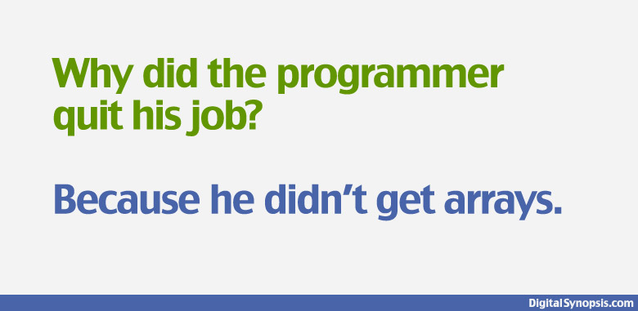
Arrays
He didn’t get arrays and he didn’t get a raise.

Slide 22
Array Lab 1
Create a new repl on replit. Write the method average which accepts an int array and returns the average of the values.
Write the method countAboveAve which accepts an int array and
returns the number of values that are above the average. You must call
average.
Write the method largest which accepts an int array and returns the largest value of the array.
Write the method indexOfsmallest which accepts an int array and returns the index of the smallest value. If there are multiple smallest values, return the index of the first one.

Slide 23
Array Lab 1
Also write the main method with an array and check to make sure your methods work!
public static double average(int[] array){}
public static int countAboveAve(int[] array){}
public static int largest(int[] array){}
public static int indexOfsmallest(int[] array){}

Slide 24
Array Lab 2
This lab is on Processing.
Write the Ball class with attributes center_x, center_y, change_x, change_y, radius(floats) and a color.
Methods:
update()
display()
Make it bounce on the screen. We have done this before but the the ball was not an object.

Slide 25
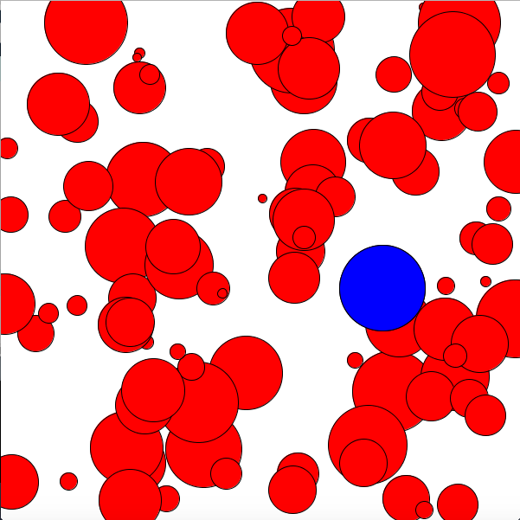
Array Lab 2
Create an array of ball objects and make it move on the screen!
Write a method largestBall
that returns the largest Ball
and set it to a different color.
There's a template with some
starter code for this lab if you need
some help. Download it here.

