Slide 1
Unit 4: Data Collections Introduction to ArrayLists
Adapted from:
1) Building Java Programs: A Back to Basics Approach
by Stuart Reges and Marty Stepp
2) Runestone CSAwesome Curriculum
https://longbaonguyen.github.io

Slide 2
Problem with Arrays
Consider the following problem: Read words from a text file and
store the data in memory.
String[] allWords = new String[2500];
Problem: You don't know how many words the text file contains.
The array above may be enough to store all the words from Wordle(about 2300).
But what if the text file contains all of the works of Shakespeare?
Hard to create an array of the appropriate size.
Luckily, there are other ways to store data besides in an array.

Slide 3
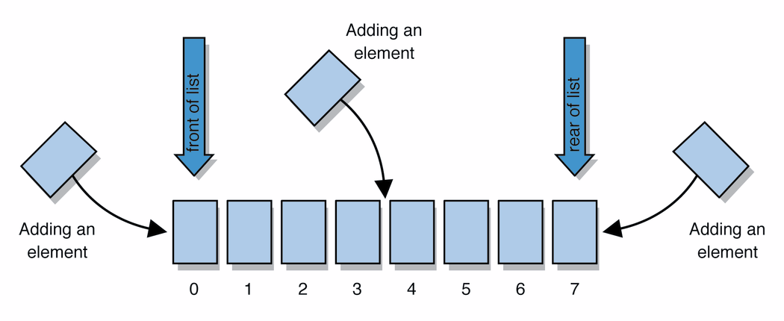
Lists
list: a collection storing an ordered sequence of elements
each element is accessible by a 0-based index
a list has a size (number of elements that have been added)
elements can be added to the front, back, or elsewhere
in Java, a list can be represented as an ArrayList object
Notes:
<number>
use jGRASP/DrJava Interactions window to create a list and add some elements, get them, check size

Slide 4
Idea of a list
Rather than creating an array of boxes, create an object that represents a "list" of items. (initially an empty list.)
[]
You can add items to the list.
The default behavior is to add to the end of the list.
[hello, ABC, goodbye, okay]
The list object keeps track of the element values that have been added to it, their order, indexes, and its total size.
Think of an "array list" as an automatically resizing array object.
Internally, the list is implemented using an array and a size field.

Slide 5
Type Parameters (Generics)
ArrayList<Type> name = new ArrayList<Type>();
When constructing an ArrayList, you must specify the type of elements it will contain between < and >.
This is called a type parameter or a generic class.
Allows the same ArrayList class to store lists of different types.
Can store arraylist of String, Student, Sprite, Car objects, etc…
ArrayList<String> names = new ArrayList<String>();
names.add("Marty Stepp");
names.add("Stuart Reges");
//notice the difference between arraylist & array
String[] names= new String[10];

Slide 6
ArrayList methods (10.1)
boolean add(E obj) | appends obj at end of list, returns true
void add(int index, E obj) | inserts given obj just before the given index, shifting subsequent values to the right
E get(int index) | returns the element at given index
E remove(int index) | removes/returns value at given index, shifting subsequent values to the left
void remove(E obj) | remove by object(Not on AP, but useful for some of our labs.
E set(int index, E obj) | replaces value at given index with given value, returns element that was previously at index.
int size() | returns the number of elements in list
toString() | returns a string representation of the list such as "[3, 42, -7, 15]"
Note: E refers to the type of objects in the arraylist.
ArrayList class is part of the java.util package.
To use ArrayList: import java.util.*;

Slide 7
ArrayList vs. array
construction
String[] names = new String[5];
ArrayList<String> list = new ArrayList<String>();
storing a value
names[0] = "Jessica";
list.add("Jessica");
retrieving a value
String s = names[0];
String s = list.get(0);

Slide 8
ArrayList vs. array
ArrayList<String> list = new ArrayList<String>();
list.add(“Michael”);
list.add(“Jessica”);
list.add(“Lee”); //{“Michael”, “Jessica”, “Lee”}
list.add(1,“Sarah”);//{“Michael”, “Sarah”,”Jessica”, “Lee”}
String store=list.set(2,”Mary”)
//{Michael,Sarah,Mary,Lee}, store=“Jessica”
String store2=list.get(3);//store2=“Lee”
String store3=list.remove(1);
//{Michael,Mary,Lee}, store3=“Sarah”

Slide 9
Traversing an Arraylist
It is common to use for loops to access arraylist elements. This is called
traversing the arraylist.
The list arrayList below is an arrayList of Strings from the previous slides.
for (int i = 0; i < list.size(); i++) {
System.out.println(list.get(i));
}
Contrast this with an array also called list.
for (int i = 0; i < list.length; i++) {
System.out.println(list[i]);
}

Slide 10
Traversing an Arraylist
We can use a for each loop traverse the arraylist. The list arrayList below is
an arrayList of Strings from the previous slides.
for (String name: list) {
System.out.println(name);
}
Note this syntax is the same for both arrays and arraylists!
Do not use the enhanced for each loop if you want to add or remove
elements when traversing a list because it will throw
a ConcurrentModificationException error. Since for each loops do not use
an index, you cannot do this special case of incrementing only if it is changed.
So if you are going to add or remove items or you need the index, use a
regular for loop or a while loop.

Slide 11
Common Error:Remove Items
Removing an element from an arraylist requires care as elements are shifted
left.
// Suppose allWords is an arraylist of words entered by
// user. Remove all words of length 3 from allWords.
for (int i = 0; i < allWords.size(); i++) {
String word = allWords.get(i);
if (word.length() == 3) {
allWords.remove(i);
}
}
This is an error! Once a word is removed, words are shifted to the
left, this will cause the next word to be skipped!

Slide 12
Remove Words
One way to fix the previous error is add a i-- correction.
// Suppose allWords is an arraylist of words entered by
// user. Remove all words of length 3 from allWords.
for (int i = 0; i < allWords.size(); i++) {
String word = allWords.get(i);
if (word.length() == 3) {
allWords.remove(i);
i--; //corrected
}
}
Can you think of another way of fixing this error?

Slide 13
Remove Words
Or alternatively, we can traverse the array backwards; this eliminates the
need to do i--. Do you see why the following works?
// Suppose allWords is an arraylist of words entered by
// user. Remove all words of length 3 from allWords.
for (int i = allWords.size() - 1; i >= 0; i--) {
String word = allWords.get(i);
if (word.length() == 3) {
allWords.remove(i);
// i-- not needed!
}
}

Slide 14
ArrayList as parameter
A method can accept an arraylist as a parameter.
public static void name(ArrayList<Type> name) {
Write a method that count all of the letters in all of the Strings from an
ArrayList of Strings.
public static int countLetters(ArrayList<String> list) {
int count = 0;
for (int i = 0; i < list.size(); i++) {
count += list.get(i).length();
}
return count;
}

Slide 15
ArrayList as parameter
Using for each:
public static int countLetters(ArrayList<String> list) {
int count = 0;
for (String item : list) {
count += item.length();
}
return count;
}

Slide 16
Returns an ArrayList
You can also return a list:
public static ArrayList<Type> methodName(params)
Write a method that accepts an array of String and return an arraylist copy of
the array.
public static ArrayList<String> copy(String[] array)
{
ArrayList<String> result = new ArrayList<String>();
for (int i = 0; i < array.length; i++) {
result.add(array[i]);
}
return result;
}

Slide 17
ArrayList of primitives?
The type you specify when creating an ArrayList must be an object type; it cannot be a primitive type.
// illegal -- int cannot be a type parameter
ArrayList<int> list = new ArrayList<int>();
But we can still use ArrayList with primitive types by using wrapper classes in their place.
// creates a list of ints
ArrayList<Integer> list = new ArrayList<Integer>();
Once you construct the list, use it with primitives as normal:
ArrayList<Double> grades = new ArrayList<Double>();
grades.add(3.2); //autoboxing
grades.add(2.7);
double myGrade = grades.get(0);//auto-unboxing

Slide 18
ArrayList of Integers
ArrayList<Integer> myList = new ArrayList<Integer>();
myList.add(50);
myList.add(30);
myList.add(20);
int total = 0;
for (int i = 0; i < myList.size(); i++){
total += myList.get(i);
}
System.out.println(total);
Output: 100

Slide 19
ArrayList "mystery"
ArrayList<Integer> list = new ArrayList<Integer>();
for (int i = 1; i <= 10; i++) {
list.add(10 * i);
}
What is in the arraylist list?
Answer: [10, 20, 30, 40, ..., 100]
for (int i = 0; i < list.size(); i++) {
list.remove(i);
}
System.out.println(list);
Answer: [20, 40, 60, 80, 100]

Slide 20
Out-of-bounds
Legal indexes are between 0 and the list's size() - 1.
Reading or writing any index outside this range will cause an IndexOutOfBoundsException.
ArrayList<String> names = new ArrayList<String>();
names.add("Marty"); names.add("Kevin");
names.add("Vicki"); names.add("Larry");
System.out.println(names.get(0)); // okay
System.out.println(names.get(3)); // okay
System.out.println(names.get(-1)); // exception
names.add(9, "Aimee"); // exception
index | 0 | 1 | 2 | 3
value | Marty | Kevin | Vicki | Larry

Slide 21
ArrayList "mystery" 2
ArrayList<Integer> list = new ArrayList<Integer>();
for (int i = 1; i <= 5; i++) {
list.add(2 * i); // [2, 4, 6, 8, 10]
}
What is the output of the following code?
for (int i = 0; i < list.size(); i++) {
list.add(i, 42); // add 42 at index i
}
System.out.println(list);
Answer: Infinite Loop!
Notes:
<number>
What happens if you get rid of the int size variable above and replace it with list.size() ? (infinite loop)

Slide 22
ArrayList "mystery" 3
ArrayList<Integer> list = new ArrayList<Integer>();
for (int i = 1; i <= 5; i++) {
list.add(2 * i); // [2, 4, 6, 8, 10]
}
What is the output of the following code?
int size = list.size();
for (int i = 0; i < size; i++) {
list.add(i, 42); // add 42 at index i
}
System.out.println(list);
Answer:
[42, 42, 42, 42, 42, 2, 4, 6, 8, 10]
Notes:
<number>
What happens if you get rid of the int size variable above and replace it with list.size() ? (infinite loop)

Slide 23
Objects storing collections
An object can have an array, list, or other collection as a field.
public class Course {
private ArrayList<Student> students;
public Course() {
students = new ArrayList<Student>();
...
}
Now each object stores a collection of data inside it.

Slide 24
Please Buy this Book
AP Computer Science A: With 6 Practice Tests (Barron's Test Prep) Ninth Edition
https://www.amazon.com/AP-Computer-Science-Practice-Barrons/dp/1438012896
Make sure it is the new ninth edition. It is the only edition that reflects all of the changes for the current exam.
If you want to do well on the AP Exam, this would be your best investment.
It is recommended that you buy the hard copy edition. Many students like to simulate the actual AP Exam experience by writing and working directly in the book.

Slide 25
Lab 1
Write the following static methods.
Write the method smallest which accepts an arraylist of integers and return the smallest. Your return type should be an Integer. MUST USE a for each loop.
Write the method longest which accepts an arraylist of strings and return the longest string. Return the first one if there are multiple longest strings. MUST USE a regular for loop.
Write the method remove which accepts an arraylist of Integers list and an integer variable x. Remove all occurrences of x in list.

Slide 26
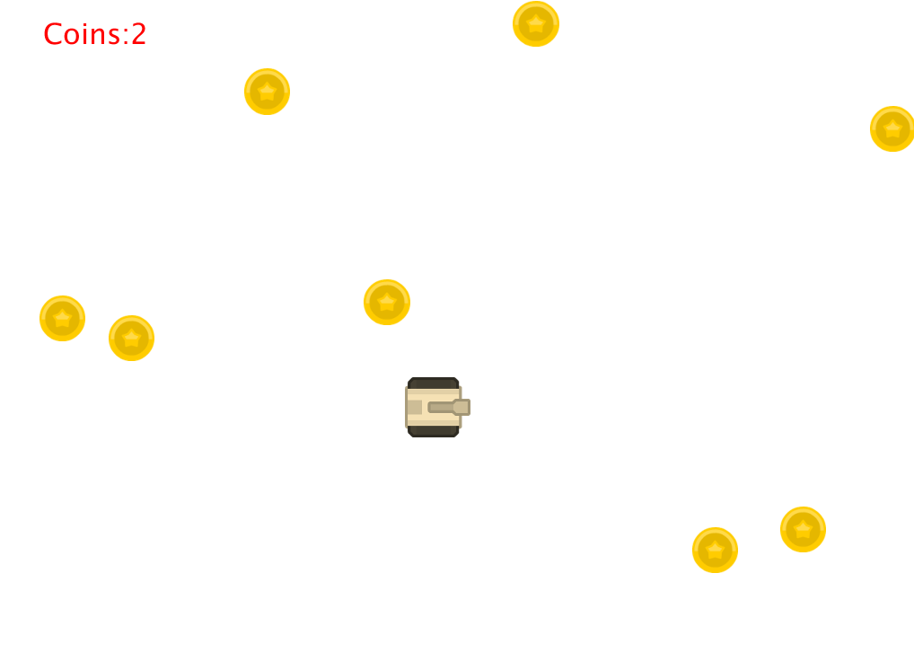
Lab 2(Processing)
A random set of coins are placed randomly on the screen. The tank moves around and collect the coins. A template for this lab with comments explaining the lab is available on my website here.
Here is the link to slides
that explain how to do
collision detection.

Slide 27
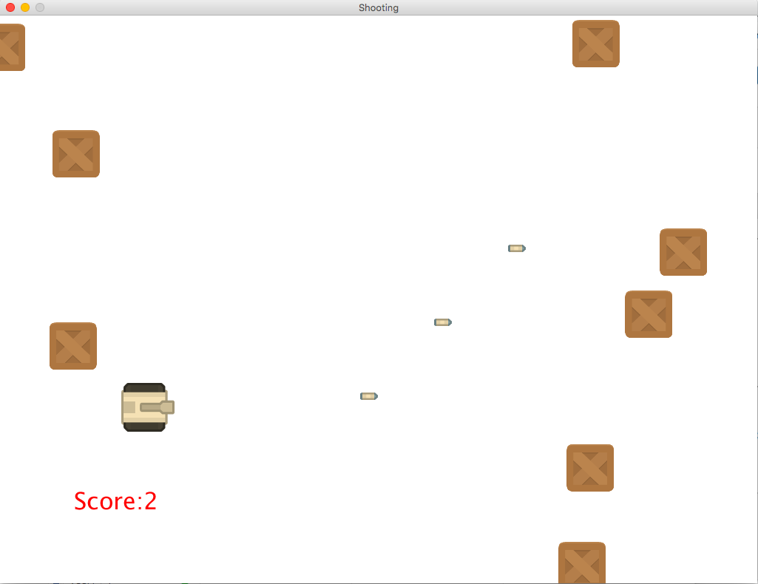
Lab 3(Processing)
Tank Shooting Lab: Download the template for this processing lab on my website.
Tank shoots bullets.
Crate is removed if
hit by a bullet.
Score keeps track
of number of
crates hit.

