Slide 1
Unit 4: Data Collections Searching and Sorting
Adapted from:
1) Building Java Programs: A Back to Basics Approach
by Stuart Reges and Marty Stepp
2) Runestone CSAwesome Curriculum
https://longbaonguyen.github.io

Slide 2
Sequential search
sequential search: Locates a target value in an array/list by examining each element from start to finish. If found, return index of first occurrence. Otherwise, return -1.
How many elements will it need to examine?
Example: Searching the array below for the value 42:
Notice that the array is sorted. Could we take advantage of this?
index | 0 | 1 | 2 | 3 | 4 | 5 | 6 | 7 | 8 | 9 | 10 | 11 | 12 | 13 | 14 | 15 | 16
value | -4 | 2 | 7 | 10 | 15 | 20 | 22 | 25 | 30 | 36 | 42 | 50 | 56 | 68 | 85 | 92 | 103
i

Slide 3
Sequential search
Implement sequential search using arrays which returns the index of the target or -1 if it is not found.
public int sequentialSearch(int[] array, int target){
for(int i = 0; i < array.length; i++){
if(array[i] == target)
return i;
}
// target not in array
return -1;
}

Slide 4
Binary search (13.1)
binary search: Locates a target value in a sorted array/list by successively eliminating half of the array from consideration.
How many elements will it need to examine?
Example: Searching the array below for the value 42:
index | 0 | 1 | 2 | 3 | 4 | 5 | 6 | 7 | 8 | 9 | 10 | 11 | 12 | 13 | 14 | 15 | 16
value | -4 | 2 | 7 | 10 | 15 | 20 | 22 | 25 | 30 | 36 | 42 | 50 | 56 | 68 | 85 | 92 | 103
min
mid
max

Slide 5
Binary search
Implement binary search using arrays. Assume that the array is sorted.
public int binarySearch(int[] sortedArray, int target){
int min = 0, max = sortedArray.length – 1;
while (min <= max) {
int mid = (min + max) / 2;
if (sortedArray[mid] < target)
min = mid + 1;
else if (sortedArray[mid] > target)
max = mid - 1;
else if (sortedArray[mid] == target)
return mid;
}
return -1;
}

Slide 6
Sorting
sorting: Rearranging the values in an array or collection into a specific order (usually into their "natural ordering").
one of the fundamental problems in computer science
can be solved in many ways:
there are many sorting algorithms
some are faster/slower than others
some use more/less memory than others
some work better with specific kinds of data
some can utilize multiple computers / processors, ...
comparison-based sorting : determining order by comparing pairs of elements:
<, >, compareTo, …

Slide 7
Sorting algorithms
There are many sorting algorithms.
Wikipedia lists over 40 sorting algorithms. The following three sorting algorithm will be on the AP exam.
selection sort: look for the smallest element, swap with first element. Look for the second smallest, swap with second element, etc…
insertion sort: build an increasingly large sorted front portion of array.
merge sort: recursively divide the array in half and sort it. Merge sort will be discussed in Unit 10.

Slide 8
Selection sort
selection sort: Orders a list of values by repeatedly putting the smallest or largest unplaced value into its final position.
The algorithm:
Look through the list to find the smallest value.
Swap it so that it is at index 0.
Look through the list to find the second-smallest value.
Swap it so that it is at index 1.
...
Repeat until all values are in their proper places.

Slide 9
Selection sort example
Initial array:
After 1st, 2nd, and 3rd passes:
For an array of n elements, the array is sorted in n – 1 passes.
After the kth pass, the first k elements are in their final sorted positions.
index | 0 | 1 | 2 | 3 | 4 | 5 | 6 | 7 | 8 | 9 | 10 | 11 | 12 | 13 | 14 | 15 | 16
value | 22 | 18 | 12 | -4 | 27 | 30 | 36 | 50 | 7 | 68 | 91 | 56 | 2 | 85 | 42 | 98 | 25
index | 0 | 1 | 2 | 3 | 4 | 5 | 6 | 7 | 8 | 9 | 10 | 11 | 12 | 13 | 14 | 15 | 16
value | -4 | 18 | 12 | 22 | 27 | 30 | 36 | 50 | 7 | 68 | 91 | 56 | 2 | 85 | 42 | 98 | 25
index | 0 | 1 | 2 | 3 | 4 | 5 | 6 | 7 | 8 | 9 | 10 | 11 | 12 | 13 | 14 | 15 | 16
value | -4 | 2 | 12 | 22 | 27 | 30 | 36 | 50 | 7 | 68 | 91 | 56 | 18 | 85 | 42 | 98 | 25
index | 0 | 1 | 2 | 3 | 4 | 5 | 6 | 7 | 8 | 9 | 10 | 11 | 12 | 13 | 14 | 15 | 16
value | -4 | 2 | 7 | 22 | 27 | 30 | 36 | 50 | 12 | 68 | 91 | 56 | 18 | 85 | 42 | 98 | 25

Slide 10
Selection Sort
Implement selection sort.
public static void selectionSort(int[] elements){
for (int j = 0; j < elements.length - 1; j++){
int minIndex = j;
for (int k = j + 1; k < elements.length; k++){
if (elements[k] < elements[minIndex])
minIndex = k;
}
if (j != minIndex){ // swap only if different
int temp = elements[j];
elements[j] = elements[minIndex];
elements[minIndex] = temp;
}
}
}

Slide 11
Insertion Sort
insertion sort: Shift each element into a sorted sub-array
The algorithm: To sort a list of n elements.
Loop through indices i from 1 to n – 1:
- For each value at position i, inserted into correct position in the sorted list from index 0 to i – 1.
index | 0 | 1 | 2 | 3 | 4 | 5 | 6 | 7 | 8 | 9 | 10 | 11 | 12 | 13 | 14 | 15 | 16
value | -4 | 12 | 18 | 22 | 27 | 30 | 36 | 50 | 7 | 68 | 91 | 56 | 2 | 85 | 42 | 98 | 25
sorted sub-array (indexes 0-7)
Notes:
<number>
A lot of 143 students implement a kind of insertion sort on their SortedIntList add operation.

Slide 12

Insertion Sort Algorithm
64 54 58 87 55
54 less than 64
Insert 54 before 64
54 64 58 87 55
58 less than 64
58 greater than 54
Insert 58 before 64
54 58 64 87 55
87 greater than 64
Go to next element
54 58 64 87 55
55 less than 87
55 less than 64
55 less than 58
55 greater than 54
Insert 55 before 58
54 55 58 64 87

Slide 13
Insertion Sort
This implementation uses ArrayLists. This code has appeared on MC questions on the AP exam. Understand it!
public void insertionSort(ArrayList<Integer> list){
for(int i = 1; i < list.size(); i++){
int current = list.remove(i); // removes & returns
int index = i - 1;
while(index >= 0 && current < list.get(index))
index--;
list.add(index+1, current);
}
}

Slide 14
Insertion Sort
This implementation uses arrays. This code has appeared on MC questions on the AP exam. Understand it!
public static void insertionSort(int[] elements){
for (int j = 1; j < elements.length; j++){
int temp = elements[j];
int possibleIndex = j;
while (possibleIndex > 0 && temp <
elements[possibleIndex - 1]){
elements[possibleIndex] = elements[possibleIndex - 1];
possibleIndex--;
}
elements[possibleIndex] = temp;
}
}

Slide 15
Insertion Sort
Some properties of insertion sort:
For an array of n elements, the array is sorted after n − 1 passes.
2) After the kth pass, a[0], a[1], ..., a[k] are sorted with respect to each other but not necessarily in their final sorted positions.
3) The worst case for insertion sort occurs if the array is initially sorted in reverse order, since this will lead to the maximum possible number of comparisons and moves.
4) The best case for insertion sort occurs if the array is already sorted in increasing order. In this case, each pass through the array will involve just one comparison, which will indicate that “it” is in its correct position with respect to the sorted list. Therefore, no elements will need to be moved.
Note: For selection sort, there is no worst or best case. Finding the smallest at each iteration requires traversing the array to the end.

Slide 16
The Complexity of An Algorithm
The complexity of an algorithm is the amount of resources
(elementary operations or loop iterations) required for running it.
(lower the complexity = faster algorithm)
The complexity f(n) is defined in terms of the input size n. For
example, sorting an array should take more resources for larger
arrays.
We can approximate the complexity of simple algorithms by counting
the number of iterations in the algorithm of the worst case scenario.

Slide 17
Example 1
How many times as a function of n does the computation x++
executed?
int x = 0;
for(int i = 0; i < n; i++){
x++;
}
Answer: n(linear function of n)
Example: Sequential/Linear Search has complexity n.

Slide 18
Example 2
How many times as a function of n does the computation x++
executed?
int x = 0;
for(int i = 0; i < n; i++){
x++;
}
for(int j = 0; j < n; j++){
x++;
}
Answer: 2n
Example: Sequential Search

Slide 19
Example 3
How many times as a function of n does the computation x++
executed?
int x = 0;
for(int i = 0; i < n; i++){
for(int j = 0; j < n; j++){
x++;
}
}
Answer: n^2
Example: Selection and Insertion are both quadratic in complexity.

Slide 20
Example 4
How many times as a function of n does the computation x++
executed?
int x = 1;
while((int)(Math.pow(2, x)) <= n){
x++;
}
Answer: log_2(n)
Example: Binary Search has complexity log_2(n).

Slide 21
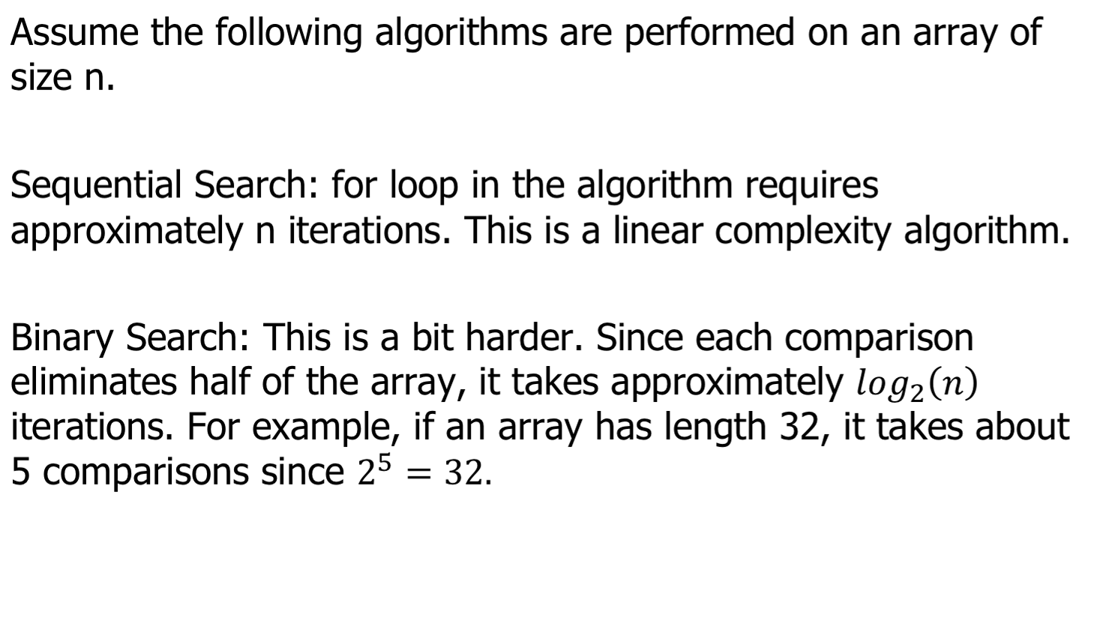
Complexity of Algorithms

Slide 22
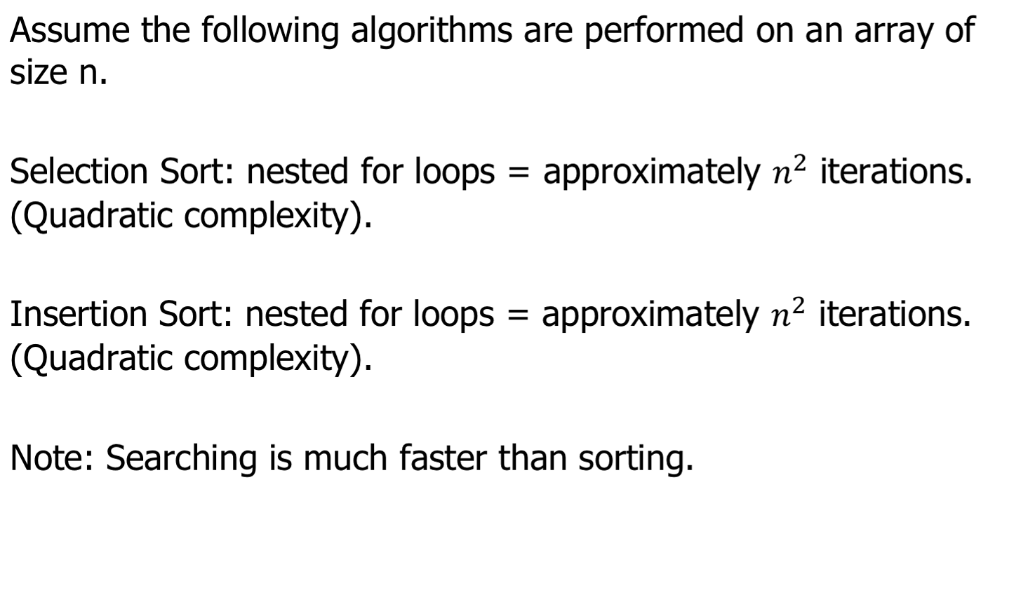
Complexity of Algorithms

Slide 23
Lab 1
Write the following methods.
Reimplement sequentialSearch using an arraylist of Integers.
Write the insertion sort method using arrays instead of arraylist.

