Slide 1
Unit 4: Data Collections 2D Arrays
Adapted from:
1) Building Java Programs: A Back to Basics Approach
by Stuart Reges and Marty Stepp
2) Runestone CSAwesome Curriculum
https://longbaonguyen.github.io

Slide 2
2D Arrays
We have only worked with one-dimensional arrays so far, which have a single row of elements.
But in the real world, data is often represented in a two-dimensional table with rows and columns.
Programming languages can also represent arrays this way with multiple dimensions.
Notes:
<number>
How would we print a multiplication table?
try printing each of the following inside the inner loop:
System.out.print(i + " ");
System.out.print(j + " ");
System.out.print((i * j) + " ");

Slide 3
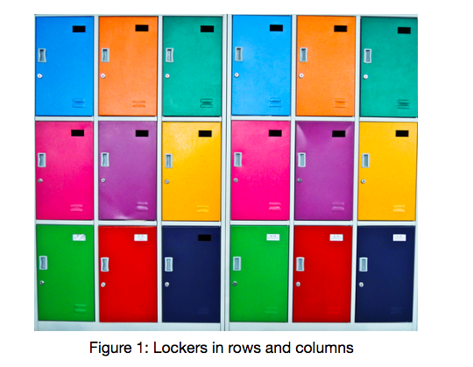
2D Arrays
A two-dimensional (2D) array has rows and columns.
A row has horizontal elements. A column has vertical elements. In the picture below there are 3 rows of lockers and 6 columns.
Notes:
<number>
How would we print a multiplication table?
try printing each of the following inside the inner loop:
System.out.print(i + " ");
System.out.print(j + " ");
System.out.print((i * j) + " ");

Slide 4
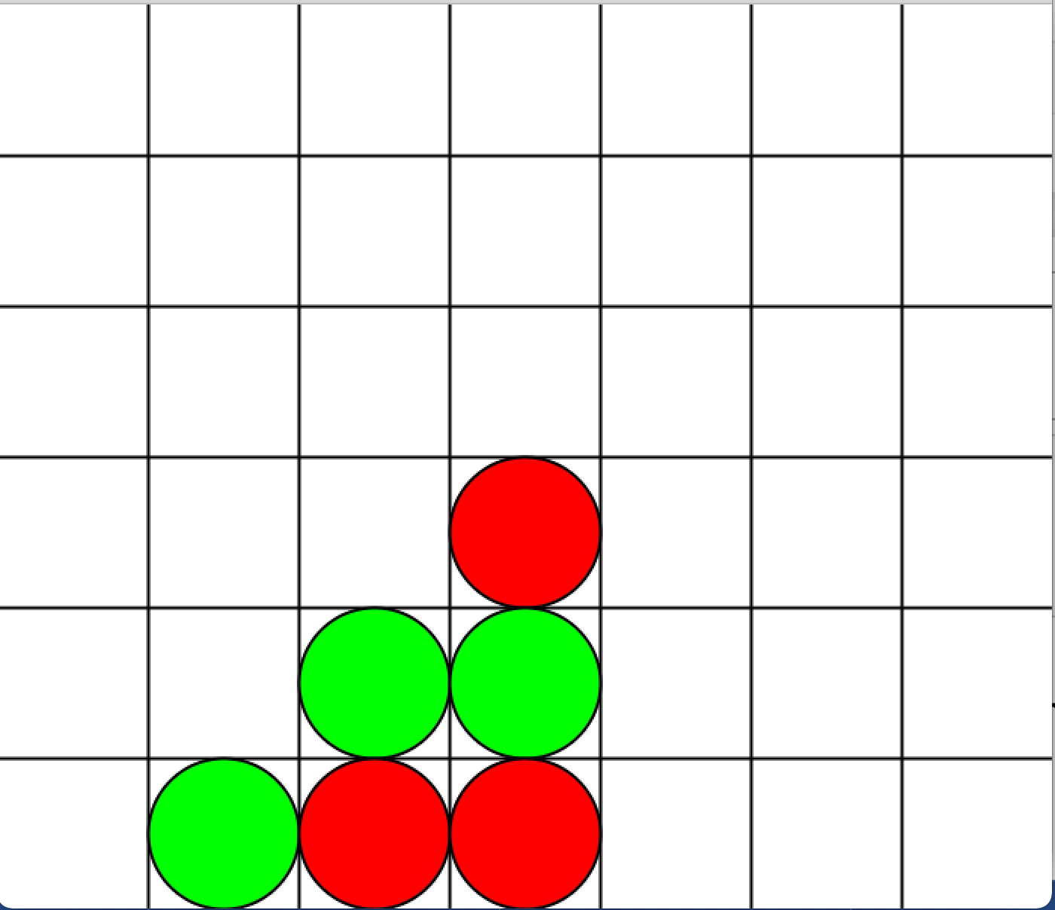
2D Arrays
Two dimensional arrays are especially useful when the data is naturally
organized in rows and columns like in a spreadsheet, bingo, battleship,
theater seats, classroom seats, connect-four game, or a picture.
One of our labs, we will implement the Connect Four game.
Notes:
<number>
How would we print a multiplication table?
try printing each of the following inside the inner loop:
System.out.print(i + " ");
System.out.print(j + " ");
System.out.print((i * j) + " ");

Slide 5
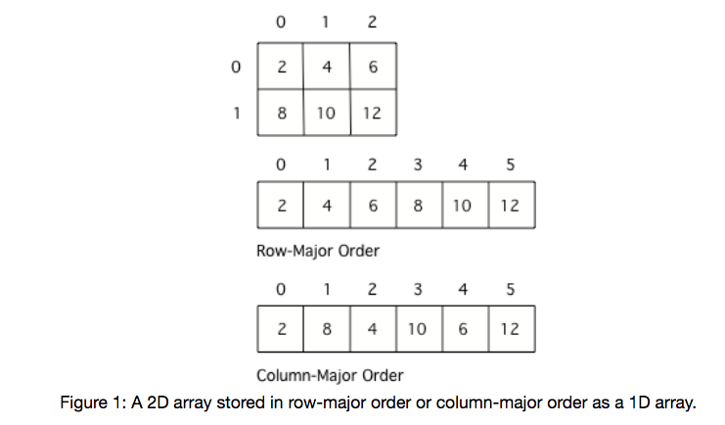
2D Arrays
Many programming languages actually store two-dimensional array data in a one-dimensional array. The typical way to do this is to store all the data for the first row followed by all the data for the second row and so on. This is called row-major order.
Some languages store all the data for the first column followed by all the data for the second column and so on. This called column-major order.
Notes:
<number>
How would we print a multiplication table?
try printing each of the following inside the inner loop:
System.out.print(i + " ");
System.out.print(j + " ");
System.out.print((i * j) + " ");

Slide 6
Declare and Initialize
To declare and initialize a 2D array,
type[][] name = new type[row][col];
where row, col is the number of rows/columns. When arrays are created their
contents are automatically initialized to 0 for numeric types, null for object
references, and false for type boolean.
int[][] matrix = new int[3][4]; //3 rows, 4 columns
//all initialized to 0.
0 | 0 | 0 | 0
0 | 0 | 0 | 0
0 | 0 | 0 | 0

Slide 7
2D Array
To explicitly put a value in an array, you can use assignment
statements specifying the row and column of the entry.
int[][] matrix = new int[3][4]; //3 rows, 4 columns
//all initialized to 0.
matrix[0][0] = 2;
matrix[1][2] = -6;
matrix[2][1] = 7;
2 | 0 | 0 | 0
0 | 0 | -6 | 0
0 | 7 | 0 | 0

Slide 8
Initializer List
You can also initialize (set) the values for the array when you
create it. In this case you don’t need to specify the size of the
array, it will be determined from the values you give. This is called
using initializer list.
int[] array = {1, 4, 3}; // 1D array initializer list.
// 2D array initializer list.
int[][] mat = {{3, 4, 5}, {6, 7, 8}};
// 2 rows, 3 columns
3 | 4 | 5
6 | 7 | 8

Slide 9
Declare and Initialize
Declaring and initializing 2D arrays.
int[][] table; //2D array of ints, null reference
double[][] matrix=new double[4][5];
// 4 rows, 5 columns
// initialized all to 0.0
String[][] strs=new String[2][5];
// strs reference 2x5 array of String objects. Each element is null.
// Using initializer list.
String[][] seatingInfo = {{"Jamal", "Maria"},
{"Jake", "Suzy"}, {"Emma", "Luke"}};

Slide 10
Array of Arrays
A 2D array is implemented as an array of row arrays. Each row is a one-dimensional array of elements. Suppose that mat is the 2D array:
Then mat is an array of three arrays:
mat[0] is the one-dimensional array {3,-4,1,2}.
mat[1] is the one-dimensional array {6,0,8,1}.
mat[2] is the one-dimensional array {-2,9,1,7}.
mat.length is the number of rows.
3 | -4 | 1 | 2
6 | 0 | 8 | 1
-2 | 9 | 1 | 7

Slide 11
Array of Arrays
1) mat.length is the number of rows. In this case, it equals 3 because there are three row-arrays in mat.
2) For each k, where 0<=k<mat.length, mat[k].length is the number of elements in that row, namely the number of columns. In this case, mat[k].length=4 for all k.
3) Java allows “jagged arrays” where each row array may have different lengths. However, on the AP exam, assume all arrays are rectangular.
3 | -4 | 1 | 2
6 | 0 | 8 | 1
-2 | 9 | 1 | 7

Slide 12
Example
int[][] mat={{3,4,5},{1,2},{0,1,-3,5}};
mat[0] = {3,4,5}
mat[1] = {1,2}
mat[2] = {0,1,-3,5}
mat.length = 3
mat[0].length = 3
mat[1].length = 2
mat[2].length = 4

Slide 13
Common Algorithms
You should know how to implement the following algorithms:
Given a 2D array:
Traverse the array by row major order
Traverse the array by column major order
Traverse one row of the 2D array
Traverse one column of the 2D array
Traverse row-by-row
Find the largest element.
Find the sum and average.
Sequential/Linear search a 2D array by sequential/search each row of 2D array.

Slide 14
Row Major Order
Suppose that mat is a 2D array initialized with integers. Use
nested for loop to print out the elements of the array. Traverse by
row-major order.
int[][] mat = {{3,4,5},{1,2},{0,1,-3,5}};
for(int row = 0;row < mat.length;row++){
for(int col = 0;col < mat[row].length;col++)
System.out.print(mat[row][col]+ " ");
System.out.println();
}
Output:
3 4 5
1 2
0 1 -3 5

Slide 15
For Each Traversal
Traverse an array by using a for each loop. For each loop, in general,
are much easier to work with. If you are not modifying your 2D array, it
is highly recommended that you use for each to avoid index errors.
int[][] mat = {{3,4,5},{1,2},{0,1,-3,5}};
for(int[] row: mat){
for(int element: row)
System.out.println(element + " ");
System.out.println();
}
Output:
3 4 5
1 2
0 1 -3 5

Slide 16
Column Major Order
Suppose that mat is a 2D array initialized with integers. Use
nested for loop to print out the elements of the array. Traverse by
column-major order. Assume that the array is rectangular.
int[][] mat = {{3,4,5},{1,2,3}};
for(int col = 0;col < mat[0].length;col++){
for(int row = 0;row < mat.length;row++)
System.out.print(mat[row][col]+ " ");
System.out.println();
}
Output:
3 1
4 2
5 3
Note that the use of regular for loops
is required to traverse column major order.
Do you see why for each will not work?

Slide 17
Row-by-Row
Suppose the following method has been implemented which prints
a 1D array.
// print out elements of array separated by spaces
public void printArray(int[] array)
{ /*implementation not shown*/ }
Use it to print out the 2D array mat by processing one row at a
time(row-by-row).
for(int i = 0;i < mat.length; i++){
printArray(mat[i]); //mat[i] is row i of mat
System.out.println();
}

Slide 18
sum
Write the method that returns the sum of a 2D array.
public int sum(int[][] a){
int sum = 0;
for(int[] row: a){
for(int value: row)
sum += value;
}
return sum;
}

Slide 19
searching an array
Write the method that searches a 2D array for a target value. Returns
true if target is in the 2D array and false otherwise. Assume the
sequentialSearch for 1D below has already been implemented. (see
previous lecture).
public boolean sequentialSearch(int[] a, int target)
{…}
public boolean search2D(int[][] a, int target){
for(int row = 0;row < a.length; row++)
if(sequentialSearch(a[row], target))
return true;
}
return false;
}
Similarly for columns.

Slide 20
2D Arrays of Objects
The AP Exam will often have free response questions that use
array/arraylist or 2D array of objects.
public class Student{
private String name;
private double gpa;
// constructors and other methods not shown
// implementation not shown
public String getName(){…}
public double getGpa(){…}
}

Slide 21
2D Arrays of Objects
The Student class is used in the following SeatingChart class.
public class SeatingChart{
private Student[][] seats;
// constructors not shown
…
/* returns the average sum of all students
*/
public double sum(){
// implement this method. See next slide.
}
}

Slide 22
Regular For Loop
public double sum(){
double sum = 0.0;
for(int i = 0; i < seats.length; i++){
for(int j = 0; j < seats[0].length; j++){
sum += seats[i][j].getGpa();
}
}
return sum;
}
We can do this more simply with a for each loop! See next slide.

Slide 23
For Each Loop
public double sum(){
double sum = 0.0;
for(Student[] row: seats){
for(Student std: row){
sum += std.getGpa();
}
}
return sum;
}

Slide 24
2D Arrays of Objects
The Student class is used in the following SeatingChart class.
public class SeatingChart{
private Student[][] seats;
// constructors not shown
…
/* returns the name of the Student with the highest
gpa. Returns the first if there are multiples.
*/
public String bestStudent(){
// implement this method. See next slide.
}
}

Slide 25
2D Arrays of Objects
public class SeatingChart{
private Student[][] seats;
/* returns the name of the Student with the highest
gpa. Returns the first if there are multiples.
*/
public String bestStudent(){
Student best = seats[0][0]; // best is first student
for(Student[] row: seats){
for(Student std: row)
if(std.getGpa() > best.getGpa())
best = std;
}
return best.getName();
}
}

Slide 26
Lab 1
Write the following methods.
sum: Write method sum which accepts a 2D array of integers and returns the sum of all of the elements. Use row-column traversal method. Use a regular nested Loop.
rowSum: rowSum accepts two parameters: a 2D array of integers and an integer row. rowSum returns the sum of the integers of elements in the row given by row.
colSum: colSum accepts two parameters: a 2D array of integers and an integer col. colSum returns the sum of the integers of elements in the column given by col.
sum2: This method is the same as sum above but you must use rowSum method in your code. One loop.

Slide 27
Lab 1
Write the following methods.
largest accepts a 2D array of integers and returns the largest
value. Use row-column traversal method to examine each value.
Use a nested for each loop.
largestByRow accepts two parameters: a 2D array of integers
and an integer row. largestByRow returns the largest value in
the row given by row.
largest2 accepts a 2D array of integers and returns the largest value. You must call largestByRow. One loop.

Slide 28
Lab 1
printTranspose: Given 2D array of integers, print the transpose of the array. The transpose of a 2D array is the array whose rows are the columns of the original array. Do not create a new array, instead, use for loops to traverse the original array.
If mat={{1,2,3},{4,5,6}}; printTranspose(mat) will
print:
1 4
2 5
3 6

Slide 29
Lab 2
A magic square is an N x N array of numbers such that
Every number from 1 through N² must appear exactly once.
Every row, column, major and minor diagonal must add up to the same total.
A template can be found on replit for this lab: (fork the repl)
https://repl.it/@LongNguyen18/MagicSquareLab
Example: N=4
16 | 3 | 2 | 13
5 | 10 | 11 | 8
9 | 6 | 7 | 12
4 | 15 | 14 | 1

Slide 30
Lab 2
Write the class MagicSquare with instance methods given in the next few slides. MagicSquare should have an instance 2D array variable square. MagicSquare should have a constructor that accepts a 2D array.
The methods rowSum, colSum, diagSums and exactlyOnce are intermediate methods to help you write the isMagic method, which determines whether a square is magic.
You must use the method headers indicated for each method.
Write a driver class with a main method to test your MagicSquare class.

Slide 31
Lab 2
public int rowSum(int row){…}
Returns the row sum indicated by row.
public int colSum(int col){…}
Returns the column sum indicated by col.

Slide 32
Lab 2
Returns whether both the major and minor diagonal sums are equal to sum. The major and minor diagonal are highlighted below.
public boolean diagSums(int sum){…}
16 | 3 | 2 | 13
5 | 10 | 11 | 8
9 | 6 | 7 | 12
4 | 15 | 14 | 1

Slide 33
Lab 2
public boolean exactlyOnce(){…}
Returns true if the numbers 1 to N² occurs exactly once in square and false otherwise. N is the number of rows(and columns) in square. Hint: Use a tally array discussed in the array algorithms lecture.
You must use the each of the above methods to write the following isMagic method.
public boolean isMagic(){…}
Returns true if square is magic and false otherwise.
A template can be found on replit for this lab here: (fork the repl)
https://repl.it/@LongNguyen18/MagicSquareLab

Slide 34
Lab 3(Grid)
Implement the Connect 4 game.
A template is provided on my website if
you wish to get some help.

