Slide 1
Unit 4: Data Collections Recursion
Adapted from:
1) Building Java Programs: A Back to Basics Approach
by Stuart Reges and Marty Stepp
2) Runestone CSAwesome Curriculum
https://longbaonguyen.github.io

Slide 2
Recursion
recursion: The definition of an operation in terms of itself.
Solving a problem using recursion depends on solving smaller occurrences of the same problem.
recursive programming: Writing methods that call themselves to solve problems recursively.
An equally powerful substitute for iteration (loops)
Particularly well-suited to solving certain types of problems

Slide 3
Why learn recursion?
"cultural experience" - A different way of thinking of problems
Can solve some kinds of problems better than iteration
Leads to elegant, simplistic, short code (when used well)
Many programming languages ("functional" languages such as Scheme, ML, and Haskell) use recursion exclusively (no loops)

Slide 4
Recursion and cases
Every recursive algorithm involves at least 2 cases:
base case: A simple occurrence that can be answered directly.
recursive case: A more complex occurrence of the problem that cannot be directly answered, but can instead be described in terms of smaller occurrences of the same problem.
Some recursive algorithms have more than one base or recursive case, but all have at least one of each.
A crucial part of recursive programming is identifying these cases.

Slide 5
Example
You are lined up in front of your favorite store for Black Friday deals. The line is long and wraps around the building so that you cannot see the front of the line. How do you figure out your position without getting out of line?
Answer: Ask the person in front of you.
Base case: If a customer is at the front of the line and someone asks him for his position, he’ll “return” 1.
Recursive case: If a customer is at position n and someone asks him for his position, he’ll ask the person in front of him.
Note: The recursive case reduces an n problem to an n-1 problem. Each person repeated asks until the question reaches the first person in line. He will answer informing the person behind him, who will then inform the person behind him, etc… until the answer reaches you.

Slide 6
Recursion in Java
Consider the following method to print a line of * characters:
// Prints a line containing the given number of stars.
// Precondition: n >= 0
public static void printStars(int n) {
for (int i = 0; i < n; i++) {
System.out.print("*");
}
System.out.println(); // end the line of output
}
Write a recursive version of this method (that calls itself).
Solve the problem without using any loops.
Hint: Your solution should print just one star at a time.

Slide 7
"Recursion Zen"
The real, even simpler, base case is an n of 0, not 1:
public static void printStars(int n) {
if (n == 0) {
// base case; just end the line of output
System.out.println();
}
else {
// recursive case; print one more star
System.out.print("*");
printStars(n - 1);
}
}
Recursion Zen: The art of properly identifying the best set of cases for a recursive algorithm and expressing them elegantly.

Slide 8
Exercise
Write a recursive method pow accepts an integer base and exponent and returns the base raised to that exponent.
Example: pow(3, 4) returns 81
Solve the problem recursively and without using loops.
// Precondition: exponent >= 0, base > 0
public static int pow(int base, int exponent) {
if (exponent == 0) {
// base case; any number to 0th power is 1
return 1;
}
else {
// recursive case: x^y = x * x^(y-1)
return base * pow(base, exponent - 1);
}
}

Slide 9
Recursive Trace 1
Consider the following recursive method:
public static int mystery(int n) {
if (n < 10) {
return n;
} else {
int a = n / 10;
int b = n % 10;
return mystery(a + b);
}
}
What is the result of the following call?
mystery(648)

Slide 10
Recursion Tree Diagram 1
mystery(648)
9 propagates all the up to mystery(648) which equals 9.
9
a = 64
b = 8
return mystery(72)
Note: This is the simplest example where the same number progagates up. Usually, at each step, more math is performed on each answer.
9
a = 7
b = 2
return mystery(9)
9
return 9

Slide 11
Recursive Trace 2
int mystery(int n){
if (n == 1 || n == 2)
return 2 * n;
else
return mystery(n - 1) - mystery(n - 2);
}
What is the result of the following call?
mystery(4);
See the next slide for a way to visualize this one. Watch the animation on the powerpoint version of this lecture.

Slide 12
Recursion Tree Diagram 2
mystery(4)
Final answer
-2
return mystery(3) – mystery(2)
2
4
return mystery(2) – mystery(1)
return 4
4
2
See the powerpoint version of this lecture for
the animation. If you're having a hard time
visualizing recursion, I highly recommend
watching the animation of this slide.
return 4
return 2

Slide 13
Recursive Trace 3
Consider the following recursive method:
public static int mystery(int n) {
if (n < 10) {
return (10 * n) + n;
} else {
int a = mystery(n / 10);
int b = mystery(n % 10);
return (100 * a) + b;
}
}
What is the result of the following call?
mystery(348)

Slide 14
Recursion Tree Diagram 3
mystery(348)
Final answer
334488
a = mystery(34)
b = mystery(8)
3344
return 334488
88
a = mystery(3)
b = mystery(4)
return 88
33
return 3344
See the powerpoint version of this lecture for
the animation. If you're having a hard time
visualizing recursion, I highly recommend
watching the animation of this slide.
44
return 33
return 44

Slide 15
Recursive Binary Search
The following implementation of recursive binary search has appeared on the AP Exam. Understand this algorithm!
public static int bSearch(int[] arr, int left,
int right, int x){
if (right >= left){
int mid = (left + right) / 2;
if (arr[mid] == x){
return mid;
}
else if (arr[mid] > x){
return bSearch(arr, left, mid - 1, x);
}
else{
return bSearch(arr, mid + 1, right, x);
}
}
return -1;
}

Slide 16
Merge sort
merge sort: Repeatedly divides the data in half, sorts each half, and combines the sorted halves into a sorted whole.
The algorithm:
Divide the list into two roughly equal halves.
Sort the left half.
Sort the right half.
Merge the two sorted halves into one sorted list.
Often implemented recursively.
An example of a "divide and conquer" algorithm.
Invented by John von Neumann in 1945

Slide 17
Merge sort example
index | 0 | 1 | 2 | 3 | 4 | 5 | 6 | 7
value | 22 | 18 | 12 | -4 | 58 | 7 | 31 | 42
split
22 | 18 | 12 | -4
58 | 7 | 31 | 42
split
split
22 | 18
12 | -4
58 | 7
31 | 42
split
split
split
split
22
18
12
-4
58
7
31
42
merge
merge
merge
merge
18 | 22
-4 | 12
7 | 58
31 | 42
merge
merge
-4 | 12 | 18 | 22
7 | 31 | 42 | 58
merge
-4 | 7 | 12 | 18 | 22 | 31 | 42 | 58

Slide 18
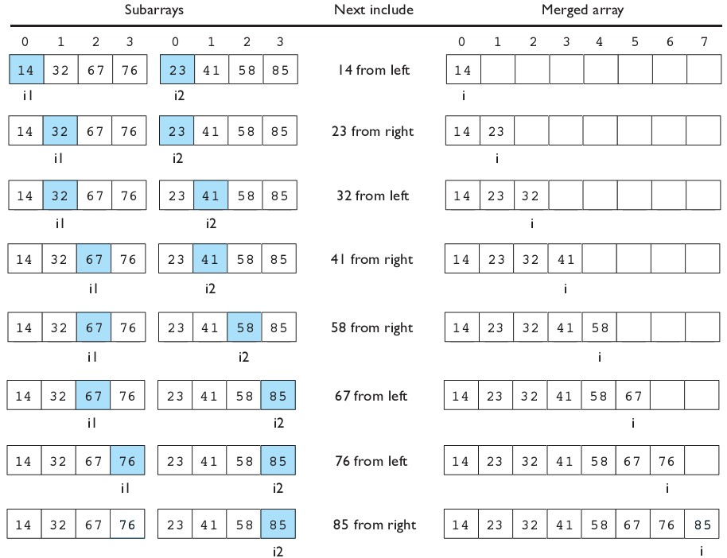
Merging sorted halves

Slide 19
Merge halves code
// Merges the left/right elements into a sorted result.
// Precondition: left/right are sorted
public static void merge(int[] result, int[] left,
int[] right) {
int i1 = 0; // index into left array
int i2 = 0; // index into right array
for (int i = 0; i < result.length; i++) {
if (i2 >= right.length ||
(i1 < left.length && left[i1] <= right[i2])) {
result[i] = left[i1]; // take from left
i1++;
} else {
result[i] = right[i2]; // take from right
i2++;
}
}
}

Slide 20
Merge sort code
// Rearranges the elements of a into sorted order using
// the merge sort algorithm (recursive).
public static void mergeSort(int[] a) {
if (a.length >= 2) {
// split array into two halves
int[] left = Arrays.copyOfRange(a, 0, a.length/2);
int[] right = Arrays.copyOfRange(a, a.length/2, a.length);
// sort the two halves
mergeSort(left);
mergeSort(right);
// merge the sorted halves into a sorted whole
merge(a, left, right);
}
}

Slide 21
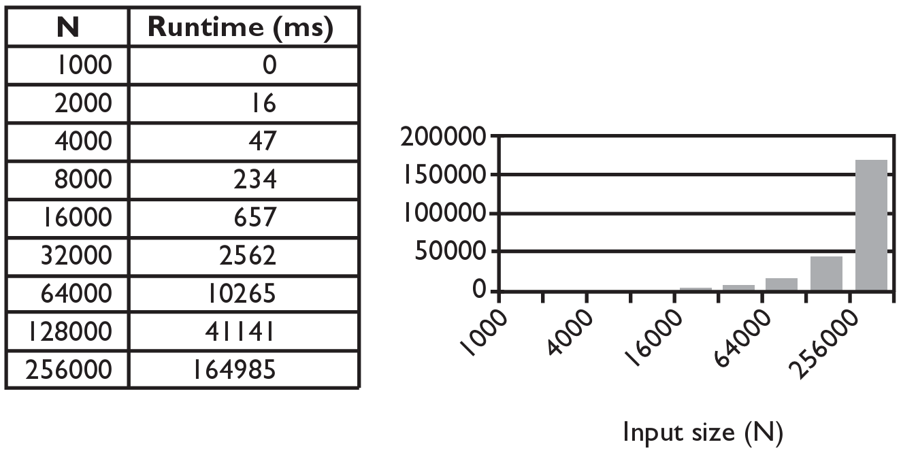
Selection sort runtime (Fig. 13.6)
What is the complexity class (Big-Oh) of selection sort?

Slide 22
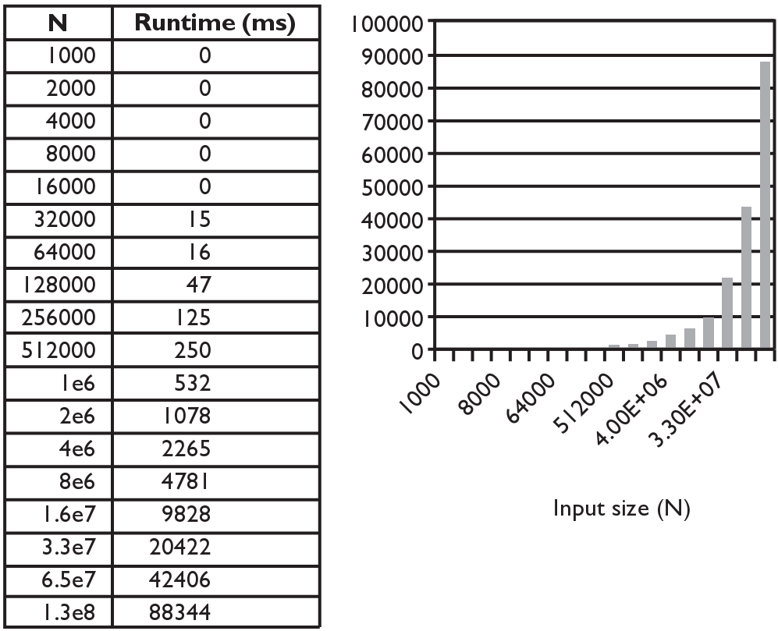
Merge sort runtime
What is the complexity class (Big-Oh) of merge sort?

Slide 23
Lab 1: Fractal Circles
Use Processing to write the recursive method to print out a recursive
pattern of circles of decreasing radii. Since this is a static image, you don't
need draw(). Use the following complete template:
void setup() {
background(255);
size(600,600);
circle(width/2,width/4,10);
}
void circle(int x, int radius, int depth)
{
// fill in your code
//(just a 4 lines of code inside an if conditional!)
}

Slide 24
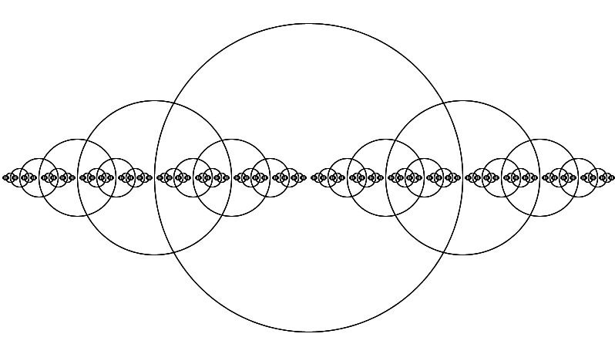
Lab 1
The previous template with correct completed code produces:

Slide 25
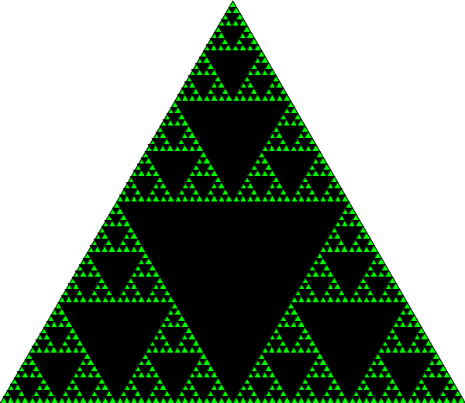
Lab 2: Sierpinski Triangle
Use Processing to write the recursive
method to draw the Sierpinski triangle.
You may use the template on the
next slide.(just 5 lines of code!)

Slide 26
Lab 2: Sierpinski Triangle
void setup() {
background(255);
size(600,600);
fill(0,255,0);
// draw the first green triangle.
triangle(0,height, width/2, 0, width, height);
// start the recursive call.
fractal(0,height, width/2, 0, width, height, 6);
}
void fractal(int x1, int y1, int x2, int y2, int x3,
int y3, int n) {
// fill in your code
//(just a 5 (algebraically careful) lines of code
// inside an if conditional!)
}

