Slide 1
Unit 1: Using Objects and Methods Methods
Adapted from:
1) Building Java Programs: A Back to Basics Approach
by Stuart Reges and Marty Stepp
2) Runestone CSAwesome Curriculum
This work is licensed under the
Creative Commons Attribution-NonCommercial-ShareAlike 4.0 International License.
https://longbaonguyen.github.io

Slide 2
Modularity
modularity: Writing code in smaller, more manageable components or modules. Then combining the modules into a cohesive system.
Modularity with methods. Break complex code into smaller tasks and organize it using methods.
Methods define the behaviors or functions for objects.
An object’s behavior refers to what the object can do (or what can be done to it). A method is simply a named group of statements.
main is an example of a method

Slide 3
Example
Consider the following code which asks the user to enter two numbers and print out the average.
Scanner console = new Scanner(System.in);
System.out.print("Enter a number: ");
int num1 = console.nextInt();
System.out.print("Enter a number: ");
int num2 = console.nextInt();
System.out.println("The average is " + (num1 + num2)/2.0);
What if we need to do this again?
We don't want to repeat this code by copying and pasting as shown in the next slide.

Slide 4
Example
If we need to repeat this task, we do not want to simply copy and paste out code:
Scanner console = new Scanner(System.in);
int num1, num2;
System.out.print("Enter a number: ");
num1 = console.nextInt();
System.out.print("Enter a number: ");
num2 = console.nextInt();
System.out.println("The average is " + (num1 + num2)/2.0);
System.out.print("Enter a number: ");
num1 = console.nextInt();
System.out.print("Enter a number: ");
num2 = console.nextInt();
System.out.println("The average is " + (num1 + num2)/2.0)

Slide 5
Method
One way to organize code and to make it more readable and reusable is to factor out useful pieces into reusable methods.
A method is a named group of programming instructions that accomplish a specific task. If we want to perform the task, we simply "call" the method by its name. A method may be called as many times as we wish to redo the task.
The "30 seconds" button on the microwave is an example of a method. If we press it(call it by its name), it will run the microwave 30 seconds. Later, if we want to heat something else, we can press it again to run the microwave another 30 seconds.
In other programming languages, methods are also called procedures or functions.

Slide 6
Example
If we need to repeat this task, we do not want to simply copy and paste out code:
Scanner console = new Scanner(System.in);
int num1, num2;
System.out.print("Enter a number: ");
num1 = console.nextInt();
System.out.print("Enter a number: ");
num2 = console.nextInt();
System.out.println("The average is " + (num1 + num2)/2.0);
System.out.print("Enter a number: ");
num1 = console.nextInt();
System.out.print("Enter a number: ");
num2 = console.nextInt();
System.out.println("The average is " + (num1 + num2)/2.0)
Let's factor out this piece of code, convert it into a method by giving it a name!
Then we can call it repeatedly if we wish to run the code.

Slide 7
Method
A method is a group of code that has a name and can be called using parentheses.
public class Main{
public static void main(String[] args){
// calling it the first time
average();
// calling it again to repeat the task
average();
}
public static void average(){
Scanner console = new Scanner(System.in);
int num1, num2;
System.out.print("Enter a number: ");
num1 = console.nextInt();
System.out.print("Enter a number: ");
num2 = console.nextInt();
System.out.println("The average is " + (num1 + num2)/2.0);
}}
Enter a number: 4
Enter a number: 6
The average is 5.0
Enter a number: 10
Enter a number: 11
The average is 10.5

Slide 8
static vs non-static
Variables and methods can be classified as static or non-static(instance). It's easiest to understand this distinction through an example.
String name1 = "John";
String name2 = "Sarah";
System.out.println(name1.length()); // 4
System.out.println(name2.length()); // 5
The length method above is an instance method(or a non-static method). It belongs to individual objects(one for each String).
int i = 10;
String s = String.valueOf(i); // s = "10"
The valueOf method above is static method. It belongs to the class String rather than any particular object.

Slide 9
static vs non-static
Variables and methods can be classified as static or non-static(instance).
static: Part of a class, rather than part of an object. Not copied into each object; shared by all objects of that class. Static methods are called using the dot operator along with the class name unless they are defined in the enclosing class.
double x = Math.pow(2, 3); // pow is a static method
// its code is in the Math class
// Note the dot notation.

Slide 10
static vs non-static
Variables and methods can be classified as static or nonstatic(instance).
Non-static or instance: Part of an object, rather than shared by the class. Non-static methods are called using the dot operator along with the object variable name.
Scanner console = new Scanner(System.in);
// the code for accepting user input is found in the
// Scanner class
// the nextInt() method is non-static or instance, it is
// called through an object(console) rather than the class.
int num = console.nextInt();
We will further clarify this distinction in Unit 5 when we learn to write our own classes. We will focus more on static methods in this lecture.

Slide 11
// static methods, called through class name(Math)
double x = Math.pow(2, 3);
dount y = Math.sqrt(9);
// non static or instance methods, call through an object
Scanner console = new Scanner(System.in);
int num = console.nextInt();

Slide 12
Static Method Inside Driver Class
The driver class is the class with the main method. Note that the main method is the begin point of a run of any program. The driver class can contain other static methods. You can call a static method from another method in the same enclosing class directly without referencing the name or object of the class. No dot notation is needed.
public class MyClass{
public static void main(String[] args){
method2();
method1();
}
public static void method1(){
System.out.println(“running method1”);
}
public static void method2(){
System.out.println(“running method2”);
}
}
MyClass.java
Output:
running method2
running method1

Slide 13
Static Method Inside Driver Class
The order of the methods in the driver class does not matter and does not affect the run or output of the program. The program below has the exact same output as the program from the previous slide. The main method is always the starting point of the run of any program.
public class MyClass{
public static void method1(){
System.out.println(“running method1”);
}
public static void main(String[] args){
method2();
method1();
}
public static void method2(){
System.out.println(“running method2”);
}
}
MyClass.java
Output:
running method2
running method1

Slide 14
Control flow
When a method is called, the program's execution...
"jumps" into that method, executing its statements, then
"jumps" back to the point where the method was called.
What is the output?
public class MethodsExample {
public static void main(String[] args) {
message1();
message2();
}
...
}
public static void message1() {
System.out.println("This is message1.");
}
public static void message2() {
System.out.println("This is message2.");
message1();
System.out.println("Done with message2.");
}
Output:
This is message1.
This is message2.
This is message1.
Done with message2.
public static void message1() {
System.out.println("This is message1.");
}
Notes:
<number>

Slide 15
Method Signature
A method signature for a method consists of the method name and the ordered, possibly empty, list of parameter types.
public void name(parameters){
statements;
}
Examples:
public static void method1(){
…
}
public static void method2(int x, double y){
…
}
The parameters in the method header are formal parameters.
void: no value is returned when method ends.
no parameters

Slide 16
Static Example
When calling a method with parameters, values provided in the parameter list
need to correspond to the order and type in the method signature.
public class MyProgram{
public static void main(String[] args){
mystery1(3, 4); // error, incompatible types!
mystery1(); // missing actual parameters
mystery1(3); // missing actual parameters
mystery1(3, true); // correct
mystery2(3.2, 3.0); // error, incompatible types!
double a = 2.5;
int b = 5;
mystery2(double a, int b); // error, no type in actual parameters
mystery2(a, b); // correct
}
public static void mystery1(int x, boolean y){
…
}
public static void mystery2(double x, int z){
…
}
}

Slide 17
Method Returns
Methods in Java can have return types. Such non-void methods return values back that can be used by the program. A method can use the keyword “return” to return a value.
public type methodName(type var1,…, type var2){
…
}
Examples:
public static int method1(){
…
}
public static double method2(int x){
…
}
Note: Method parameters are its inputs and method returns are its outputs.
return types

Slide 18
Return
return: To send out a value as the result of a method.
The opposite of a parameter:
Parameters send information in from the caller to the method.
Return values send information out from a method to its caller.
A call to the method can be used as part of an expression.
-42
Math.abs(-42)
42
main
2.71
3
Math.round(2.71)
Notes:
<number>

Slide 19
Returns
Returned values can be stored in a variable, used in other math expressions or printed on the console.
public class Main{
public static void main(String[] args) {
System.out.println("the sum of 3 and 5 is" + sum(3, 5));
int s = sum(10, 20);
System.out.println(s);
}
public static int sum(int a, int b){
return a + b;
}
}
returned value is concatenated with a string
returned value is stored in a variable.

Slide 20
Return
Non-void methods return a value that is the same type as the return type in the signature.
To use the return value when calling a non-void method, it must be stored in a variable or used as part of an expression.
Procedural abstraction allows a programmer to use a method by knowing what the method does even if they do not know how the method was written.
For example, the Math library, part of the java.lang package contains many useful mathematical methods. We may not know how these methods were implemented but we can still use them.

Slide 21
Common error: Not storing
Many students forget to store the result of a method call.
public static void main(String[] args) {
Math.abs(-4); // error! Returned value not stored nor used
// (not a compiler/syntax error)
// corrected
int result = Math.abs(-4);
System.out.println(result); // 4
System.out.println(“the square root of 4 is “ + Math.sqrt(4));
// the square root of 4 is 2.0
System.out.println(sum(3, 5)); // 8
int result2 = sum(5, 7); // 12
}
public static int sum(int a, int b){
return a + b;
}
returned value is concatenated with a string

Slide 22
NullPointerException
Using a null reference to call a method or access an instance variable causes a NullPointerException to be thrown.
public static void main(String[] args) {
Sprite a = null; //currently the variable a references no object
a.display(); // NullPointerException, can’t call method on
// a reference to nothing!
System.out.println(a.center_x); // NullPointerException
}

Slide 23
Void Methods
Void methods do not have return values. Once the execution of the method completes, the flow of control returns to the point immediately following where the method was called.
public void methodName(type var1,…, type var2){
…
}
Examples:
public static void method1(){
…
}
public static void method2(int x){
…
}
void

Slide 24
Void Methods
Void methods do not have return values and are therefore not called as part of an expression.
public class MyClass{
public static void main(String[] args){
int a = 3 + printX(5); //error! Does not return!
int b = 5 * twiceX(3); // correct, b = 30
printX(5); // correct
// Output: The input x is 5
}
public static void printX(int x){
System.out.println(“The input x is” + x);
}
public static int twiceX(int x){
return 2 * x;
}
}

Slide 25
Overloaded Methods
Methods are said to be overloaded when there are multiple methods with the same name but a different signature.
public class MyClass{
public static void main(String[] args){
double a = add(1, 2) + add(1.8, 5.2) + add(1, 2, 3);
System.out.println(a); // 16.0
}
public static int add(int x, int y){
return x + y;
}
public static double add(double x, double y){
return x + y;
}
public static int add(int x, int y, int z){
return x + y + z;
}
}
Three methods named “add”.

Slide 26
Value Semantics
Parameters are passed using call by value or value semantics. Call by value initializes the formal parameters with copies of the actual parameters.
When primitive variables (int, double,boolean) and String(the only object class that does this) are passed as parameters, their values are copied.
Modifying the parameter will not affect the variable passed in.
public class MyClass{
public static void main(String[] args){
int x = 23;
strange(x);
System.out.println("2. x = " + x);
}
public static void strange(int x){
x = x + 1;
System.out.println("1. x = " + x);
}
}
Note: The value of x in main did not change.
The x variable in main is different than the x variable in strange.
Output:
1. x = 24
2. x = 23

Slide 27
Value semantics
Value semantics: methods cannot change the values of primitive types(int, boolean, float) and String.
public class MyClass{
public static void main(String[] args){
int x = 5;
doubleMyNumber(x);
System.out.println(“My number is” + x); //My number is 5
}
public static void doubleMyNumber(int x){
x = x * 2;
}
}
Note: The value of x in main did not change.

Slide 28
Find all errors.
public class MyClass{
public static void main(String[] args){
printX();
add();
add(3, 5);
System.out.println(printX(5)); System.out.println(“3 + 5 = “ + add(3, 5));
int y = 3 + add(4, 6.0);
}
public static void printX(int x){
System.out.println(“The input x is” + x);
}
public static int add(int x, int y){
return x + y;
}
}

Slide 29
Answers
public class MyClass{
public static void main(String[] args){
printX(); // missing actual parameter.
add(); // missing actual parameters.
add(3, 5); // returned value not stored
// but not a syntax error.
System.out.println(printX(5)); // error!
//no returned value!
System.out.println(“3 + 5 = “ + add(3, 5));//correct!
int y = 3 + add(4, 6.0); // incompatible types!
}
public static void printX(int x){
System.out.println(“The input x is” + x);
}
public static int add(int x, int y){
return x + y;
}
}

Slide 30
Lab
Create a new repl on repl.it.
Write a driver class with the following five static methods.
// given two integers x and y, returns their average.
public static double average(int x, int y)
{…}
// given two points (x1, y1) and (x2,y2), returns
// the slope of the line through them. You may assume
// x1 is not equal to x2.
public static double slope(int x1,int y1,int x2,int y2)
{…}

Slide 31
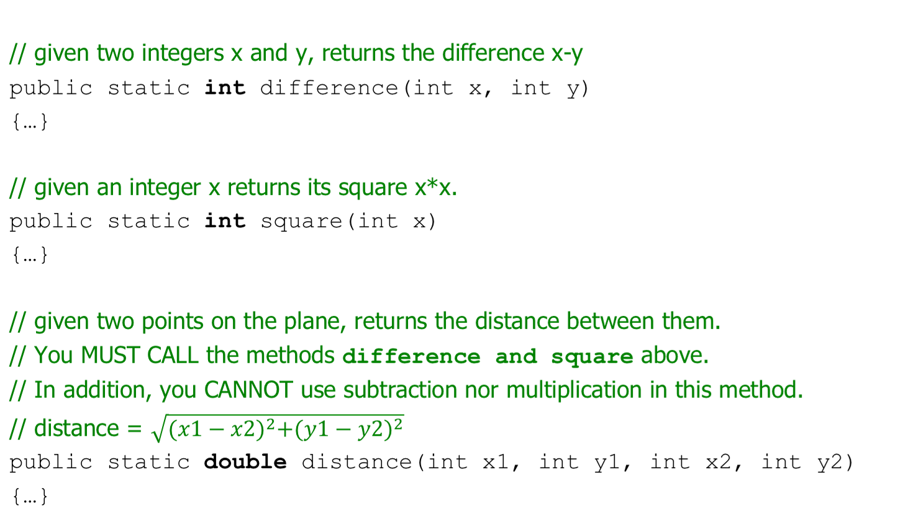
Lab

Slide 32
Lab
Write your program so that it has EXACTLY THE FOLLOWING OUTPUT.
Program Output: (underlined values are user-entered inputs)
Enter x1: 2
Enter y1: -1
Enter x2: 3
Enter y2: 5
The average of 2 and -1 is 0.5.
The slope of the line between (2,-1) and (3,5) is 6.0
The distance between (2,-1) and (3,5) is 6.082762530298219

Slide 33
References
For more tutorials/lecture notes in Java, Python, game programming, artificial intelligence with neural networks:
https://longbaonguyen.github.io
Building Java Programs: A Back to Basics Approach by Stuart Reges and Marty Stepp
2) Runestone CSAwesome Curriculum: https://runestone.academy/runestone/books/published/csawesome/index.html

