Slide 1
Unit 2: Selection and Iteration Boolean Expressions and if statements
Adapted from:
1) Building Java Programs: A Back to Basics Approach
by Stuart Reges and Marty Stepp
2) Runestone CSAwesome Curriculum
https://longbaonguyen.github.io

Slide 2
Type boolean
boolean: A logical type whose values are true and false.
It is legal to:
create a boolean variable
pass a boolean value as a parameter
return a boolean value from methods
call a method that returns a boolean and use it as a test
int age = 22;
boolean minor = age < 21; // false
boolean lovesAPCS = true;
boolean is1049Prime = isPrime(1049);

Slide 3
Relational expressions
Tests use relational operators:
Operator | Meaning | Example | Value
== | equals | 1 + 1 == 2 | true
!= | does not equal | 3.2 != 2.5 | true
< | less than | 10 < 5 | false
> | greater than | 10 > 5 | true
<= | less than or equal to | 126 <= 100 | false
>= | greater than or equal to | 5.0 >= 5.0 | true
Notes:
<number>
Note that == tests equality, not = . The = is used for the assignment operator!

Slide 4
Relational Expressions
public class Boolean_Class{
public static void main(String[] args){
int x = 2, y = 3;
System.out.println(x == y); // false
System.out.println(x != y); // true
System.out.println(2 + 4 * 3 <= 15); // true
System.out.println(x > 5); // false
System.out.println(y >= 3); // true
}
}

Slide 5
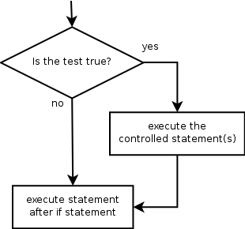
The if statement
Executes a block of statements only if a test is true
if (test) {
statement;
...
statement;
}
statement;
Notes:
<number>

Slide 6
The if statement
double gpa = 2.1;
if (gpa >= 2.0) {
System.out.println("Application accepted.");
}
Output:
Application accepted.
double gpa = 1.9;
if (gpa >= 2.0) {
System.out.println("Application accepted.");
}
Output: (No output)
Notes:
<number>

Slide 7
The if/if/if statement
executes any block whose condition is true (independent tests; not exclusive)
if (test) {
statement(s);
}
if (test) {
statement(s);
}
if (test) {
statement(s);
}
Any, all or none of the above can execute.
Notes:
<number>

Slide 8
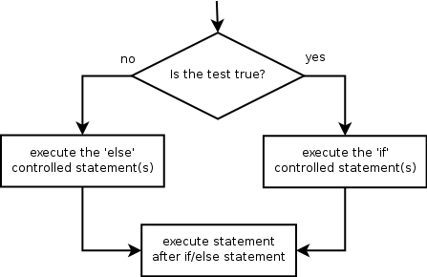
The if/else statement
Executes one block if a test is true, another if false
if (test) {
statement(s);
} else {
statement(s);
}
Notes:
<number>

Slide 9
The if/else statement
double gpa = 3.0;
if (gpa >= 2.0){
System.out.println("Welcome to Mars University!");
} else{
System.out.println("Application denied.");
}
Output:
Welcome to Mars University.
Notes:
<number>

Slide 10
The if/else statement
double gpa = 1.0;
if (gpa >= 2.0){
System.out.println("Welcome to Mars University!");
} else{
System.out.println("Application denied.");
}
Output:
Application denied.
Notes:
<number>

Slide 11
Misuse of if
What's wrong with the following code?
int percent = <Code to ask user to enter a percentage>
if (percent >= 90) {
System.out.println("You got an A!");
}
if (percent >= 80) {
System.out.println("You got a B!");
}
if (percent >= 70) {
System.out.println("You got a C!");
}
if (percent >= 60) {
System.out.println("You got a D!");
}
if (percent < 60) {
System.out.println("You got an F!");
}
...

Slide 12
Misuse of if
What's wrong with the following code?
int percent = 90;
if (percent >= 90) {
System.out.println("You got an A!");
}
if (percent >= 80) {
System.out.println("You got a B!");
}
if (percent >= 70) {
System.out.println("You got a C!");
}
if (percent >= 60) {
System.out.println("You got a D!");
}
if (percent < 60) {
System.out.println("You got an F!");
}
...
Output:
You got an A!
You got a B!
You got a C!
You got a D!

Slide 13
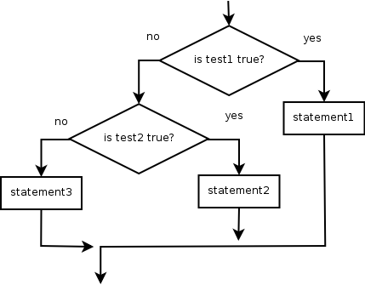
Nested if/else
Chooses between outcomes using many tests
if (test) {
statement(s);
}
else if (test){ {
statement(s);
}
else {
statement(s);
}
Exactly one of the above can execute.
Notes:
<number>

Slide 14
Nested if/else
int x = 10;
if (x > 0) {
System.out.println("Positive");
}
else if (x < 0) {
System.out.println("Negative");
}
else {
System.out.println("Zero");
}
Output:
Positive
Notes:
<number>

Slide 15
Nested if/else
int x = 0;
if (x > 0) {
System.out.println("Positive");
}
else if (x < 0) {
System.out.println("Negative");
}
else {
System.out.println("Zero");
}
Output:
Zero
Notes:
<number>

Slide 16
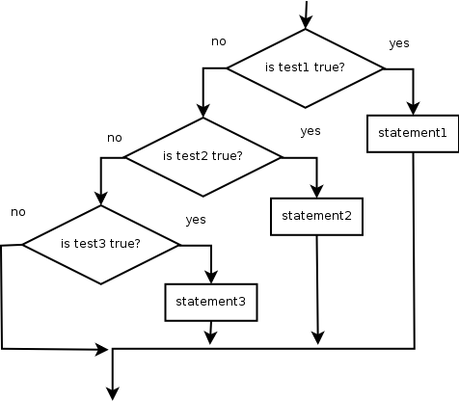
Nested if/else/if
If it ends with else, exactly one path must be taken.
If it ends with else if, the code might not execute any path.
if (test) {
statement(s);
}
else if (test) {
statement(s);
}
else if (test) {
statement(s);
}
One or none of the above can execute.

Slide 17
Nested if/else/if
int place = 2;
if (place == 1) {
System.out.println("Gold medal!");
}
else if (place == 2) {
System.out.println("Silver medal!");
}
else if (place == 3) {
System.out.println("Bronze medal.");
}
Output:
Silver medal!

Slide 18
Nested if/else/if
int place = 6;
if (place == 1) {
System.out.println("Gold medal!");
}
else if (place == 2) {
System.out.println("Silver medal!");
}
else if (place == 3) {
System.out.println("Bronze medal.");
}
Output:
No output.

Slide 19
Nested if structures
exactly 1 path (mutually exclusive) if (test) { statement(s); } else if (test) { statement(s); } else { statement(s); } | 0 or 1 path (mutually exclusive) if (test) { statement(s); } else if (test) { statement(s); } else if (test) { statement(s); }
0, 1, or many paths (independent tests; not exclusive) if (test) { statement(s); } if (test) { statement(s); } if (test) { statement(s); }
Most common
use case
Notes:
<number>

Slide 20
Which nested if/else?
(1) if/if/if (2) nested if/else (3) nested if/else if
Whether a user is lower, middle, or upper-class based on income.
(2) nested if / else if / else
Whether you made the dean's list (GPA ≥ 3.8) or honor roll (3.5-3.8).
(3) nested if / else if
Whether a number is divisible by 2, 3, and/or 5.
(1) sequential if / if / if
Computing a grade of A, B, C, D, or F based on a percentage.
(2) nested if / else if / else if / else if / else

Slide 21
"Boolean Zen", part 1
Students new to boolean often test if a result is true:
Suppose isPrime(n) returns whether n is prime(a boolean).
if (isPrime(57) == true) { // bad
...
}
But this is unnecessary and redundant. Preferred:
if (isPrime(57)) { // good
...
}

Slide 22
"Boolean Zen", part 1
A similar pattern can be used for a false test:
if (isPrime(57) == false) { // bad
…
}
if (!isPrime(57)) { // good
…
}
Note: ! is the "not" operator, which flips the
boolean value from true to false and false to
true.

Slide 23
"Boolean Zen", part 2
Methods that return boolean often have an if/else that returns true or false:
public static boolean odd(int n) {
if (n % 2 != 0) {
return true;
} else {
return false;
}
}
But the code above is unnecessarily verbose.

Slide 24
"Boolean Zen", part 3
We could store the result of the logical test.
public static boolean both(int n) {
boolean test = n % 2 != 0;
if (test) { // test == true
return true;
} else { // test == false
return false;
}
}
Notice: Whatever test is, we want to return that.
If test is true , we want to return true.
If test is false, we want to return false.

Slide 25
Final "Boolean Zen"
Observation: The if/else is unnecessary.
The variable test stores a boolean value; its value is exactly what you want to return. So return that!
public static boolean odd(int n) {
boolean test = n % 2 != 0;
return test;
}
An even shorter version:
We don't even need the variable test. We can just perform the test and return its result in one step.
public static boolean odd(int n) {
return n % 2 != 0;
}

Slide 26
"Boolean Zen" template
Replace
public static boolean name(parameters) {
if (test) {
return true;
} else {
return false;
}
}
with
public static boolean name(parameters) {
return test;
}

Slide 27
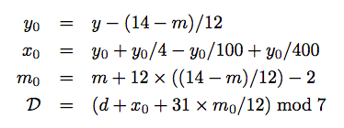
Lab 1: Day Of the Week
Create a new repl on replit. Write a program that outputs the day of
the week for a given date! You program has just the main method and
the dayOfWeek method below.
Given the month, m, day, d and year y, the day of the week(Sunday =
0, Monday = 1, …, Saturday = 6) D is given by:
Note: the division above is integer division. mod is the % operator.
Your program needs one method:
public static String dayOfWeek(int m, int d, int y){
// fill in code
}
Notes:
<number>
// This program computes two people's body mass index (BMI) and
// compares them. The code uses parameters, returns, and Scanner.
import java.util.*; // so that I can use Scanner
public class BMI {
public static void main(String[] args) {
System.out.println("This program reads in data for two people and");
System.out.println("computes their body mass index (BMI)");
System.out.println();
// finish me!
}
}

Slide 28
Lab 1: Day Of the Week
Write the main method so that the output is similar
to the following: (Use scanner)
Output:
Enter month: 10
Enter day: 15
Enter year: 2019
Day of the week: Tuesday
Use conditionals! And try entering your birthday and test your parents!
Notes:
<number>
// This program computes two people's body mass index (BMI) and
// compares them. The code uses parameters, returns, and Scanner.
import java.util.*; // so that I can use Scanner
public class BMI {
public static void main(String[] args) {
System.out.println("This program reads in data for two people and");
System.out.println("computes their body mass index (BMI)");
System.out.println();
// finish me!
}
}

Slide 29
References
For more tutorials/lecture notes in Java, Python, game programming, artificial intelligence with neural networks:
https://longbaonguyen.github.io
Building Java Programs: A Back to Basics Approach by Stuart Reges and Marty Stepp
2) Runestone CSAwesome Curriculum: https://runestone.academy/runestone/books/published/csawesome/index.html

