Slide 1
Introduction to Python
An Introduction to Numpy

Slide 2
Topics
Numpy

Slide 3
Numpy
Python is currently one of most popular languages for data science and machine learning.
In the next set of lectures, we will focus on working with and analyzing data.
Python has many optimized libraries for working with data. We will cover two powerful libraries for scientific computing and data processing: Numpy and pandas.
Notes:
Crash Course: Cybersecurity

Slide 4
Numpy
Numpy is a Python library that provides a high-performing multidimensional array object(matrices) and mathematical operations to work with these arrays.
import numpy as np
a = np.array([1,2,3,4])
b = np.array([[1,2,3,4], [5,6,7,8]])
print(a.shape) # (4,)
print(b.shape) # (2, 4)
print(b.dtype) # int64
Numpy arrays can only store data of a
single type and are super fast.
Python lists can hold objects of different types and are very slow.
Notes:
Crash Course: Cybersecurity

Slide 5
Numpy
import numpy as np
a = np.array([[1,2,3,4],
[5,6,7,8],
[9,10,11,12]])
print(a[0, 0]) # 1
print(a[1, 3] # 8
print(a[:, 1:3])
[[ 2, 3],
[ 6, 7],
[10, 11]]
Note the use of commas, if it was a 2D Python list:
print(a[0][0])
Numpy uses commas(tuples) for indexing.
# all rows, columns 1 and 2.
Similar to Python lists, slicing works with Numpy arrays!
Notes:
Crash Course: Cybersecurity

Slide 6
arange(integer ranges)
import numpy as np
In[5]: np.arange(5)
Out[5]: array([0, 1, 2, 3, 4])
In[5]: np.arange(5, 10)
Out[5]: array([5, 6, 7, 8, 9])
In[5]: np.arange(5)
Out[5]: array([0, 1, 2, 3, 4])
In[5]: np.arange(7, 1, -2)
Out[5]: array([7, 5, 3])
Notes:
Crash Course: Cybersecurity

Slide 7
linspace(floating-point ranges) and reshape
import numpy as np
In[5]: np.linspace(0.0, 1.0, num=5)
Out[5]: array([0. , 0.25, 0.5 , 0.75, 1. ])
In[5]: np.arange(6).reshape(2, 3)
Out[6]:
array([[0, 1, 2],
[3, 4, 5]])
Notes:
Crash Course: Cybersecurity

Slide 8
zeros and ones
import numpy as np
In[5]: np.zeros((3, 2))
Out[7]:
array([[0., 0.],
[0., 0.],
[0., 0.]])
In[5]: np.ones((3, 2), dtype=int64)
Out[7]:
array([[0, 0],
[0, 0],
[0, 0]])
Notes:
Crash Course: Cybersecurity

Slide 9
Numpy Operators
import numpy as np
In[1]: numbers = np.arange(6).reshape(2, 3)
In[2]: numbers
Out[2]:
array([[0, 1, 2],
[3, 4, 5]])
In[3]: numbers * 2
Out[3]:
array([[0, 2, 4],
[6, 8, 10]])
Note that numbers is unchanged!
In[4]: numbers
Out[4]:
array([[0, 1, 2],
[3, 4, 5]])
Notes:
Crash Course: Cybersecurity

Slide 10
Numpy Operators
import numpy as np
In[5]: numbers ** 3
Out[5]:
array([[ 0, 1, 8],
[ 27, 64, 125]])
In[5]: numbers += 5
In[6]: numbers
Out[6]:
array([[ 5, 6, 7],
[ 8, 9, 10]])
Note that numbers is changed!
Notes:
Crash Course: Cybersecurity

Slide 11
Numpy Operators
import numpy as np
In[5]: a = np.array([[1,2,3,4],
[5,6,7,8]])
In[6]: b = np.array([[10,11,12,13],
[14,15,16,18]])
In[6]: a + b
Out[6]:
array([[11, 13, 15, 17],
[19, 21, 23, 26]])
Notes:
Crash Course: Cybersecurity

Slide 12
Comparing Arrays
import numpy as np
In[5]: a = np.array([[1,2,3,4],
[5,6,7,8]])
In[6]: a >= 4
Out[6]:
array([[False, False, False, True],
[ True, True, True, True]])
Notes:
Crash Course: Cybersecurity

Slide 13
Comparing Arrays
import numpy as np
In[5]: a = np.array([[1,2,3,4],
[5,6,7,8]])
In[6]: b = np.array([[0,0,0,0],
[14,15,16,18]])
In[6]: a < b
Out[6]:
array([[False, False, False, False],
[ True, True, True, True]])
Notes:
Crash Course: Cybersecurity

Slide 14
Comparing Arrays
import numpy as np
In[5]: a = np.array([[1,2,3,4],
[5,6,7,8]])
In[6]: b = np.array([[0,0,0,0],
[5,6,7,8]])
In[6]: a == b
Out[6]:
array([[False, False, False, False],
[ True, True, True, True]])
Notes:
Crash Course: Cybersecurity

Slide 15
Descriptive Statistics
import numpy as np
In[1]: grades = np.array([[87, 96, 70], [100, 87, 90],
[94, 77, 90], [100, 81, 82]])
In[2]: grades
Out[2]:
array([[ 87, 96, 70],
[100, 87, 90],
[ 94, 77, 90],
[100, 81, 82]])
In[3]: grades.sum()
Out[3]:
1054
Notes:
Crash Course: Cybersecurity

Slide 16
Basic Statistics
import numpy as np
In[4]: grades.min()
Out[4]:
70
In[5]: grades.max()
Out[5]:
100
In[6]: grades.mean()
Out[6]:
87.83333333333333
In[7]: grades.std()
Out[7]:
8.792357792739987
Notes:
Crash Course: Cybersecurity

Slide 17
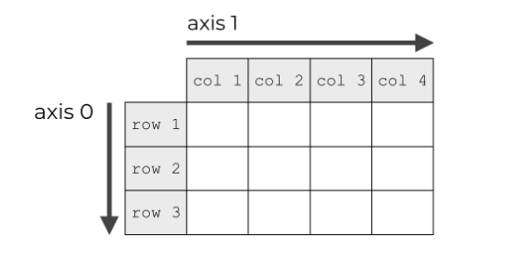
Calculations by Rows/Columns
Numpy arrays have axes.
In a 2-dimensional NumPy array, the axes are the directions along the rows and columns.
In a NumPy array, axis 0 is the “first” axis. Axis 0 is the axis that runs downward down the rows. Axis 1 is the "second" axis that runs horizontally across the columns.
Notes:
Crash Course: Cybersecurity

Slide 18
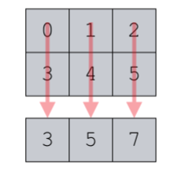
Calculations by Rows/Columns
Remember, functions like sum(), mean(), min(), and other statistical functions aggregate your data.
The axis parameter controls which axis will be collapsed.
import numpy as np
In[1]: a = np.array([[0, 1, 2],
[3, 4, 5]])
In[2]: a.sum(axis=0)
Out[21]: array([3, 5, 7])
When we set axis = 0, we’re aggregating the data
such that we collapse the rows … we collapse axis 0.
Notes:
Crash Course: Cybersecurity

Slide 19
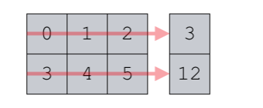
Calculations by Rows/Columns
import numpy as np
In[1]: a = np.array([[0, 1, 2],
[3, 4, 5]])
In[2]: a.sum(axis=1)
Out[2]: array([3, 12])
When we set axis = 1, we’re aggregating
the data such that we collapse the columns …
we collapse axis 1.
Notes:
Crash Course: Cybersecurity

Slide 20
An Application
import numpy as np
In[1]: grades = np.array([[87, 96, 70],
[100, 87, 90],
[94, 77, 90],
[100, 81, 82]])
In[3]: grades.mean(axis=0)
Out[2]:
array([95.25, 85.25, 83. ])
In[3]: grades.mean(axis=1)
Out[2]:
array([84.33333333, 92.33333333, 87., 87.66666667])
Test 1
Test 2
Test 3
Suppose we have
four students, each took three
tests. Their scores are stored
in the grades array.
What does this compute?
The average of each test.
What does this compute? The average of
each student across all three tests.
Notes:
Crash Course: Cybersecurity

Slide 21
References
Paul Deitel, Harvey Deitel. Intro to Python for Computer Science and Data Science, Pearson.

