Slide 1
Introduction to Python
Basic Syntax
Operations and Variables

Slide 2
Topics
Operations
Arithmetic
Comparison
Boolean
Variables
Assignments and Augmented Assignments
User input

Slide 3
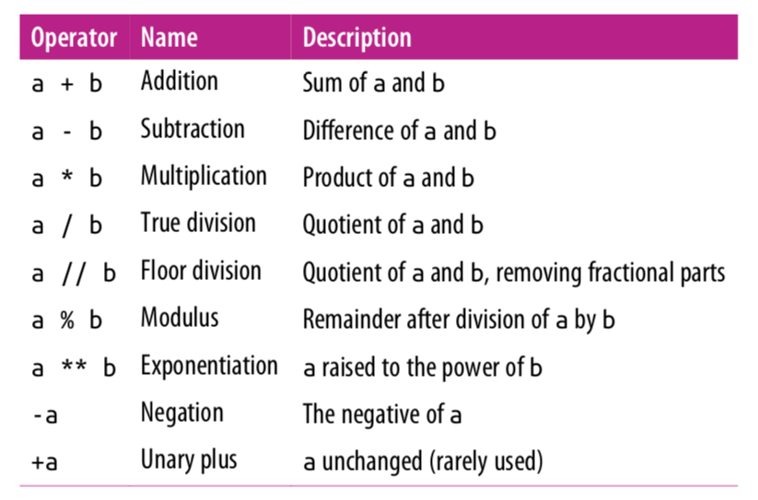
Arithmetic Operations

Slide 4
Mixing Types
Any expression that two floats produce a float.
In[1]: 17.0 – 10.0
Out [1]: 7.0
When an expression’s operands are an int and a float, Python automatically converts the int to a float.
In[2]: 17.0 – 10
Out [1]: 7.0
In[3]: 17 – 10.0
Out [1]: 7.0

Slide 5
True Division vs Floor Division
The operator / is true division and the operator // returns floor division(round down after true divide).
In[1]: 23 // 7
Out [1]: 3
In[2]: 3 // 9
Out [2]: 0
In[2]: -4 // 3
Out [2]: -2
In[3]: 6 / 5
Out [3]: 1.2

Slide 6
Modulo Operator
The operator % returns the modulus which is the remainder after floor division.
In[1]: 18 % 5
Out [1]: 3
In[2]: 3 % 9
Out [2]: 3
In[2]: 125 % 10
Out [2]: 5
In[3]: -17 % 10
Out [3]: 3
In[3]: 17 % -10
Out [3]: -3
Note: This is different than Java, which gives the remainder after integer division. But the two are the same for positive operands.

Slide 7
Why floor/modulo division is useful
Floor division allows us to extract the integer part of the division while the modulo operator extracts the remainder part of the division. Consider the question:
How many weeks and days are there in 25 days?
Answer: 3 weeks plus 4 days.
In[1]: 25 // 7 # extracting number of weeks
Out [1]: 3
In[1]: 25 % 7 # extracting number of days
Out [1]: 4

Slide 8
Why the modulo operator is useful
If today is a Tuesday, which day is 43 days from today?
Answer: 43 divided by 7 is 6 with a remainder of 1. Thus it will be Wednesday.
In[1]: 43 % 7
Out [1]: 1
Even/odd: A number x is even if x % 2 == 0 and odd if
x % 2 !=0

Slide 9
Exponentiation and Negation
In[1]: 2 ** 3
Out[3]: 8
Negation is a unary operator. It applies to only one operand. Other operations such as +, -, *, /, //, % are binary operators, they apply to two operands.
In[2]: -5
Out [3]: -5
In[3]: --5
Out[3]: 5

Slide 10
Operator Precedence
Precedence | Operator | Operation
highest | ** | exponentiation
 | - | negation
 | *, /, //, % | multiplication, division, floor division, modulus
lowest | +, - | adding, subtraction
Operators on the same row are applied left to right. Exponentiation, however, is
applied right to left. Expressions in parenthesis are evaluated first(PEMDAS).

Slide 11
Operator Precedence
In[1]: -2 ** 4
Out[3]: -16
In[2]: 7 – 4 * 5 % (1 + 2)
Out [3]: 5
7 - 4 * 5 % (1 + 2)
7 – 4 * 5 % 3
7 – 20 % 3
7 – 2
5

Slide 12
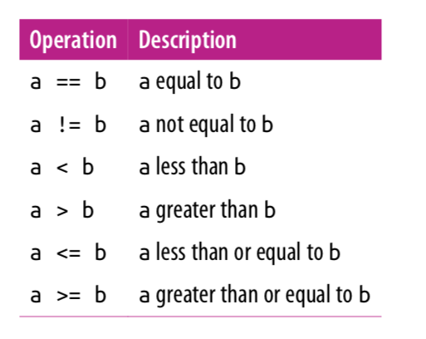
Comparison Operators
Note that = is for assignment and
== is for equals.
These operators return either True or
False.

Slide 13
Comparison Operators
In[1]: 10 == 5
Out[1]: False
In[2]: 3 <= 7
Out[2]: True
In[3]: 3 != 7
Out[3]: True

Slide 14
Boolean Operations
Python provides operators to combine the values using the standard concepts of “and”, “or”, and “not”.
These operators are expressed using the words and, or, and not:
Or above is "inclusive or".
X | Y | X or Y
True | True | True
True | False | True
False | True | True
False | False | False
X | Y | X and Y
True | True | True
True | False | False
False | True | False
False | False | False
X | not X
True | False
False | True

Slide 15
Boolean Operations
In[1]: x = 4
(x < 6) and (x > 2)
Out[1]: True
In[2]: (x > 10) or (x % 2 == 0)
Out[2]: True
In[3]: not (x < 6) Out[3]: False

Slide 16
Operator Precedence
Precedence | Operator | Operation
highest | ** | exponentiation
 | - | negation
 | *, /, //, % | multiplication, division, floor division, modulus
 | +, - | adding, subtraction
 | ==,!=,<,>,<=,>= | comparisons
 | not | logical not
 | and | logical and
 | or | logical or
lowest | = | assignment

Slide 17
Boolean Operations
Math operators have the highest precedence. Then comparison operators are followed by logical operators. The assignment operator is evaluated last.
In[1]: result = 3 + 2 * 4 < 14 or 3 == 5
result
Out[1]: True

Slide 18
Variables
We can use variables to refer to values that can be used later.
You can create a new variable by given it a value.
In[1]: x = 4
x
Out[1]: 4
Variable names can use letters, digits, and the underscore symbol (but they can’t start with a digit).

Slide 19
= is not equality
Unlike in math, = is not equality in Python. It is an assignment: assign the expression on the right side of = to the variable on the left.
In[1]: x = 4
x = x + 1 # in math, this has no solutions!
x
Out[1]: 5
Assignment is not symmetric.
In[1]: x = 4 # correct!
10 = y # error!

Slide 20
Augmented Assignment
An augmented assignment combines an assignment statement with an operator to make the statement more concise.
Shorthand Equivalent version
variable += value; variable = variable + value;
variable -= value; variable = variable - value;
variable *= value; variable = variable * value;
variable /= value; variable = variable / value;
variable %= value; variable = variable % value;
In[1]: x = 4
x += 1 # equivalent to x = x + 1
x
Out[1]: 5

Slide 21
Augmented Assignment
In[1]: x = 3
x *= 2 + 5
x
Out[1]: 21
In[1]: number = 5
number *= number
number
Out[1]: 25

Slide 22
Input
Programs may use the input function to obtain information from the user.
print('Please enter some text:')
x = input()
print('Text entered:', x)
print('Type:', type(x))
Please enter some text:
hello
Text entered: hello
Type: <class 'str'>

Slide 23
Input
Since user input almost always requires a message to the user about the expected input, the input function optionally accepts a string that it prints just before the program stops to wait for the user to respond.
x = input('Please enter an integer value: ')
y = input('Please enter another integer value: ')
num1 = int(x)
num2 = int(y)
print(num1, '+', num2, '=', num1 + num2)
Please enter an integer value: 4
Please enter another integer value: 5
4 + 5 = 9

Slide 24
Input
Or even more succinctly.
num1 = int(input(‘Please enter an integer value: ’))
num2 = int(input('Please enter another integer value: ‘))
print(num1, '+', num2, '=', num1 + num2)
Please enter an integer value: 4
Please enter another integer value: 5
4 + 5 = 9

Slide 25
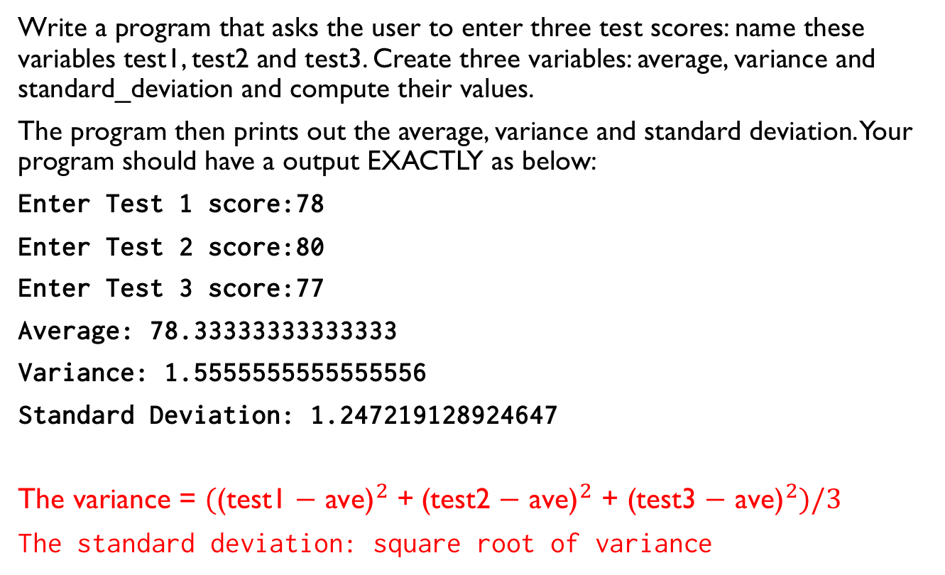
Lab
Write a program that asks the user to enter three test scores: name these variables test1, test2 and test3. Create three variables: average, variance and standard_deviation and compute their values.
The program then prints out the average, variance and standard deviation. Your program should have a output EXACTLY as below:
Enter Test 1 score:78
Enter Test 2 score:80
Enter Test 3 score:77
Average: 78.33333333333333
Variance: 1.5555555555555556
Standard Deviation: 1.247219128924647
The variance = ${\text{(}\text{(}\text{test}\text{1 − }\text{ave}\text{)}}^{2}$ +${\text{(}\text{test}\text{2 − }\text{ave}\text{)}}^{2}\text{ +} {\text{(}\text{test}\text{3}\text{ − }\text{ave}\text{)}}^{2})/3$
The standard deviation: square root of variance

Slide 26
References
Vanderplas, Jake, A Whirlwind Tour of Python, O’reilly Media.
This book is completely free and can be downloaded online at O’reilly’s site.

