Slide 1

Global Impact

Slide 2
The Impact of Computing
Computing enhances communication, interaction, and cognition.
Email, texting(SMS), and video conferencing and video chat have fostered new ways to communicate and collaborate.
cloud computing: performing calculations and modeling on servers that have more resources(AWS(Amazon Web Services), Google Apps, Cloud 9).
Widespread access to information facilitates the identification of problems, development of solutions, and dissemination of results.
Public data, such as databases of temperature readings or databases of court cases, provides widespread access and enables solutions to identified problems.
Trends of what people search for in the Internet are predictors of behavior.
Social media, including blogs and twitter, have enabled dissemination.
Notes:
Crash Course: Cybersecurity

Slide 3
The Impact of Computing
Global Positioning System (GPS) and related technologies have changed how humans travel, navigate, and find information related to geo-location.
Sensor networks facilitate new ways of interacting with the environment and with physical systems.
Smart grids(electricity):an electricity supply network that uses digital communications technology to detect and react to local changes in usage.(Google Dictionary)
smart buildings, and smart transportation are changing and facilitating human capability.
Notes:
https://www.smartgrid.gov/the_smart_grid/smart_grid.html

Slide 4
Contributions
Computing contributes to many assistive technologies that enhance human capabilities.
for example, artificial legs controlled by microprocessors and automated reading applications for the blind.
The Internet and the Web have enhanced methods of and opportunities for communication and collaboration.
e-commerce(online shopping e.g., Amazon), health care, access to information and entertainment, and online learning.
impacted productivity, positively through things like communication and access to data, and negatively through things like distractions to workers and setbacks due to cyber crime.
The move from desktop computers to a proliferation of always-on mobile computers is leading to new applications, such as instagram, airline boarding passes on phones, blue tooth vending and other mobile apps.
Notes:
https://www.smartgrid.gov/the_smart_grid/smart_grid.html

Slide 5
Contributions
An algorithm, design, networking protocol, program, or other system is said to scale (or be scalable) if it is suitably efficient and practical when applied to large situations.(Wiki)
e.g. a large input data set, a large number of outputs or users, or a large number of participating nodes in the case of a distributed system.(Wiki)
Science has been impacted by using scale and “citizen science” to solve scientific problems using home computers in scientific research
citizen science is scientific research conducted, in whole or in part, by amateur (or nonprofessional) scientists, e.g. folding@home(protein folding) and Galaxy Zoo(classify galaxies).
human computation, such as Games with a Purpose,(for example ESP Game) harnesses contributions from many humans to solve problems related to digital data and the Web
Human capabilities are enhanced by digitally enabled collaboration.
Some online services use the contributions of many people to benefit both individuals and society. (e.g. crowdsourcing such as reCAPTCHA and ESP Game offers new models for collaboration.)
Notes:
https://www.smartgrid.gov/the_smart_grid/smart_grid.html

Slide 6
Contributions
Crowdsourcing is a sourcing model in which individuals or organizations obtain goods and services, including ideas and finances, from a large, relatively open and often rapidly-evolving group of internet users.(Wiki)
it divides work between participants to achieve a cumulative result.
E.g. “idea competitions” and “innovation contests”. (Netflix Prize, Lego Ideas)
Tedious "microtasks" performed in parallel by large, paid crowds (e.g. Amazon Mechanical Turk, Bitcoin miners) are another form of crowdsourcing.
A CAPTCHA(Completely Automated Public Turing test to tell Computers and Humans Apart) is a type of challenge-response test used in computing to determine whether or not the user is human.
reCAPTCHA is a CAPTCHA-like system designed to assist in the digitization of books.
reCAPTCHA has completed digitizing the archives of The New York Times and books from Google Books, as of 2011 and digitized books that are too illegible to be scanned by computers in 2015.
Notes:
https://www.smartgrid.gov/the_smart_grid/smart_grid.html

Slide 7

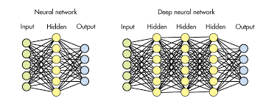

Contributions
Computing enables innovation in nearly every field.
Machine learning, data mining and scientific computing have enabled innovation in medicine, business, and science.
autonomous driving(Tesla)
speech recognition(natural language processing, Alexa, Siri, Watson)
Health(IBM Watson, Google DeepMind)
Computing enables innovation by providing access to and sharing of information.
Open Access and Creative Commons have enabled broad access to digital information. Open and curated scientific databases have benefited scientific researchers.
Open Access
Machine Learning(Neural Network)
Notes:
https://www.smartgrid.gov/the_smart_grid/smart_grid.html

Slide 8
Global Effects
Computing has global effects – both beneficial and harmful – on people and society.
Innovations enabled by computing raise legal and ethical concerns.
Downloading movies/music, streaming movies, access to digital content through peer-to-peer networks(for example, BitTorrent)
Digital access to digital books(PDF, EPUB)
Commercial and governmental censorship of digital information
Open source and licensing of software and content.
Is human knowledge advanced by full and free access to all information, allowing engineers and developers to correct and improve on already existing systems?
Or does a lack of strong protection for Intellectual Property(IP) discourage innovation by removing the financial incentive for developing it?
What is the balance of these potential benefits over these potential harms?
See: https://www.scu.edu/ethics/focus-areas/internet-ethics/resources/unavoidable-ethical-questions-about-open-source/
Notes:
https://www.smartgrid.gov/the_smart_grid/smart_grid.html

Slide 9
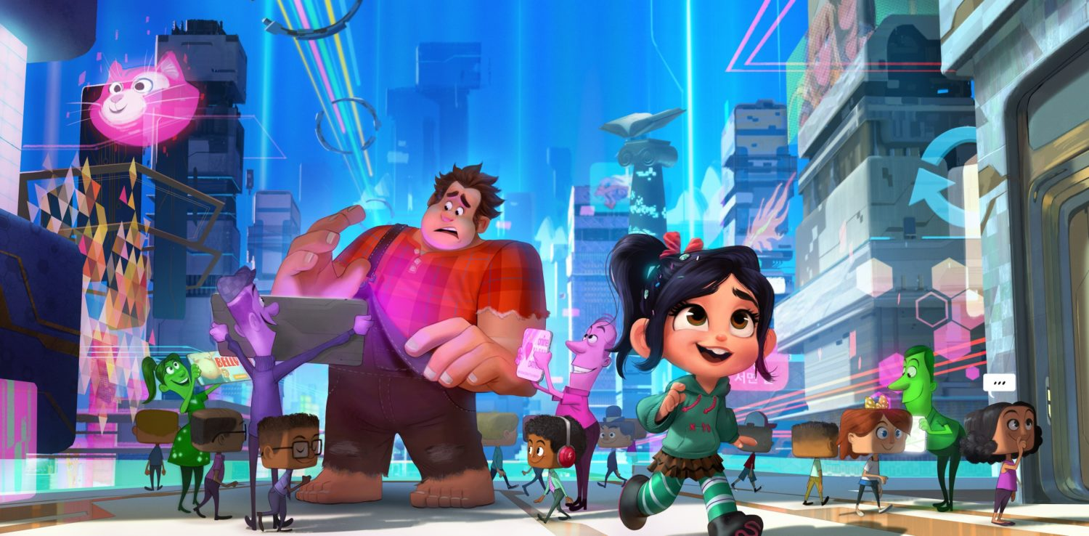
Privacy
Privacy and security concerns arise in the development and use of computational systems and artifacts.
privacy: Privacy relates to any rights you have to control your personal information and how it’s used. A bank selling your info to marketers without your consent is a breach in privacy.
security: Security, on the other hand, refers to how your personal information is protected. Cybercriminals breaking into the bank's servers and stealing your information is a breach in security.
Aggregation of information including geo-location, cookies, and browsing history raises privacy and security concerns.
cookies can track browsing habits and used for ads.
Targeted advertising is used to help individuals
but it can be misused at both individual and
aggregate levels.
Notes:
https://www.smartgrid.gov/the_smart_grid/smart_grid.html

Slide 10
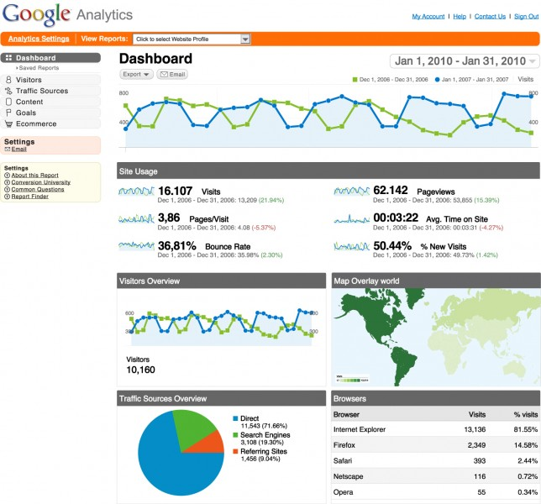
Privacy
There are also analytics
services that make it easy for
website owners to track even
more information about their
visitors.
Google, for example,
offers a free service called
Google Analytics, which is
shown below.
Track what pages visited
how found site, time spent
on sites.
Notes:
https://www.smartgrid.gov/the_smart_grid/smart_grid.html

Slide 11
Proxy Server
Anonymity in online interactions can be enabled through the use of online anonymity software and proxy servers.
The idea behind proxy servers is similar to that behind NAT(Network Address Translation) and private IP addresses.
Remember, when you make a request from a private IP address, the server is tricked into thinking that the request actually came from another device, which is the router.
With a proxy server, you can essentially do the same thing: after connecting to a proxy, it can make requests to other web pages on your behalf and then forward you the responses.
That way, only the proxy knows what your IP address actually is, and the websites you're browsing only see the IP address of the proxy.
Notes:
https://www.smartgrid.gov/the_smart_grid/smart_grid.html

Slide 12
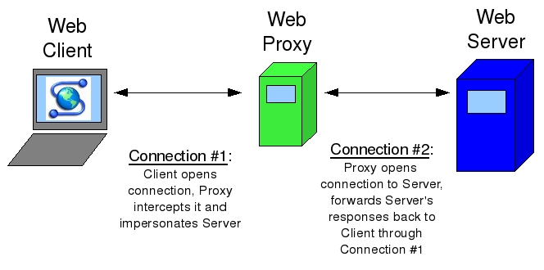
Proxy Server
A few free web proxies:
Proxify
Hide my ass(www.hidemyass.com) (I am serious.)
Proxies are nice, but they can potentially slow down your web browsing a bit, since just like any other web server, if lots of people are using the same proxy, it might have trouble keeping up.
Furthermore, proxies might not support HTTPS connections, so be careful what information you entrust to the owner of the service!
Notes:
https://www.smartgrid.gov/the_smart_grid/smart_grid.html

Slide 13
TrueCrypt
Taking advantage of the cryptography we saw in the last section is another easy way to protect your privacy.
For example, there are lots of different programs that will encrypt your entire hard drive, so all of your information is safe from harm if your computer is lost or stolen.
TrueCrypt is one such piece of software for Windows, Mac, and Linux, and Mac OS X actually has full disk encryption built right into the operating system via a program called FileVault.
TrueCrypt, for example, allows you to create a special file that acts as a container for the files you want to protect; only with a password of your choosing can anyone open up the container to access the files stored inside.
This container, though, looks just like any other file on your computer, so it might not be immediately obvious to an attacker where your encrypted files are located in the first place!
Notes:
https://www.smartgrid.gov/the_smart_grid/smart_grid.html

Slide 14
Piracy
While you might be interested in protecting the information on your laptop, many software companies are naturally interested in protecting something else: their software.
Despite many companies' attempts to charge users money for software products, warez, or cracked versions of software, abounds on the internet.
This unauthorized use of another’s work is piracy. Many apps are protected by some kind of activation key, which is a long, hard-to-guess value that users need to supply in order to use the software.
Usually, activation keys follow the same pattern, so an app can check if an activation process is valid by following a sequence of steps. Unfortunately, if someone is able to figure out that pattern, then they'll be able to supply fake activation keys that unlock the software!
Cracking refers to this process of breaking into software.
Notes:
https://www.smartgrid.gov/the_smart_grid/smart_grid.html

Slide 15
Cyberlaw
DMCA, or the Digital Millenium Copyright Act was signed into law in 1998 Bill Clinton, is divided into two main parts: copyright and anti-circumvention.
First, copyright is a legal protection for authors of content, whether the work be literary, musical, or graphical.
the owner of a work has the exclusive rights to reproduce, make new derivatives, and distribute it.
Like any law, there are a few exceptions, including fair use, which allows you to use copyrighted works for educational purposes as well as criticism and parodies.
if a video is uploaded to Youtube without the consent of the author, the author can issue a DCMA takedown notice to ask the hosting site to remove it.(Youtube has a web form for this process)
Megaupload(HK based online company) hosted file storage was shutdown for copyright infringement.
Notes:
https://www.smartgrid.gov/the_smart_grid/smart_grid.html

Slide 16
Cyberlaw
DMCA also deals with anti-circumvention, which prohibits people from breaking into protected software systems.
circumvention: decrypting information, removing an access control layer, or otherwise breaking some digital lock placed on a copyrighted work.
An example of one of these digital locks is DRM, or Digital Rights Management.
DRM is a layer that enforces some kind of access policy on software, whether that be preventing an e-book or music from being copied or distributed to other computers.
Apple, for example, used to use a form of DRM called FairPlay that prevented music files from playing on "unauthorized" computers.
However, software applications could be downloaded to remove DRM from music files, or you could simply burn the music to a CD and then rip it back off to break the digital lock.
Under fair use, people are allowed to break copy protection on DVDs as well as jailbreak mobile devices in order to use a phone on a different carrier or install different software.
Notes:
https://www.smartgrid.gov/the_smart_grid/smart_grid.html

Slide 17
Social Contexts
The innovation and impact of social media and online access is different in different countries and in different socioeconomic groups.
Mobile, wireless, and networked computing have an impact on innovation throughout the world.
The global distribution of computing resources raises issues of equity, access, and power.
Groups and individuals are affected by the “digital divide” — differing access to computing and the Internet based on socioeconomic or geographic characteristics.
Networks and infrastructure are supported by both commercial and governmental initiatives.
Notes:
https://www.smartgrid.gov/the_smart_grid/smart_grid.html

Slide 18
Homework
Watch or Read:
a)Crowdsourcing and Crowdfunding:
https://www.youtube.com/watch?v=-38uPkyH9vI
https://www.youtube.com/watch?v=Buyub6vIG3Q
b) reCAPTCHA:
https://thehustle.co/the-genius-whos-tricking-the-world-into-doing-his-work-recaptcha (Please read!)
https://www.youtube.com/watch?v=PQ-xzwj_p_4 (described by inventor Luis von Ahn himself)
c) Citizen Science
https://www.youtube.com/watch?v=SZwJzB-yMrU

Slide 19
References
AP CollegeBoard. AP Computer Science Course Description. (2017).
2) Unversity of Rhode Island. AP Computer Science Principles. Global Impact. Retrieved from
http://computing-concepts.cs.uri.edu/index.php/Main_Page

