Slide 1
Understanding Data
Images

Slide 2
Images
We have seen examples of text encoding schemes such as ASCII, UTF-8, etc…
Images also have various encoding schemes: JPEG, PNG, GIF. These schemes have additional complexity layers including compression(lossless vs lossy) algorithms.
We will discuss images in a later lecture.

Slide 3
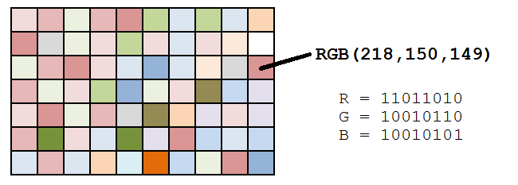
Encoding Data in Binary

Slide 4
References
1) What Every Programmer Absolutely, Positively Needs To Know About Encodings And Character Sets To Work With Text, by David Zentgraf. http://kunststube.net/encoding/
2) Part of this lecture is taken from a lecture from an OpenCourseWare course below.
Computer Science E-1 at Harvard Extension School
Understanding Computers and the Internet
by Tommy MacWilliam.

