Slide 1
The Create Task

Slide 2
Create Task
Written in Python
Processing or replit
Game, application, or mathematical simulation.

Slide 3
Programming is a collaborative and creative process that brings ideas to life through the development of software. In the Create performance task, you will design and implement a program that might solve a problem, enable innovation, explore personal interests, or express creativity. Your submission must include the elements listed in the Submission Requirements section below.
You are allowed to collaborate with your partner(s) on the development of the program only. The written response and the video that you submit for this performance task must be completed individually, without any collaboration with your partner(s) or anyone else. You can develop the code segments used in the written responses (parts 3b and 3c) with your partner(s) or on your own during the administration of the performance task.
Note: Because of all of the citation requirements, I recommend that you work on this task individually. If the program you are writing requires help from others, consider something simpler!

Slide 4
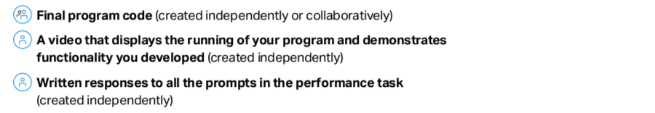
Requirements

Slide 5
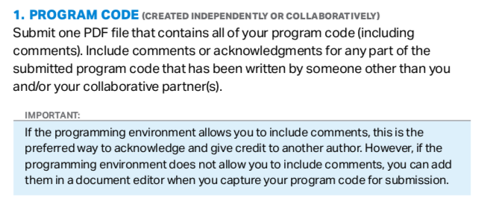

Slide 6
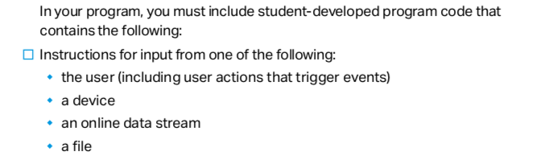
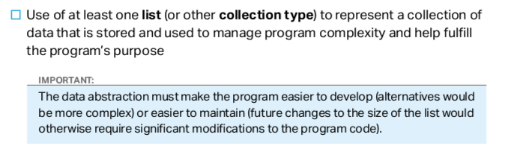

Slide 7
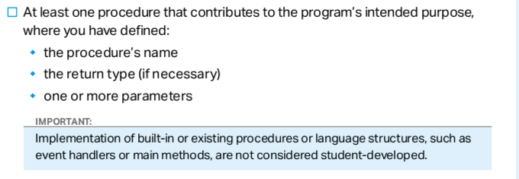


Slide 8
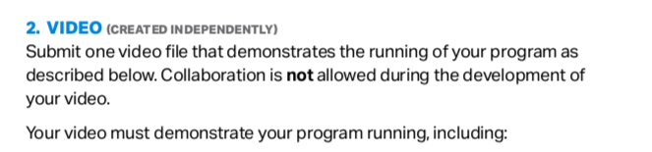
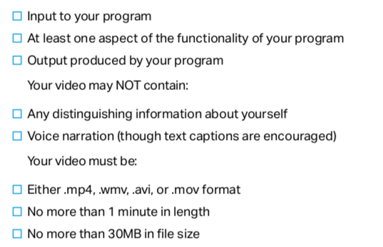

Slide 9
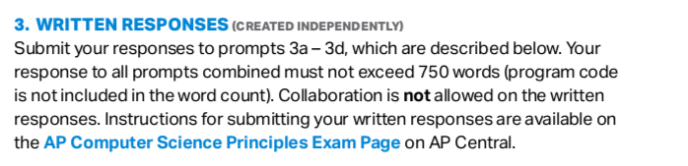

Slide 10
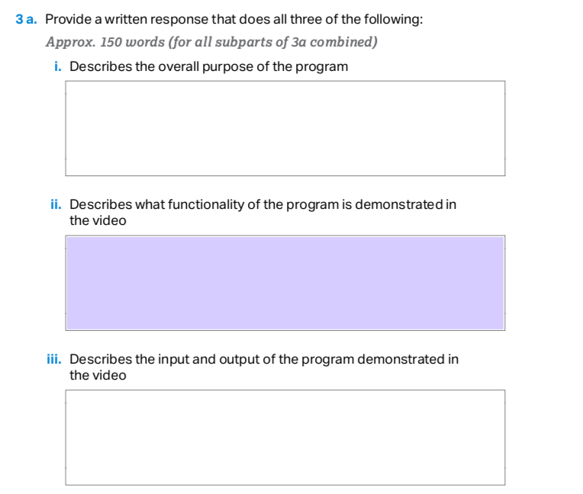

Slide 11
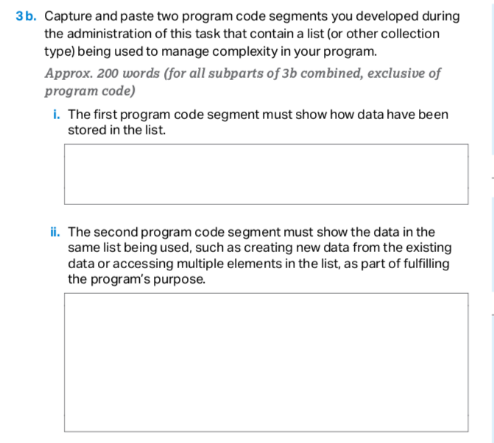

Slide 12
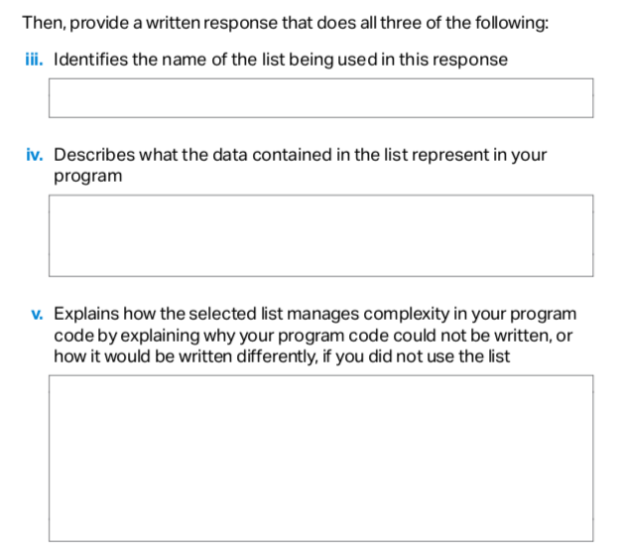
3b continued

Slide 13
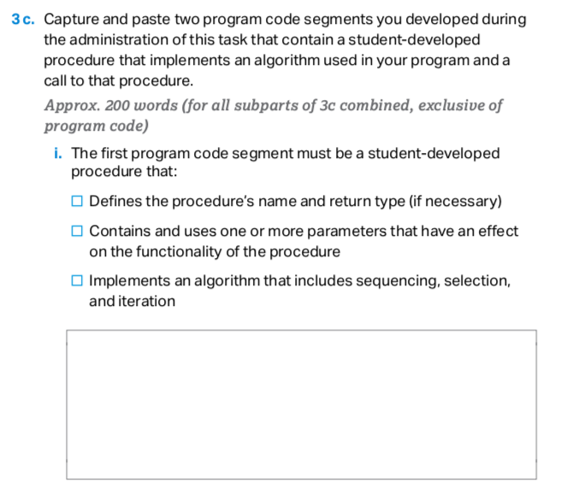

Slide 14
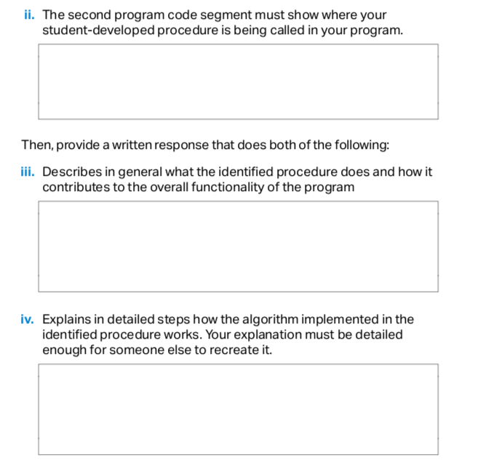
3c continued

Slide 15
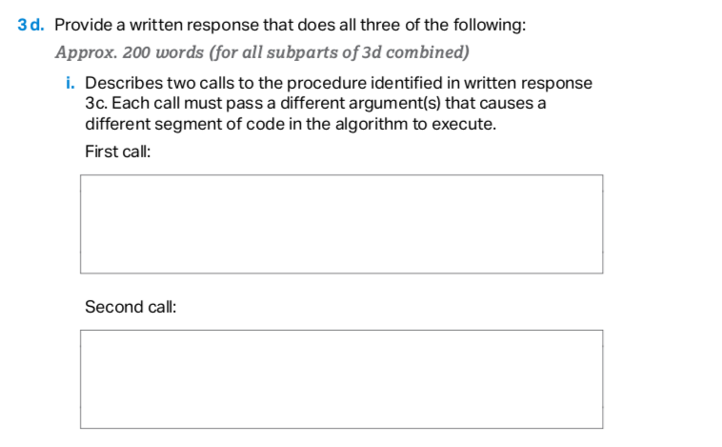

Slide 16
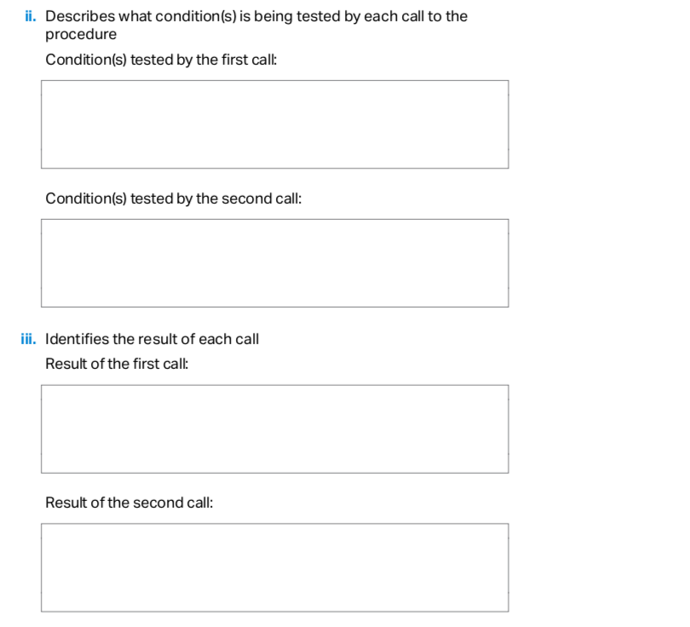

Slide 17
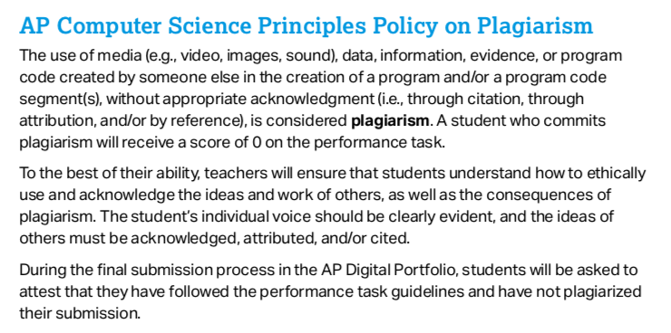

Slide 18
If there is a game that you have always wanted to write, DON'T do it for the create task!
The create task should be as minimal as possible, satisfying all of the requirements and tailored to answer the free response questions!
As we'll see from the examples this week, it can be a very simple program(see the replit example Substitution Encryption). And it's ok if it's a boring program!
It's not the program that gives you a high score; it's the free response answers! A student in the past wrote Tetris and only got a 3!

Slide 19
You can use:
1) replit: This is a highly recommended option for most students. This will limit your create task to something simple without all of the debugging errors that come with Processing.
2) Processing: I don't recommend this option.
Students end up spending too much time on getting the program to work and less time on the free response answers and often score low on the task.
Use only this option if you have done all of the labs and were able to get them to work without too much help. In fact, you'll need permission from me if you like to use Processing for your create task.

Slide 20
Create Task Example
We will walk through a full example of a Create Task. In this example, we will do a simple encryption program. Given a message plaintext, we like to encrypted into a secret message called ciphertext.
We do this by simply substituting each letter with a different letter from a secret key which is some permutation of the alphabet.
Sample key: YTNSHKVEFXRBAUQZCLWDMIPGJO
In this case, 'A' is replaced with 'Y', 'B' is replaced with 'T', etc…
This substitution is case sensitive 'a' is replaced with 'y', 'b' with 't', etc…
Any character not in the key is kept the same.

Slide 21
Create Task Example
Sample key: YTNSHKVEFXRBAUQZCLWDMIPGJO
If the plaintext is 'cat', the cipertext is 'nyd'.
If the plaintext is 'Cat', the cipertext is 'Nyd'.
If the plaintext is 'Cat123', the cipertext is 'Nyd123'.

Slide 22
Create Task Example
Some preliminaries:
ord() converts a single Unicode character to its integer code point.
In [1]: ord('A')
Out [1]: 65
In [2]: ord('a')
Out [2]: 97
In [2]: ord('😀')
Out [2]: 128512

Slide 23
Create Task Example
key = "YTNSHKVEFXRBAUQZCLWDMIPGJO"
letter = 'D'
index = ord(letter) – ord('A')
cipherletter = key[index]

