Slide 1
The Create Task

Slide 2
Create Task
Written in Python
Processing or replit
Game, application, or mathematical simulation.

Slide 3
Programming is a collaborative and creative process that brings ideas to life through the development of software. In the Create performance task, you will design and implement a program that might solve a problem, enable innovation, explore personal interests, or express creativity. Your submission must include the elements listed in the Submission Requirements section below.
You are allowed to collaborate with your partner(s) on the development of the program only. The written response and the video that you submit for this performance task must be completed individually, without any collaboration with your partner(s) or anyone else. You can develop the code segments used in the written responses (parts 3b and 3c) with your partner(s) or on your own during the administration of the performance task.
Note: Because of all of the citation requirements, I recommend that you work on this task individually. If the program you are writing requires help from others, consider something simpler!

Slide 4
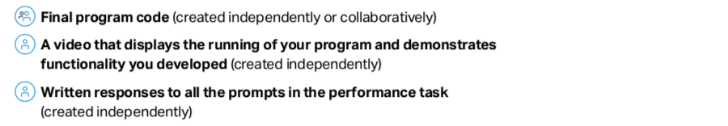
Requirements

Slide 5
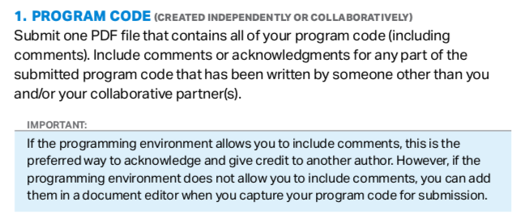

Slide 6
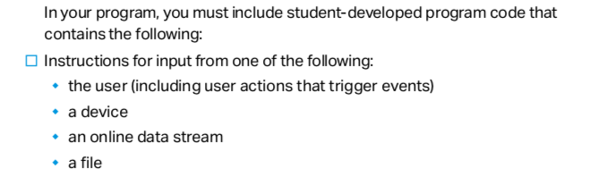
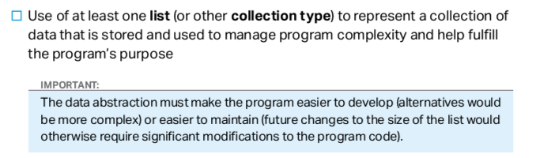

Slide 7
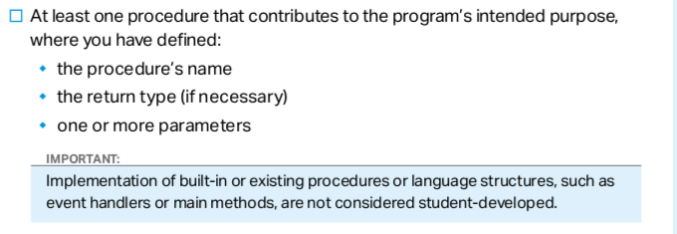


Slide 8
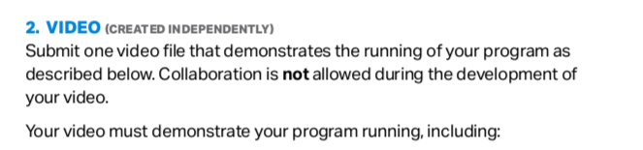
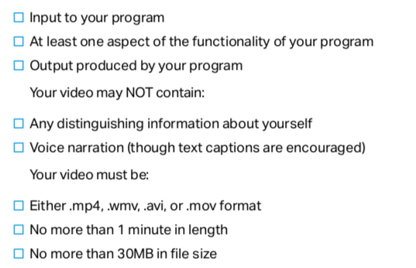

Slide 9
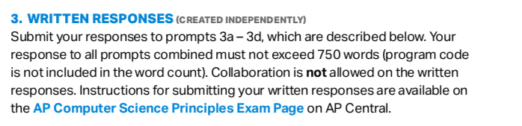

Slide 10
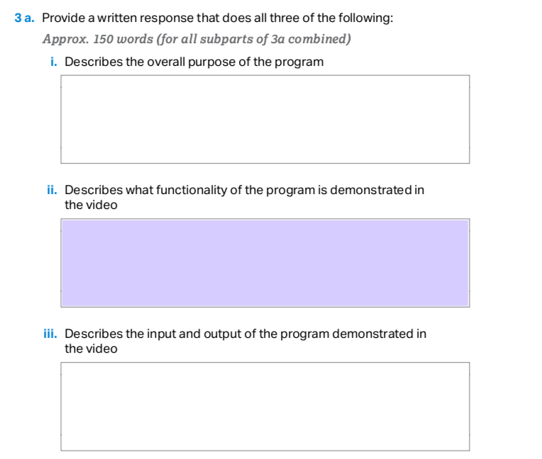

Slide 11
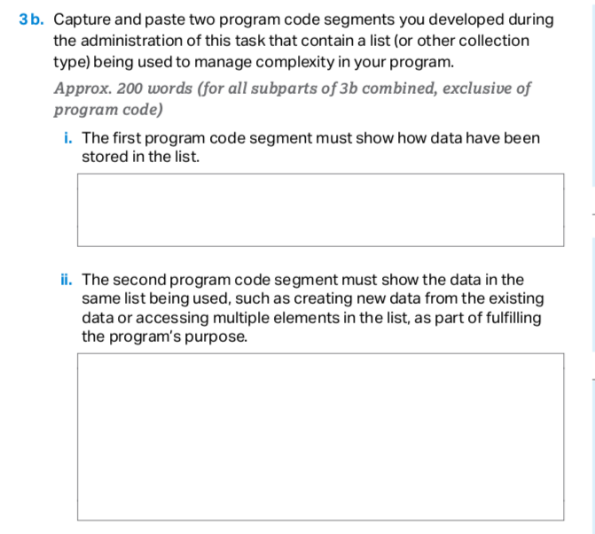

Slide 12
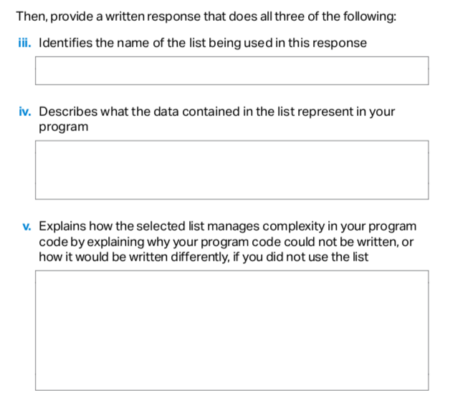
3b continued

Slide 13
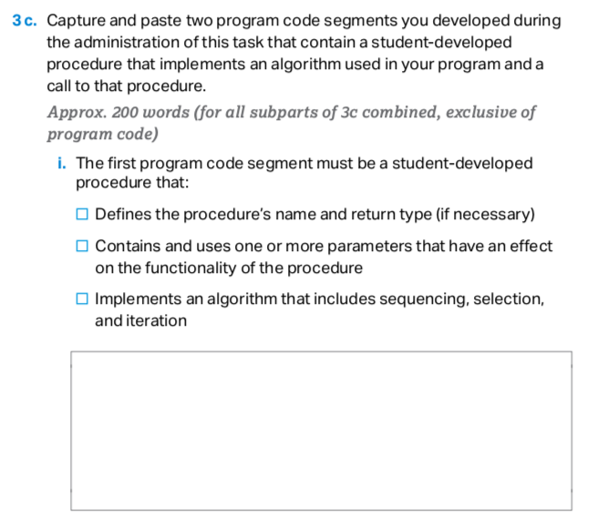

Slide 14
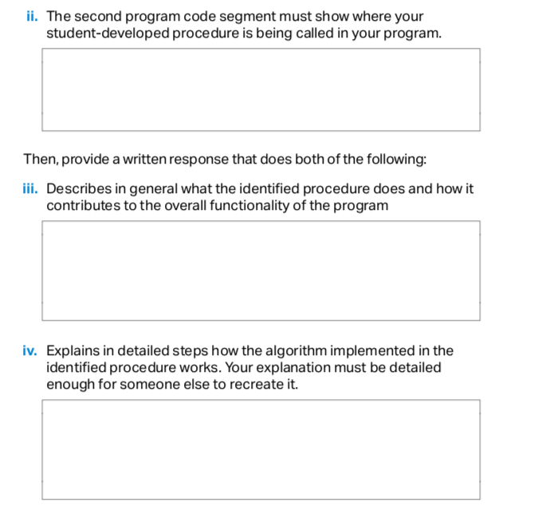
3c continued

Slide 15
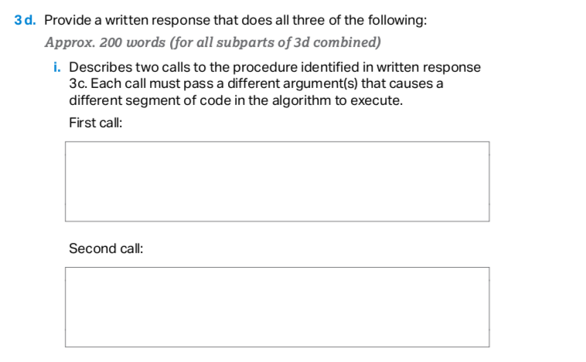

Slide 16
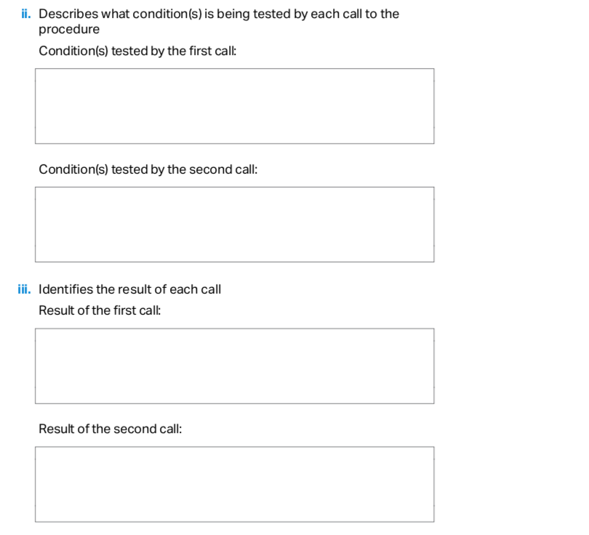

Slide 17
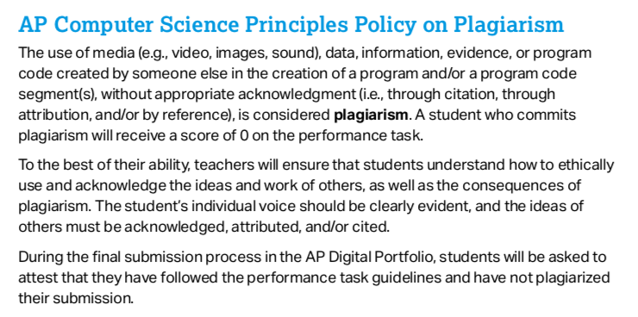

Slide 18
If there is a game that you have always wanted to write, DON'T do it for the create task!
The create task should be as minimal as possible, satisfying all of the requirements and tailored to answer the free response questions!
As we'll see from the examples this week, it can be a very simple program(see the replit example Substitution Encryption). And it's ok if it's a boring program!
It's not the program that gives you a high score; it's the free response answers! A student in the past wrote Tetris and only got a 3!

Slide 19
You can use:
1) replit: This is a highly recommended option for most students. This will limit your create task to something simple without all of the debugging errors that come with Processing.
2) Processing: I don't recommend this option.
Students end up spending too much time on getting the program to work and less time on the free response answers and often score low on the task.
Use only this option if you have done all of the labs and were able to get them to work without too much help. In fact, you'll need permission from me if you like to use Processing for your create task.

Slide 20
Create Task Example 1
We will walk through a full example of a Create Task. In this example, we will do a simple encryption program. Given a message plaintext, we like to encrypted into a secret message called ciphertext.
We do this by simply substituting each letter with a different letter from a secret key which is some permutation of the alphabet.
Sample key: YTNSHKVEFXRBAUQZCLWDMIPGJO
In this case, 'A' is replaced with 'Y', 'B' is replaced with 'T', etc…
This substitution is case sensitive 'a' is replaced with 'y', 'b' with 't', etc…
Any character not in the key is kept the same.

Slide 21
Create Task Example 1
Sample key: YTNSHKVEFXRBAUQZCLWDMIPGJO
If the plaintext is 'cat', the cipertext is 'nyd'.
If the plaintext is 'Cat', the cipertext is 'Nyd'.
If the plaintext is 'Cat123', the cipertext is 'Nyd123'.

Slide 22
Create Task Example 1
Some preliminaries:
ord() converts a single Unicode character to its integer code point.
In [1]: ord('A')
Out [1]: 65
In [2]: ord('a')
Out [2]: 97
In [2]: ord('😀')
Out [2]: 128512

Slide 23
Create Task Example 1
key = "YTNSHKVEFXRBAUQZCLWDMIPGJO"
letter = 'D'
index = ord(letter) – ord('A')
cipherletter = key[index]
The full code for this task can be found here.

Slide 24
Example 2(Optional)
This is a second example of a create task. In this example, the input to the program will be a text file. In the previous example, our list was a list of letters that represent some key.
Suppose we are writing a program that manages a database of students. Our list will now store a collection of students. We need a data type that contains information about a student.
A student has more than just one piece of information: name, age, id, address, etc…These collectively are the data of a student.
A student might have some functionality: ability to print personal information, change their address, update school information.
How do we store such complex information about a student?

Slide 25
Example 2(Optional)
We have seen this before in Processing. The class Sprite was able to store many pieces of data about a Sprite: position, velocity, image. It also stored different functionality of what a Sprite can do: draw itself, update itself, get left side of Sprite, set left side of Sprite, etc..
We like a data type that can bundle data and functionality into one variable.
A class bundles together data (instance variables or attributes) and functionality (methods). Another name for class is type.
Motivated by the Sprite class, we will write the Student class. Compare this example to the Sprite class we have used in Processing.

Slide 26
An Example of a class(Optional)
main.py
class Student:
def __init__(self, name, id):
self.name = name
self.id = id
def print_info(self):
print(self.name, self.id)
def main():
s1 = Student("Mike Smith", 34323)
s2 = Student("Sarah Jones", 67432)
print(s1.name) # Mike Smith
print(s2.name) # Sarah Jones
print(s1.id) # 34323
s1.print_info() # Mike Smith 34323
s2.print_info() # Sarah Jones 67432
main()
Student is a class(or type) and s1 and s2 are two of its objects.

Slide 27
(Optional)
This Create Task example will read in a text file of students: name and list of grades. It will create a list of Student objects and have provide some filtering capabilities.
https://replit.com/@LongNguyen18/CreateTaskStudentGrades

Slide 28
Steps for Create Task
Design Program: Brainstorm and think carefully about your program. What is your list? What is the student-developed procedure with parameters that used iteration(loops) and selection(conditionals)? Plan before writing code can save a lot of time!
Code the Program: Troubleshoot, test and refine. Start writing the student developed procedure and test it with hard-coded inputs. For example, from our encrypt example: print(encrypt("hello", sub)). Refine and repeat.
Make Video
Complete Written Response 3a.
Four Screenshots for 3b: i and ii, 3c: i and ii.
Complete written response 3b, 3c and 3d.
Submit portfolio on College Board site.

Slide 29
Timeframe
Design including brainstorming(2 hours)
Coding(5 hours)
Video(1 hour)
Written Response(2 Hours)
Review and refine written response answers using rubric(1 hour)
Uploading to Digital Portfolio(1 hour)
Total: 12 hours
This is the minimum amount of time you should spend on this. Likely you will need to spend more time(outside of class) to refine and create the best possible portfolio.

Slide 30
Program Code
Minimum Requirements:
Some type of input and output(input can be from keyboard or from file)
At least one list or dictionary that manages complexity. The list or dictionary should be essential to your program. Your program should be very difficult to write without the use of this list/dictionary.
At least one student-developed procedure that has an algorithm which uses one or more parameters that used iteration(loops) and selection(conditionals).

Slide 31
Program Code
The goal is to complete your code by April 16(day before April break).
There will be weekly check-ins. See Google classroom assignments.
First Check In(April 2): list and student-developed function, tested with hard-coded inputs.
Second Check-In(April 9): helper functions and refining program.
Third Check-In(April 16): main function and finishing up program. At the lastest, program should be done after April break.

Slide 32
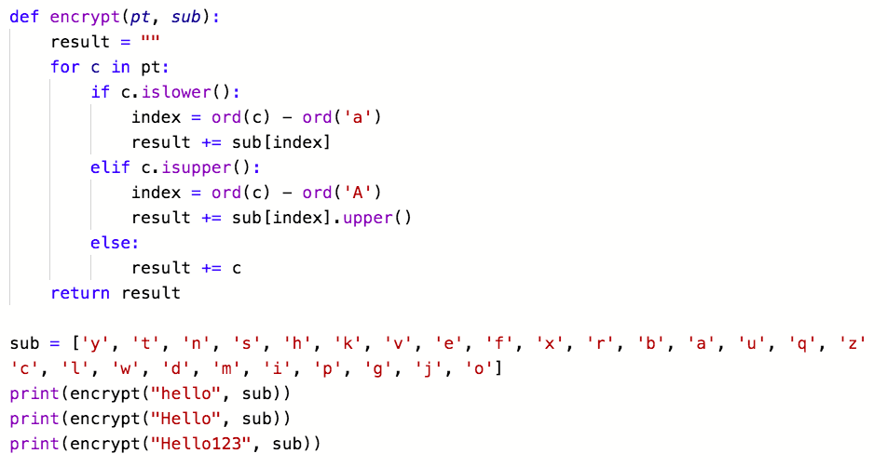
First Check-In Example:
list and student-developed function, tested with hard-coded inputs.

Slide 33
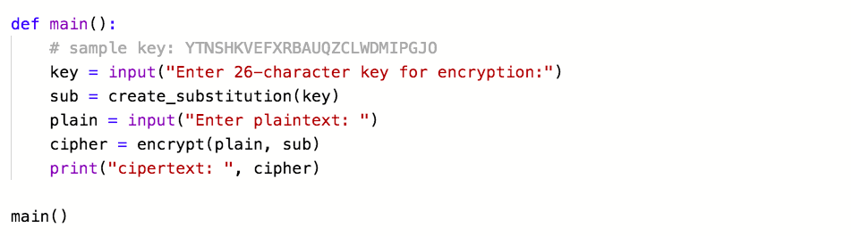
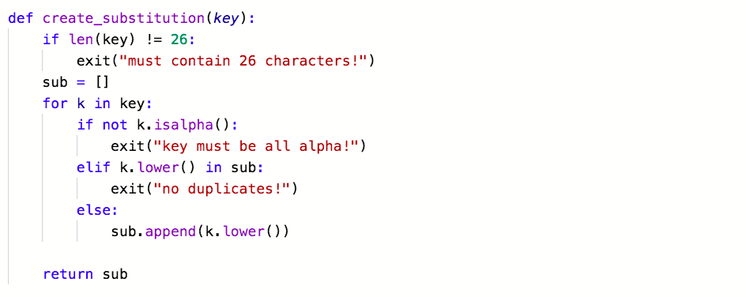
Second Check-In Example:
helper functions and refining program.
Previous code from last slide PLUS:

Slide 34
Third Check-In Example:
adding main function and finishing up program
Previous code from last two slides PLUS:

