Slide 1
Lecture 21: Searching and Sorting
Building Java Programs: A Back to Basics Approach
by Stuart Reges and Marty Stepp
Copyright (c) Pearson 2013. All rights reserved.

Slide 2
Sequential search
sequential search: Locates a target value in an array/list by examining each element from start to finish.
How many elements will it need to examine?
Example: Searching the array below for the value 42:
Notice that the array is sorted. Could we take advantage of this?
index | 0 | 1 | 2 | 3 | 4 | 5 | 6 | 7 | 8 | 9 | 10 | 11 | 12 | 13 | 14 | 15 | 16
value | -4 | 2 | 7 | 10 | 15 | 20 | 22 | 25 | 30 | 36 | 42 | 50 | 56 | 68 | 85 | 92 | 103
i

Slide 3
Binary search (13.1)
binary search: Locates a target value in a sorted array/list by successively eliminating half of the array from consideration.
How many elements will it need to examine?
Example: Searching the array below for the value 42:
index | 0 | 1 | 2 | 3 | 4 | 5 | 6 | 7 | 8 | 9 | 10 | 11 | 12 | 13 | 14 | 15 | 16
value | -4 | 2 | 7 | 10 | 15 | 20 | 22 | 25 | 30 | 36 | 42 | 50 | 56 | 68 | 85 | 92 | 103
min
mid
max

Slide 4
The Arrays class
Class Arrays in java.util has many useful array methods:
Method name | Description
binarySearch(array, value) | returns the index of the given value in a sorted array (or < 0 if not found)
copyOfRange(array, index1, index2) | returns a new resized copy of an array starting with index1 to index2-1
equals(array1, array2) | returns true if the two arrays contain same elements in the same order
fill(array, value) | sets every element to the given value
sort(array) | arranges the elements into sorted order
toString(array) | returns a string representing the array, such as "[10, 30, -25, 17]"

Slide 5
Using binarySearch
// index 0 1 2 3 4 5 6 7 8 9 10 11 12 13 14 15
int[] a = {-4, 2, 7, 9, 15, 19, 25, 28, 30, 36, 42, 50, 56, 68, 85, 92};
int index = Arrays.binarySearch(a, 42); // index1 is 10
int index2 = Arrays.binarySearch(a, 21); // index2 is -7
binarySearch returns the index where the value is found
if the value is not found, binarySearch returns:
-(insertionPoint + 1)
where insertionPoint is the index where the element would have been, if it had been in the array in sorted order.
To insert the value into the array, negate (returnedValue + 1)
int indexToInsert21 = -(index2 + 1); // 6

Slide 6
Recursive binary search (13.3)
Write a recursive binarySearch method.
If the target value is not found, return its negative insertion point.
int index = binarySearch(data, 42); // 10
int index2 = binarySearch(data, 66); // -1
Note: Recursive version does not return
-(insertionPoint+1).
index | 0 | 1 | 2 | 3 | 4 | 5 | 6 | 7 | 8 | 9 | 10 | 11 | 12 | 13 | 14 | 15 | 16
value | -4 | 2 | 7 | 10 | 15 | 20 | 22 | 25 | 30 | 36 | 42 | 50 | 56 | 68 | 85 | 92 | 103

Slide 7
Exercise solution
// Returns the index of an occurrence of the given value in
// the given array, or a negative number if not found.
// Precondition: elements of a are in sorted order
public static int binarySearch(int[] a, int target) {
return binarySearch(a, target, 0, a.length - 1);
}
// Recursive helper to implement search behavior.
private static int binarySearch(int[] a, int target,
int min, int max) {
if (min > max) {
return -1; // target not found
} else {
int mid = (min + max) / 2;
if (a[mid] < target) { // too small; go right
return binarySearch(a, target, mid + 1, max);
} else if (a[mid] > target) { // too large; go left
return binarySearch(a, target, min, mid - 1);
} else {
return mid; // target found; a[mid] == target
}
}
}

Slide 8
For Each Loop
The for-each loop is another traversing technique
for (type var : arr) {
…
}
where type is the type of objects in the array arr.
The for-each loop cannot be used for replacing or removing elements as you traverse.
The loop hides the index variable that is used with arrays.

Slide 9
For Each Examples
int[] numbers = {1,2,3,4,5};
ArrayList<String> list = new ArrayList<String>();
list.add(“Mike”); list.add(“John”);
for(int x : numbers)
System.out.println(x);
for(String name: list)
System.out.println(name);
Note: The syntax is the same for both arrays and arraylists.

Slide 10
For Each 2D arrays
int[][] numbers = {{1,2},{3,4}};
for(int[] row: numbers)
for(int entry: row)
System.out.println(entry);

Slide 11
For each example
The for-each loop cannot be used for replacing or removing elements as you traverse.
int[] numbers = {1,2,3,4};
for(int x : numbers)
x = 7;
System.out.println(Arrays.toString(numbers));
// {1,2,3,4}
// channging local variable x DOES NOT change
// array!

Slide 12
Sorting
sorting: Rearranging the values in an array or collection into a specific order (usually into their "natural ordering").
one of the fundamental problems in computer science
can be solved in many ways:
there are many sorting algorithms
some are faster/slower than others
some use more/less memory than others
some work better with specific kinds of data
some can utilize multiple computers / processors, ...
comparison-based sorting : determining order by comparing pairs of elements:
<, >, compareTo, …

Slide 13
Sorting algorithms
bubble sort: swap adjacent pairs that are out of order
selection sort: look for the smallest element, move to front
insertion sort: build an increasingly large sorted front portion
merge sort: recursively divide the array in half and sort it
heap sort: place the values into a sorted tree structure
quick sort: recursively partition array based on a middle value

Slide 14
Sorting algorithms
bubble sort: swap adjacent pairs that are out of order
selection sort: look for the smallest element, move to front
insertion sort: build an increasingly large sorted front portion
merge sort: recursively divide the array in half and sort it
heap sort: place the values into a sorted tree structure
quick sort: recursively partition array based on a middle value

Slide 15
Bubble sort
bubble sort: For each pass through the array, look at adjacent elements and swap them if they are out of order. Repeat until the entire array is sorted.
What’s the result at the end of the first pass?
The largest element is at the end of the array.

Slide 16
Selection sort
selection sort: Orders a list of values by repeatedly putting the smallest or largest unplaced value into its final position.
The algorithm:
Look through the list to find the smallest value.
Swap it so that it is at index 0.
Look through the list to find the second-smallest value.
Swap it so that it is at index 1.
...
Repeat until all values are in their proper places.

Slide 17
Selection sort example
Initial array:
After 1st, 2nd, and 3rd passes:
index | 0 | 1 | 2 | 3 | 4 | 5 | 6 | 7 | 8 | 9 | 10 | 11 | 12 | 13 | 14 | 15 | 16
value | 22 | 18 | 12 | -4 | 27 | 30 | 36 | 50 | 7 | 68 | 91 | 56 | 2 | 85 | 42 | 98 | 25
index | 0 | 1 | 2 | 3 | 4 | 5 | 6 | 7 | 8 | 9 | 10 | 11 | 12 | 13 | 14 | 15 | 16
value | -4 | 18 | 12 | 22 | 27 | 30 | 36 | 50 | 7 | 68 | 91 | 56 | 2 | 85 | 42 | 98 | 25
index | 0 | 1 | 2 | 3 | 4 | 5 | 6 | 7 | 8 | 9 | 10 | 11 | 12 | 13 | 14 | 15 | 16
value | -4 | 2 | 12 | 22 | 27 | 30 | 36 | 50 | 7 | 68 | 91 | 56 | 18 | 85 | 42 | 98 | 25
index | 0 | 1 | 2 | 3 | 4 | 5 | 6 | 7 | 8 | 9 | 10 | 11 | 12 | 13 | 14 | 15 | 16
value | -4 | 2 | 7 | 22 | 27 | 30 | 36 | 50 | 12 | 68 | 91 | 56 | 18 | 85 | 42 | 98 | 25

Slide 18
Insertion Sort
insertion sort: Shift each element into a sorted sub-array
faster than selection sort (examines fewer values)
index | 0 | 1 | 2 | 3 | 4 | 5 | 6 | 7 | 8 | 9 | 10 | 11 | 12 | 13 | 14 | 15 | 16
value | -4 | 12 | 18 | 22 | 27 | 30 | 36 | 50 | 7 | 68 | 91 | 56 | 2 | 85 | 42 | 98 | 25
sorted sub-array (indexes 0-7)
7
Notes:
A lot of 143 students implement a kind of insertion sort on their SortedIntList add operation.

Slide 19
Insertion Sort Algorithm
Check element.
If larger than the previous element, leave it.
If smaller than the previous element, shift previous larger elements down until you reach a smaller element (or beginning of array).
Insert element.

Slide 20

Insertion Sort Algorithm
64 54 18 87 35
54 less than 64
Shift down and insert 54
54 64 18 87 35(1st pass)
18 less than 64
18 less than 54
Shift down and insert 18
18 54 64 87 35(2nd pass)
87 greater than 64
Go to next element
18 54 64 87 35(3rd pass)
35 less than 87
35 less than 64
35 less than 54
35 greater than 18
Shift down and insert 35
18 35 54 64 87(4th pass)

Slide 21
Merge sort
merge sort: Repeatedly divides the data in half, sorts each half, and combines the sorted halves into a sorted whole.
The algorithm:
Divide the list into two roughly equal halves.
Sort the left half.
Sort the right half.
Merge the two sorted halves into one sorted list.
Often implemented recursively.
An example of a "divide and conquer" algorithm.
Invented by John von Neumann in 1945

Slide 22
Merge sort example
index | 0 | 1 | 2 | 3 | 4 | 5 | 6 | 7
value | 22 | 18 | 12 | -4 | 58 | 7 | 31 | 42
split
22 | 18 | 12 | -4
58 | 7 | 31 | 42
split
split
22 | 18
12 | -4
58 | 7
31 | 42
split
split
split
split
22
18
12
-4
58
7
31
42
merge
merge
merge
merge
18 | 22
-4 | 12
7 | 58
31 | 42
merge
merge
-4 | 12 | 18 | 22
7 | 31 | 42 | 58
merge
-4 | 7 | 12 | 18 | 22 | 31 | 42 | 58

Slide 23
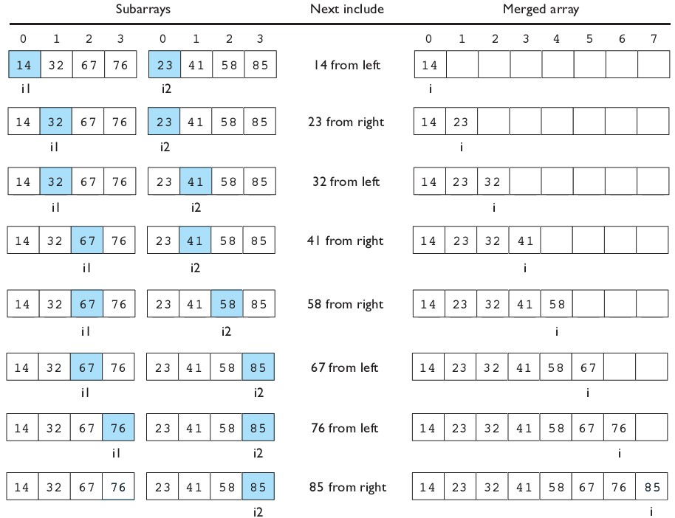
Merging sorted halves

Slide 24
Merge halves code
// Merges the left/right elements into a sorted result.
// Precondition: left/right are sorted
public static void merge(int[] result, int[] left,
int[] right) {
int i1 = 0; // index into left array
int i2 = 0; // index into right array
for (int i = 0; i < result.length; i++) {
if (i2 >= right.length ||
(i1 < left.length && left[i1] <= right[i2])) {
result[i] = left[i1]; // take from left
i1++;
} else {
result[i] = right[i2]; // take from right
i2++;
}
}
}

Slide 25
Merge sort code
// Rearranges the elements of a into sorted order using
// the merge sort algorithm (recursive).
public static void mergeSort(int[] a) {
if (a.length >= 2) {
// split array into two halves
int[] left = Arrays.copyOfRange(a, 0, a.length/2);
int[] right = Arrays.copyOfRange(a, a.length/2, a.length);
// sort the two halves
mergeSort(left);
mergeSort(right);
// merge the sorted halves into a sorted whole
merge(a, left, right);
}
}

Slide 26
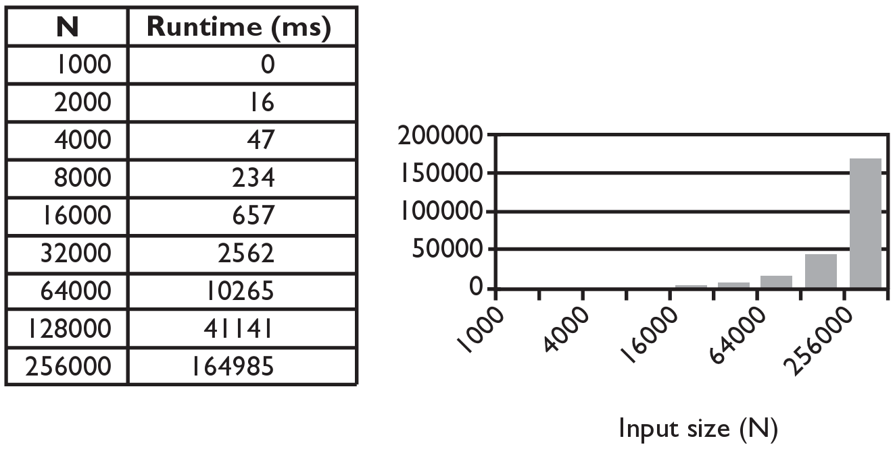
Selection sort runtime (Fig. 13.6)
What is the complexity class (Big-Oh) of selection sort?

Slide 27
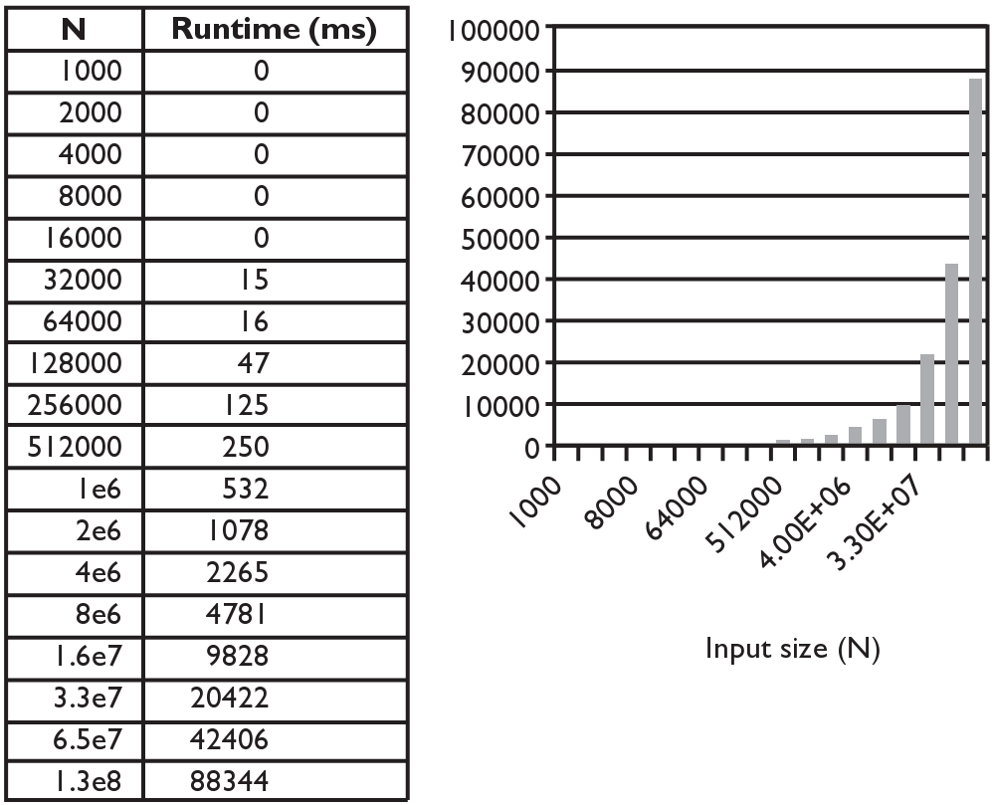
Merge sort runtime
What is the complexity class (Big-Oh) of merge sort?

Slide 28
Searching/Sorting in Java
The Arrays and Collections classes in java.util have a static method sort that sorts the elements of an array/list
Arrays.sort() is used for arrays.
String[] words = {"foo", "bar", "baz", "ball"};
Arrays.sort(words);
System.out.println(Arrays.toString(words));
// [ball, bar, baz, foo]
int index = Arrays.binarySearch(words, “bar”); // 1

Slide 29
Searching/Sorting in Java
Collections.sort() is used for arraylists.
List<String> words2 = new ArrayList<String>();
for (String word : words) {
words2.add(word);
}
Collections.sort(words2);
System.out.println(words2);
// [ball, bar, baz, foo]

Slide 30
Computational Complexity
Computational complexity of an algorithm is the amount of computational resources(e.g. comparison operations) needed to perform the algorithm.
This measure is a function of the input size(e.g. the size of the array.)
Can either be worst-case complexity or average-case complexity

Slide 31
Computational Complexity for Searching
Suppose we have an array of size n.
1) What is the average number of comparisons needed to find the target using sequential search?
Answer: Approximately n/2. ( Big O(n))
2) What is the overall all number of comparisons needed to find the target using binary search?
Answer: Approximately log(n). ( Big O(logn))

Slide 32
Computational Complexity for Sorting
Suppose we have an array of size n.
1) What is the number of comparisons needed for bubble sort?
Answer: Efficiently can be done in n(n+1)/2. Approximately n^2. Big O(n^2)
2) What is the number of comparisons needed for selection sort?
Answer: : Efficiently can be done in n(n+1)/2. Approximately n^2. Big O(n^2).
2) What is the number of comparisons needed for mergesort?
Answer: Approximately nlog(n).

Slide 33
Some Examples
What’s the total number of operations?
for(int i = 0; i < n; i++){
for(int j = 0; j < n; j++)
// do one simple operation.
}
Answer: n^2
for(int i = 0; i < n; i++){
for(int j = i; j < n; j++)
// do one simple operation.
}
Answer: n(n+1)/2 or Big O(n^2)

Slide 34
Exponential Complexity Problems
Algorithms that can be implemented with a polynomial time complexity can be executed quickly on a modern processor. (Problems of this type belong to a class called P, Polynomial Time.)
However, there exists important and practical problems for which there exists no known polynomial time algorithm.
E.g. given a set of integers, find a subset that sums to zero. A brute-force algorithm would try every possible subset. But there are 2^n different subsets. This is an example of an exponential time algorithm. If n is large, even the fastest computers would take too long.

Slide 35
Travelling Salesman(TSP)
Given a set of cities and paths connecting them, find the shortest path that visit each of them exactly once.
There is no known polynomial time algorithm that solves TSP. Solving TSP can, for example, lead to better transportation and bus routes.
TSP belongs to a class of related problems called NP(Non-deterministic Polynomial Time). None of these problems has a polynomial time solution. And if one does, then so do the rest.

Slide 36
Is P=NP?
Is P=NP? In other words, can Travelling salesman and the other NP-complete problems be solved in polynomial time? Mathematicians believe that P is not equal to NP. No proof is known.
This is one of 7 Millenium Problems. The Clay Mathematics Institute has offered a million dollar prize for solving any of them.
Grigori Perelman solved one of the Millenium Problems, the Poincare Conjecture. He declined the million dollar prize as well as the Fields Medal, the equivalent of the Nobel Prize for Mathematics.
https://medium.com/@phacks/how-grigori-perelman-solved-one-of-maths-greatest-mystery-89426275cb7

Slide 37
What if P=NP?
What if P=NP? Many very important problems in math, physics and engineering are currently intractable, i.e., solutions take exponential time. If P=NP, then there are efficient algorithms for solving them. This can lead to many advances in science.
But P=NP can have negative consequences.
For example, cryptography relies on certain problems being difficult. Public-key cryptography, a foundation for security applications including financial transactions over the internet, would be vulnerable if one can prove P=NP constructively.
Most mathematicians believe that P is not equal to NP.

Slide 38
Lab 1
Write the nonrecursive version of binarySearch method.
// Returns the index of an occurrence of target in the
// array a, or a negative number(-(min+1)) if the target
// is not found.
public static int binarySearch(int[] a, int target) {
}

Slide 39
Lab 2
Write the methods selectionSort and swap.
public static void selectionSort(int[] a)
{…}
public static void swap(int[] a, int i, int j)
{…}

