Slide 1

Scoring Guidelines for the Create Task

Slide 2
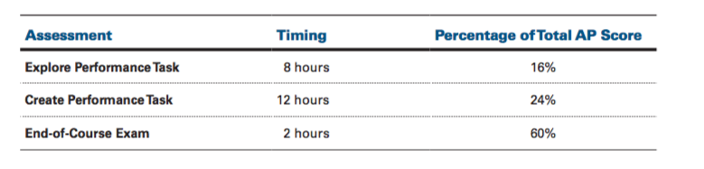
General Requirements

Slide 3
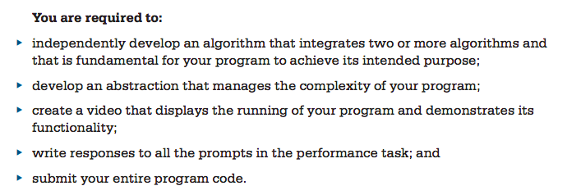
General Requirements

Slide 4
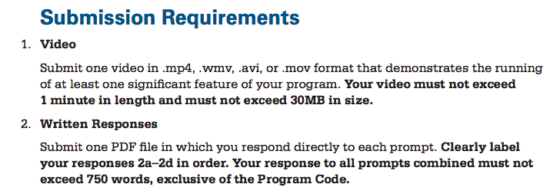
Submission Requirements

Slide 5
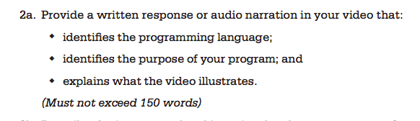
2A) Written Response
Note: Your video can narrate the answers to all of the above three questions for this prompt. To be safe, you can also write your answers to those three questions.
One point for this response. (1/8)

Slide 6
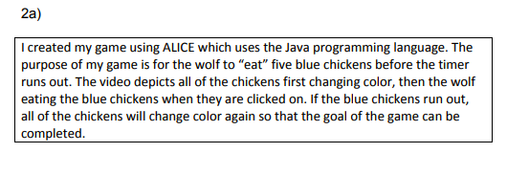
2A) Sample Good Response

Slide 7
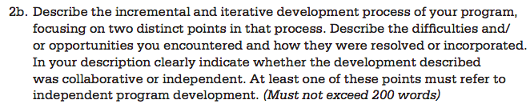
2B) Written Response
Development processes are iterative and cyclical in nature and require students to reflect AND improve on what they have created. Examples of iterative development could include reflection, revision, testing and refining, and improvements based on feedback.
Incremental development refers to all of the steps leading to the creation of the application/game. (create Ball class, write bounce() method for walls, write collision method for bouncing from bricks, testing methods, correcting bounce, etc…)
Two points for this response. Row 2 and Row 3. (2/8)

Slide 8
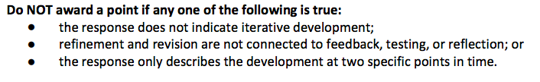
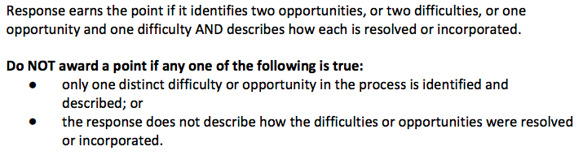
2B) Points and No Points
Row 2
Row 3

Slide 9
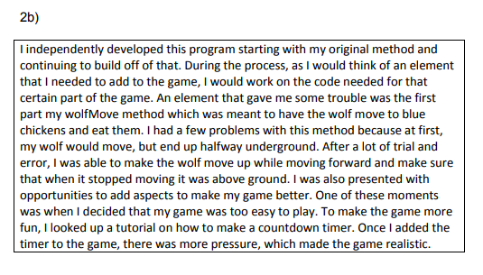
2B) Sample Good Response

Slide 10
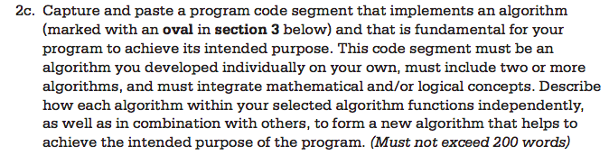
2C) Written Response
Algorithms make use of sequencing, selection or iteration.
Sequencing: Statements are executed one at a time, in order.
Selection: Use conditionals if/else if to select statements to execute.
Iteration: Use loops to iterate over statements.
3 points for this response. Rows 4, 5 and 6. (3/8)

Slide 11
2C) Written Response
Selected code segment implements an algorithm that includes at least two or more algorithms.
At least one of the included algorithms uses mathematical or logical concepts.
Mathematical concepts include mathematical expressions using arithmetic operators and mathematical functions. (distance between objects)
Logical concepts include Boolean algebra and compound expressions. (if, else-if blocks)

Slide 12
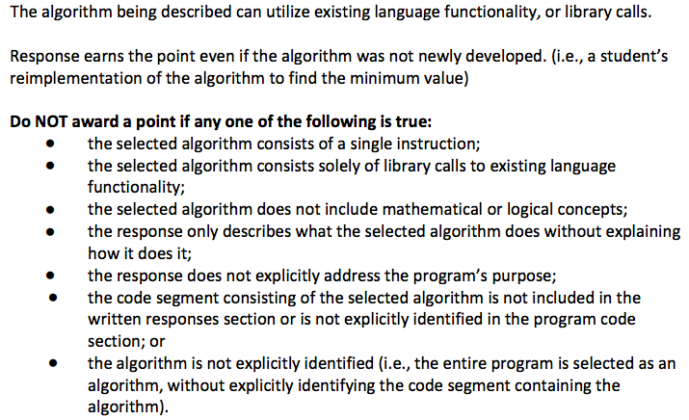
2C) Written Response Points/No Points

Slide 13
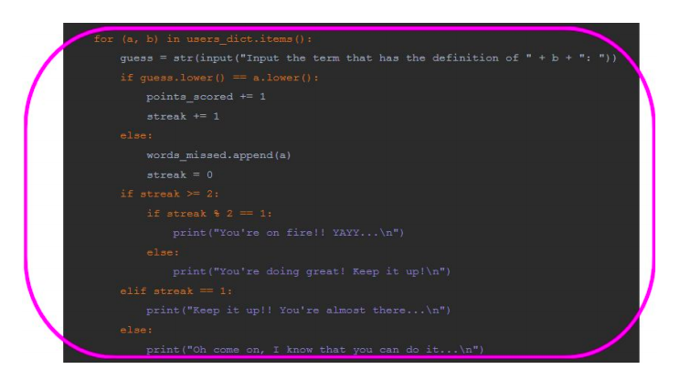
2C) Sample Good Response
You need to put an oval around the main algorithm and include it in your 2C) written response.

Slide 14
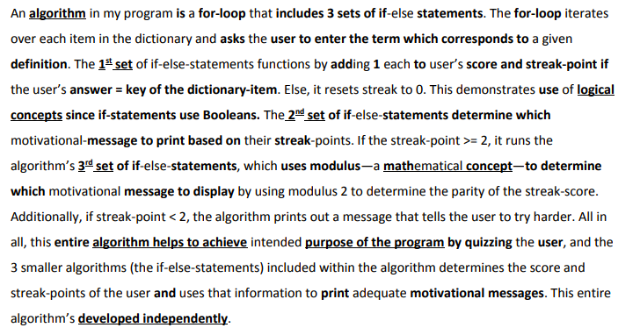
2C) Sample Good Response
Note the explicit use of “logical concepts” and “mathematical concepts” in the answer.
Note also the discussion of how this algorithm achieves the intended purpose of the program.

Slide 15
2C) Another(Processing) Example
Enemy[] enemies; Player p;
void setup(){}
void draw(){
displayEnemies();
}
void displayEnemies(){
for(int i = 0; i < enemies.length; i++){
Enemy current = enemies[i];
current.drawEnemy();
if(isHit(current))
enemies.remove(i);
}
}
Main algorithm: displayEnemies
Sub algorithms: drawEnemy(), isHit(),remove() and distanceToPlayer()

Slide 16
Example
..continue from last slide
boolean isHit(Enemy e){
float dist = distanceToPlayer(e);
if(dist < 50)
return true;
else
return false;
}
float distanceToPlayer(Enemy e){
float dx = e.x – p.x
float dy = e.y – p.y
return sqrt(dx*dx+dy*dy);
}
Main algorithm: displayEnemies
Sub algorithms: drawEnemy(), isHit(),remove() and distanceToPlayer()
(next slide)

Slide 17
Algorithms
The main algorithm displayEnemies depends on drawEnemy, isHit and distanceToPlayer.
It also uses math and logical concepts.
It also used a loop to perform the same task over and over again without the need for redundant code.

Slide 18
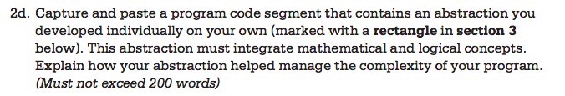
2D) Written Response
The following are examples of abstractions. PICK ONLY ONE OF THE FOLLOWING:
1) arrays/arraylists or 2D arrays of objects, e.g., arraylist of Ball objects, array of Bullet objects.
2) methods/functions with parameters. (e.g. isHit() method which accepts a Bullet object and a Asteroid object)
2 points for this response. Rows 7 and 8. (2/8)

Slide 19
2D) Abstractions
Two ways to meet the abstraction requirement for create task.
(Recommended) You should have in your program an array/arraylist of objects. (arraylist of Balls, Enemies, Bullets, etc...). This is your abstraction. You need to explain how it helps you manage the complexity of your code. Write about each of the following!
  Write the class(template) only once, but can create hundreds of objects. (reusability , avoid redundancy)
  If the class needs to be changed, change it in only one place. The rest of the code remains intact. (editability)
  Helps debug. If the Enemy objects are not working, look in the Enemy class. (debuggability)
  Use a for loop to move and display all of them together without needing to use redundant code to move them one by one.

Slide 20
2D) Abstraction
2) A Function/Method/Procedure with parameters can be an abstraction. For example, if your program requires a set of ball objects to collide with a set of brick objects, the method
boolean collide(Ball b, Brick c){}
can be an abstraction. Write about each of these:
Allows you to call it repeated with different parameters(different ball/brick pairs).
Avoid redundancy. Instead of repeating the code for every ball/brick pair, the method can be called instead.

Slide 21
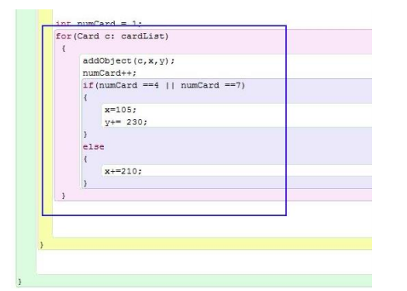
2D) Sample Good Response
You need to put an rectangle around the abstraction and include it in your 2D) written response.

Slide 22
2D) Sample Good Response
I created a list consisting of 9 cards to apply abstraction. The iterative process of going through each item in the list increases code efficiency because I no longer had to add every card to the background separately (I had around 9 separate addObject statements and 9 separate calls to the card’s act() method.) I made a counter variable which I use to decide what coordinates to update. For example, if the program has already added 3 cards, it must know that it needs to start the second row. I also made variables for the x and y coordinate. If the counter variable equals 4 or 7, I would need to add 230 to the y coordinate variable and reset the x coordinate variable to 105,

Slide 23
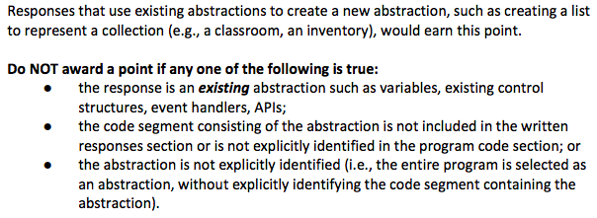
2D) Points/No Points

Slide 24
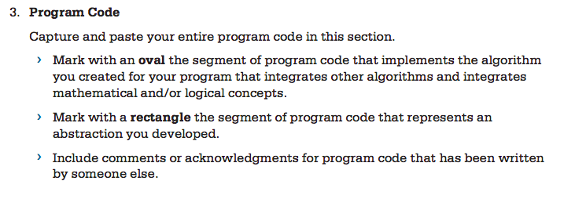
Program Code

Slide 25
Some More Advice
Consider doing the following to make your code more readable for the AP reader.
Indent nicely.
Refactor your code. If the draw method(or your main algorithm method) is too long, consider moving some blocks of code to different methods.

Slide 26
Some More Advice
3) Some of you borrow some code from previous labs we did in class. For example, the Grid and Cell class or the ArrayList Lab. Address this in your written response to indicate that these segments of code/ classes are from a lab done in class. Many people from both classes use these labs. Not properly documenting this will risk getting a zero! You can say that you wrote those classes yourself.
4) If you used some code found online(a tutorial or youtube video), cite and document these references!
5) Consult the attached Scoring Guidelines to make sure your writing answers satisfy all of the criteria they are looking for!

