Slide 1

Lecture 13: ArrayLists
AP Computer Science Principles

Slide 2
Problem with Arrays
Ask the user to enter a list of words, save the words in
an array.
String[] allWords = new String[1000];
int wordCount = 0;
Problem: You don't know how many words the user will enter.
  Hard to create an array of the appropriate size.
  Can not lengthen an array by adding elements to it.
  Elements of arrays cannot be removed.
Luckily, there are other ways to store data besides in an array.

Slide 3
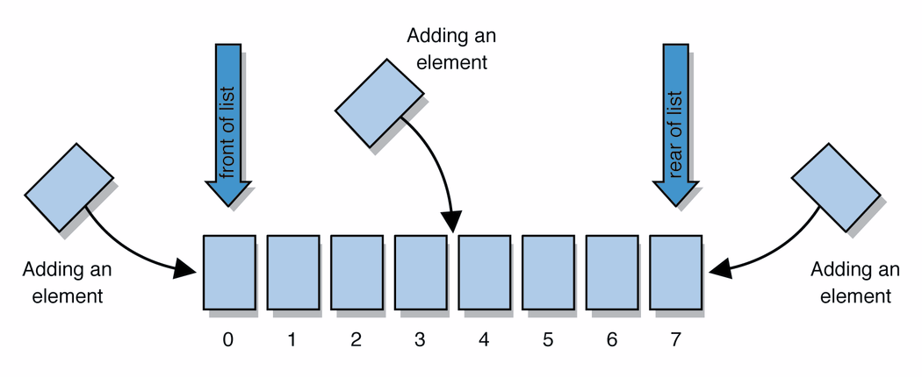
Lists
list: a collection storing an ordered sequence of elements
  each element is accessible by a 0-based index
  a list has a size (number of elements that have been added)
  elements can be added to the front, back, or elsewhere
  in Java, a list can be represented as an ArrayList object
Notes:
use jGRASP/DrJava Interactions window to create a list and add some elements, get them, check size

Slide 4
Idea of a arraylist
Rather than creating an array of boxes, create an object that represents a "list" of items. (initially an empty list.)
  []
You can add items to the list.
  The default behavior is to add to the end of the list.
  [hello, ABC, goodbye, okay]
The list object keeps track of the element values that have been added to it, their order, indexes, and its total size.
  Think of an "array list" as an automatically resizing array object.

Slide 5
ArrayList methods (10.1)
add(value) | appends value at end of list
add(index, value) | inserts given value just before the given index, shifting subsequent values to the right
E get(index) | returns the value at given index
E remove(index) | removes/returns value at given index, shifting subsequent values to the left
E set(index, value) | replaces value at given index with given value, returns element that was previously at index.
int size() | returns the number of elements in list
Note: E refers to the type that is being returned. This depends on the type of objects in the Arraylist.

Slide 6
Type Parameters (Generics)
ArrayList<Type> name = new ArrayList<Type>();
When constructing an ArrayList, you must specify the
type of elements it will contain between < and >.
  Allows the same ArrayList class to store lists of different types.
  ArrayList<String> names = new ArrayList<String>();
  names.add("Marty Stepp");
  names.add("Stuart Reges");
  //notice the difference between arraylist & array
  String[] names= new String[10];

Slide 7
ArrayList vs. array
construction
  String[] names = new String[5];
  ArrayList<String> list = new ArrayList<String>();
storing a value
  names[0] = "Jessica";
  list.add("Jessica");
retrieving a value
  String s = names[0];
  String s = list.get(0);

Slide 8
ArrayList vs. array
  ArrayList<String> list = new ArrayList<String>();
  list.add(“Michael”);
  list.add(“Jessica”);
  list.add(“Lee”); //{“Michael”, “Jessica”, “Lee”}
  list.add(1,“Sarah”);//{“Michael”, “Sarah”,”Jessica”, “Lee”}
  String store = list.set(2,”Mary”)
  //{Michael,Sarah,Mary,Lee}, store=“Jessica”
  String store2 = list.get(3);//store2=“Lee”
  String store3 = list.remove(1);
  //{Michael,Mary,Lee}, store3=“Sarah”

Slide 9
ArrayList vs. array 2
doing something to each value that starts with "B"
  for (int i = 0; i < names.length; i++) {
  if (names[i].equals(“John”) {
  // do something...
  }
  }
  for (int i = 0; i < list.size(); i++) {
  if (list.get(i).equals(“John”)) {
  // do something...
  }
  }

Slide 10
ArrayList of primitives?
The type you specify when creating an ArrayList must be an object type; it cannot be a primitive type.
  // illegal -- int cannot be a type parameter
  ArrayList<int> list = new ArrayList<int>();
But we can still use ArrayList with primitive types by using wrapper classes in their place.
  // creates a list of ints
  ArrayList<Integer> list = new ArrayList<Integer>();
Once you construct the list, use it with primitives as normal:
  ArrayList<Float> grades = new ArrayList<Float>();
  grades.add(3.2); //autoboxing
  grades.add(2.7);
  float myGrade = grades.get(0);//auto-unboxing

Slide 11
Wrapper Classes
Java allows wrapper object for each of its primitive types.
Primitive Type | Wrapper Type
int | Integer
float | Float
boolean | Boolean

Slide 12

Wrapper Classes
Integer and Float are wrapper classes…not Rapper Classes.
These are Rapper Classes:
public class Tupac{…}
public class Biggie extends Tupac{…}
public class JayZ extends Biggie{…}
public class KendrickLamar extends Biggie{…}

Slide 13
ArrayList "mystery"
  ArrayList<Integer> list = new ArrayList<Integer>();
  for (int i = 1; i <= 10; i++) {
  list.add(10 * i);
  }
What is in the arraylist list?
  [10, 20, 30, 40, ..., 100]

Slide 14
ArrayList "mystery"
  ArrayList<Integer> list = new ArrayList<Integer>();
  for (int i = 1; i <= 10; i++) {
  list.add(10 * i);// [10, 20, 30, 40, ..., 100]
  }
What is the output of the following code?
  for (int i = 0; i < list.size(); i++) {
  list.remove(i);
  }
  println(list);
Answer:
  [20, 40, 60, 80, 100]

Slide 15
Remove Plurals
ArrayList<String> words = new ArrayList<String>();
// words is an arraylist of words
// assume words has been populated with Strings.
// remove all plural words(ends with s)
for (int i = 0; i < words.size(); i++) {
String word = words.get(i);
if (word.endsWith("s")) {
words.remove(i);
}
}
//error, once a word is remove, words are shifted to the
//left, this will cause the next word to be skipped

Slide 16
Remove elements
// Removes all elements with even values from the given list.
void filterEvens(ArrayList<Integer> list) {
for (int i = 0; i <list.size(); i++) {
int n = list.get(i);
if (n % 2 == 0) {
list.remove(i);
}
}
}
// INCORRECT!!

Slide 17
Solution 1
// Removes all elements with even values from the given
// list.
void filterEvens(ArrayList<Integer> list) {
for (int i = 0; i <list.size(); i++) {
int n = list.get(i);
if (n % 2 == 0) {
list.remove(i);
i--; // prevents skipping
}
}
}
// CORRECT!!

Slide 18
Solution 2
Or alternatively, we can traverse the array backwards; this
eliminates the need to do i--.
void filterEvens(ArrayList<Integer> list) {
for (int i = list.size() - 1; i >= 0; i--) {
int n = list.get(i);
if (n % 2 == 0) {
list.remove(i);
}
}
}
// Correct Version, go backwards, no need to do
// i--.

Slide 19
Out-of-bounds
Legal indexes are between 0 and the list's size() - 1.
  Reading or writing any index outside this range will cause an
  IndexOutOfBoundsException.
  ArrayList<String> names = new ArrayList<String>();
  names.add("Marty"); names.add("Kevin");
  names.add("Vicki"); names.add("Larry");
  println(names.get(0)); // okay
  println(names.get(3)); // okay
  println(names.get(-1)); // exception
  names.add(9, "Aimee"); // exception
index | 0 | 1 | 2 | 3
value | Marty | Kevin | Vicki | Larry

Slide 20
ArrayList "mystery" 2
  ArrayList<Integer> list = new ArrayList<Integer>();
  for (int i = 1; i <= 5; i++) {
  list.add(2 * i);
  }
  // [2, 4, 6, 8, 10]
What is the output of the following code?
  int size = list.size(); // size = 5
  for (int i = 0; i < size; i++) {
  list.add(i, 42); // add 42 at index i
  }
  System.out.println(list);
Answer:
  [42, 42, 42, 42, 42, 2, 4, 6, 8, 10]
Notes:
What happens if you get rid of the int size variable above and replace it with list.size() ? (infinite loop)

Slide 21
ArrayList "mystery" 2
  ArrayList<Integer> list = new ArrayList<Integer>();
  for (int i = 1; i <= 5; i++) {
  list.add(2 * i); // [2, 4, 6, 8, 10]
  }
What is the output of the following code?
  for (int i = 0; i < list.size(); i++) {
  list.add(i, 42); // add 42 at index i
  }
  println(list);
Answer: Infinite Loop!
Notes:
What happens if you get rid of the int size variable above and replace it with list.size() ? (infinite loop)

Slide 22
ArrayList as parameter
void name(ArrayList<Type> name) {
Example:
  // Removes all plural words from the given list.
void removePlural(ArrayList<String> list) {
  for (int i = 0; i < list.size(); i++) {
  if (list.get(i).endsWith("s")) {
  list.remove(i);
  i--;
  }
  }
  }
You can also return a list:
ArrayList<Type> methodName(params)

Slide 23
ArrayList as parameter
You can also return a list:
ArrayList<Type> name(ArrayList<Type> name) {
Example:
  // add all plural words from the given list to a
  // new arraylist and return the new arraylist
ArrayList<String> addPlural(ArrayList<String> list) {
  ArrayList<String> result = new ArrayList<String>();
  for (int i = 0; i < list.size(); i++) {
  if (list.get(i).endsWith("s")) {
  result.add(list.get(i));
  }
  }
  return result;
  }

Slide 24
Lab 1
Download the files ArrayListLab.pde and Ball.pde on classroom.
Follow the directions in the comments to complete the lab.
This lab allows you to create an arraylist of Ball objects and then remove them as they touch the mouse.

Slide 25
Lab 2
Download the ShootLab from the website.
Follow the directions in the comments to complete the lab.
This lab allows you to “shoot” ball objects and remove them.
This can be modified to some version of the asteroid shooting game.

Slide 26
References
Part of this lecture is taken from the following book.
Stuart Reges and Marty Stepp. Building Java Programs: A Back to Basics Approach. Pearson Education. 2008.

