Slide 1
Introduction to Python
Functions

Slide 2
Topics
Functions
Function Inputs vs Outputs
Function Arguments
Flow of Program
Template for programs
String Methods

Slide 3
Example
Consider the following code which asks the user to enter a number and prints out the absolute value of the number. This problem was a lab assignment in the last lecture.
x = int(input(‘Enter an integer: ’))
if x >= 0:
print(“The absolute value of”, x, "is", x)
else:
print(“The absolute value of”, x, "is", -x)
Sample Output:
Enter an integer: -4
The absolute value of -4 is 4

Slide 4
Example
Now what if the program asks the user for two numbers and then compute their absolute values? What do you think of the following code?
x = int(input(‘Enter an integer: ’))
if x >= 0:
print(“The absolute value of”, x, "is", x)
else:
print(“The absolute value of”, x, "is", -x)
x = int(input(‘Enter an integer: ’))
if x >= 0:
print(“The absolute value of”, x, "is", x)
else:
print(“The absolute value of”, x, "is", -x)
Note the redundancy!
We like to reuse code
without rewriting or copying/pasting
code!

Slide 5
Functions
One way to organize Python code and to make it more readable and reusable is to factor out useful pieces into reusable functions.
A function is a named group of programming instructions that accomplish a specific task. It may have parameters and return values. If we want to perform the task, we simply "call" the function by its name. A function may be called as many times as we wish to redo the task.
The "30 seconds" button on the microwave is an example of a function. If we press it(call it by its name), it will run the microwave 30 seconds. Later, if we want to heat something else, we can press it again to run the microwave another 30 seconds.
In other programming languages, functions are also called procedures or methods.

Slide 6
Example
We like to take the redundant code below and convert it to a function.
x = int(input(‘Enter an integer: ’))
if x >= 0:
print(“The absolute value of”, x, "is", x)
else:
print(“The absolute value of”, x, "is", -x)
x = int(input(‘Enter an integer: ’))
if x >= 0:
print(“The absolute value of”, x, "is", x)
else:
print(“The absolute value of”, x, "is", -x)
Let's factor out this piece of code, convert it into a function by giving it a name!
Then we can call it repeatedly if we wish to run the code.

Slide 7
Functions
A function or procedure is a group of code that has a name and can be called using parentheses.
A function may have parameters or input variables to the function. Parameters are input variables that provide information to the function to accomplish its task. Using parameters allows procedures to be generalized, enabling the procedures to be reused with a range of input values or arguments.
In Python, a function is defined using the def statement.
def function_name(parameters):
block of code

Slide 8
Absolute Value
We like to take the redundant code below and convert it to a function called absolute().
def absolute(x):
if x >= 0:
print(“The absolute value of”, x, "is", x)
else:
print(“The absolute value of”, x, "is", -x)
# several calls to abs()
absolute(-10) # The absolute value of -10 is 10
absolute(5) # The absolute value of 5 is 5
We placed the code into a function named absolute().
This block of code is called the function definition.
The function definition
must precede any
function calls.
Now we can reuse this code by calling on absolute() with different inputs!
Output:
The absolute value of -10 is 10
The absolute value of 5 is 5

Slide 9
Absolute Value
def absolute(x):
if x >= 0:
print(“The absolute value of”, x, "is", x)
else:
print(“The absolute value of”, x, "is", -x)
absolute(-10)
absolute(5)
The first time absolute() is called, input x variable has the value of -10
Once this function call is done executing. This value of x is released from memory.
Output:
The absolute value of -10 is 10
The absolute value of 5 is 5

Slide 10
Absolute Value
def absolute(x):
if x >= 0:
print(“The absolute value of”, x, "is", x)
else:
print(“The absolute value of”, x, "is", -x)
absolute(-10)
absolute(5)
The second time absolute() is called, a new variable x is created with the value 5.
Once this function call is done executing. This value of x is again released from memory.
Output:
The absolute value of -10 is 10
The absolute value of 5 is 5

Slide 11
Function Outputs
The previous example prints out a message as part of its output. But what if another programmer who wishes to use our function does not want that message printed? Or if another programmer simply wants the output to be used in another calculation?
We typically want functions to output or return some answer. The answer can then be printed in a message or used in a different calculation.
def absolute(x):
if x >= 0:
return x
else:
return -x
print("The absolute value of -10 is", absolute(-10))
the function returns or outputs 10 which is stored in the expression absolute(-10)

Slide 12
Function Outputs
If a function returns a value, the function call expression represents the returned value!
For example, below, the expression absolute(-10) is equal to the returned value of 10.
def absolute(x):
if x >= 0:
return x
else:
return -x
print("The absolute value of -10 is", absolute(-10))
This function notation is perfectly consistent with the math notation used in algebra.
If f(x) = 3x, then the expression f(5) is equal to 15 and the expression
f(10) is equal to 30.
The expression absolute(-10) is equal to 10.
the function returns or outputs 10 which is stored in the expression absolute(-10)

Slide 13
Function Outputs
The output or returned value can be used in another calculation.
def absolute(x):
if x >= 0:
return x
else:
return -x
print("The absolute value of -10 is", absolute(-10))
x = absolute(-5) + 3
print(x) # 8
Here the returned value is used in
another calculation.

Slide 14
Function Outputs
def absolute(x):
if x >= 0:
return x
else:
return -x
print("The absolute value of -10 is", absolute(-10))
x = absolute(-5) + 3
print(x) # 8
Note: Python already has a built-in absolute value function called abs().
The important takeaway here is:
Functions should NOT print the answer. It should RETURN the answer!
Printing should be done outside the function. Print the returned value.

Slide 15
Functions
Parameters are input variables of a procedure. Arguments specify the values of the parameters when a procedure is called.
def add(a, b):
return a + b
print(add(2, 4))
print(add(2)) # too few arguments
print(add(2, 4, 6)) # too many arguments
parameters
Function definition.
arguments
Function calling.

Slide 16
Functions Arguments (input)
def add(a, b):
return a + b
a = add(2, 4)
print(a) # 6
In function calling, the actual arguments
2 and 4 are sent to the formal parameters
a and b respectively.

Slide 17
Functions Arguments (input)
def add(a, b):
return a + b
a = add(2, 4)
print(a) # 6
Note that the returned value 6 is sent back to the call expression add(2, 4).
This value add(2, 4) is stored in the variable a.
The variable a is then printed to the console.
6

Slide 18
Returned Value
A returned value from a function should be stored, printed or used in another calculation. Be careful to avoid the error explained below!
def add(a, b):
return a + b
a = add(2, 4) # returned value 6 is stored in a.
print(a) # 6
b = add(2, 4) - 3 # returned value 6 used in a calculation.
add(4, 6) # returned value 10 is neither stored nor printed
# this value is lost! This is a common error!
# This line of code effectively does nothing.

Slide 19
AP Exam(Important)
Abstraction means removing unnecessary detail. We can press the gas pedal to move a car forward without the need to understand the details of how an engine work.
One common type of abstraction is procedural abstraction, which provides a name for a process and allows a procedure to be used only knowing what it does, not how it does it.
For example, we can use the sqrt function without knowing how it works.
import math
x = math.sqrt(23)

Slide 20
AP Exam(Important)
There are benefits to using procedural abstraction in our code.
Procedural abstraction
allows code to be readable
Provides an opportunity for to give a name to a block of code that describes the purpose of the code block.
allows for code reuse and reducing the amount of duplicated code

Slide 21
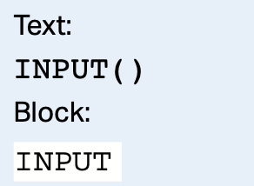
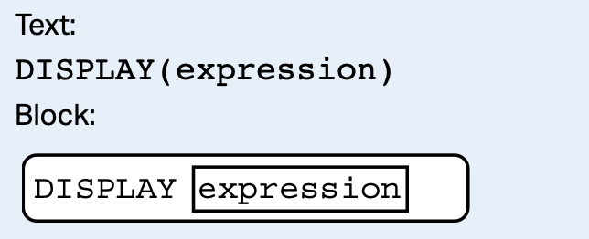
AP Exam(Important)
Procedures use on the AP Exam:
which accepts a value from the user
and returns the input value.
to display the value of expression, followed
by a space.

Slide 22
You Try it!
Write a computer program that, given the lengths of the two sides of a right triangle adjacent to the right angle, computes the length of the hypotenuse of the triangle. Use the template below.
# given a and b sides of a triangle, return hypotenuse
def hypotenuse(a, b):
# implement your code here
# ask user for sides: side1 and side2
# store hypotenuse for side1 and side2 in variable h
# print h

Slide 23
Flow of a Program
A Python script is executed line by line top to bottom. A function(procedure) call interrupts the sequential execution of statements, causing the program to execute the statements within the function before continuing. Once the last statement in the function (or a return statement) has executed, flow of control is returned to the point immediately following where the function was called.
def fun():
print("fun")
print("hello")
fun()
print(”after call")
Output:
hello
fun
after call
Function definitions are packaged into an executable unit to
be executed later.
The code within a function definition executes only when
invoked by a caller.

Slide 24
Flow of a Program
A Python script is executed line by line top to bottom.
def fun():
print("fun")
print("hello")
Output:
hello
The function fun() was never called. Its code doesn’t run!

Slide 25
Variables and Parameters are Local
An assignment statement in a function creates a local variable for the variable on the left hand side of the assignment operator. It is called local because this variable only exists inside the function and you cannot use it outside.
def square(x):
y = x * x # y only exists inside function
return y
z = square(8)
print(z)
print(y) # NameError! name 'y' is not defined.

Slide 26
Functions calling other functions
Each function we write can be used and called from other functions.
def square(x):
y = x * x
return y
def sum_of_squares(x, y, z):
a = square(x)
b = square(y)
c = square(z)
return a + b + c
a = int(input())
b = int(input())
c = int(input())
result = sum_of_squares(a, b, c)
print(result)
The variables x and y are local variables in both functions
and may even have different values.
Even though they are named the same, they are, in fact,
very different.
Similarly, a, b and c in the sum_of_squares function are
different than a, b and c outside of it.
Sample Run:
-3
4
5
50

Slide 27
Python Program Template
# declare and initialize global variables with file scope, these
# variables exist everywhere in the rest of the file including inside
# functions.
x = 3
# function definitions
def func1():
…
def func2():
…
# program logic flow starts here
# ask for user inputs, call functions above, etc..
a = func1()
print(a)
From now on, when we write a
program, we will use this template.

Slide 28
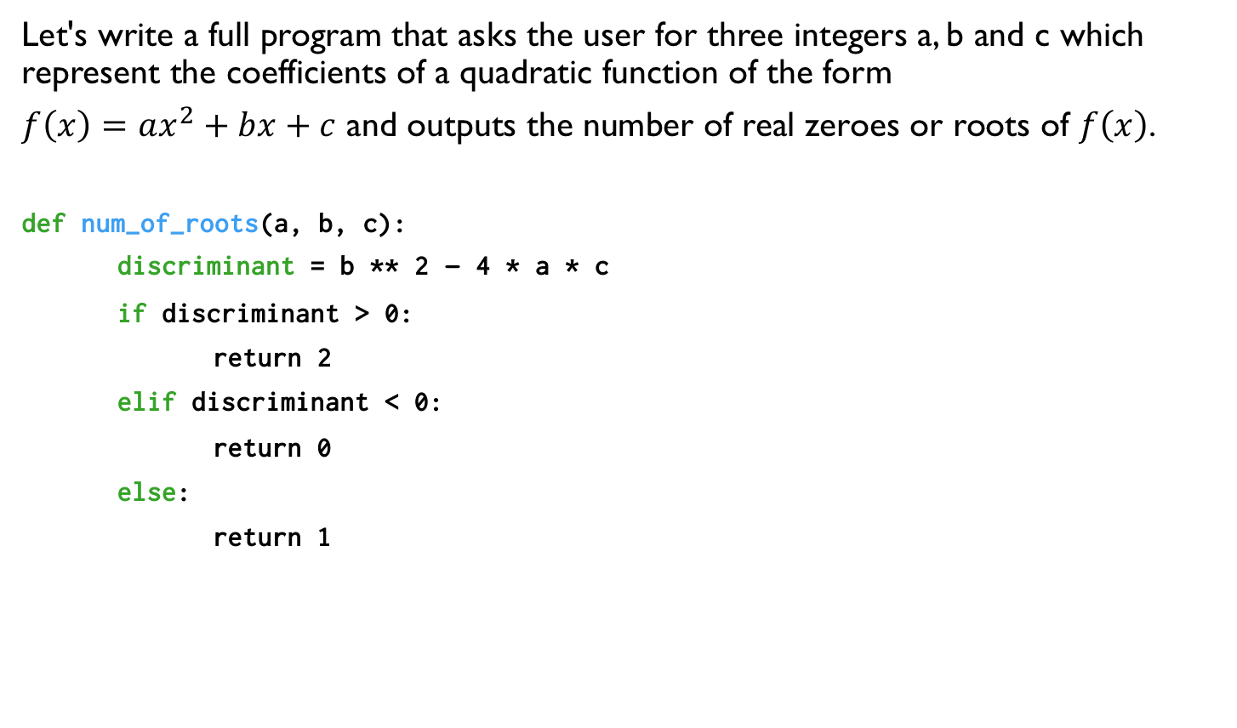
Writing a Simple Program: Quadratic Roots
Let's write a full program that asks the user for three integers a, b and c which represent the coefficients of a quadratic function of the form
$f\left(x\right)=ax^{2}+bx+c$ and outputs the number of real zeroes or roots of $f\left(x\right)$.
def num_of_roots(a, b, c):
discriminant = b ** 2 – 4 * a * c
if discriminant > 0:
return 2
elif discriminant < 0:
return 0
else:
return 1
a = float(input('Enter a:'))
b = float(input('Enter b:'))
c = float(input('Enter c:'))
numroots = num_of_roots(a, b, c)
print("This quadratic has", numroots, "real root(s).")

Slide 29
Functions on Strings
Functions we discussed so far are isolated, independent entities. Sometimes functions are associated with some object and operates on the data of that object. In this context, functions are called methods.
Strings is an example of a type of objects which contains methods. These methods can be accessed through the dot notation applied to a string variable or literal.
find(value) | returns the lowest index of a substring value in a string. If substring is not found, returns -1.
upper() and lower() | returns a copy of the string capitalizing(or lower casing) all characters in the string

Slide 30
String Methods
s = "Hi, Mike!"
index = s.find("Hi")
print(index) # 0, first letter’s index is 0.
print(s.find(" ")) # 3
print(s.find("Mike")) # 4
index2 = s.find("mike") # -1, not found
b = "python"
print(b.upper()) # PYTHON
print("JAVA".lower()) # java

Slide 31
String Methods
Note that upper(), lower() do not modify the original string but rather returns a new copy of the string.
s = "HI MIKE"
s.lower() # returned value "hi mike" is lost
print(s) # HI MIKE (s is unchanged)
s = s.lower() # store the modified, returned string back in s
print(s) # hi mike

Slide 32
f-Strings
f-Strings is the new way to format strings in Python. (v 3.6)
Also called “formatted string literals,” f-strings are string literals that have an f at the beginning and curly braces containing expressions that will be replaced with their values.
name = “Mike”
gpa = 3.2
f_str = f“I am {name} with a {gpa} gpa.”
print(f_str)
I am Mike with a 3.2 gpa.

Slide 33
f-Strings
An f-string is special because it permits us to write Python code within a string; any expression within curly brackets, {}, will be executed as Python code, and the resulting value will be converted to a string and inserted into the f-string at that position.
grade1 = 1.5
grade2 = 2.5
ave = f“average is {(grade1+grade2)/2}”
print(ave) # average is 2.0
This is equivalent but it is preferable to use an f-string.
average = “average is " + str((grade1+grade2)/2)

Slide 34


Lab 1: Math Calculations
Create a new repl on replit. Write a program that implement the functions
below. Test your functions by calling them and printing out their returned values.
area_rectangle: returns the area of the rectangle with length and width.
area_trapezoid: returns area of trapezoid with two bases and a height.
A = h(a + b)/2
area_triangle: returns area of a triangle given the sides: a, b and c.
fahrenheit_to_celsius: returns the temperature in celsius given the temperature in fahrenheit.
Notes:
// This program computes two people's body mass index (BMI) and
// compares them. The code uses parameters, returns, and Scanner.
import java.util.*; // so that I can use Scanner
public class BMI {
public static void main(String[] args) {
System.out.println("This program reads in data for two people and");
System.out.println("computes their body mass index (BMI)");
System.out.println();
// finish me!
}
}

Slide 35
Lab 1: Math Calculations
Sample Output for Lab1: The output doesn't have to be exactly like shown below. Be sure to check that all the functions are implemented correctly.
Enter length of rectangle: 10
Enter width of rectangle: 2
Area of rectangle is 20
Enter side1 of triangle: 3
Enter side2 of triangle: 4
Enter side3 of triangle: 5
Area of triangle is 6.0
Notes:
// This program computes two people's body mass index (BMI) and
// compares them. The code uses parameters, returns, and Scanner.
import java.util.*; // so that I can use Scanner
public class BMI {
public static void main(String[] args) {
System.out.println("This program reads in data for two people and");
System.out.println("computes their body mass index (BMI)");
System.out.println();
// finish me!
}
}

Slide 36
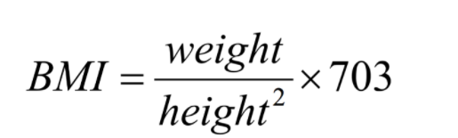
Lab 2: BMI
Create a new repl on replit. Write a program that asks the user to enter their
height in inches and weight in pounds and display the body mass index(BMI).
Implement the function bmi to calculate the bmi.
def bmi(height, weight):
# implement this function to compute the bmi given the height
# and weight.
# ask the user to enter height
# ask the user to enter weight
# call the bmi function and display the result.
Notes:
// This program computes two people's body mass index (BMI) and
// compares them. The code uses parameters, returns, and Scanner.
import java.util.*; // so that I can use Scanner
public class BMI {
public static void main(String[] args) {
System.out.println("This program reads in data for two people and");
System.out.println("computes their body mass index (BMI)");
System.out.println();
// finish me!
}
}

Slide 37
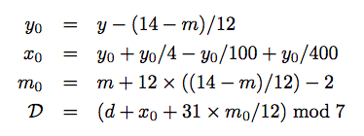
Lab 3: Day Of the Week
Create a new repl on replit. Write a program that outputs the day of the week for a given
date! You program must the program template discussed in this lecture.
Given the month, m, day, d and year y, the day of the week(Sunday = 0, Monday = 1, …,
Saturday = 6) D is given by:
Note: the / operator from the above equations is floor division // in Python. The
mod operator is %.
Use the template on the next page.
Notes:
// This program computes two people's body mass index (BMI) and
// compares them. The code uses parameters, returns, and Scanner.
import java.util.*; // so that I can use Scanner
public class BMI {
public static void main(String[] args) {
System.out.println("This program reads in data for two people and");
System.out.println("computes their body mass index (BMI)");
System.out.println();
// finish me!
}
}

Slide 38
Lab 3: Day Of the Week
Use the following template.
def compute_day(month, day, year):
""" This function computes the values given from the previous slide
and returns an integer in the set {0,1,..,5,6}.
"""
def day_of_week(d):
""" Given d which computed from compute_day above. This function returns
a string according to the value of d: "Sunday" for 0, "Monday for 1,
etc..
"""
# ask users for month, day and year
# call compute_day and day_of_week above
# print out day of the week.

Slide 39
Lab 3: Day Of the Week
Your program should have output similar to the following:
Enter month: 10
Enter day: 27
Enter year: 2020
Day of the week: Tuesday
And try entering your birthday and test your parents!
Notes:
// This program computes two people's body mass index (BMI) and
// compares them. The code uses parameters, returns, and Scanner.
import java.util.*; // so that I can use Scanner
public class BMI {
public static void main(String[] args) {
System.out.println("This program reads in data for two people and");
System.out.println("computes their body mass index (BMI)");
System.out.println();
// finish me!
}
}

Slide 40
References
Vanderplas, Jake, A Whirlwind Tour of Python, O’reilly Media.
Halterman, Richard, Fundamentals of Python Programming.

