Slide 1
Introduction to Python
Basic Datatypes
Integers, Floats, Booleans, NoneType

Slide 2
Topics
Python interpreters
Python Scripts
repl.it
Printing with print()
Basic Built-In Number Types
Integers (division vs. floor division)
Floats
Booleans
NoneType

Slide 3
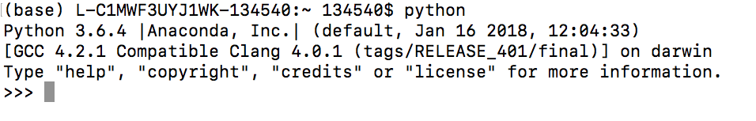
Python Interpreter
The most basic way to execute Python code is line by line within the Python interpreter.
Assuming that Python is already installed, typing “python” at the command prompt (Terminal on Mac OS X and Unix/Linux systems, Command Prompt or Anaconda Prompt in Windows):

Slide 4
Python Interpreter
With Python interpreter, we can execute Python code line by line.
>>> 1 + 1
2
>>> x = 5
>>> x * 3
15

Slide 5
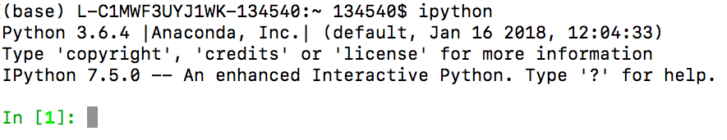
IPython Interpreter
It is recommended that you install Anaconda distribution which includes Python and many useful packages for scientific computing and data science.
Bundled with Anaconda is the IPython interpreter. Type “ipython” on your terminal(Mac). For windows, bundled with Anaconda is a set of programs. Open the “Anaconda Prompt” program. Then type “ipython”.

Slide 6
IPython Interpreter
The main difference between the Python interpreter and the enhanced IPython interpreter lies in the command prompt:
Python uses >>> by default, while IPython uses numbered commands.
In[1]: 1 + 1
Out[1]: 2
In[2]: x = 5
In[3]: x * 3
Out[3]: 15

Slide 7
IPython Interpreter
Running Python snippets line by line using the Ipython interpreter is useful if you’re trying to experiment and learn Python syntax or explore how to solve a problem.
Every line is executed one at a time, allowing you to see output as you explore.
We will use the Ipython interpreter to teach/learn Python syntax in these lecture slides.

Slide 8
Python Scripts
But for more complicated programs it is more convenient to save code to file and execute it all at once.
By convention, Python scripts are saved in files with a .py extension.
Scripts are written using an IDE(Integrated Development Environment). We will initially use an online IDE (repl.it, login with your Google account) to learn the basics of Python.
A popular IDE that can be installed locally on your computer is Visual Studio Code.

Slide 9
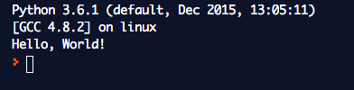
Our First Program
print("Hello, World!")
1) The print() function prints messages on the console.
2) Characters enclosed in quotes(single or double) forms a literal string.
3) The console output string does not include the quotes.

Slide 10
print(*objects, sep=‘ ’, end=‘\n’)
print("hello")
print("hello", "Mike")
print("hello", "Mike", "how are you?", sep=",")
print("home", "user", "documents", sep="/")
Output:
hello
hello Mike
hello,Mike,how are you?
home/user/documents
any number of positional arguments
specify separator character; defaults to space
specify end character; defaults to newline

Slide 11
print(*objects, sep=‘ ’, end=‘\n’)
print("mon", "tues”, sep=", ", end=", ")
print("wed", "thurs", sep=", ”, end=", ")
print("fri", "sat", "sun", sep=", ")
print("cursor is now here")
Output:
mon, tues, wed, thurs, fri, sat, sun
cursor is now here
any number of positional arguments
specify separator character; defaults to space
specify end character; defaults to newline

Slide 12
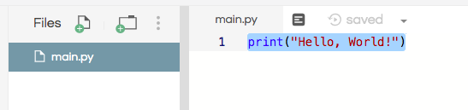

Python Scripts
repl.it: Create a new repl and pick Python as the language, name the repl.
Type in the code in the file main.py. Click on run.
print("Hello, World!")

Slide 13


A Syntax Example
In [1]:
# initialize x
x = 5
if x < 10:
x = x + 4
print(x)
print(x)
a block of code is a set of statements that should be treated as a unit.
indented code are always preceded by a colon on the previous line.
code blocks
are denoted by indentation
(4 spaces)

Slide 14
Dynamic Typing
Python is dynamically typed: variable names can point to objects of any type.
Unlike Java or C, there is no need to “declare” the variable.
In [1]: x = 1 # x is an integer
x = ‘hello’ # now x is a string
x = [1, 2, 3] # now x is a list

Slide 15
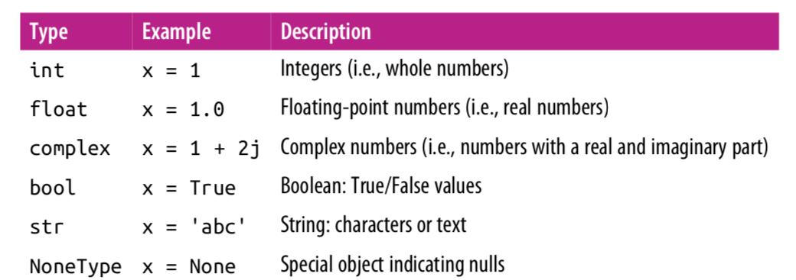
Basic Built-In Types

Slide 16
Built-In Function type()
In[1]: x = 4
In[2]: type(x)
Out[2]: int
In[3]: x = ‘hello’
In[4]: type(x)
Out[4]: str
In[5]: x = 3.14159
In[6]: type(x)
Out[6]: float

Slide 17
Integers
The most basic numerical type is the integer.
Any number without a decimal point is an integer.
In [1]: x = 1
type(x)
Out [1]: int
Python integers are variable-precision, so you can do computations that would overflow in other languages.
In [2]: 2 ** 200
Out [2]: 1606938044258990275541962092341162602522202993782792835301376

Slide 18
Integers
By default, division upcasts integers to floating-point type:
In [3]: 5 / 2
Out [3]: 2.5
You can use the floor-division operator //. Floor-division rounds down to next integer after division.
In [4]: 5 // 2
Out [4]: 2

Slide 19
Floating Point
The floating-point type can store fractional numbers.
They can be defined either in standard decimal notation, or in exponential notation:
In [5]: x = 0.000005
y = 5e-6
print(x == y)
True
In [6]: x = 1400000.00
y = 1.4e6
print(x == y)
True

Slide 20
Floating Point Precision
One thing to be aware of with floating-point arithmetic is that its precision is limited, which can cause equality tests to be unstable.
In [8]: 0.1 + 0.2 == 0.3
Out [8]: False
In [9]: print(f‘0.1 = {0.1:.17f}’) # this is an f-string
print(f‘0.2 = {0.2:.17f}’) # prints 17 characters
print(f‘0.3 = {0.3:.17f}’) # after decimal point
0.1 = 0.10000000000000001
0.2 = 0.20000000000000001
0.3 = 0.29999999999999999
We will cover f-strings later in another lecture.

Slide 21
Casting
The int() and float() functions can be called to cast a value to an integer or float, respectively.
In[3]: x = int(1) # x will be 1
y = int(2.8) # y will be 2
z = int(‘3’) # z will be 3
a = float(2.8) # a will be 2.8
b = float(“3”) # b will be 3.0
c = float(‘4.2’) # c will be 4.2

Slide 22
Boolean Type
The Boolean type is a simple type with two possible values: True and False.
Boolean values are case-sensitive: unlike some other languages, True and False must be capitalized!
Comparison operators return
True or False values.
In [2]: result = (4 < 5)
result
Out[2]: True
In[3]: 3 == 5
Out[3]: False
In[1]: x = False
type(x)
Out[1]: bool

Slide 23
NoneType
Python includes a special type, the NoneType, which has only a single possible value: None.
In [24]: type(None)
Out [24]: NoneType
None is often used as the default value for parameters of methods. More on this later.

Slide 24
Lab 1
Download and install Anaconda on your home computer.
https://www.anaconda.com/distribution/
On your computer. Open the IPython interpreter. Experiment with some of the concepts we learn:
Print some strings. Experiment with the “sep” and “end” parameters.
Try division vs floor division with integers. Try some which has negative dividends as well as negative divisors.
Initialize some floating point variables in both standard decimal notation and in exponential notation.
Experiment with the type() function.
Try to use int() and float() to cast.
Work with boolean expressions.

Slide 25
Lab 2
Create a new repl on repl.it.
Repeat some of the things you did from Lab 1 in the script main.py.
The IPython interpreter runs your code and display the outputs. In your script, you won’t have this feature. Instead, use the print() function to print out the values of your variables.

Slide 26
References
Vanderplas, Jake, A Whirlwind Tour of Python, O’reilly Media.
This book is completely free and can be downloaded online at O’reilly’s site.

