Slide 1
Lecture 4: Conditionals
Building Java Programs: A Back to Basics Approach
by Stuart Reges and Marty Stepp
Copyright (c) Pearson 2013.
All rights reserved.

Slide 2
Type boolean

Slide 3
Type boolean
boolean: A logical type whose values are true and false.
  It is legal to:
    create a boolean variable
    pass a boolean value as a parameter
    return a boolean value from methods
    call a method that returns a boolean and use it as a test
  int age = 18;
  String name = “Mr. Smith”;
  boolean minor = (age < 21);
  boolean lovesAPCS = true;

Slide 4
Using boolean
Why is type boolean useful?
  Can capture a complex logical test result and use it later
  Can write a method that does a complex test and returns it
  Makes code more readable
  Can pass around the result of a logical test (as param/return)
  int age = 21, height = 88;
  double salary = 100000;
  boolean goodAge = age >= 12 && age < 29;//true
  boolean goodHeight = height >= 78 && height < 84;//false
  boolean rich = salary >= 100000.0;//true
  NOTE: && is the “and” operator. See slide 13.

Slide 5

The if statement
Executes a block of statements only if a test is true
  if (test) {
  statement;
  ...
  statement;
  }
Example:
  double gpa = console.nextDouble();
  if (gpa >= 2.0) {
  System.out.println("Application accepted.");
  }

Slide 6
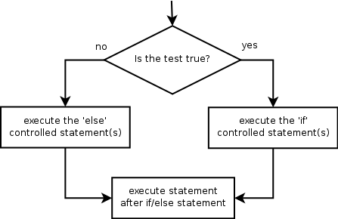
The if/else statement
Executes one block if a test is true, another if false
  if (test) {
  statement(s);
  } else {
  statement(s);
  }
Example:
  double gpa = console.nextDouble();
  if (gpa >= 2.0) {
  System.out.println("Welcome to Mars University!");
  } else {
  System.out.println("Application denied.");
  }

Slide 7
Relational expressions
Tests use relational operators:
Operator | Meaning | Example | Value
== | equals | 1 + 1 == 2 | true
!= | does not equal | 3.2 != 2.5 | true
< | less than | 10 < 5 | false
> | greater than | 10 > 5 | true
<= | less than or equal to | 126 <= 100 | false
>= | greater than or equal to | 5.0 >= 5.0 | true
Notes:
Note that == tests equality, not = . The = is used for the assignment operator!

Slide 8
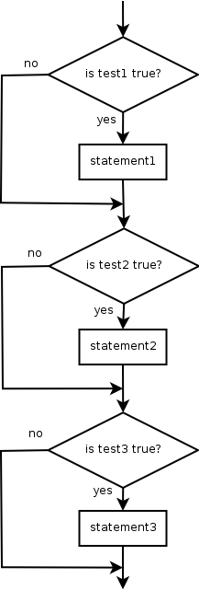
Misuse of if
What's wrong with the following code?
  int percent = <Code to ask user to enter a percentage>
  if (percent >= 90) {
  System.out.println("You got an A!");
  }
  if (percent >= 80) {
  System.out.println("You got a B!");
  }
  if (percent >= 70) {
  System.out.println("You got a C!");
  }
  if (percent >= 60) {
  System.out.println("You got a D!");
  }
  if (percent < 60) {
  System.out.println("You got an F!");
  }
  ...

Slide 9

Nested if/else
Chooses between outcomes using many tests
  if (test) {
  statement(s);
  } else if (test) {
  statement(s);
  } else {
  statement(s);
  }
Example:
  if (x > 0) {
  System.out.println("Positive");
  } else if (x < 0) {
  System.out.println("Negative");
  } else {
  System.out.println("Zero");
  }

Slide 10
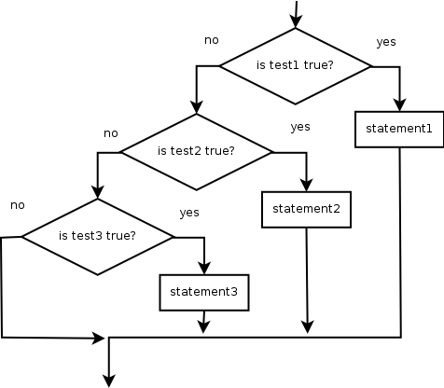
Nested if/else/if
  If it ends with else, exactly one path must be taken.
  If it ends with if, the code might not execute any path.
  if (test) {
  statement(s);
  } else if (test) {
  statement(s);
  } else if (test) {
  statement(s);
  }
Example:
  if (place == 1) {
  System.out.println("Gold medal!");
  } else if (place == 2) {
  System.out.println("Silver medal!");
  } else if (place == 3) {
  System.out.println("Bronze medal.");
  }

Slide 11
Nested if structures
exactly 1 path (mutually exclusive) if (test) { statement(s); } else if (test) { statement(s); } else { statement(s); } | 0 or 1 path (mutually exclusive) if (test) { statement(s); } else if (test) { statement(s); } else if (test) { statement(s); }
0, 1, or many paths (independent tests; not exclusive) if (test) { statement(s); } if (test) { statement(s); } if (test) { statement(s); }

Slide 12
Which nested if/else?
(1) if/if/if (2) nested if/else (3) nested if/else/if
  Whether a user is lower, middle, or upper-class based on income.
    (2) nested if / else if / else
  Whether you made the dean's list (GPA ≥ 3.8) or honor roll (3.5-3.8).
    (3) nested if / else if
  Whether a number is divisible by 2, 3, and/or 5.
    (1) sequential if / if / if
  Computing a grade of A, B, C, D, or F based on a percentage.
    (2) nested if / else if / else if / else if / else

Slide 13
Logical operators
Tests can be combined using logical operators:
"Truth tables" for each, used with logical values p and q:
Operator | Description | Example | Result
&& | and | (2 == 3) && (-1 < 5) | false
|| | or | (2 == 3) || (-1 < 5) | true
! | not | !(2 == 3) | true
p | q | p && q | p || q
true | true | true | true
true | false | false | true
false | true | false | true
false | false | false | false
p | !p
true | false
false | true

Slide 14
Using boolean
  boolean goodAge = age >= 12 && age < 29;
  boolean goodHeight = height >= 78 && height < 84;
  boolean rich = salary >= 100000.0;
  if ((goodAge && goodHeight) || rich) {
  System.out.println("Okay, let's go out!");
  } else {
  System.out.println("It's not you, it's me...");
  }

Slide 15
Using boolean
  boolean minor = (age < 21);
  boolean isProf = name.contains("Prof");
  boolean lovesAPCS = true;
  // allow only APCS-loving students over 21
  if (minor || isProf || !lovesAPCS) {
  System.out.println("Can't enter the club!");
  }

Slide 16
Evaluating logic expressions
Relational operators have lower precedence than math.
    5 * 7 >= 3 + 5 * (7 - 1)
    5 * 7 >= 3 + 5 * 6
    35 >= 3 + 30
    35 >= 33
    true
Relational operators cannot be "chained" as in algebra.
    2 <= x <= 10
    true <= 10 (assume that x is 15)
    error!
  Instead, combine multiple tests with && or ||
    2 <= x && x <= 10
    true && false
    false

Slide 17
Evaluating logic expressions
AND is evaluated before OR.
int x = 2;
int y = 4;
int z = 5;
    z > 2 || x > 3 && y < 3 ;
    // true if evaluate && before ||
    // false if evaluate || before &&
    // the correct answer is true: &&
    // must be evaluated before ||

Slide 18
Logical questions
What is the result of each of the following expressions?
  int x = 42;
  int y = 17;
  int z = 25;
  y < x && y <= z
  x % 2 == y % 2 || x % 2 == z % 2
  x <= y + z && x >= y + z
  !(x < y && x < z)
  (x + y) % 2 == 0 || !((z - y) % 2 == 0)
    Answers: true, false, true, true, false

Slide 19
if/else with return
  // Returns the larger of the two given integers.
  public static int max(int a, int b) {
  if (a > b) {
  return a;
  } else {
  return b;
  }
  }
Methods can return different values using if/else
  Whichever path the code enters, it will return that value.
  Returning a value causes a method to immediately exit.
  All paths through the code must reach a return statement.

Slide 20
All paths must return
  public static int max(int a, int b) {
  if (a > b) {
  return a;
  }
  // Error: not all paths return a value
  }
The following also does not compile:
  public static int max(int a, int b) {
  if (a > b) {
  return a;
  } else if (b >= a) {
  return b;
  }
  }
  The compiler thinks if/else/if code might skip all paths, even though mathematically it must choose one or the other.

Slide 21
if/else, return question
Write a method quadrant that accepts a pair of real numbers x and y and returns the quadrant for that point:
  Example: quadrant(-4.2, 17.3) returns 2
    If the point falls directly on either axis, return 0.
y+
quadrant 2
quadrant 1
x-
x+
quadrant 3
quadrant 4
y-

Slide 22
if/else, return answer
  public static int quadrant(double x, double y) {
  if (x > 0 && y > 0) {
  return 1;
  } else if (x < 0 && y > 0) {
  return 2;
  } else if (x < 0 && y < 0) {
  return 3;
  } else if (x > 0 && y < 0) {
  return 4;
  } else { // at least one coordinate equals 0
  return 0;
  }
  }

Slide 23
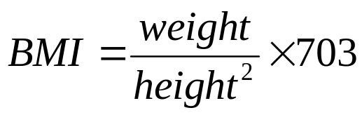
Lab 1: BMI
Create a folder called BMI for
these labs.
Formula for body mass index (BMI):
Write a program that produces output like the following:
  Height (in inches) 70.0
  Weight (in pounds) 194.25
  BMI = 27.868928571428572
  Overweight
BMI | Weight class
below 18.5 | underweight
[18.5 – 25) | normal
[25.0 – 30) | overweight
30.0 and up | obese
Notes:
// This program computes two people's body mass index (BMI) and
// compares them. The code uses parameters, returns, and Scanner.
import java.util.*; // so that I can use Scanner
public class BMI {
public static void main(String[] args) {
System.out.println("This program reads in data for two people and");
System.out.println("computes their body mass index (BMI)");
System.out.println();
// finish me!
}
}

Slide 24
BMI
Your program must include two methods:1) the method bmi which takes two double parameters height and weight and returns the bmi and 2) the method weightClass which takes two double parameters height and weight and returns a string classifying the weight class. The weightClass method must call the bmi method!
public static double bmi(double height, double weight)
{…}
public static String weightClass(double height, double weight)
{…}
Notes:
// This program computes two people's body mass index (BMI) and
// compares them. The code uses parameters, returns, and Scanner.
import java.util.*; // so that I can use Scanner
public class BMI {
public static void main(String[] args) {
System.out.println("This program reads in data for two people and");
System.out.println("computes their body mass index (BMI)");
System.out.println();
// finish me!
}
}

Slide 25
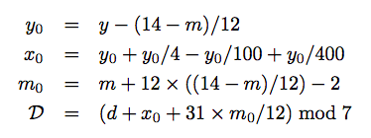
Lab 2: Day Of the Week
Write a program that outputs the day of the week for a given date.
Create a new folder in CS50 called DayOfWeek.
Given the month, m, day, d and year y, the day of the week(Sunday =
0, Monday = 1, …, Saturday = 6) D is given by:
Your program needs one method:
public static int dayOfWeek(int m, int d, int y){
}
Notes:
// This program computes two people's body mass index (BMI) and
// compares them. The code uses parameters, returns, and Scanner.
import java.util.*; // so that I can use Scanner
public class BMI {
public static void main(String[] args) {
System.out.println("This program reads in data for two people and");
System.out.println("computes their body mass index (BMI)");
System.out.println();
// finish me!
}
}

Slide 26
Day Of the Week
Write the main method so that the output is similar
to the following:
Output:
Date: 9-25-2018
Day of the week: Tuesday
Use conditionals!
Notes:
// This program computes two people's body mass index (BMI) and
// compares them. The code uses parameters, returns, and Scanner.
import java.util.*; // so that I can use Scanner
public class BMI {
public static void main(String[] args) {
System.out.println("This program reads in data for two people and");
System.out.println("computes their body mass index (BMI)");
System.out.println();
// finish me!
}
}

