Slide 1
Introduction to Python
Operations and Variables

Slide 2
Topics
Arithmetic Operations
Floor Division vs True Division
Modulo Operator
Operator Precedence
String Concatenation
Augmented Assignment

Slide 3
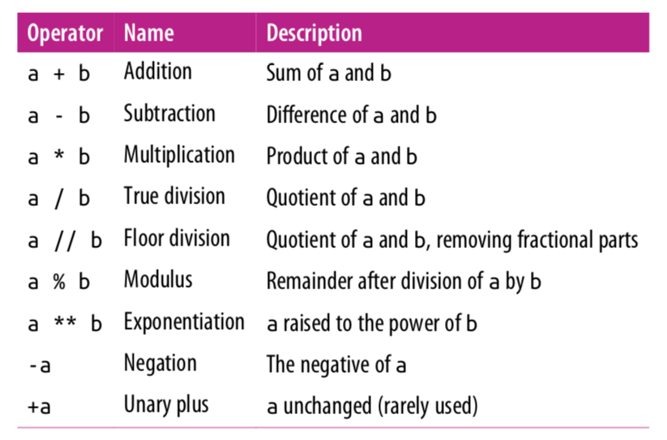
Arithmetic Operations

Slide 4
Mixing Types
Any expression that two floats produce a float.
x = 17.0 – 10.0
print(x) # 7.0
When an expression’s operands are an int and a float, Python automatically converts the int to a float.
x = 17.0 – 10
print(x) # 7.0
y = 17 – 10.0
print(y) # 7.0

Slide 5
True Division vs Floor Division
The operator / is true division and the operator // returns floor division(round down after true divide). True divide / always gives the answer as a float.
print(23 // 7) # 3
print(3 // 9) # 0
print(-4 // 3) # -2
print(6 / 5) # 1.2
print(6 / 3) # 2.0 NOT 2!

Slide 6
Remainder with %
The % operator computes the remainder after floor division.
14 % 4 is 2
218 % 5 is 3 3 43 4 ) 14 5 ) 218 12 20 2 18 15 3
Applications of % operator:
Obtain last digit of a number: 230857 % 10 is 7
Obtain last 4 digits: 658236489 % 10000 is 6489
See whether a number is odd: 7 % 2 is 1, 42 % 2 is 0
Notes:
6
What is 8 % 20? It's 8, but students often say 0.

Slide 7
Modulo Operator
The operator % returns the modulus which is the remainder after floor division.
print(18 % 5) # 3
print(2 % 9) # 2, if first number is smaller, it's the answer
print(125 % 10) # 5
print(0 % 10) # 0
print(10 % 0) # ZeroDivisionError

Slide 8
Why floor/modulo division is useful
Floor division allows us to extract the integer part of the division while the modulo operator extracts the remainder part of the division. Consider the question:
How many weeks and days are there in 25 days?
Answer: 3 weeks plus 4 days.
num_weeks = 25 // 7 # extracting number of weeks
print(num_weeks) # 3
num_days = 25 % 7 # extracting number of days
print(num_days) # 4

Slide 9
Why the modulo operator is useful
If today is a Tuesday, which day is 43 days from today?
Answer: 43 divided by 7 is 6 with a remainder of 1. Thus, it will be Wednesday.
print(43 % 7) # 1
Even/odd: A number x is even if x % 2 is 0 and odd if x % 2 is 1.
num = int(input(‘Please enter an integer value: ’))
print(num, 'is even:', num % 2 == 0)
Output 1:
Please enter an integer value: 4
4 is even: True
Output 2:
Please enter an integer value: 13
13 is even: False

Slide 10
Expressions
Find the exact change for 137 cents using quarters, dimes, nickels and cents. Use the least
number of coins.
How many quarters? 137 // 25 = 5 quarters (Floor Division!)
What’s leftover? 137 % 25 = 12 cents
How many dimes? 12 // 10 = 1 dime
What’s leftover? 12 % 10 = 2 cents
How many nickels? 2 // 5 = 0 nickels.
What’s leftover? 2 % 5 = 2 cents.
How many pennies? 2 // 1 = 2 pennies
What’s leftover? 2 % 1= 0 cents. Done!

Slide 11
Extracting Digits
Given a three-digit integer. Extract its the ones, tens and hundreds digits.
For example, if the integer is 352. Its ones digit is the 2, its tens digit is the 5 and
its hundreds digit is the 3.
number = 352
print("ones:", number % 10)
number = number // 10
print(number)
print("tens:", number % 10)
number = number // 10
print(number)
Note: Modulo 10 (% 10) extracts the last digit. Floor division (// 10) discards the
last digit. Later in another lecture, we will see how to generalize this to
any number of digits.
# ones: 2
# number = 35 (discards last digit)
# 35
# tens: 5
# number = 3 (discards last digit)
# 3

Slide 12
Extracting Digits
Alternatively:
number = 352
ones = number % 10
tens = (number // 10) % 10
hundreds = number // 100
print("ones:", ones, "tens", tens, "hundreds:", hundreds)
Output:
ones: 2 tens: 5 hundreds: 3

Slide 13
Exponentiation and Negation
x = 2 ** 3
print(x) # 8
Negation is a unary operator. It applies to only one operand. Other operations such as +, -, *, /, //, % are binary operators, they apply to two operands.
x = -5
y = --5
print(x) # -5
print(y) # 5

Slide 14
Operator Precedence
Precedence | Operator | Operation
highest | ** | exponentiation
 | - | negation
 | *, /, //, % | multiplication, division, floor division, modulus
lowest | +, - | adding, subtraction
Operators on the same row are applied left to right. Exponentiation, however, is
applied right to left. Expressions in parenthesis are evaluated first(PEMDAS).

Slide 15
Operator Precedence
x = -2 ** 4
print(x) # -16
y = 7 – 4 * 5 % (1 + 2)
print(y) # 5
7 - 4 * 5 % (1 + 2)
7 – 4 * 5 % 3
7 – 20 % 3
7 – 2
5

Slide 16
Augmented Assignment
An augmented assignment combines an assignment statement with an operator to make the statement more concise.
Shorthand Equivalent version
variable += value variable = variable + value
variable -= value variable = variable - value
variable *= value variable = variable * value
variable /= value variable = variable / value
variable %= value variable = variable % value
x = 4
x += 1 # equivalent to x = x + 1
print(x) # 5

Slide 17
Augmented Assignment
x = 3
x *= 2 + 5
print(x) # 21
number = 5
number *= number
print(number) # 25

Slide 18
String Concatenation
Two strings can be combined, or concatenated, using the + operator:
string1 = "abra" string2 = "cadabra" magic_string = string1 + string2
first = "Michael" last = "Smith" full_name = first + " " + last
Concatenating a string and a number raises a TypeError. Must first cast the number into a string using str().
apples = "I have " + 3 + "apples" # error! apples = "I have " + str(3) + "apples" # correct!

Slide 19
Lab 1: Modulo Operator
Create a new repl on repl.it. Write code to match the following console output. Underline numbers are user inputs; you must use the input() function.
Create the following variables: ones, tens and hundreds
Enter a three-digit number: 245
The sum of the digits of 245 is 11.
Create the following variables: quarters, dimes, nickels and pennies.
Enter amount in cents: 137
Number of quarters: 5
Number of dimes: 1
Number of nickels: 0
Number of pennies: 2

Slide 20
References
Vanderplas, Jake, A Whirlwind Tour of Python, O’Reilly Media.
This book is completely free and can be downloaded online at O’reilly’s site.

