Slide 1
2021 AP CS A Exam Exam Overview

Slide 2
AP Exam
When: Tuesday June 1, 2021 at 4PM Eastern Standard Time.
At home. On Digital Testing App.
Preparing:
Download! https://download.app.collegeboard.org/
The Digital Testing App can be installed on desktops and laptops. Personal Chromebooks are not allowed. Only school-managed Chromebooks which already have the App installed can be used.
2) Practice with Example Questions in the Digital Testing App.
3) 1–3 Days Before Exam Day, Complete Exam Setup for Each Digital Exam. You cannot take the exam without completing this step!
4) On Exam Day: 30 Minutes Before the Exam | Check In to the Exam
On exam day, you must check in 30 minutes before the official start time of the exam—at 11:30 a.m. EDT for 12 p.m. exams and 3:30 p.m. EDT for 4 p.m. exams—to complete final pre-exam checks.

Slide 3
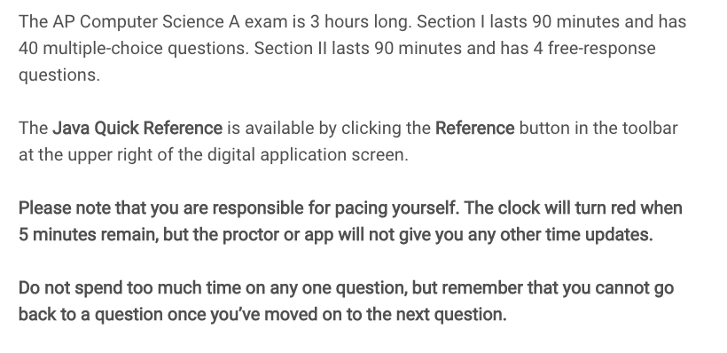

Exam Directions(from actual Exam)
This directions are the same as on your actual exam. Read it now and don't waste time reading it on the exam!
IMPORTANT!!

Slide 4
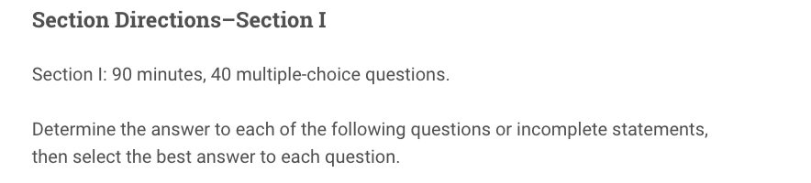
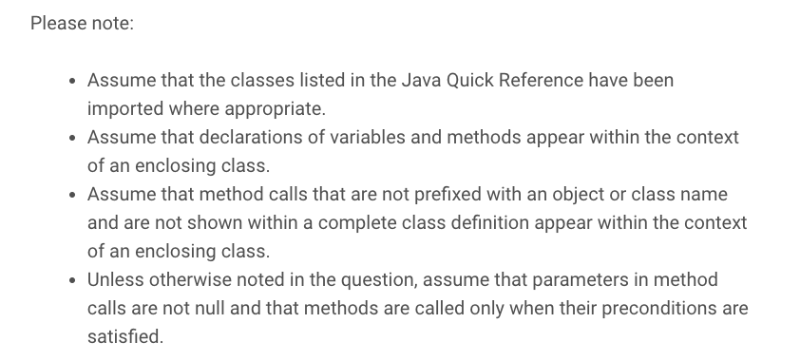

Slide 5
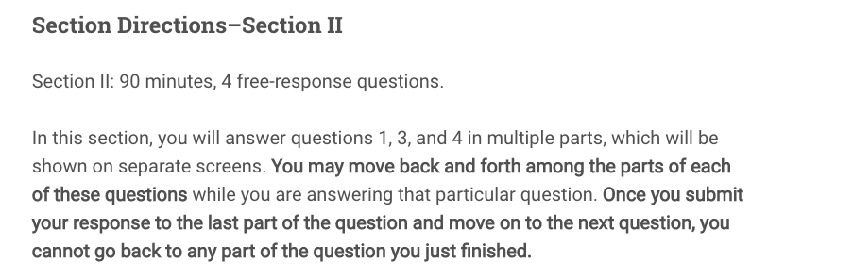
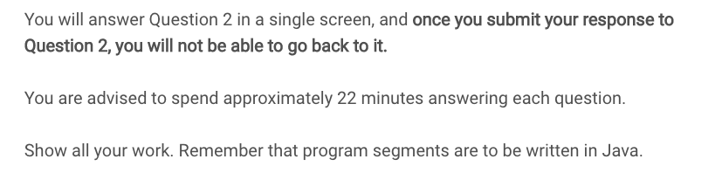

Slide 6
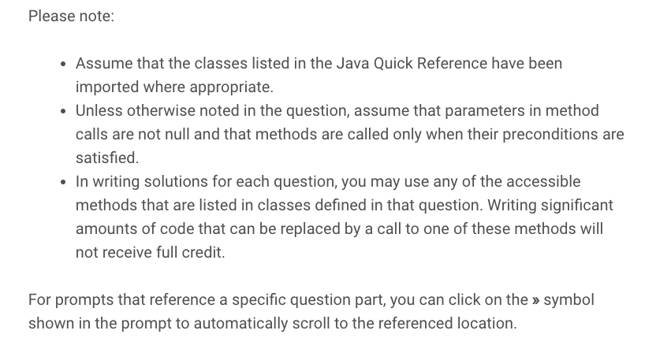

Slide 7
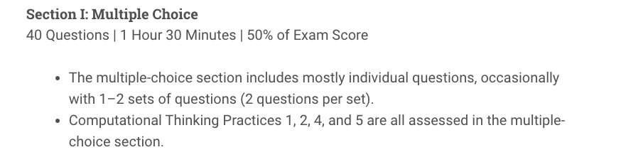

Slide 8
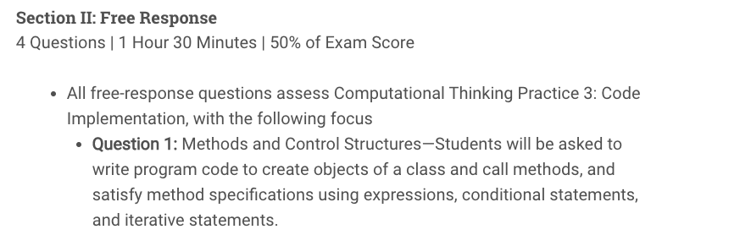

Note that Question 2 will be answered completely on one screen.
Questions 1, 3 and 4 have multiple parts and for each question, you can move among the parts but once you submit your answer, you cannot go back.

Slide 9
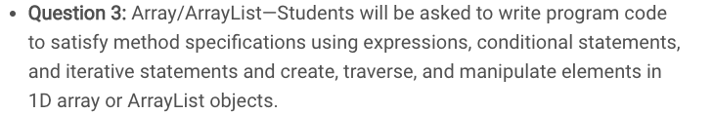
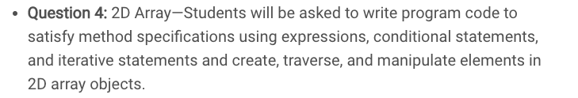
Even though not explicitly listed, Strings are very popular on the Free Response part of the AP exams. Know the string methods listed on the reference sheet really well!
Java Reference Sheet
or here:
https://apcentral.collegeboard.org/pdf/ap-computer-science-a-java-quick-reference.pdf

Slide 10
Strings
Strings and String methods have shown up every year. Likely it will show up on this year's AP Exam.
You may have to work with 1D array or ArrayList of Strings.
You should know how to use substring(int beg, int end), substring(int beg), indexOf, equals, length and compareTo methods. See the College Board reference sheet.

Slide 11
At Home Test
We're confident that the vast majority of AP students will follow the rules for taking the exams.
For the small number of students who may try to gain an unfair advantage, we have a comprehensive and strict set of protocols in place to prevent and detect cheating.
While some of these practices are confidential to maximize their effectiveness, students and education professionals can learn more about our security measures.

Slide 12
At Home Test
At a minimum, test takers should understand that those attempting to gain an unfair advantage will either be blocked from testing or their AP scores will be canceled, and their high school will be notified as will colleges or other organizations to which the student has already sent any College Board scores (including SAT® scores).
And they may be prohibited from taking a future Advanced Placement® Exam as well as the SAT, SAT Subject Tests™, or CLEP® assessments.

Slide 13
Collaboration
Collaborating with others is not considered acceptable open notes: AP Exams give you an opportunity to show your mastery of a subject—not someone else’s. It is strictly forbidden to give or receive aid during the exam. Any students found using the work of others, exchanging or sharing information on exam topics, collaborating via any online platform, or soliciting tips for problem-solving approaches will be investigated for violating exam security.

Slide 14
Free Response
General Strategies for FRQS:
1) Read the questions before you read the code! This will help you focus.
2) Unless a question specifically addresses efficiency, focus on clear, simple code rather than complicated, efficient code.
3) Comments are not necessary. Use only to organize your thoughts.
4) Pay attention to the code they give you:
Do you have more than one class? Use it!
Did they give you methods? You will need them!
Are there instance variables that you should use? If so, use them. Do not re-declare.
Only use accessor and mutator methods to access private instance variables.
Do not re-write or change method headers.
Use parameters (names and types) as given

Slide 15
Free Response
General Strategies for FRQS:
5) If part (b) references a method written in part (a), you will likely need to use this method. If it is not clear to you how, stop and think before you write.
6) Pay attention to the return type. If it is not void, be sure to include a return statement!
7) If a method comment says /* Implementation not shown */. You do not to implement the method. But you'll likely need to use the method in your code at least once.

Slide 16
Free Response
General Strategies for FRQS:
8) Write down some code for every question! Leave Nothing Blank! Get partial credit if not full credit!
does it need a loop?
an if statement?
return statement or assignment statement?
Example 1:
public double funMethod(){
double result;
…
return result;
}

Slide 17
More Examples
Leave Nothing Blank! Get partial credit if not full credit!
public int[] funMethod(int length){
int[] list = new int[length];
…
return list;
}
public ArrayList<Bug> funMethod(){
ArrayList<Bug> buggies = new ArrayList<Bug>();
…
return buggies;
}

Slide 18
More Examples
Leave Nothing Blank! Get partial credit if not full credit!
public boolean funMethod(int something){
…
if(something > somethingElse)
return true;
// must have a default return; every return can’t be // locked in an if
return false;
}

Slide 19
Question 3: Arraylist/1D Array See previous years' similar FRQs: 2010 #1, 2013 #1, 2017 #1, 2018 #2, 2021#3

Slide 20
ArrayList/1D Arrays
We will first prepare for the FRQs by reviewing ArrayList and 1D arrays. This will be Question 3 on the Free Response.
From previous years' exams, it is likely that Question 3 is an ArrayList question instead of/in addition to an 1D array question.(ArrayList or both, unlikely to be just a 1D array question)
See the following problems 2010 #1, 2013 #1, 2017 #1, 2018 #2
It's very common to have a class(e.g Student) and another class which contains either a 1D array of Student objects or an ArrayList of Student objects.
public class Student {
…
public String getName(){..}
public double getGpa(){…}
}

Slide 21
ArrayList/1D Arrays
public class Course {
private ArrayList<Student> students;
public Course() {
students = new ArrayList<Student>();
...
}
}
OR
public class Course {
private Student[] students;
}
}

Slide 22
Traversing 1D Array vs. ArrayList
Arrays:
double sum = 0;
for(int i = 0; i < students.length; i++){
sum += students[i].getGpa();
}
ArrayLists:
double sum = 0;
for(int i = 0; i < students.size(); i++){
sum += students.get(i).getGpa();
}

Slide 23
Traversing 1D Array vs. ArrayList
Use for each loops if you are only traversing the arraylist and not removing items from it.
Both Arrays and Arraylists:
double sum =0;
for(Student s: students){
sum += s.getGpa();
// notice no [i] and no get(i)!!
}

Slide 24
ArrayList
Remember for Arraylists that if you remove an item, items to the right of it will shift left!
And if you add an item to the list, items will shift right to accommodate!
Make sure to take this into account when you are adding or removing items.

Slide 25
ArrayList/1D Array Tips
When using the ArrayList method remove(), remember you can only REMOVE BY INDEX (not by object), so you must use a traditional for loop (and NOT a for each loop).
for(int i=0; i<list.size(); i++){
if(list.get(i).getScore() <= 50)
list.remove(i);
i--;//AND don’t forget to decrement the index!
}
//OR traverse the list backwards, i.e.
for(int i=list.size()-1, i>=0, i--){
if(list.get(i).getScore() <= 50)
list.remove(i--); }

Slide 26
ArrayList/1D Array Tips
Avoid array and ArrayList out-of-bounds exceptions! Especially when comparing consecutive elements.
Example: You need to compare consecutive elements to determine if the values are increasing.
public boolean increasing(int[] numbers){
for(int i=0; i < numbers.length-1; i++)
if(numbers[i] >= numbers[i+1])
return false;
return true;
}

Slide 27
Finding the smallest or largest
When you need to return an element in a list (i.e. largest, smallest,…), assign the initial element to the first one in the list.
Example : You need to find the Dog with the most fleas.
//returns the Dog object in pack with the most fleas
public Dog mostFleas(ArrayList<Dog> pack){
Dog most = pack.get(0);
for(Dog dog : pack)
if(dog.getNumFleas() > most.getNumFleas())
most = dog;
return most;
}

Slide 28
Manipulating an Array using Arraylist
An ArrayList can be helpful when you are trying to manipulate an array (i.e. remove items, rearrange in random order, etc.).
Example:
If you need to remove several objects from an array based one some condition, a strategy would be to save all the objects to an ArrayList and remove the objects before storing the remaining objects back to the array.
See code on the next slide.

Slide 29
Manipulating an Array using Arraylist
//returns a new array with bad things removed
public Thing[] removeBadThing(Thing[] widgets){
ArrayList<Thing> good = new ArrayList<Thing>();
for(Thing wid : widgets){
if(!wid.isBad()) // i.e good
good.add(wid);
}
Thing[] goodOnes = new Thing[good.size()];
for(int i=0; i < goodOnes.length; i++)
goodOnes[i] = good.get(i);
return goodOnes;
}

Slide 30
Question 3
Please do the following 2010 #1, 2013 #1, 2017 #1, 2018 #2, 2021 #3 and check your solutions to prepare for Question 3.

Slide 31
Question 4: 2D Array See previous years' similar FRQs: 2019 #4, 2018 #4, 2017 #4, 2016 #3, 2021#4

Slide 32
Row Major Order Traversal
Example : Count the number of Students objects whose GPA is above a threshold. (row major order)
public class Course{
Student[][] students;
// constructors not shown
public int aboveThreshold(double threshold){
int count = 0;
for(int row = 0; row < students.length; row++){
for(int col = 0; col < students[0].length; col++){
if(students[row][col].getGpa() > threshold)
count++;
}}
return count;
}

Slide 33
Column Major Order Traversal
Example : Count the number of Students objects whose GPA is above a threshold. (column major order)
public class Course{
Student[][] students;
// constructors not shown
public int aboveThreshold(double threshold){
int count = 0;
for(int col = 0; col < students[0].length; col++){
for(int row = 0; row < students.length; row++){
if(students[row][col].getGpa() > threshold)
count++;
}
return count;
}

Slide 34
Along One Row
Example : Count the number of Students objects whose GPA is above a threshold in the given row.
public class Course{
Student[][] students;
// constructors not shown
public int aboveThreshold(int row, double threshold){
int count = 0;
for(int col = 0; col < students[row].length; col++){
if(students[row][col].getGpa() > threshold)
count++;
}
return count;
}

Slide 35
Along One Column
Example : Count the number of Students objects whose GPA is above a threshold in the given column.
public class Course{
Student[][] students;
// constructors not shown
public int aboveThreshold(int col, double threshold){
int count = 0;
for(int row = 0; row < students.length; row++){
if(students[row][col].getGpa() > threshold)
count++;
}
return count;
}

Slide 36
Major Diagonal Traversal
Example : Count the number of Students objects whose GPA is above threshold along the major diagonal. Assume 2D array is square.
public class Course{
Student[][] students;
// constructors not shown
public int aboveThreshold(double threshold){
int count = 0;
for(int i = 0; i < students.length; i++){
if(students[i][i].getGpa() > threshold)
count++;
}
return count;
}

Slide 37
Minor Diagonal Traversal
Example : Count the number of Students objects whose GPA is above threshold along the minor diagonal. Assume 2D array is square.
public class Course{
Student[][] students;
// constructors not shown
public int aboveThreshold(double threshold){
int count = 0;
int dim = students.length;
for(int i = 0; i < dim; i++){
if(students[i][dim – 1 - i].getGpa() > threshold)
count++;
}
return count;
}

Slide 38
Question 4
Please do the following 2019 #4, 2018 #4, 2017 #4, 2016 #3, 2021 #4 and check your solutions to prepare for Question 4.

Slide 39
Question 1: Methods and Control Structures See previous years' similar FRQs: 2018 #1, 2019 #1, 2017 #3, 2018 #2, 2021#1

Slide 40
Methods and Control Structures
Question 1 of the FRQ will likely ask you to write methods that utilize control structures(for vs while loops, conditionals).
Using Strings and its methods is likely to be in this question(or Question 2). See for example 2017 #3 for a String question that fits "Methods and Control Structures" question.
You should know how to use substring(int beg, int end), substring(int beg), indexOf, equals, length and compareTo methods. See the College Board reference sheet.

Slide 41
String methods
Method name | Description
String(String str) | Constructs a new String object that represents the same sequence of characters as str
int length() | Returns number of characters in this string
substring(index1, index2) or substring(index1) | Returns the characters in this string from index1 (inclusive) to index2 (exclusive); if index2 is omitted, grabs till end of string
boolean equals(String other) | Returns true if this is equal to other; returns false otherwise
int compareTo(String other) | Returns a value < 0 if this is less than other; returns zero if this is equal to other; returns a value > 0 if this is greater than other
indexOf(str) | Returns index where the start of the given string appears in this string (-1 if not found)

Slide 42
String method examples
// index 0123456789012345678
String s1 = ”programming in java";
System.out.println(s1.length());
// 19
System.out.println(s1.indexOf(“i")); // 8
System.out.println(s1.indexOf(“gram")); // 3
System.out.println(s1.indexOf(“hi")); // -1
System.out.println(s1.substring(7, 10)); // ”min"
System.out.println(s1.substring(12)); // ”in java”
System.out.println(s1.substring(2,3));// ”o”
String s2 = s1.substring(10, 17); // ”g in ja”

Slide 43
String Example
public static mystery(String str){
String answer = "";
for(int i = 0; i < str.length(); i++){
String currentLetter = str.substring(i, i+1);
if("aeiou".indexOf(currentLetter) != -1)
answer += current;
}
return answer; }
What is the output?
System.out.println(mystery("cat in hat"));
Answer: aia

Slide 44
Do Problem 2018 #2
Complete 2018 #2.
This is a good problem that uses 1D array, Arraylist, and Strings and is a good Question 1(Methods/Control Structures) type of problem.
Also do the following 2018 #1, 2019 #1, 2017 #3, 2021 #1 to prepare for Question 1.

Slide 45
Question 2: Writing Classes See previous years' similar FRQs: 2019 #2, 2021 #2, 2016 #1, 2015 #2, 2021#2

Slide 46
Question 2
This question will ask you to write an entire class including private instance variables, constructors and methods.
The Point class' implementation on the next slide provides an example of the anatomy of a class.

Slide 47
An Implementation of Point
public class Point {
private int x;
private int y;
public Point(){
x = 0;
y = 0;
}
public Point(int newX, int newY){
x = newX;
y = newY;
}
public void translate(int dx, int dy){
x += dx;
y += dy;
}
public double distanceToOrigin(){
return Math.sqrt(x * x + y * y);
}
}
instance variables
overloaded constructors to initialize instance variables.
mutator method
accessor method

Slide 48
Question 2
Please do the following 2019 #2, 2021 #2, 2016 #1, 2015 #2, 2021#2 and check your solutions to prepare for Question 2.

