Slide 1

Introduction to Jupyter Notebook

Slide 2
Jupyter Notebook
Jupyter notebook is a document which contain both computer code (e.g. Python) and rich text elements (text, equations, visualizations, etc…).
Notebook documents are both human-readable documents containing the analysis description and the results (figures, tables, etc..) as well as executable documents which can be run to perform data analysis.
Notes:
Crash Course: Cybersecurity

Slide 3
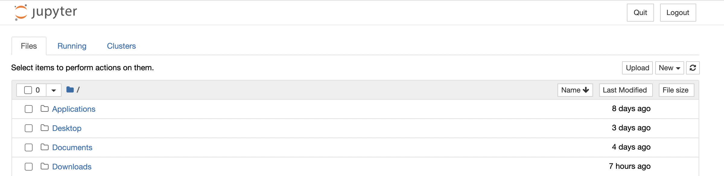
Opening Jupyter Notebook
Open the Jupyter notebook app.(Or on the terminal, type in “jupyter notebook”). This will start up Jupyter and your default browser should start (or open a new tab) to the following URL: http://localhost:8888/tree
Notes:
Crash Course: Cybersecurity

Slide 4
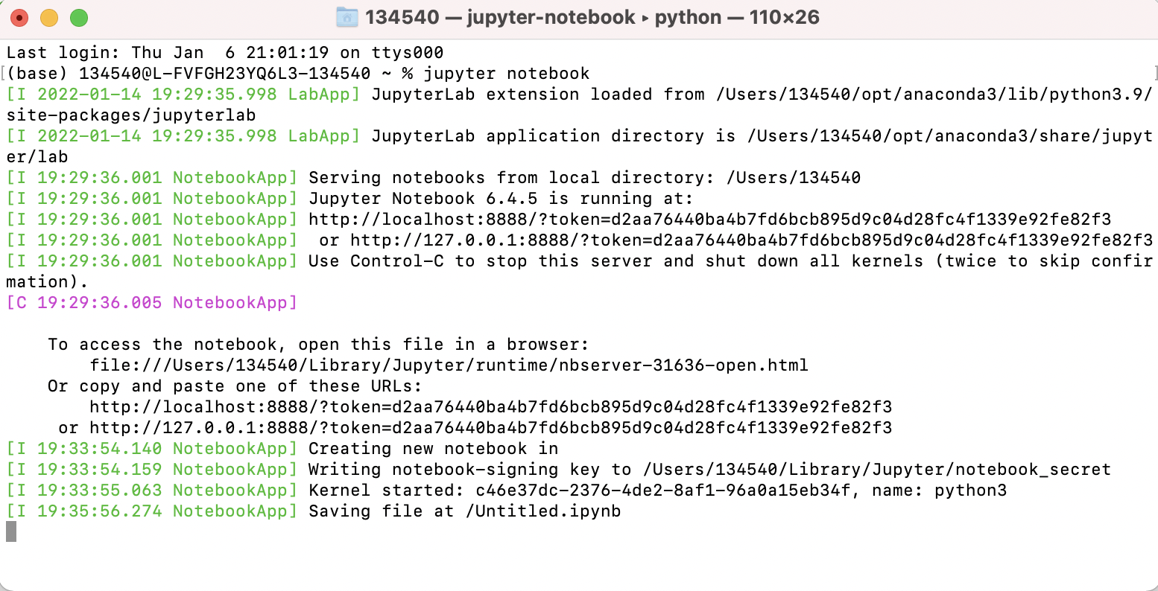
Server
In addition to the browser interface shown in the previous slide, another window should open that looks like:
This is a “notebook server” that is running on your machine - it basically handles all of the communication between your browser and your machine.
DO NOT close this window! Closing it will close the server causing your notebook to no longer work!
Notes:
Crash Course: Cybersecurity

Slide 5
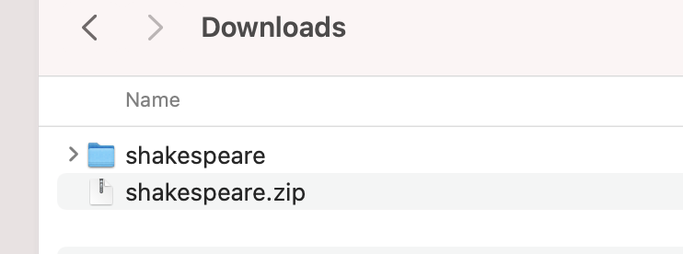
Zip Folder
A Jupyter notebook file has the extension .ipynb. Double clicking on it will not open the notebook! You must open it from the browser interface.
How to open a .ipynb notebook(next three slides):
For our class, Jupyter notebook assignments will contain Jupyter notebook .ipynb file along with other files such as text files or images bundled in a zip(compressed) folder.
Download the zip folder. Uncompress it by either double click on it(on Mac) or right click and “extract all”(on Windows).
unzipped(uncompressed) folder
zip(compressed) folder
Notes:
Crash Course: Cybersecurity

Slide 6
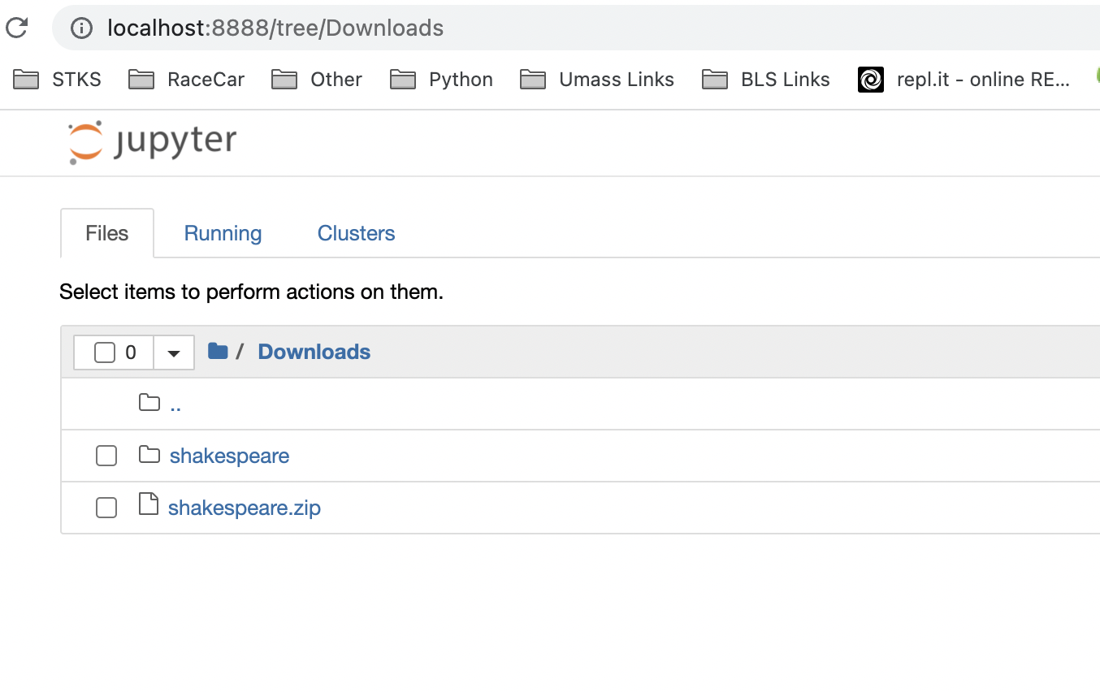
Opening a .ipynb file
To open the Jupyter notebook, navigate using the browser interface to the folder. Then click on the unzipped folder:
Click on the
unzipped(uncompressed) folder
Notes:
Crash Course: Cybersecurity

Slide 7
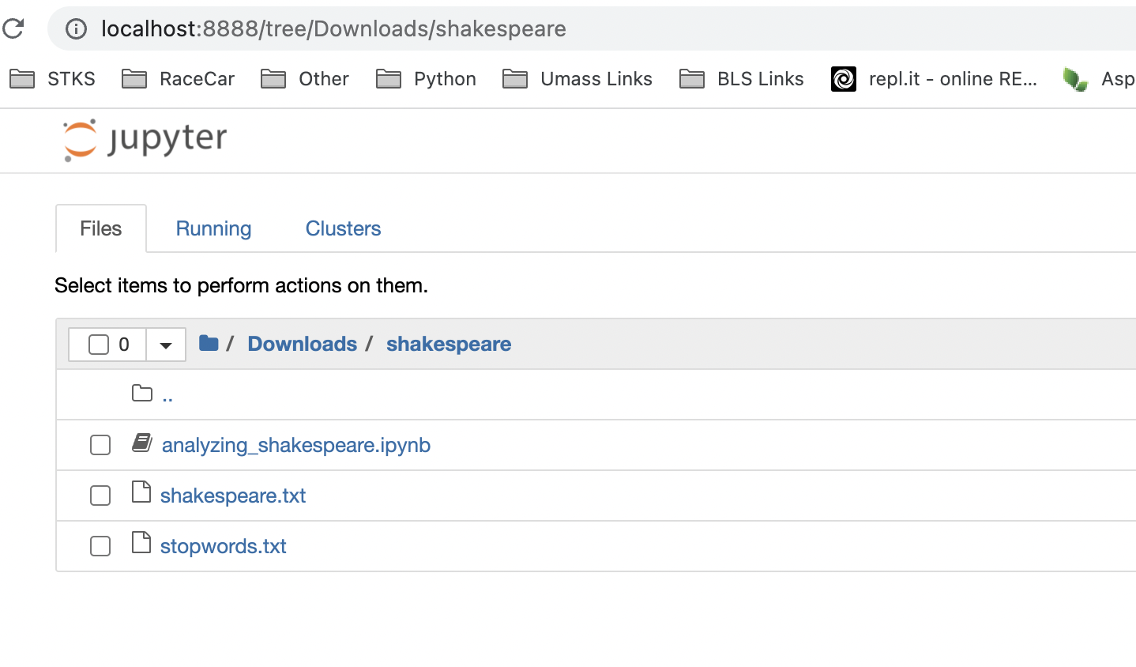
Opening a .ipynb file
Then click on the .ipynb file.
Click on the
.ipynb file
Notes:
Crash Course: Cybersecurity

Slide 8

Cells
There are two kinds of cells in a Jupyter notebook.
Markdown cells contain text, images, equations, etc..
Code cells contain code that can be executed.
To run a cell and execute the code in the cell, press: Shift + Enter.
Notes:
Crash Course: Cybersecurity

Slide 9

Edit Mode
A notebook has two modes of operation: command and edit modes.
Edit Mode (Click on textbox in the cell to begin editing the cell)
Edit mode allows you to edit that cell by writing either code or markdown. Your selected cell will be surrounded by a green border when you are in edit mode.
Notes:
Crash Course: Cybersecurity

Slide 10

Command Mode
Command Mode (Press <ESC> to activate)
When in command mode, you can use keyboard shortcuts to create/delete/cut/paste notebook cells, and to change a cell’s type between code and markdown modes.
Your selected cell will be surrounded by a blue border when you are in command mode.
Notes:
Crash Course: Cybersecurity

Slide 11
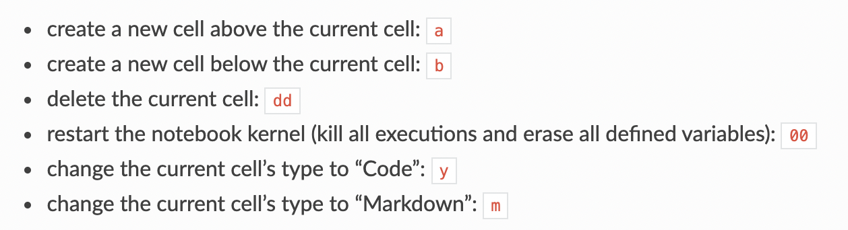
Command Mode
When in command mode, you can use keyboard shortcuts to create/delete/cut/paste notebook cells, and to change a cell’s type between code and markdown modes.
Notes:
Crash Course: Cybersecurity

Slide 12
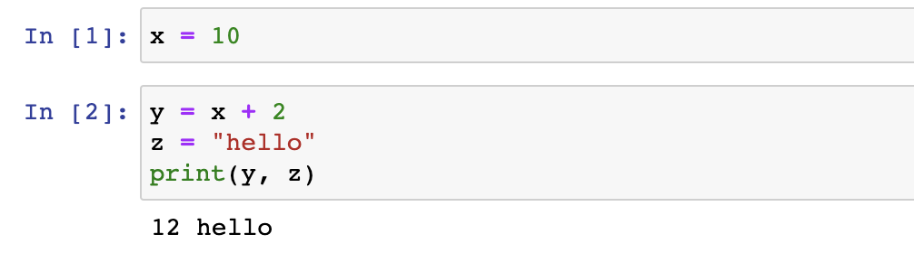
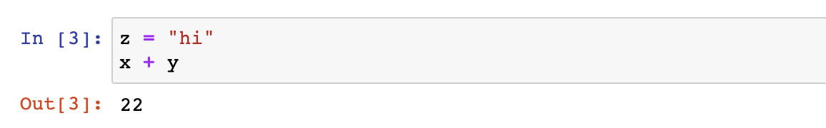
Cells
You can write code across multiple cells and execute them one at a time. (press Shift + Enter)
Notebook keeps track
of order of executed cells.
Printing output
Last expression is returned
in an output cell.
Note: Notice that the notebook “knows” about its variables across its cells. This
doesn’t just work from top to bottom. You can define z = 2 in the third cell, and
then execute code that references z in the first cell. What really matters is the order
in which the cells are executed.
Notes:
Crash Course: Cybersecurity

Slide 13
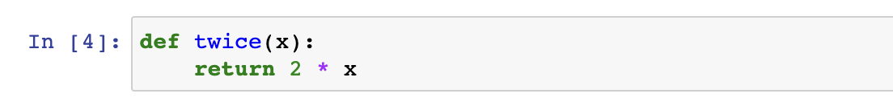
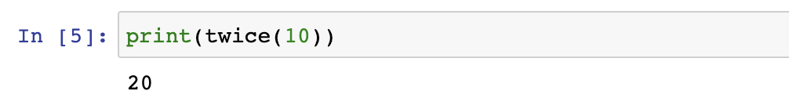
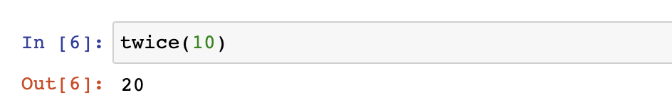
Cells
Instead of printing returned value as we did in Replit,
we can get the returned value from the output cell.
Notes:
Crash Course: Cybersecurity

Slide 14
References
Python Like You Mean it. Retrieved from:
http://www.pythonlikeyoumeanit.com/index.html

