Slide 1
Unit 1: Primitive Types Variables and Datatypes
Adapted from:
1) Building Java Programs: A Back to Basics Approach
by Stuart Reges and Marty Stepp
2) Runestone CSAwesome Curriculum

Slide 2
Data Types
A type is a set of values (a domain) and a set of operations on them.
Data types can be categorized as either primitive or reference.
The primitive data types used in this course define the set of operations for numbers and Boolean values.
Reference variables or object variables that hold a reference(or address) to an object of a class(more on this later).
Notes:
a variable is also like the MS / MR buttons on a calculator
variables must be declared before they are used, just like methods

Slide 3
Primitive types
The primitive types on the Advanced Placement Computer Science A exam are:
int - which store integers (whole numbers like 3, -76, 20393)
double - which store floating point numbers (decimal numbers like 6.3, -0.9, and 60293.93032)
boolean - which store Boolean values (either true or false).
Notes:
a variable is also like the MS / MR buttons on a calculator
variables must be declared before they are used, just like methods

Slide 4
Receipt example
What's bad about the following code?
  public class Receipt {
  public static void main(String[] args) {
  // Calculate total owed, assuming 8% tax / 15% tip
  System.out.println("Subtotal:");
  System.out.println(38 + 40 + 30);
  System.out.println("Tax:");
  System.out.println((38 + 40 + 30) * .08);
  System.out.println("Tip:");
  System.out.println((38 + 40 + 30) * .15);
  System.out.println("Total:");
  System.out.println(38 + 40 + 30 +
  (38 + 40 + 30) * .08 +
  (38 + 40 + 30) * .15);
  }
  }
  The subtotal expression (38 + 40 + 30) is repeated
  So many println statements
  We will use variables to solve the above problems.

Slide 5

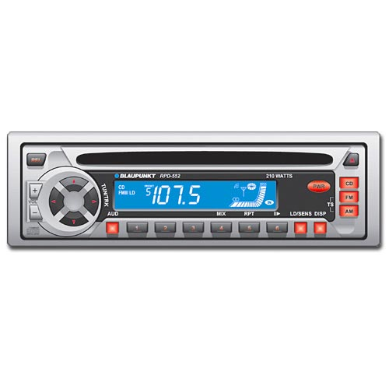
Variables
variable: A piece of the computer's memory that is given a name and type, and can store a value.
  Like preset stations on a car stereo, or cell phone speed dial:
  Steps for using a variable:
    Declare it - state its name and type
    Initialize it - store a value into it
    Use it - print it or use it as part of an expression
Notes:
a variable is also like the MS / MR buttons on a calculator
variables must be declared before they are used, just like methods

Slide 6
Declaration
variable declaration: Sets aside memory for storing a value.
  Variables must be declared before they can be used.
Syntax:
  type name;
    The name is an identifier.
  int x;
  double myGPA;
x
myGPA

Slide 7
Assignment
assignment: Stores a value into a variable.
  The value can be an expression; the variable stores its result.
Syntax:
  name = expression;
  int x;
  x = 3;
  double myGPA;
  myGPA = 1.0 + 2.25;
x | 3
myGPA | 3.25

Slide 8
Using variables
Once given a value, a variable can be used in expressions:
  int x;
  x = 3;
  System.out.println("x is " + x); // x is 3
  System.out.println(5 * x - 1); // 14
You can assign a value more than once:
  int x;
  x = 3;
  System.out.println(x + " here"); // 3 here
  x = 4 + 7;
  System.out.println("now x is " + x); // now x is 11
x | 3
x | 11

Slide 9
Declaration/initialization
A variable can be declared/initialized in one statement.
Syntax:
  type name = value;
  double myGPA = 3.95;
  int x = (12 - 3) * 2;
myGPA | 3.95
x | 18

Slide 10
Assignment and algebra
Assignment uses = , but it is not an algebraic equation.
  = means, "store the value at right in variable at left"
    The right side expression is evaluated first,
    and then its result is stored in the variable at left.
What happens here?
  int x = 3;
  x = x + 2; // ???
x | 3
x | 5
Notes:
x = x + 2; increases the value stored in variable x by two.

Slide 11
Multiple Variables
Multiple variables of the same type can be declared and initialized at the same time.
Syntax:
  type name1, name 2, name3;
  type name1 = value1, name2 = value2, name3 = value3;
  int x, y, z; // declare three integers.
  int a = 1, b = 2, c = 3;// declare and initialize // three integers.

Slide 12
Assignment and types
A variable can only store a value of its own type.
  int x = 2.5; // ERROR: incompatible types
An int value can be stored in a double variable.
  The value is converted into the equivalent real number.
  double myGPA = 4;
myGPA | 4.0

Slide 13
Compiler errors
Order matters.
  int x;
  7 = x; // ERROR: should be x = 7;
A variable can't be used until it is assigned a value.
  int x;
  System.out.println(x); // ERROR: x has no value
You may not declare the same variable twice.
  int x;
  int x; // ERROR: x already exists
  int x = 3;
  int x = 5; // ERROR: x already exists
    How can this code be fixed?

Slide 14
Printing a variable's value
Use + to print a string and a variable's value on one line.
  double grade = (95.1 + 71.9 + 82.6) / 3.0;
  System.out.println("Your grade was " + grade);
  int students = 11 + 17 + 4 + 19 + 14;
  System.out.println("There are " + students +
  " students in the course.");
  Output:
  Your grade was 83.2
  There are 65 students in the course.

Slide 15
Receipt question
Improve the receipt program using variables.
public class Receipt {
public static void main(String[] args) {
// Calculate total owed, assuming 8% tax / 15% tip
System.out.println("Subtotal:");
System.out.println(38 + 40 + 30);
System.out.println("Tax:");
System.out.println((38 + 40 + 30) * .08);
System.out.println("Tip:");
System.out.println((38 + 40 + 30) * .15);
System.out.println("Total:");
System.out.println(38 + 40 + 30 +
(38 + 40 + 30) * .15 +
(38 + 40 + 30) * .08);
}
}

Slide 16
Receipt answer
public class Receipt {
public static void main(String[] args) {
// Calculate total owed, assuming 8% tax / 15% tip
int subtotal = 38 + 40 + 30;
double tax = subtotal * .08;
double tip = subtotal * .15;
double total = subtotal + tax + tip;
System.out.println("Subtotal: " + subtotal);
System.out.println("Tax: " + tax);
System.out.println("Tip: " + tip);
System.out.println("Total: " + total);
}
}

Slide 17
Type boolean
boolean: A logical type whose values are true and false.
  It is legal to:
    create a boolean variable
    pass a boolean value as a parameter
    return a boolean value from methods
    call a method that returns a boolean and use it as a test
  int age = 18;
  boolean minor = (age < 21);
  boolean lovesAPCS = true;

Slide 18
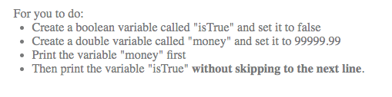
final
The keyword final can be used in front of a variable declaration to make it a constant that cannot be changed. Constants are traditionally capitalized.
public class TestFinal
{
public static void main(String[] args)
{
final double PI = 3.14;
System.out.println(PI);
PI = 4.2; // This will cause a syntax error
}
}

Slide 19
repl.it assignments
The following labs are repl.it assignments. Log on to your account to complete them. They are included here for your reference.
Lab 1: Create Variables and Printing:

Slide 20
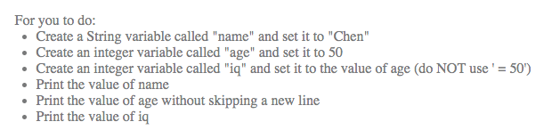
repl.it assignments
The following labs are repl.it assignments. Log on to your account to complete them. They are included here for your reference.
Lab 2: Create Variables and Printing 2:

