Slide 1
Introduction to Python
Arithmetic, Comparison and Boolean Operations

Slide 2
Topics
Variables
Operations
Arithmetic
Comparison
Boolean

Slide 3
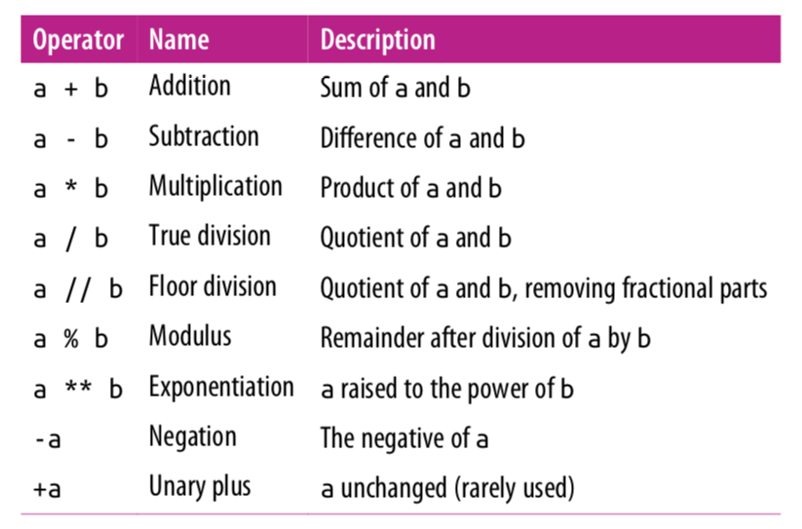
Arithmetic Operations

Slide 4
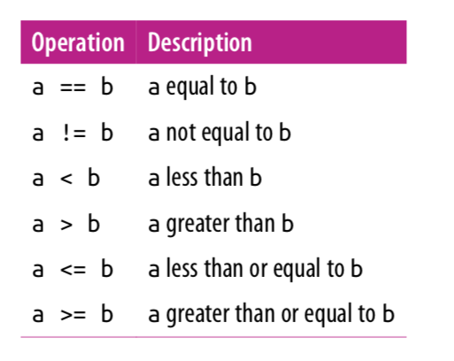
Comparison Operators

Slide 5
Boolean Operations
Python provides operators to combine the values using the standard concepts of “and”, “or”, and “not”.
Predictably, these operators are expressed using the words and, or, and not:
In[15]: x = 4
(x < 6) and (x > 2)
Out [15]: True
In[16]: (x > 10) or (x % 2 == 0)
Out [16]: True
In[17]: not (x < 6) Out [17]: False

Slide 6
References
Vanderplas, Jake, A Whirlwind Tour of Python, O’reilly Media.
This book is completely free and can be downloaded online at O’reilly’s site.

