Slide 1

Linear Algebra Notes
Lecture 2:
Geometry of Solutions
Math Seminar

Slide 2
Reference
These notes follow the textbook Interactive Linear Algebra by Dan Margalit and Joseph Rabinoff, School of Mathematics, Georgia Institute of Technology. Definitions, examples and figures in these slides are taken or adapted from it.
https://textbooks.math.gatech.edu/ila/
Interactive Linear Algebra © 2017 Georgia Institute of Technology. Permission is granted to copy, distribute and/or modify that document under the terms of the GNU Free Documentation License, Version 1.2 or any later version published by the Free Software Foundation; with no Invariant Sections, no Front-Cover Texts, and no Back-Cover Texts.
These slides are a modified version of that work and are distributed under the same license:
https://www.gnu.org/licenses/fdl-1.3.html

Slide 3

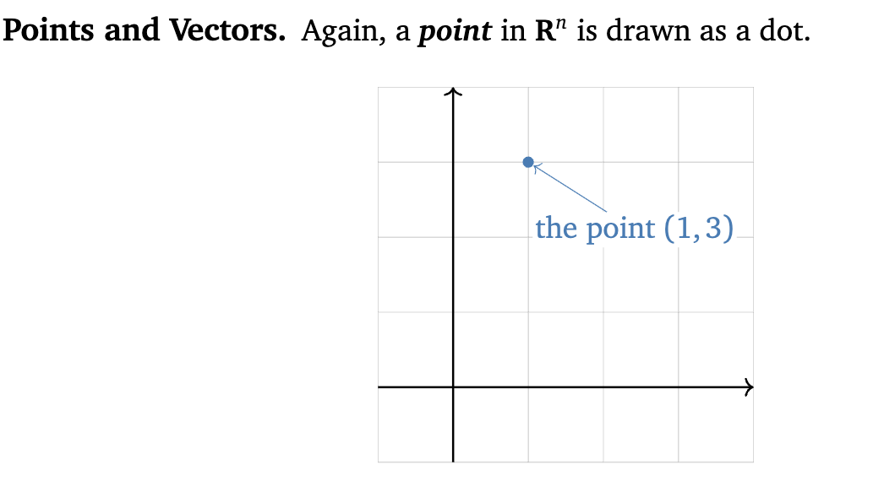
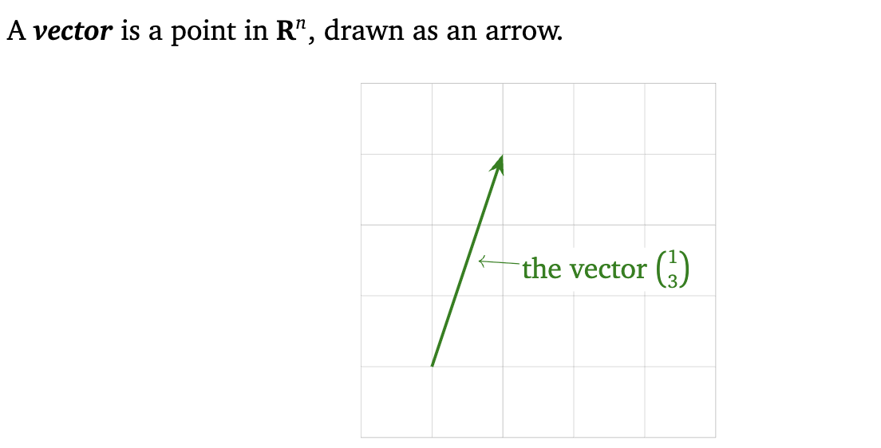

Slide 4
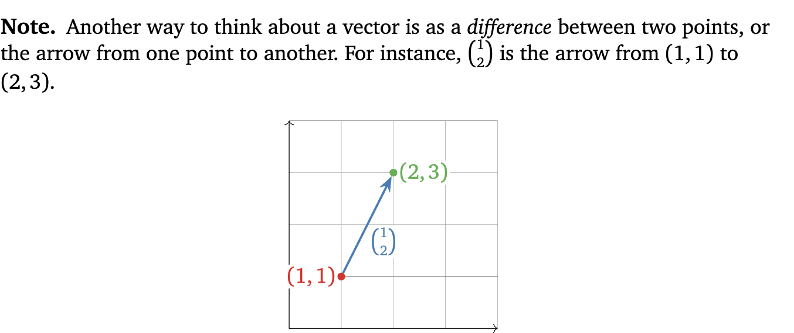

Slide 5
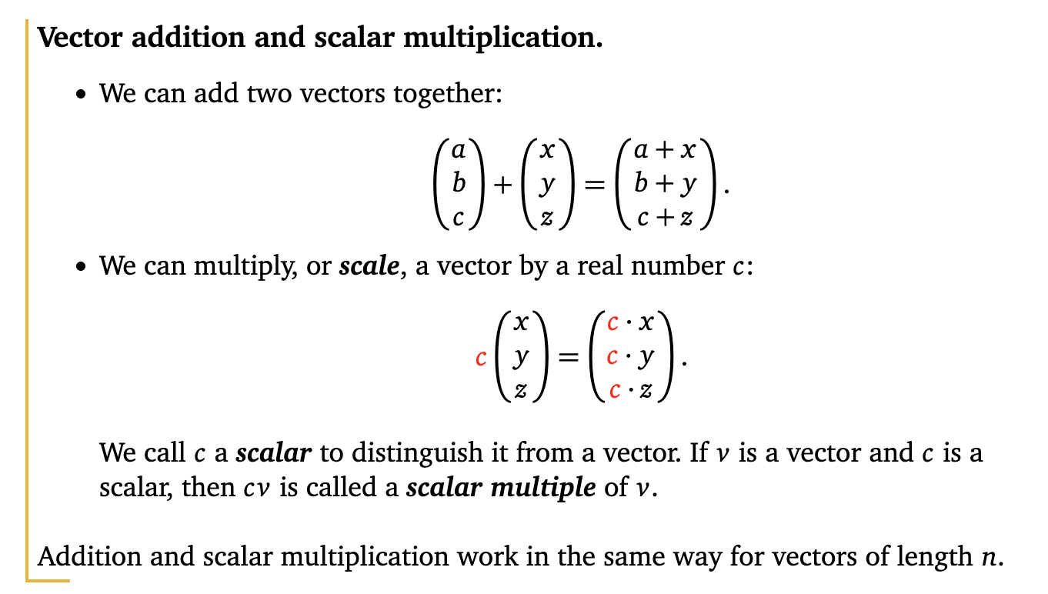

Slide 6

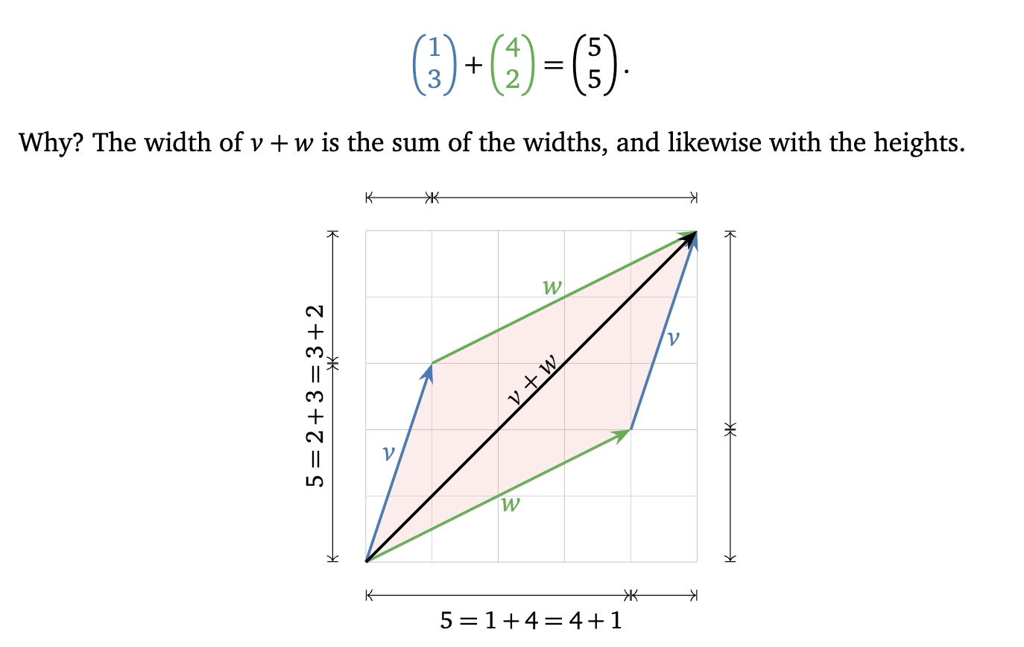

Slide 7
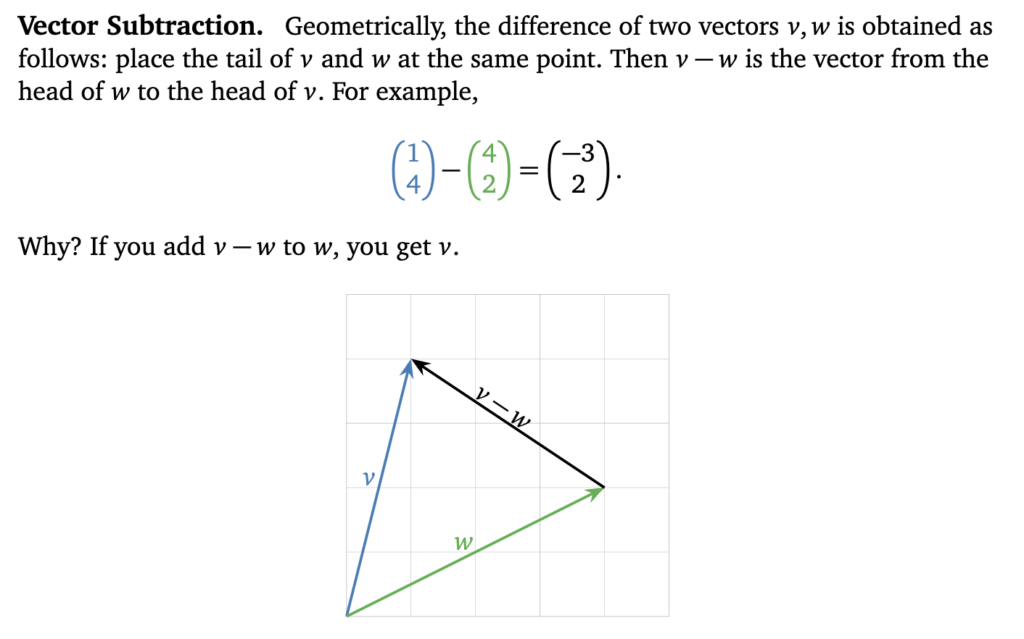

Slide 8
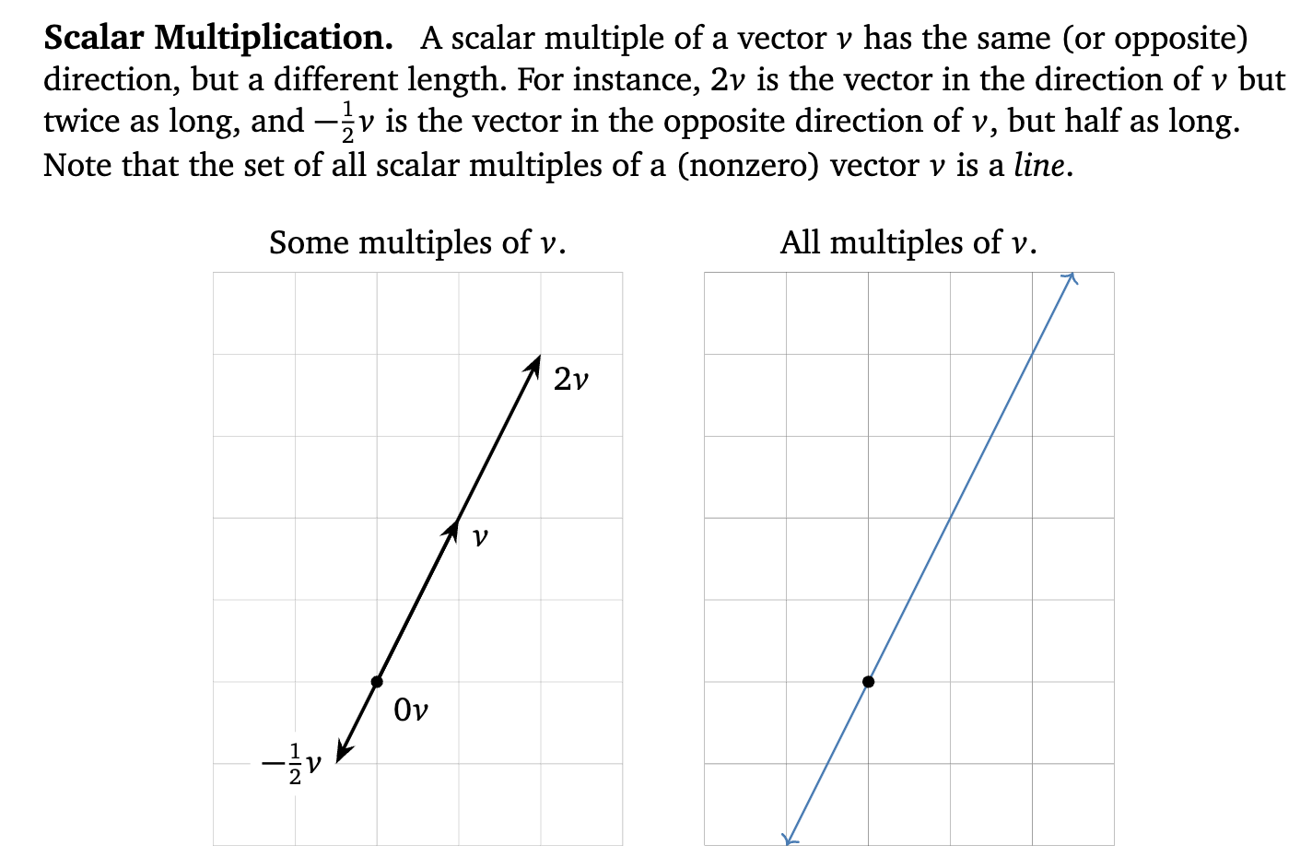

Slide 9
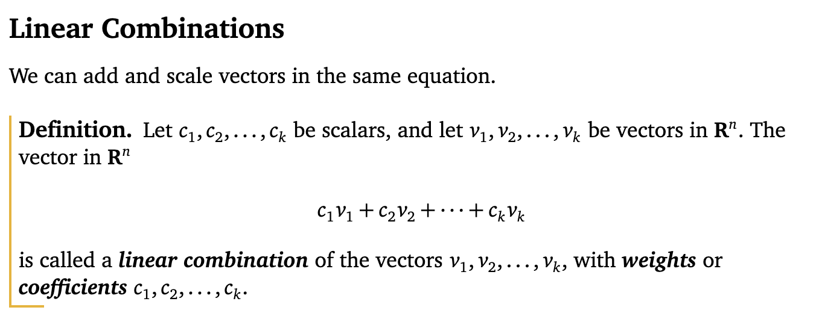


Slide 10
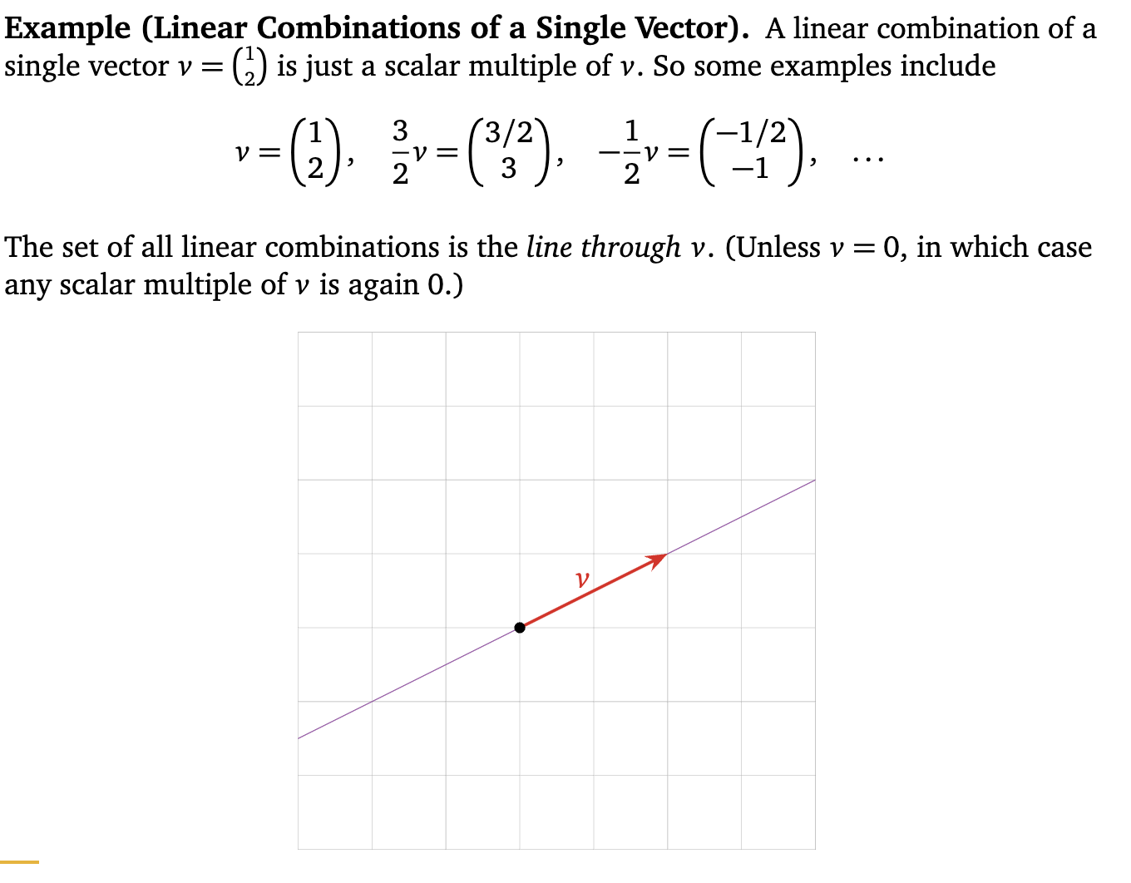

Slide 11
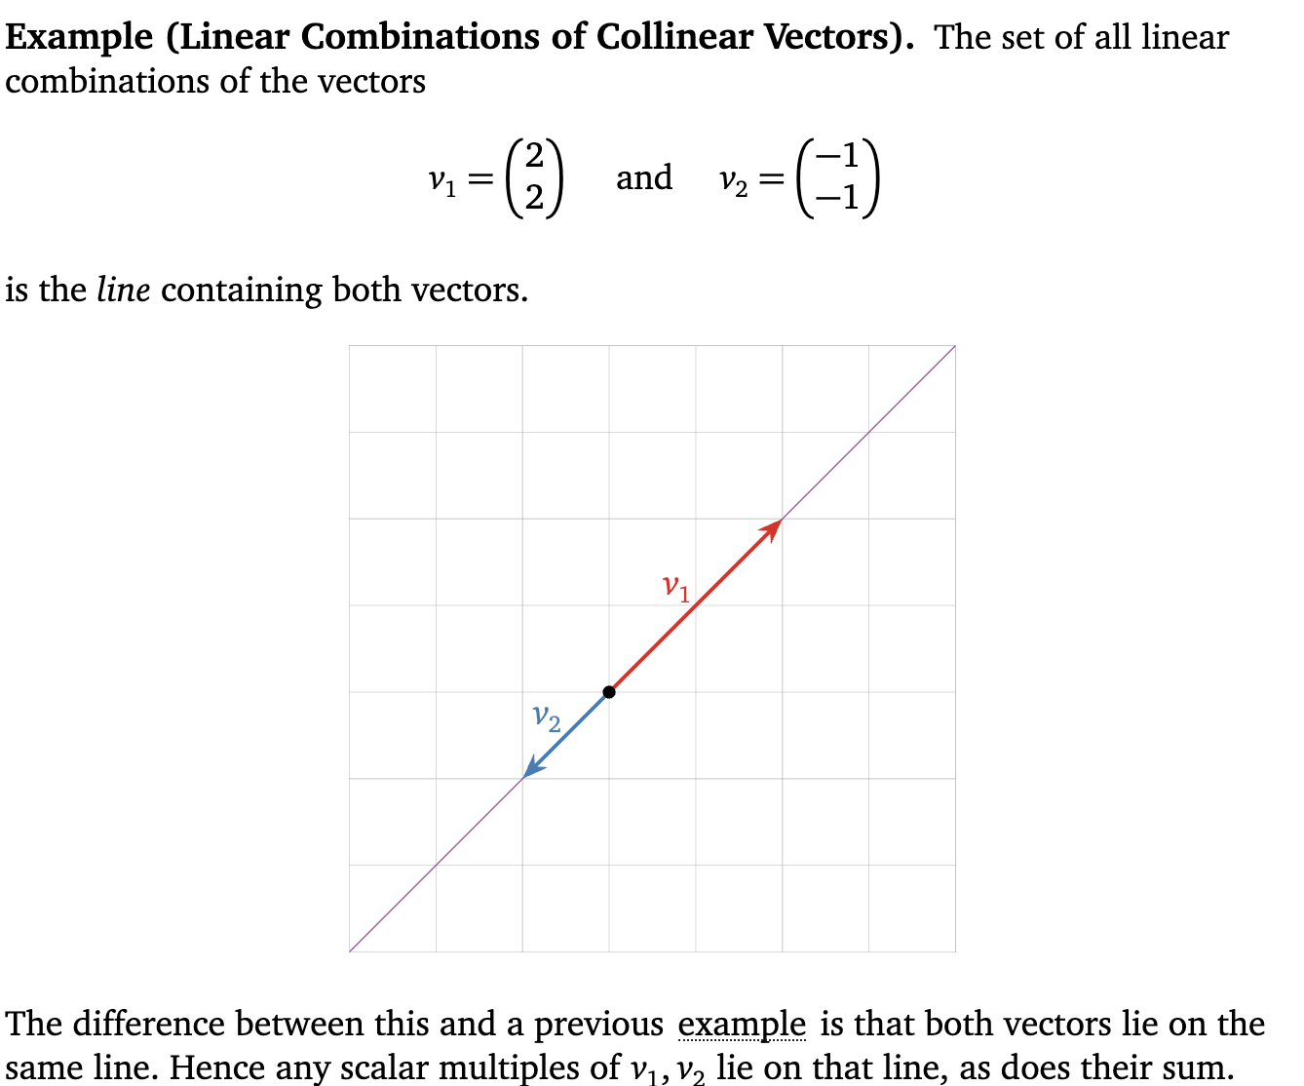

Slide 12
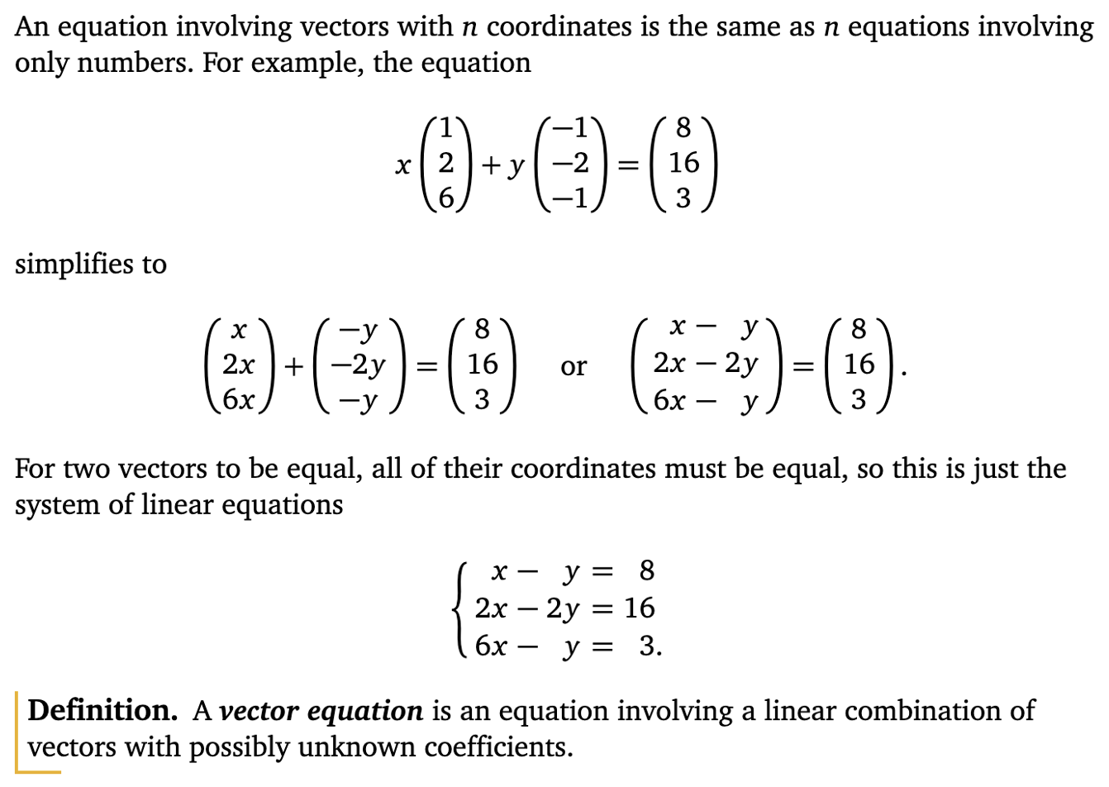

Slide 13
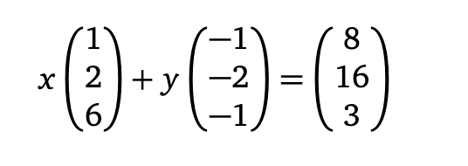


Slide 14
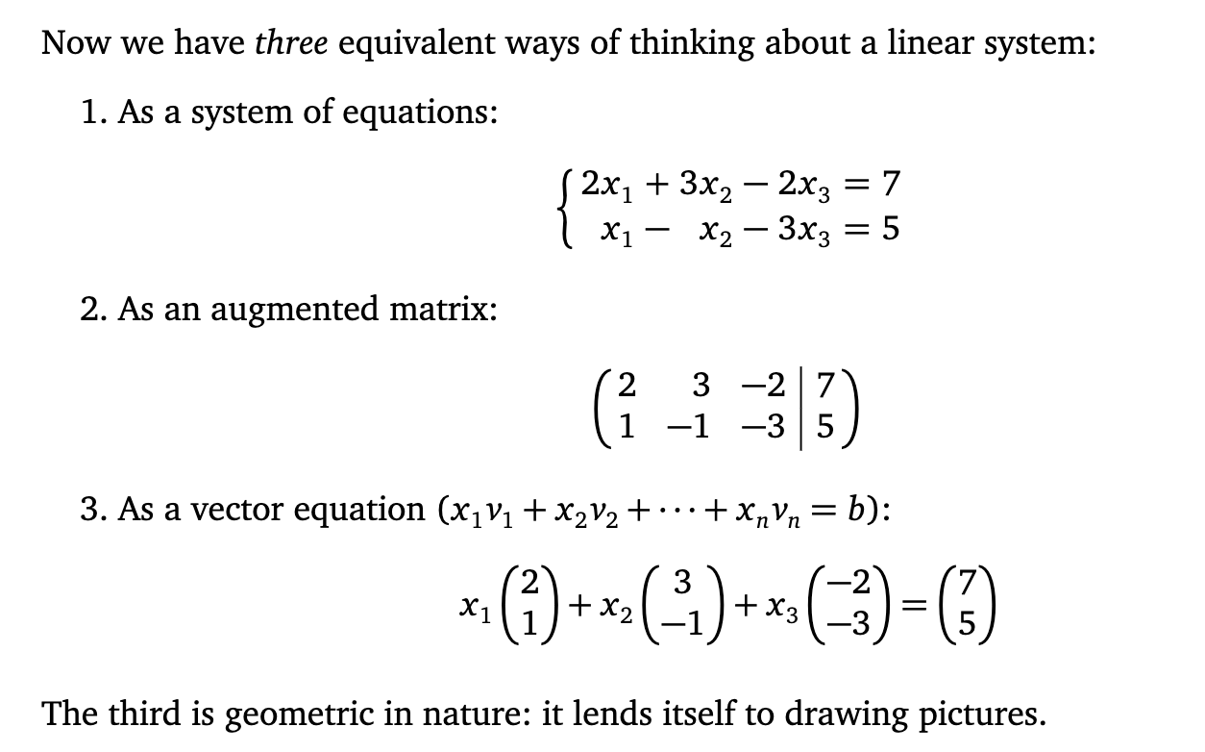

Slide 15



Slide 16
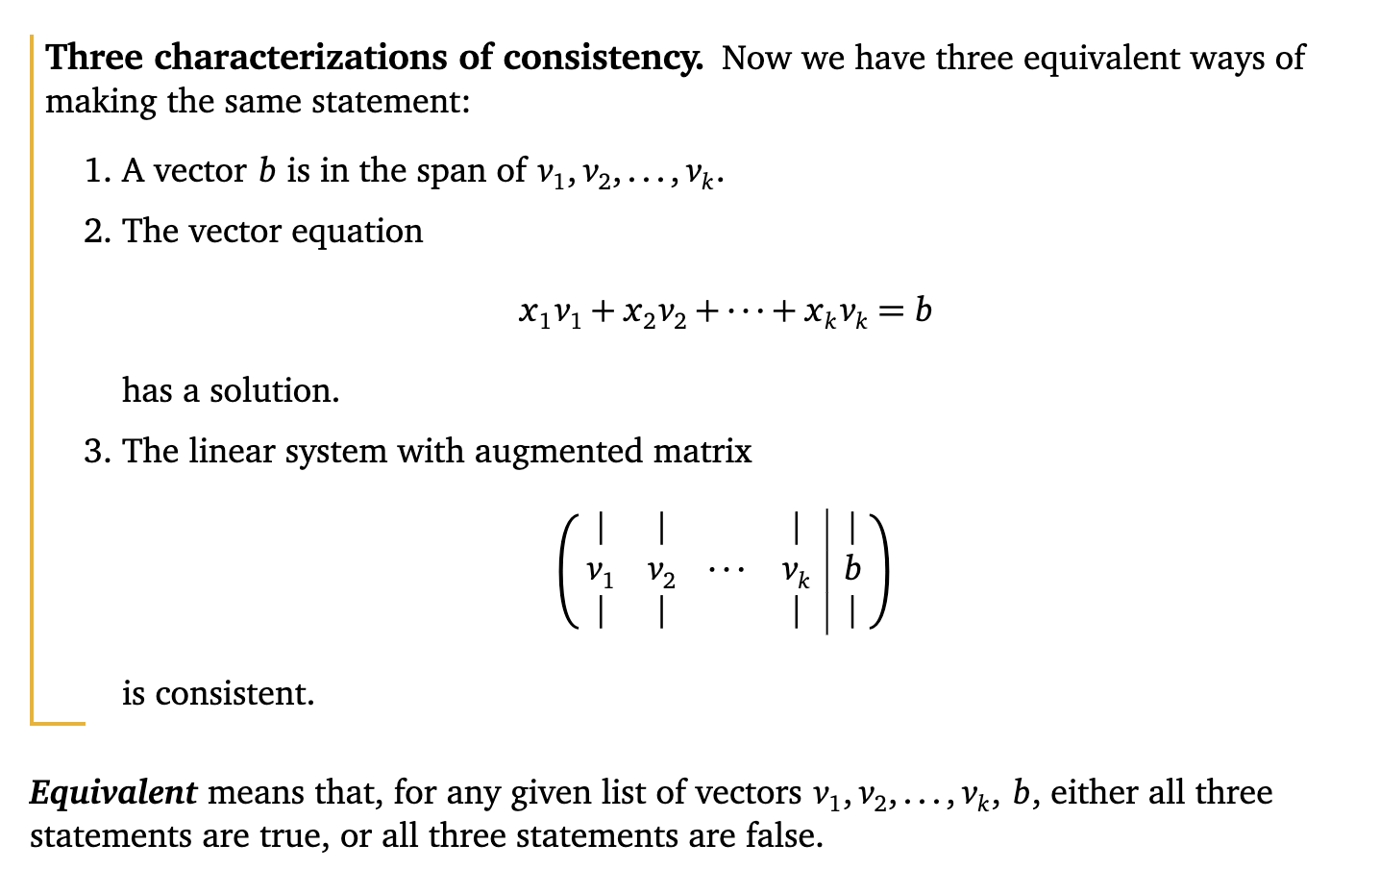

Slide 17
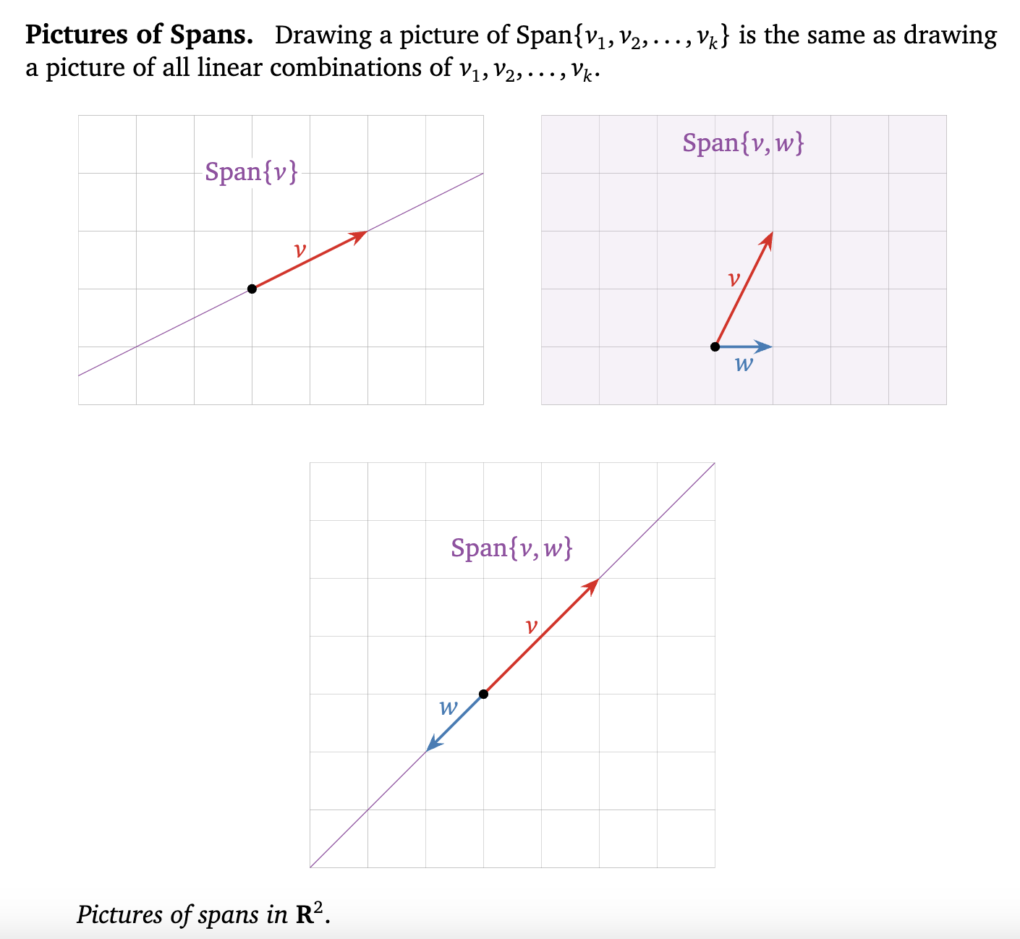

Slide 18
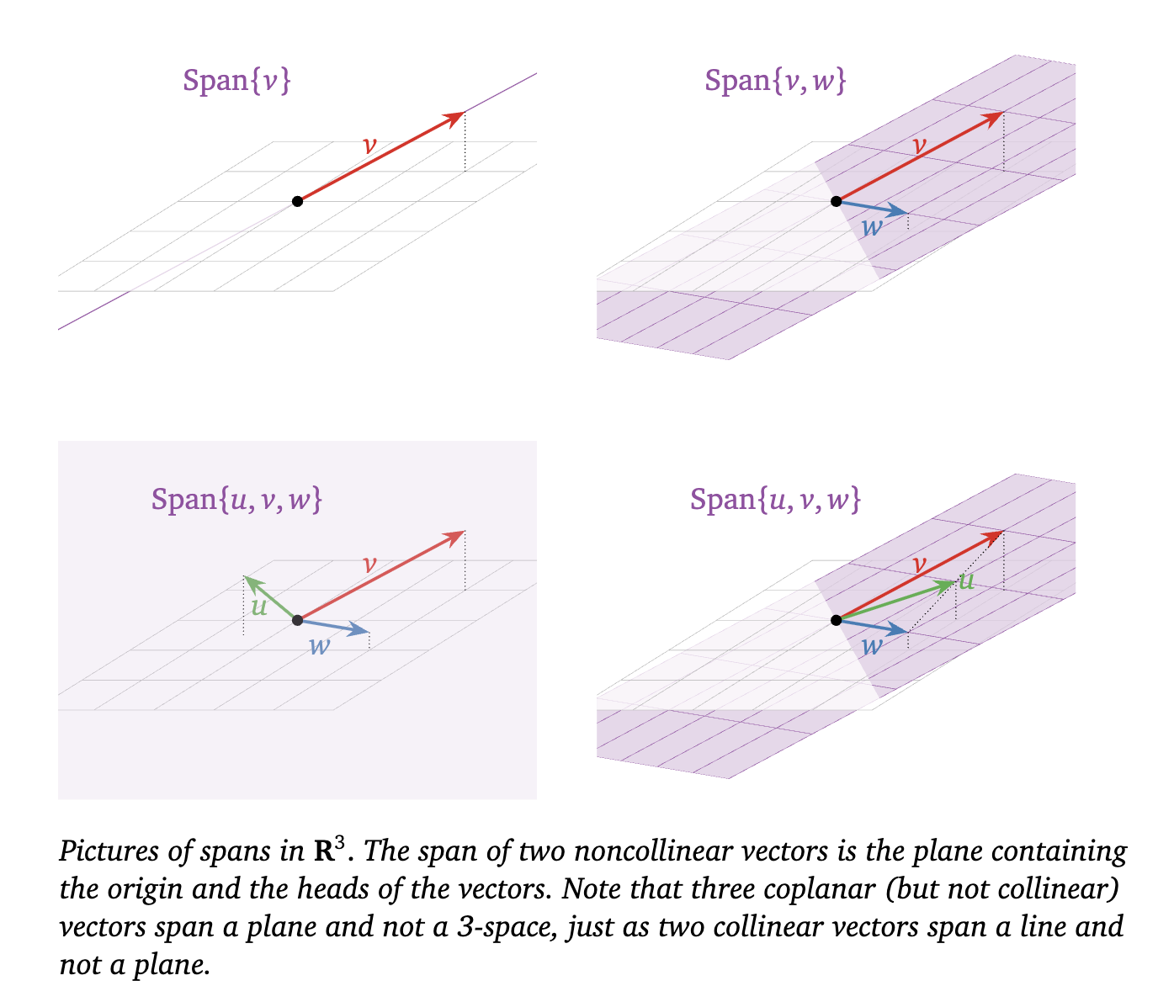

Slide 19
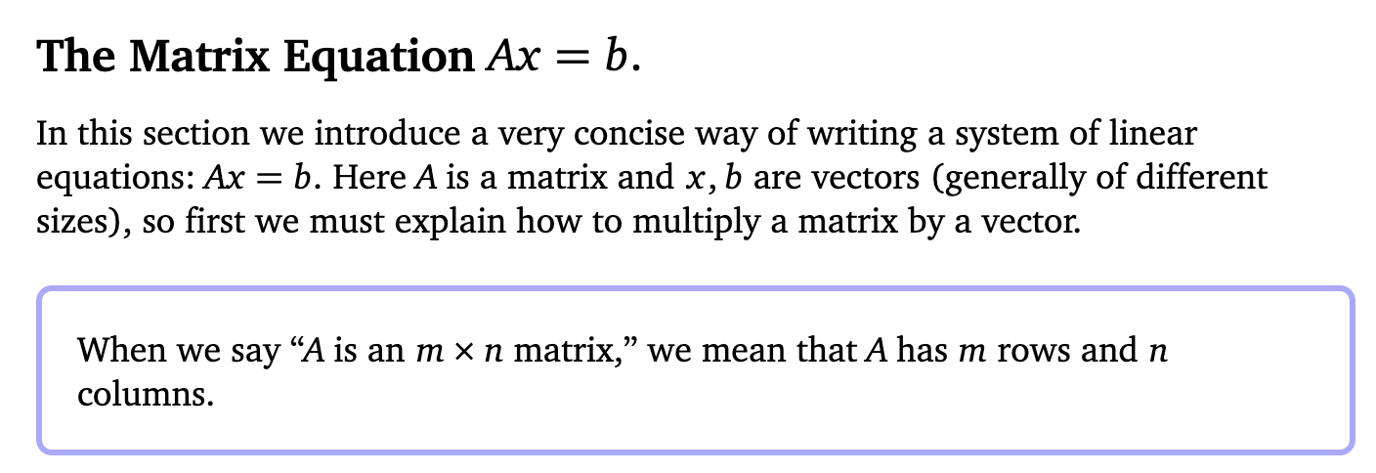
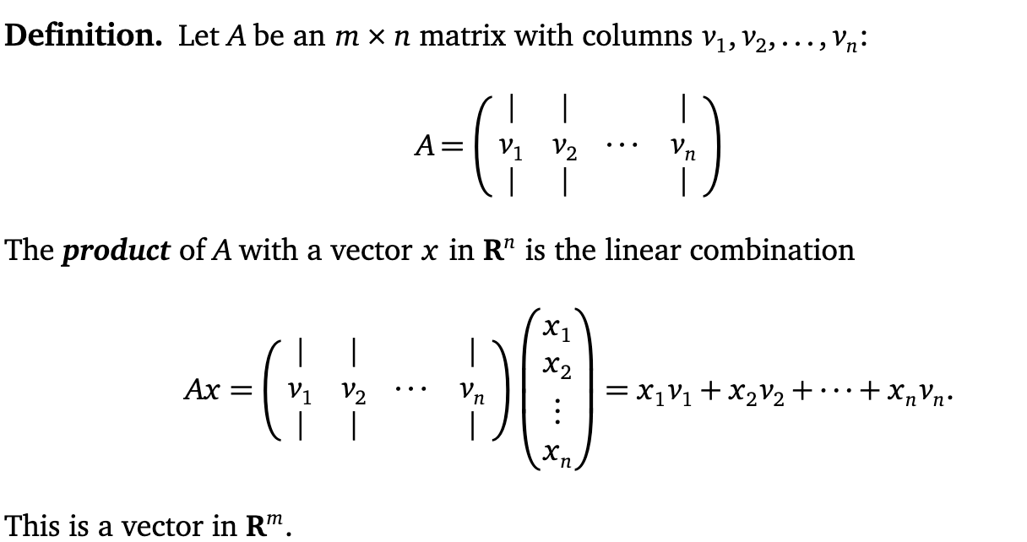

Slide 20
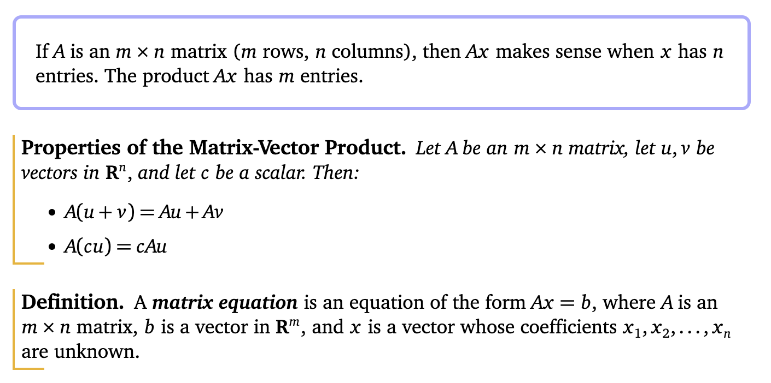

Slide 21
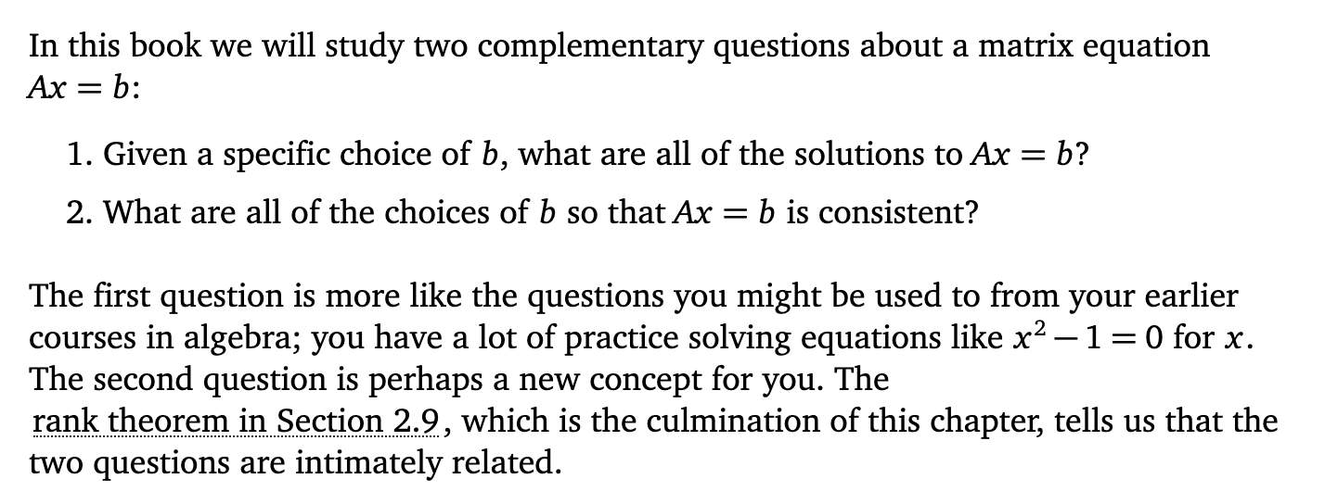

Slide 22
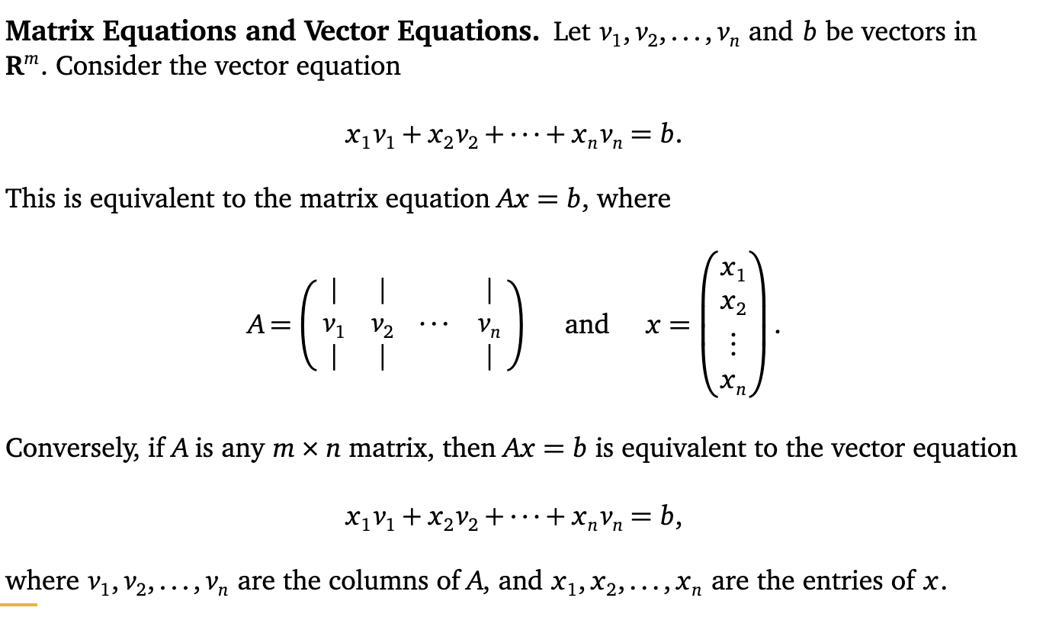

Slide 23
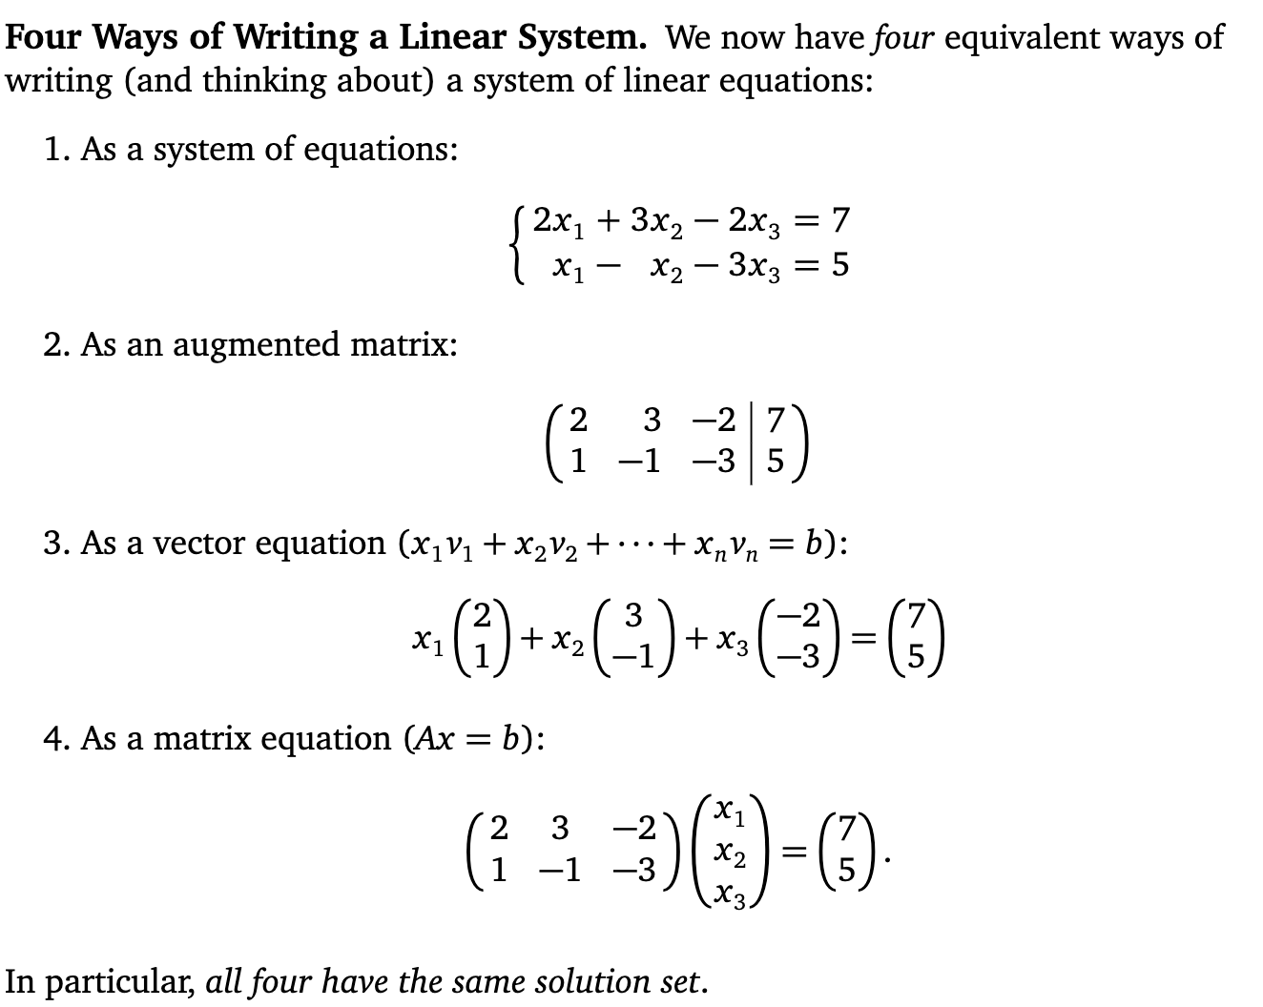

Slide 24
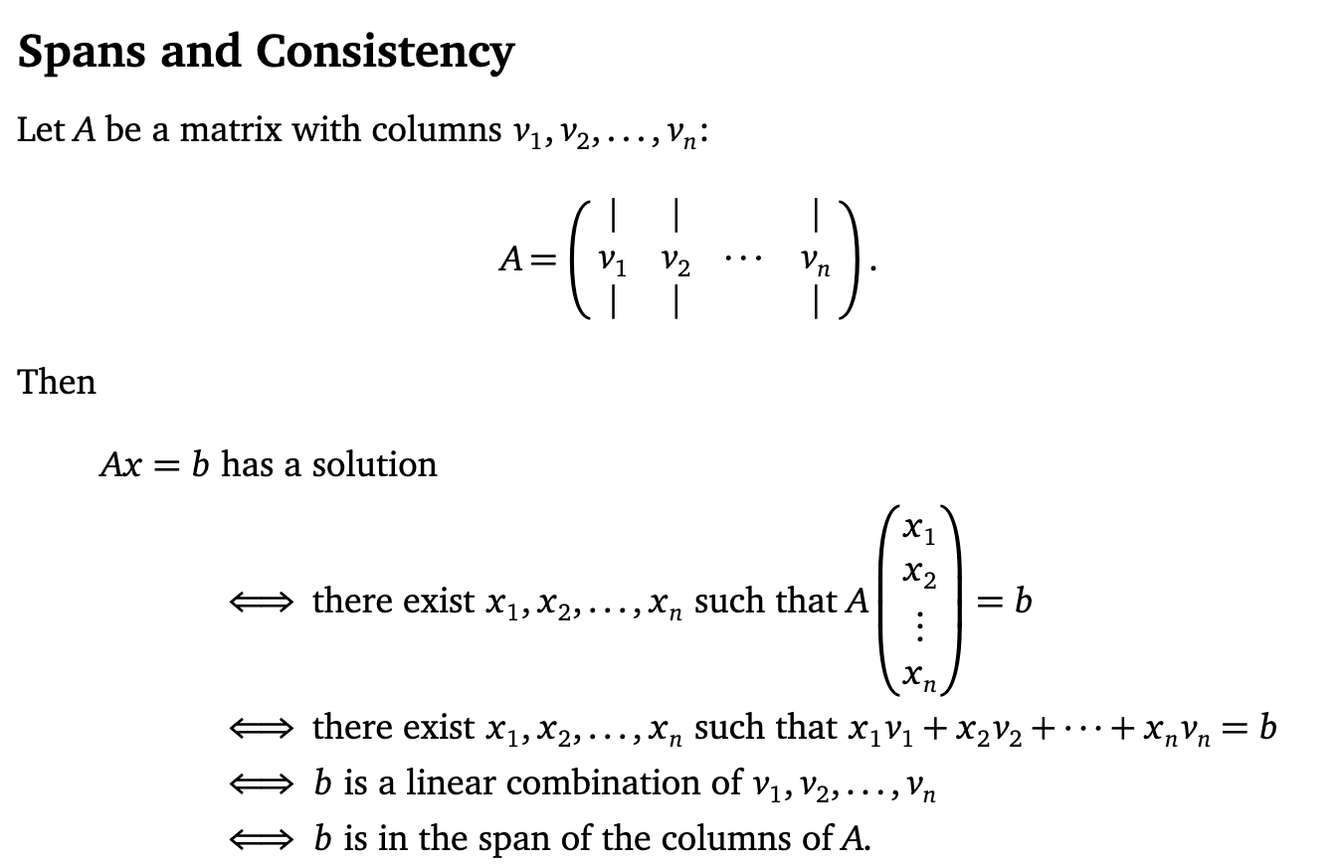

Slide 25



Slide 26
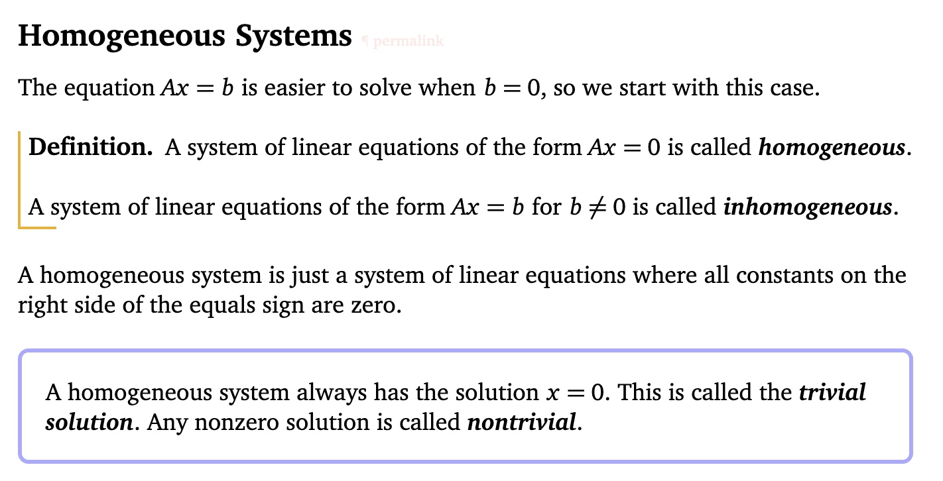

Slide 27

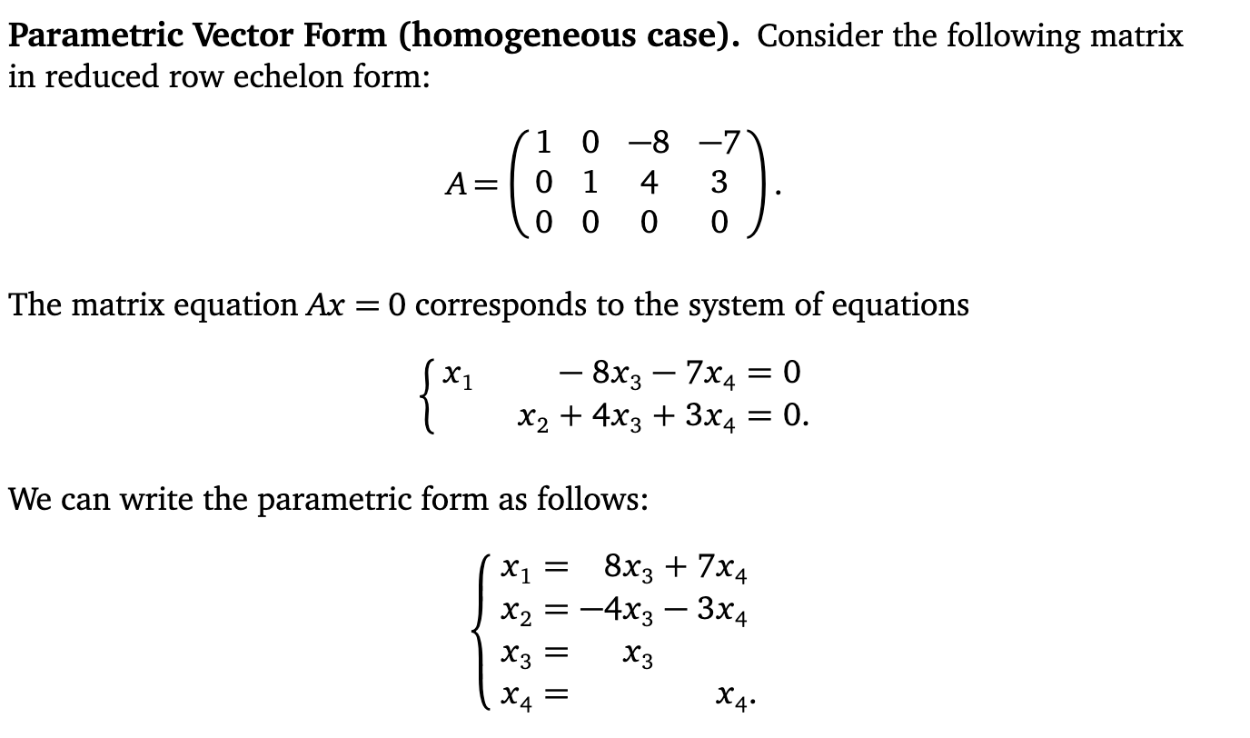

Slide 28
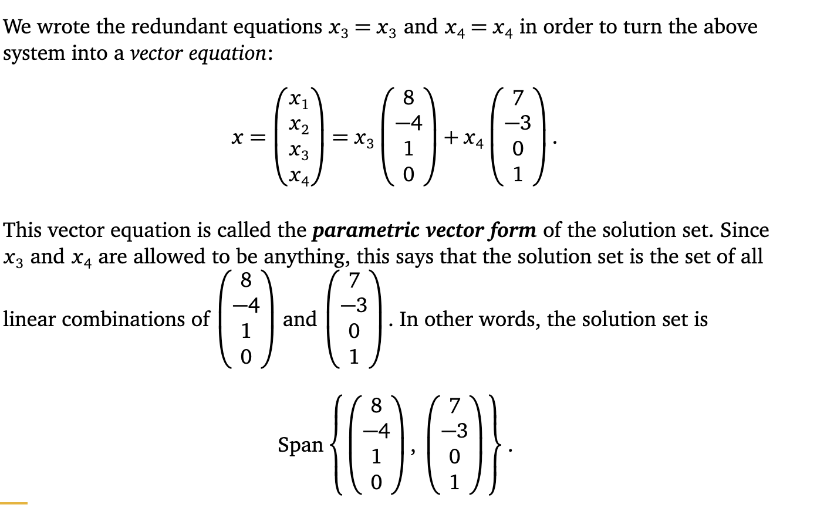


Slide 29
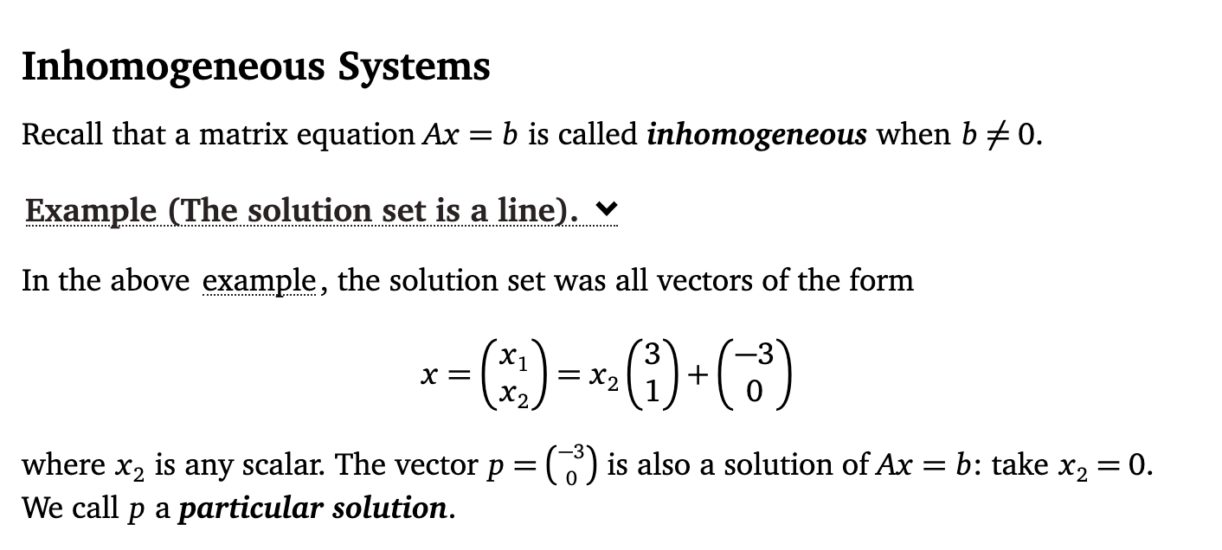

Slide 30
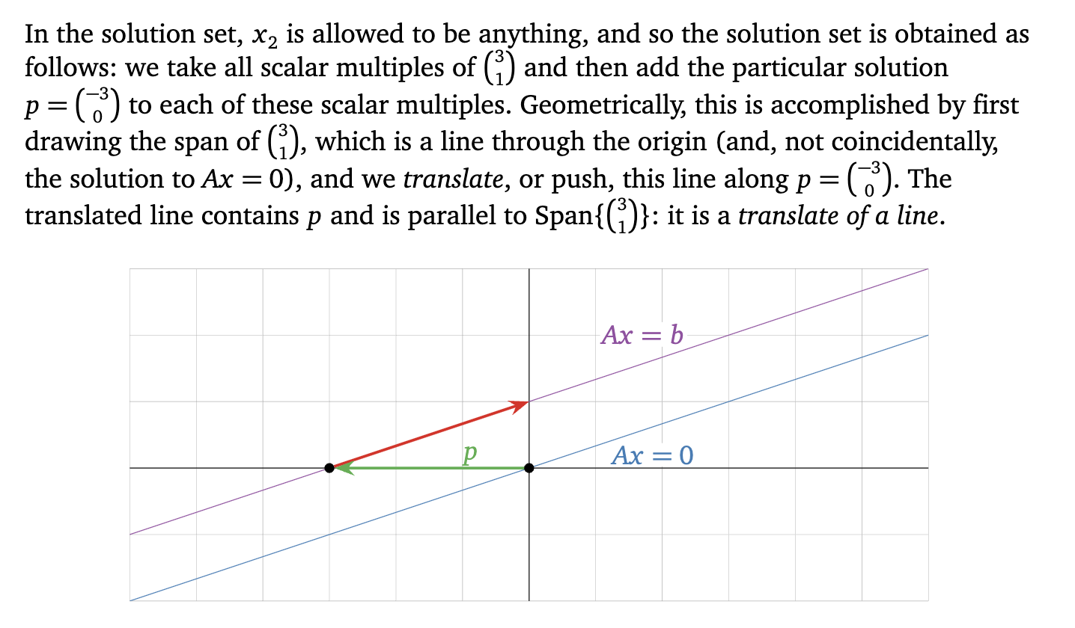

Slide 31


Slide 32
