Slide 1

AP Exam Preparation

Slide 2
AP Exam
When: Monday June 7, 2021 at 4PM Eastern Standard Time.
At home. On Digital Testing App.
Preparing:
1) Download! https://download.app.collegeboard.org/
2) Practice with Example Questions in the Digital Testing App.
3) 1–3 Days Before Exam Day, Complete Exam Setup for Each Digital Exam. You cannot take the exam without completing this step!
4) On Exam Day: 30 Minutes Before the Exam | Check In to the Exam
On exam day, you must check in 30 minutes before the official start time of the exam—at 11:30 a.m. EDT for 12 p.m. exams and 3:30 p.m. EDT for 4 p.m. exams—to complete final pre-exam checks.

Slide 3
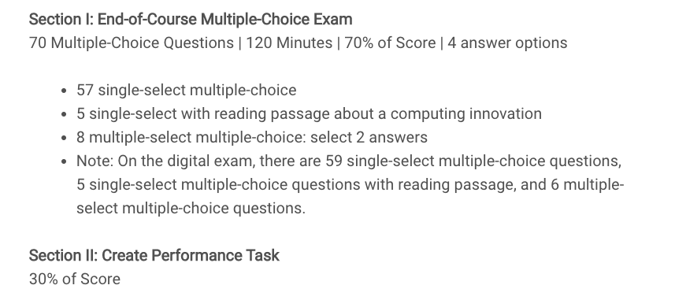
AP Exam

Slide 4
Topics
The AP Multiple Choice end-of-year covers 5 Big Ideas:
Creative Development(10%-13%)
Data(17%-22%)
Algorithms and Programming(30%-35%)
Computer Systems and Networks(11%-15%)
Impact of Computing(21%-26%)

Slide 5
AP Exam Review
Up to this point, I have been teaching Computer Science principles rather than teaching to the AP test.
This lecture slides is teaching to the AP test. It will provide review material for the AP test that we might not have covered during the course of the year.
We will go over each of the 5 ideas in summary.

Slide 6
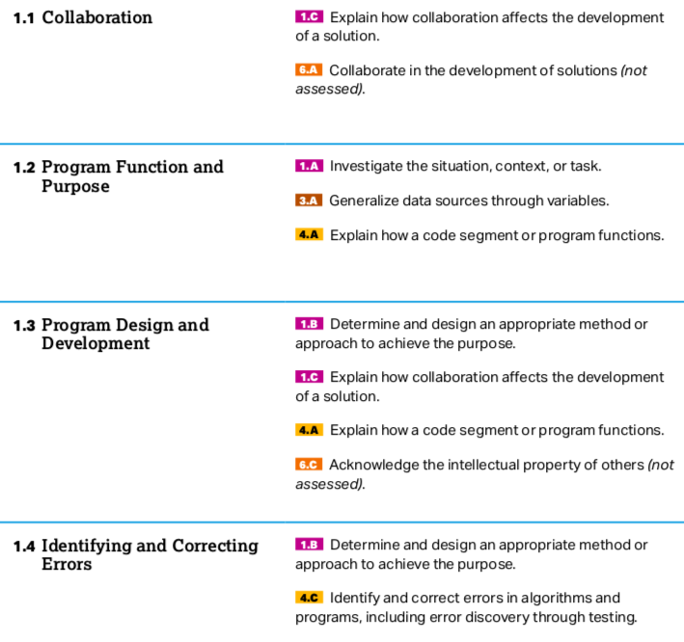
Big Idea 1

Slide 7
Big Idea 1
Please read Chapter 2: Big Idea 1: Creative Development. of the AP Barron's book. The following slides provide a summary of the material covered in this chapter.
A computing innovation includes a program as an integral part of its function.
A computing innovation can be physical (e.g., self-driving car), nonphysical computing software (e.g., picture editing software),or a nonphysical computing concept (e.g., e-commerce).
﻿Hardware is the physical components of a computing device, while software is the instructions in a programming language to the computing device. A computing innovation can have hardware components. However, the computing innovation is about the software, not the hardware.

Slide 8
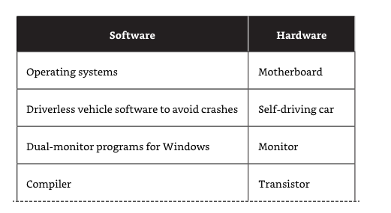
Big Idea 1
﻿Computing hardware has gotten smaller and more powerful over the years. Moore’s law predicts that the size of transistors halves every two years while the cost also halves every two years. Computers went from taking up 1,800 square feet and weighing almost 50 tons to being able to fit in your pocket.

Slide 9
Big Idea 1
﻿Collaboration helps people learn from each other. Collaboration that includes diverse perspectives helps to avoid bias in the development of computing innovations.
For example, if females play video games at the same percentage as males, a game company might not avoid bias if it employed males to write the code for the games. Bringing in female coders could bring additional perspectives that might not have been achieved otherwise.
Programming companies often hire people who not only are good programmers but also have interpersonal skills needed to collaborate effectively. Effective collaboration can help one gain insight and knowledge by applying multiple perspectives, experiences, and skill sets.

Slide 10
Big Idea 1
﻿﻿Collaboration is a learned skill. That skill includes but is not limited to: ■​Communication
■​Consensus building
■​Conflict resolution
■​Negotiation
﻿
Collaboration with others can make the programmer more self-aware.
Group programming can match up your weaknesses with someone else’s strengths, which results in a better product and leads to insight and knowledge not obtainable when working alone.
﻿

Slide 11
Big Idea 1
﻿
Collaboration is not limited by location. Current computing tools allow people in different physical locations to share data.
Online collaboration tools, such as Google Docs, Zoom, Slack, Yammer, and—by the time you read this—dozens of other tools, allow programmers to collaborate from home or from anywhere that has internet access.
﻿﻿A program is a collection of program statements that performs a specific task when run by a computer. A program is often referred to as software.
﻿
A code segment refers to a collection of program statements that are part of a program.

Slide 12
Big Idea 1
﻿Program input is data sent to a computer for processing by a program. Input can come in a variety of forms, such as tactile, audio, visual, or text. For example, a cell phone can convert voice (audio) to text to send a message.
﻿A weather program on your phone could take input in many forms.﻿This weather app was triggered by the user saying (audio) “Hey Phone…,” which would be an example of audio input.
This triggering is called an event. The event is the action that supplies input data to a program. Events can be generated when a key is pressed, a mouse is clicked, a program is started, or by any other defined action that affects the flow of execution.

Slide 13
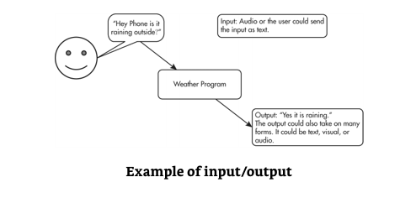
Big Idea 1
Program outputs are any data sent from a program to a device. Program output can come in a variety of forms, such as tactile, audio, visual, or text. Program output is usually based on a program’s input or prior state (e.g., internal values).

Slide 14
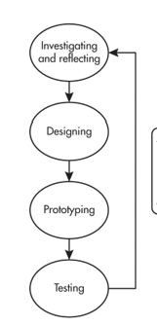
Big Idea 1
A development process can be ordered and intentional, or exploratory in nature.
A development process that is incremental is one that
breaks the problem into smaller pieces and makes sure
each piece works before adding it to the whole.
A development process that is iterative requires refinement
and revision based on feedback, testing, or reflection
throughout the process. This may require revisiting earlier
phases of the process.

Slide 15
Big Idea 1
﻿The design of a program incorporates investigations to determine its requirements. Most programs are designed to be used by people other than the programmers.
To meet the needs of the users, the investigation must identify the program constraints as well as the concerns and interests of people who will use the program.
Some ways investigations can be performed are as follows:
■​Collecting data through surveys
■​User testing
■​Interviews
■​Direct observations

Slide 16
Big Idea 1
﻿The design phase of a program may include:
■​Brainstorming
■​Planning and storyboarding
■​Organizing the program into modules and functional components
■​Creating diagrams that represent the layouts of the user interface ■​Developing a testing strategy for the program
﻿Program documentation is a written description of the function of a code segment, event, procedure, or program and how it was developed.
Program documentation helps in developing and maintaining correct programs when working individually or in collaborative programming environments.

Slide 17
Big Idea 1
Programmers should document a program throughout its development.
Documentation helps the programmer remember what he or she was thinking or the collaborative partners were thinking at the time they were programming.
Comments are a form of program documentation written into the program that do not affect how the program runs. Comments do not affect the run speed of a program. Python, for example, uses # for comments.

Slide 18
Big Idea 1
﻿Three types of program errors can occur:
■​Logic error—This is a mistake in the algorithm or program that causes it to behave incorrectly or unexpectedly. (incorrect implementation of algorithm)
■​Syntax error—This is a mistake in the program where the rules of the programming language are not followed. (missing parenthesis, incorrect indentation, misspelling name of function calls)
■​Runtime error—This is a mistake in the program that occurs during the execution of a program. Programming languages define their own runtime errors.(divide by 0, accessing out-of-bounds index of a list)

Slide 19
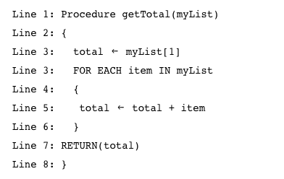
Big Idea 1
Read the code below. Assume that myList is a nonempty list of numbers. Identify the error. What kind of error is it?
Logic Error. The code adds the first number twice in the sum.

Slide 20
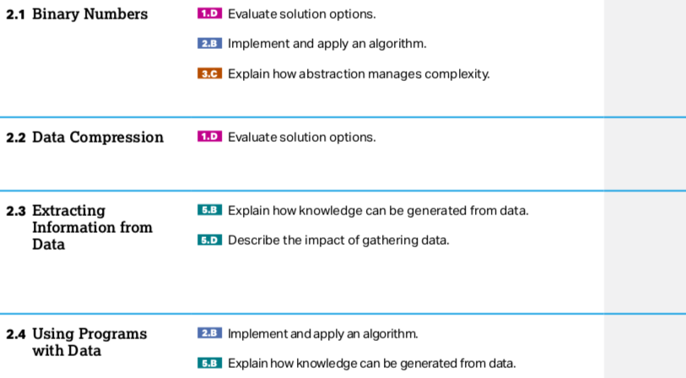
Big Idea 2: Data

Slide 21
Big Idea 2: Data
﻿A bit is shorthand for a single binary digit and is either 0 or 1. A byte is 8 bits. For example, the binary sequence 0110 1111 contains 8 bits or 1 byte.
﻿Binary sequences can be used to represent all digital data. Binary sequences can represent colors, Boolean logic, lists, and so on. Anything that can be stored on a computer can be represented by binary sequences.
﻿Some data take many bits to represent it. For example, a single 10 MP (1 MP is one million pixels) picture uses 10,000,000 pixels.
Each pixel (16-bit mode RGB) contains 16 * 3 = 48 bits = 6 bytes. That means there are 48 bits * 10,000,000 = 480,000,000 bits in a single 10 MP (16-bit mode) picture.
Logic Error. The code adds the first number twice in the sum.

Slide 22
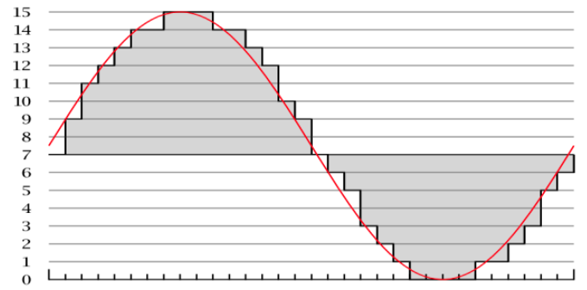
Digital vs. Analog
Many physical phenomena can be modeled by analog signal(sound, colors, temperature). Analog signals are continuous signals.
Computers can only understand digital signals (discrete or finite signal(0s and 1s).)
analog signals are continuous and can take on an infinite possible values(the real numbers)
digital signals are finite.
For example, 8 bit colors can take on one of 256 discrete, finite possibilities. But actual colors can take on any of an infinite possible values or shades.
Sampling allow computers to
approximate analog signals such
as sound.
The number of samples is the
sampling rate, the higher the rate
the better the quality.
Notes:
Crash Course: Cybersecurity

Slide 23
Big Idea 2: Data
﻿In many programming languages, integers are represented by a fixed number of bits, which limit the range of integer values and mathematical operations on those values.
For example in JAVA, the range of the value of an integer is from −2,147,483,648 to +2,147,483,647. Trying to store a number bigger than the limits will result in an overflow error.
Some languages like Python, integers do not have limits on number size but, instead, expand to the limit of the available memory.

Slide 24

Big Idea 2: Data
Example 1:
With 4 bits, the largest integer that can be stored is 2^4-1 = 15.
Example 2:
A 4-bit integer can any value in {0,1,2,..,15}. Thus storing the value of 10 + 6 = 16 would cause an overflow error since the 16 = 10000 requires at least 5 bits.
Example 3:
If x is a 3-bit integer, then x = 111 + 111 will cause an overflow error since the sum is 1110 which requires at least 4 bits.

Slide 25
Big Idea 2: Data
1/3 does not always equal 1/3. A roundoff error occurs when decimals (real numbers) are rounded.
One computer might calculate 1/3 as 0.333333. Another computer might calculate 1/3 as 0.3333333333. In this case, 1/3 on one computer is not equal to 1/3 on a second computer.

Slide 26

Big Idea 2: Data
Number bases, including binary, decimal, and hexadecimal, are used to represent and investigate digital data.
On your AP exam, you will be expected to convert binary to decimal and decimal to binary only.

Slide 27




Big Idea 2: Data
There is one 16 in 30.
What is left is 30 – 16 = 14. There is one 8 in 14 so:

Slide 28

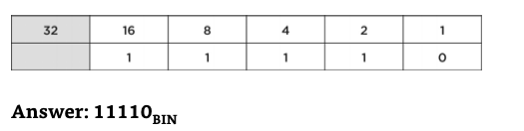
14 – 8 = 6
There is one 4 in 6 so:
6 – 4 = 2. And there is a 2 in 2 so:
2 – 2 = 0. Thus

Slide 29
Big Idea 2: Data
﻿INFORMATION EXTRACTED FROM DATA
People generate significant amounts of digital data daily. Some always-on devices are collecting geographic location data constantly, while social media sites are collecting premium data based on your usage.
People can use computer programs to process information as well as to gain insight and knowledge. Information is the collection of facts and patterns extracted from data.
Gaining insight from this valuable data involves a combination of statistics, mathematics, programming, and problem solving.

Slide 30
Big Idea 2: Data
Large data sets may be analyzed computationally﻿ to reveal patterns, trends, and associations.
These trends are powerful predictors of future behaviors. Investors are constantly reviewing trends in past pricing to influence their future investment decisions.
However, sometimes trends can be misinterpreted and result in business disasters. Digitally processed data may show correlation between variables.
A correlation found in data does not necessarily indicate that a causal relationship exists. Additional research is needed to understand the exact nature of the relationship.

Slide 31
Big Idea 2: Data
Depending on how the data were collected, the information may not be uniform. For example, if users entered data into an open field, the way they chose to abbreviate, spell, or capitalize something may vary from user to user. Data sets pose challenges regardless of size, such as:
■​The need to clean data
﻿■​Incomplete data
■​Invalid data
■​The need to combine data sources
Cleaning data is a process that makes the data uniform without changing their meaning.
One example is replacing all equivalent abbreviations with the same word. This can also be done with various spellings and with different capitalizations.

Slide 32
Big Idea 2: Data
﻿Data can get too large for traditional data-processing applications. The ability to process data depends on the capabilities of the users and their tools. Social media activity generates an enormous amount of data.
Some data sets are difficult to process using a single computer and may require parallel systems.
﻿Problems of bias are often created by the types and sources of data being collected. Bias is not eliminated by ﻿simply collecting more data. A large amount of data is generated by humans. Algorithms that use this data will reflect this bias.
Despite the advantages of big data, a large sample size can magnify the bias associated with the data being used. Data can have little value if the sample is not representative of the population to which the results will be generalized.

Slide 33
Big Idea 2: Data
﻿Predicting algorithms use information collected from big data to influence our daily lives. For example:
■​A credit card company can use purchasing patterns to identify when to extend credit or flag a purchase for possible fraud.
■​Social media sites can use patterns to target advertising based on viewing habits.
■An online store analyzing customers’ past purchases can suggest new products the customer may be interested in buying.
■​An entertainment application may recommend an additional movie to watch based on the viewer’s interests.

Slide 34
Big Idea 2: Data
﻿Using appropriate visualizations when presenting digitally processed data can help one gain insight and knowledge. Although big data is a powerful tool, the data will lose their value if they cannot be presented in a way that can be interpreted.
Visualization tools can communicate information about data. Column charts, line graphs, pie charts, bar charts, XY charts, radar charts, histograms, and waterfall charts can make complex data easier to interpret.
Python's pandas library can be used to explore, process and visualize data. See the optional lecture slides "pandas for Tabular data". Python's pandas library is a powerful alternative to Excel.

Slide 35
Big Idea 2: Data
Privacy concerns arise through the mass collection of data. The content of the data may contain personal information and can affect the choice in storage and transmitting.
Anything done online is likely to lead to sharing of private data. Using Gmail to order a pair of shoes from Clarks could result in ads for shoes showing up in your search engine.

Slide 36
Big Idea 2: Data
﻿Metadata are data that describe your data—for example, a picture of you standing in front of a waterfall is data. The location and time the picture was taken are metadata.
Metadata are used for finding, organizing, and managing information. Metadata can increase the effective use of data or data sets by providing additional information about various aspects of that data.
Changes and deletions made to metadata do not change the primary data.

Slide 37
Big Idea 3: Programming and Algorithms
The AP exam will use a language-agnostic syntax for programming and algorithm questions.
Please see the following reference sheet(also available during the actual exam) for more details about the syntax.
https://apcentral.collegeboard.org/pdf/ap-computer-science-principles-exam-reference-sheet.pdf

Slide 38
Big Idea 3: Programming and Algorithms
﻿In computer science, an abstraction is a way to represent essential features without including the background details or explanations. Abstractions reduce complexity and allow for efficient design and implementation of complex software systems.
Abstractions become a necessity as systems become more complex. For example, anytime you check your stories on Instagram, you are using a bunch of processes in the background that you have no control over.
Without these abstractions, it would be difficult to send a message to a friend. With the use of abstractions, you can focus on content, not the technical details of how the application works.

Slide 39
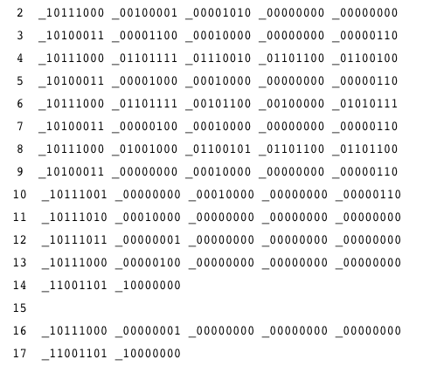
Big Idea 3: Programming and Algorithms
﻿Programmers also use abstractions. The purpose of abstraction is to hide coding details so the programmer can focus on the current problem.
Computers can understand only binary machine code. Machine code is a strictly numerical language that runs fast but is hard to use.
The code on the right is written in machine
code to outputs "Hello World" to the
screen.
In Python it can be done using the print()
abstraction:
print("Hello World")

Slide 40
Big Idea 3: Programming and Algorithms
﻿Abstractions allow for programmers to use semihuman language to program(Python, Java, etc…).
﻿Rarely will programmers deal directly in machine code. Machine code is a base language where no abstractions are implemented. Programmers have worked to hide details by using abstractions.
﻿Different program languages offer different levels of abstractions. High-level programming languages provide more abstractions than do lower-level languages.
Coding in a programming language is often translated into code in another low-level language that the computer can execute.

Slide 41
Big Idea 3: Programming and Algorithms
﻿Abstraction Examples Used on the AP Exam:
One common type of abstraction is procedural abstraction, which provides a name for a process and allows a procedure to be used only knowing what it does, not how it does it.
﻿DISPLAY(expression) is an abstraction that is used on your AP exam to display a value of expression followed by a space. The input parameter for the DISPLAY abstraction is expression.
﻿Another abstraction used on your AP exam is RANDOM(a, b), which evaluates to a random number from a to b inclusive. The input parameters in this abstraction are a and b.
﻿An abstraction generalizes functionality with input parameters that allow software reuse. Being aware of and using multiple levels of abstractions in developing programs helps to apply available resources and tools more effectively to solve problems.

Slide 42
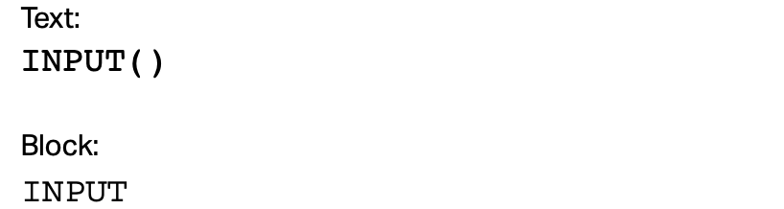
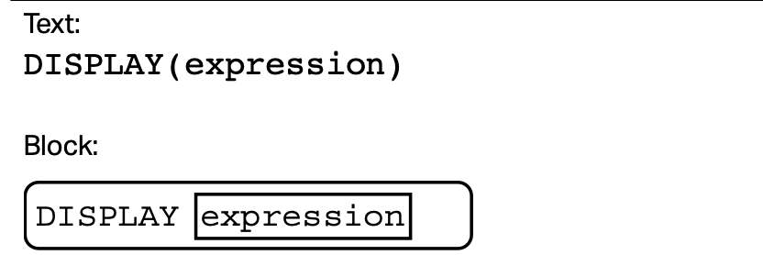
Important Procedures(Functions)

Slide 43
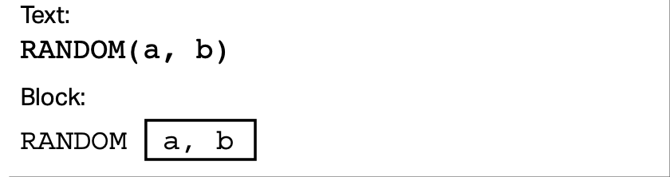
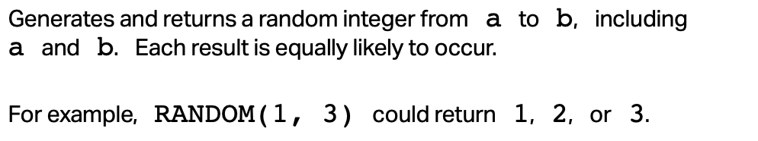
Important Procedures(Functions)

Slide 44
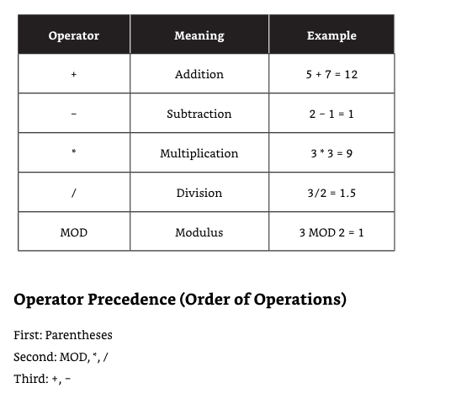

Slide 45
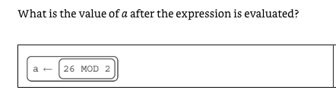
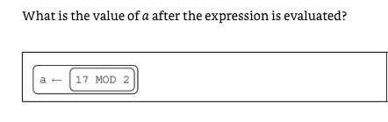
Big Idea 3: Programming and Algorithms

Slide 46
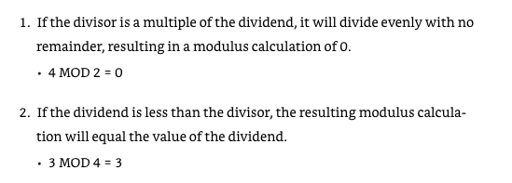
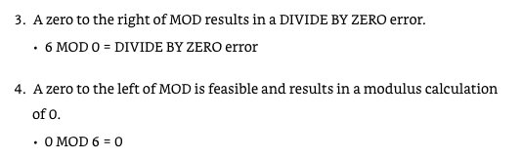
Big Idea 3: Programming and Algorithms

Slide 47
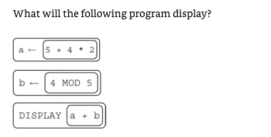

Big Idea 3: Programming and Algorithms

Slide 48
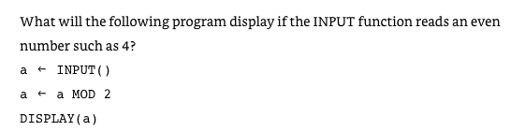
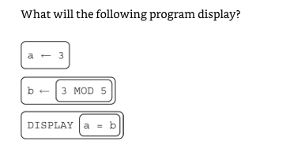

Big Idea 3: Programming and Algorithms

Slide 49
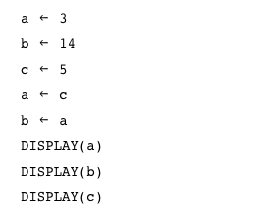
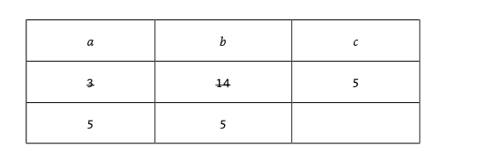
Big Idea 3: Programming and Algorithms

Slide 50
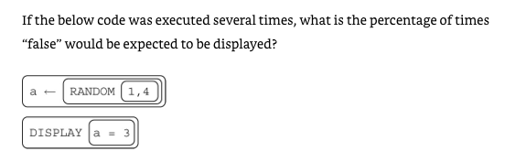

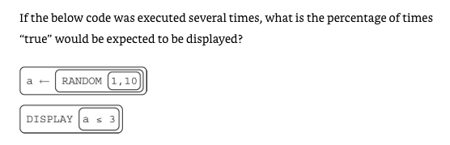

Slide 51
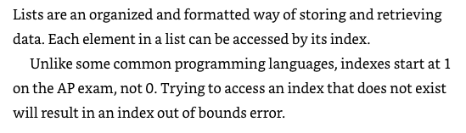
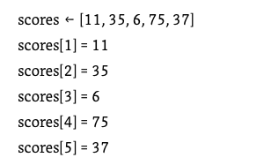
Lists

Slide 52
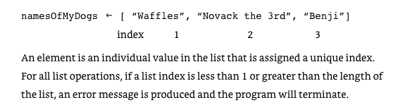
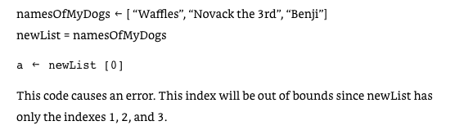
Lists

Slide 53


The INSERT(list, i, item) will insert the item at index i and shift right items at index i or higher.

Slide 54
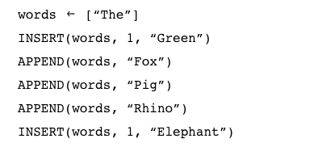
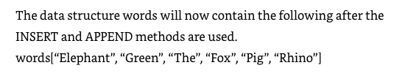
The APPEND(list, item) will add the item to the end of the list.

Slide 55

The REMOVE(list, i) will remove the item at index i and shift left items at index i or higher.
Line 4: REMOVE(words, 3)
Line 5: DISPLAY(words)
Answer: ["Green", "The", "Pig", "Rhino", "Fox"]

Slide 56
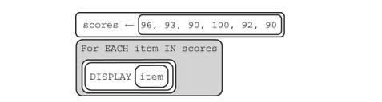


Slide 57
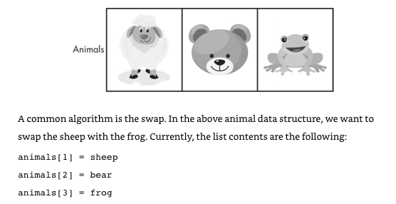


Slide 58





Slide 59
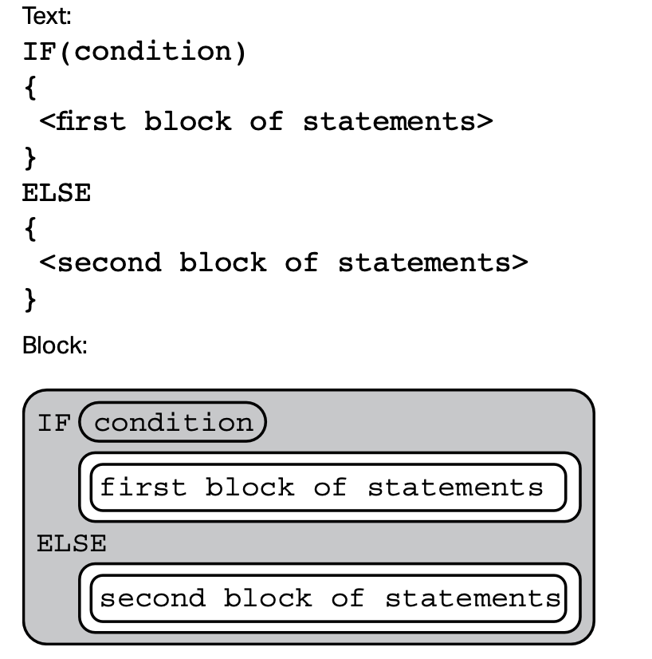
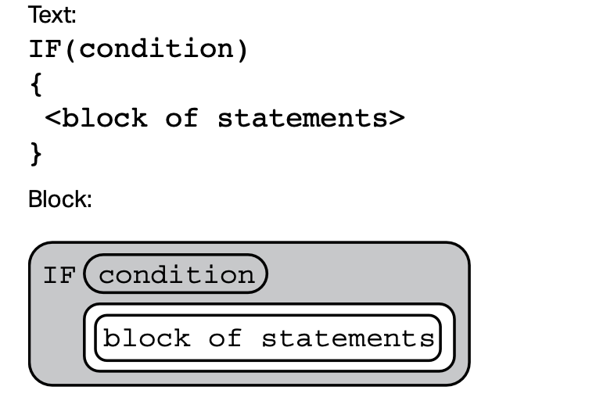
Conditionals

Slide 60
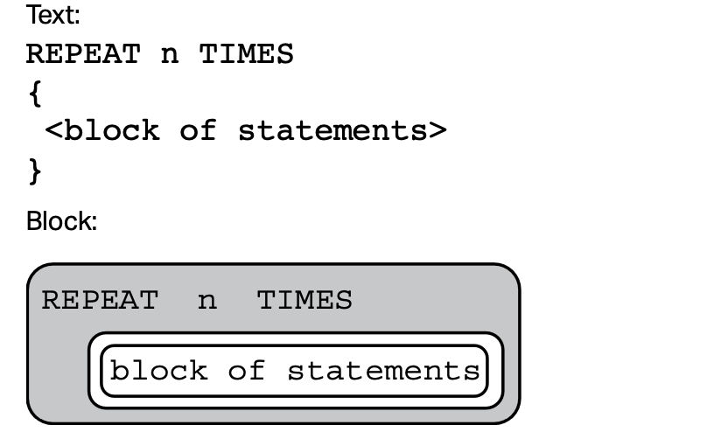
Loop 1: Repeat n Times
The code in block of statements is executed n times.

Slide 61
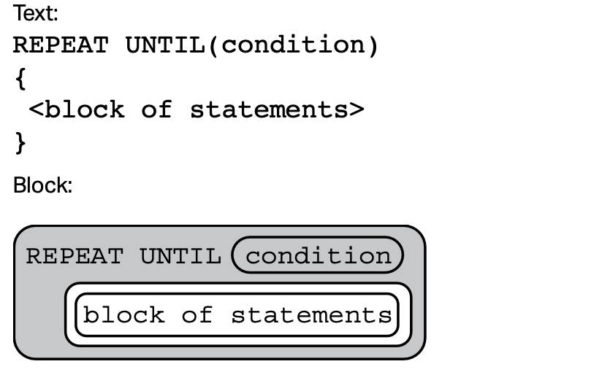
Loop 2: Repeat Until Condition
The code in block of statements is repeated until the Boolean expression condition evaluates to true.
This is different than Python’s while loop.
Python’s while loop runs as long as the
condition is true and terminates when
the condition is false.
REPEAT UNTIL (condition) loop runs as
long as the condition is false and terminates
when the condition is true.

Slide 62
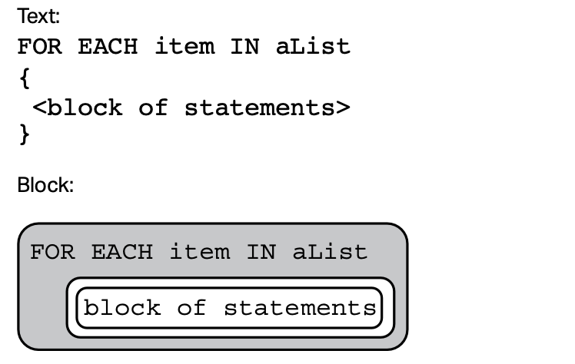
Loop 3: Looping Through a List
The variable item is assigned the value of each element of aList sequentially, in order, from the first element to the last element. The code in block of statements is executed once for each assignment of item.

Slide 63
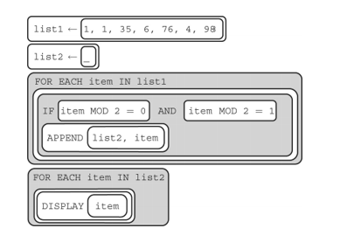
Example: Looping Through a List
What is the output?
Answer: Empty list, a number cannot be both even and odd. No number is appended to list2.

Slide 64

Loop 4: Looping Through a List(version 2)
Another way to loop through a list is to loop LENGTH(list) TIMES. What does the following code do?
Print out the sum of a list of numbers.
sum 0
n LENGTH(list)
REPEAT n TIMES
{
sum sum + item
}
DISPLAY(sum)

Slide 65
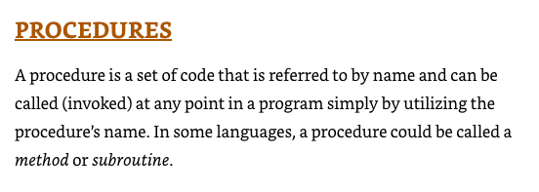

Slide 66
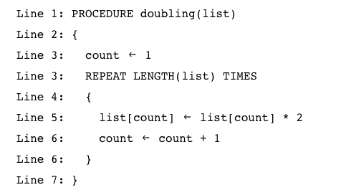
What does the code do?
Answer: Double each value in the list.

Slide 67
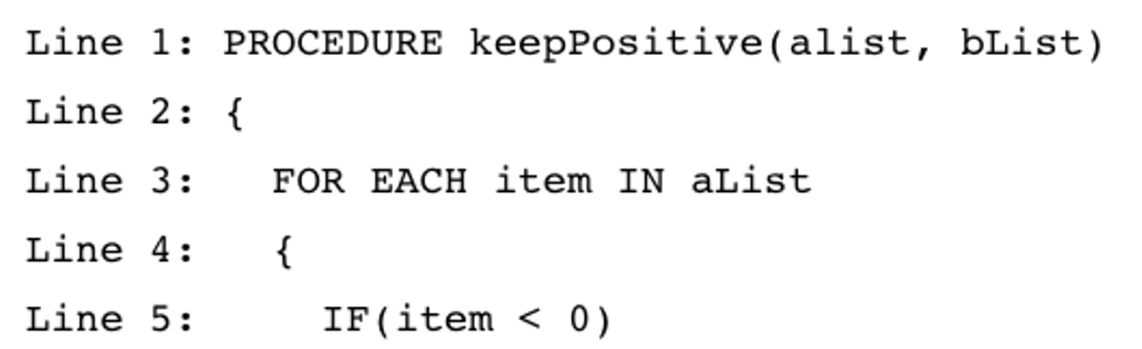


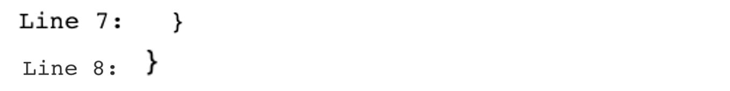


What does the code do?
Answer: Add negative numbers from alist to the end of bList.

Slide 68
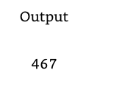
What is the output?
scores
[90, 89, 98, 100, 90]
total
finalTotal(scores)
Function call
Note: In Python, we put function definitions
on top of the file. Any code that calls
functions is below the function definitions.
On the AP exam, function definitions can
before function calls as shown here.
DISPLAY(total)
PROCEDURE findTotal(scores)
{
sum 0
FOR EACH item IN scores
{
sum sum + item
}
RETURN sum
}

Slide 69
Algorithms to Know
The AP MCQ will ask questions about standard algorithms every programmer should know:
Find total sum of a list of numbers
Find average of a list of numbers
Find maximum/minimum of a list of numbers
Find word from a list of words
Please know these algorithms and know how to quickly recognize them! If the code for any of the algorithm above is given with the name "mystery_algorithm", you should be able to quickly recognize what it does.
We'll go over each of them.

Slide 70
Find sum of a list
PROCEDURE findTotal(scores)
{
sum 0
FOR EACH item IN scores
{
sum sum + item
}
RETURN sum
}

Slide 71
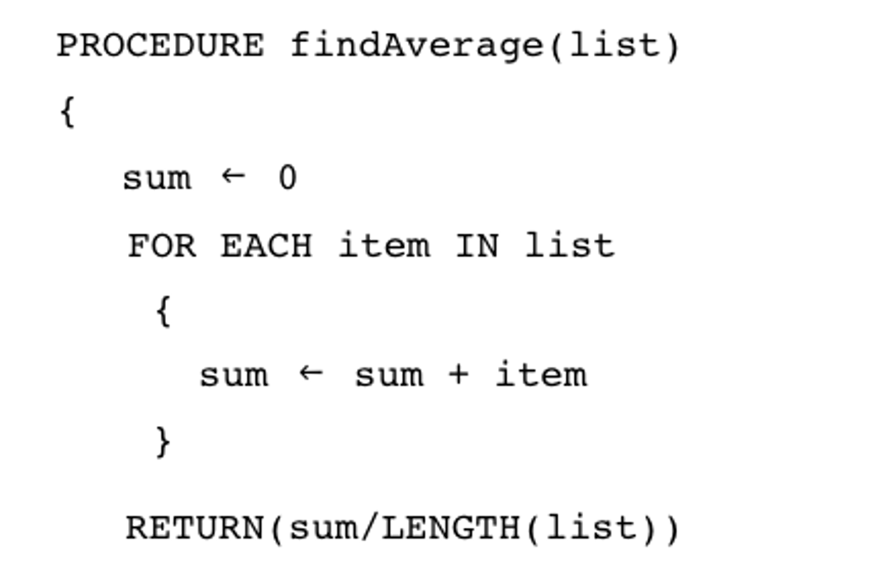

Find average of a list(implementation #1)
Implementation #1: Use for Each Loop.

Slide 72
Find average of a list(implementation #2)
Implementation #2: Use REPEAT n times loop.
PROCEDURE findAverage(list)
{
sum 0
n LENGTH(list)
REPEAT n TIMES
{
sum sum + item
}
RETURN sum / n
}

Slide 73









Find maximum of a list(implementation #1)
Implementation #1: Use for Each Loop.

Slide 74
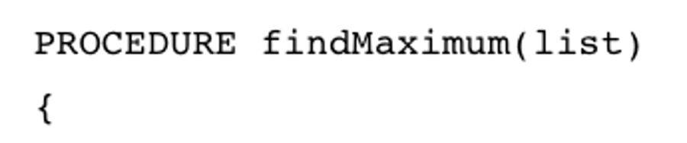
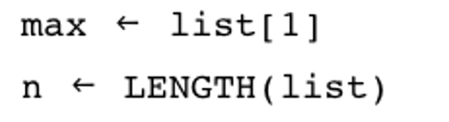
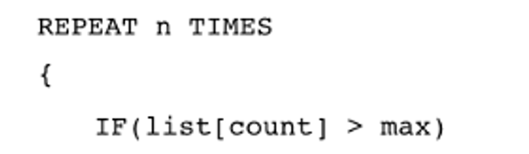




Find maximum of a list(implementation #2)
Implementation #2: Use REPEAT n times loop.
count 1
count count + 1

Slide 75


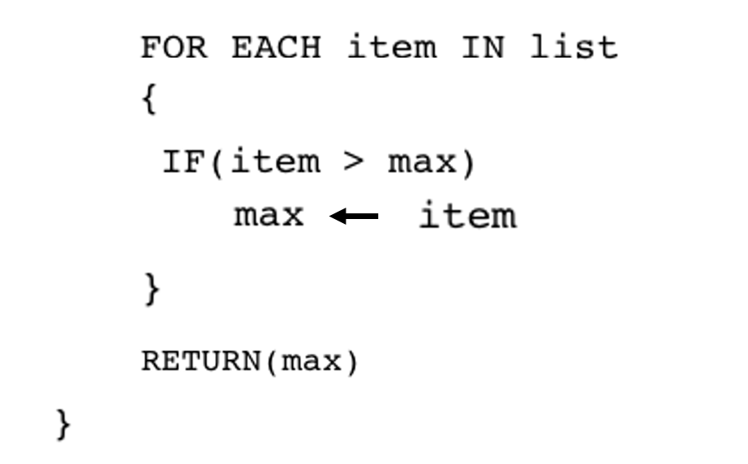

Common Error Example 1
The AP exam will try to give you code that is the wrong implementation of an algorithm. Can you find the error?

Slide 76

Common Error Example 2
The AP exam will try to give you code that is the wrong implementation of an algorithm. Can you find the error?
PROCEDURE findMinimum(list)
{
min list[1]
FOR EACH item IN list
{
IF(item < min)
min item
ELSE
min 0
}
RETURN min
}

Slide 77
Correct findMinimum
Here's the correct implementation of findMinimum.
PROCEDURE findMinimum(list)
{
min list[1]
FOR EACH item IN list
{
IF(item < min)
min item
}
RETURN min
}

Slide 78
Find word from list of words
PROCEDURE findWord(list, word)
{
index 1
FOR EACH item IN list
{
IF(item = word)
{
RETURN index
}
ELSE
{
index index + 1
}
}
RETURN “Word not in list”
}
This code also works if we remove
the Else block:
IF(item = word)
{
RETURN index
}
index ← index + 1

Slide 79

Big Idea 3: Programming and Algorithms

Slide 80

Big Idea 3: Programming and Algorithms

Slide 81


Slide 82


Slide 83


What is the result of executing the above code?
Answer: Robot moves forward 4 steps.

Slide 84



Does the code work as intended?
Yes, as an exercise, trace the code to convince yourself that the robot will reach destination.

Slide 85

Does the code work as intended?
No! Robot get stuck in an infinite loop at the top right corner.

Slide 86




Slide 87




Slide 88


Slide 89



Slide 90



Slide 91


Slide 92



Slide 93


Slide 94



Slide 95

Program Design

Slide 96



Slide 97


Trace the code and determine the output of the following program.
Answer:

Slide 98

Trace the code and determine the output of the following program.
Answer: Display 3.

Slide 99
Algorithmic Efficiency
Some problems cannot be solved in a reasonable amount of time because there is no efficient algorithm for solving them. In these cases, approximate solutions are sought.
Algorithms with a polynomial efficiency(constant, linear, square, cube, etc.) are said to run in a reasonable amount of time. They can be executed quickly on a modern processor.
However, there exists important and practical problems for which there exists no known polynomial time algorithm. Algorithms with exponential or factorial efficiencies are examples of algorithms that run in an unreasonable amount of time.

Slide 100
Algorithmic Efficiency
A heuristic is an approach to a problem that produces a solution that is not guaranteed to be optimal but may be used when techniques that are guaranteed to always find an optimal solution are impractical.
For example, ﻿a file-organizing algorithm determines the content of a file based on a certain number of bytes in the beginning of the file. This is an approximate solution since only a few bytes are examined. But it is more practical and faster to run than examining every byte of every file.

Slide 101
Programmers break down problems into smaller and more manageable pieces. By creating procedures and leveraging parameters, programmers generalize processes that can be reused.
Procedures allow programmers to draw upon existing code that has already been tested, allowing them to write programs more quickly and with more confidence.
A software library contains procedures that may be used in creating new programs. (e.g. Python's random, numpy libraries)
The use of libraries simplifies the task of creating complex programs (abstraction).

Slide 102
Application program interfaces (APIs) are specifications for how the procedures in a library behave and can be used.
For example, Twitter's API allow programmers to access and analyze tweets.
Documentation for an API/library is necessary in understanding the behaviors provided by the API/library and how to use them. Twitter has documentation that allows programmers to learn how to use their API.
﻿A computing device is a physical artifact that can run a program. Some examples include computers, tablets, servers, routers, and smart sensors. The device must be able to take inputs, process the inputs, and then calculate results based on those inputs.
Reichelson, Seth. AP Computer Science Principles Premium with 6 Practice Tests (Barron's Test Prep) (p. 321). Barrons Educational Series. Kindle Edition.

Slide 103

Big Idea 4: Computer Systems and Network

Slide 104
Big Idea 4: Computer Systems and Networks
﻿A computing device is a physical artifact that can run a program. Some examples include computers, tablets, servers, routers, and smart sensors. The device must be able to take inputs, process the inputs, and then calculate results based on those inputs.
﻿A computing system is a group of computing devices and programs working together for a common purpose. A type of computing system is a computer network. A computer network is a group of interconnected computing devices capable of sending or receiving data.
﻿The bandwidth of a computer network is the maximum amount of data that can be sent in a fixed amount of time.

Slide 105
Big Idea 4: Computer Systems and Networks
﻿A path between two computing devices on a computer network (a sender and receiver) is a sequence of directly connected computing devices that begins at the sender and ends at the receiver. Routing is the process of finding a path from sender to receiver.
﻿If the path from sender to receiver is broken, the path will be rerouted. This fault-tolerant nature of the internet makes connections between computing devices more reliable.
﻿The internet connects devices and networks from all over the world. The internet is a physical network of fiber optics, radio transmitters, and cabling. Devices and networks that make up the internet are connected and communicate using standardized, open communication protocols.

Slide 106
Big Idea 4: Computer Systems and Networks
A protocol is an agreed-upon set of rules that specify the behavior of a system.
These internet protocols, including those for addresses and names, have evolved to allow for the internet to be scalable.
The scalability of a system is the capacity for the system to change in size and scale to meet new demands.
﻿Internet protocol (IP) is responsible for addressing and routing your online requests. For a device to connect to the internet, it is first assigned an internet protocol address.

Slide 107
Big Idea 4: Computer Systems and Networks
﻿Currently, we are switching between the fourth and sixth versions of the internet protocol.
The fourth version (IPv4) uses 32 bits to store IP addresses. These 32 bits can hold 2^32 IP addresses. When multiplied out, 2^32 is actually 4,294,967,296 unique addresses.
The newer version, IPv6, uses 128 bits, which can hold 2^128 IP addresses.
﻿Transmission control protocol (TCP) is a protocol that defines how computers send packets of data to each other. Data traveling in the internet is broken down into small chunks of data called packets. TCP protocols guide the rules on how data are subdivided into packets before transmission.

Slide 108
Big Idea 4: Computer Systems and Networks
﻿User datagram protocol (UDP) is a protocol that allows computer applications to send messages without checking for missing packets to save on time needed to retransmit missing packets. UDP is not as reliable as TCP, which does resend packets lost when transmitting.
﻿The internet has been engineered to be fault tolerant. If a system fails, a different path can be chosen between the sending computer and the receiving computer.
Redundancy is the inclusion of extra paths that can mitigate the failure of a system if other components fail. This is important because elements can fail at any time, and fault tolerance allows users to continue to use the network.

Slide 109
Big Idea 4: Computer Systems and Networks
﻿The internet refers to the hardware. It is made up of the computers, cables, routers, and many more components that make up the entire network. It is a global decentralized network connecting millions of computers.
The World Wide Web, in contrast, refers to the software used on the internet. HTTP is a protocol used by the World Wide Web to transmit data.
The internet allows access to the World Wide Web, which is a system of linked pages, programs, and files.

Slide 110

Big Idea 4: Computer Systems and Networks
﻿Sequential computing is a computational model in which operations are performed in order one at a time. A sequential solution takes as long as the sum of all of the steps.
﻿A sequential computing solution takes as long as the sum of all its steps. In the above example, the total processing time is 4 + 1 + 6 + 2 + 3 + 1 + 5 + 1 = 23 seconds.

Slide 111

Big Idea 4: Computer Systems and Networks
In contrast, parallel computing involves breaking up a task into smaller, sequential pieces. Then those sequential pieces are all executed at the same time, each on its own processor or on a set of computers that have been networked together.
A parallel solution takes at least as long as the longest branch in the program. ﻿In the above example, the total processing time is 9 seconds.

Slide 112

Big Idea 4: Computer Systems and Networks
﻿Parallel computing can consist of a parallel portion and a sequential portion. A parallel computing solution takes as long as its sequential tasks plus the longest of its parallel tasks. Most modern computers are parallel in architecture with multiple processors.
﻿In the above example, the total processing time is 2 + 1 + 4 + 3 + 1 = 11 seconds.

Slide 113
Big Idea 4: Computer Systems and Networks
﻿Some examples of complex computer simulations that benefit from parallel computing include weather forecasting, flight simulators, car crash modeling, seismic surveying, and so on.
The “speedup” of a parallel solution is measured in the time to complete the task sequentially divided by the time to complete the task when done in parallel:
Speedup = (sequential run time)/(parallel run time)

Slide 114
Big Idea 4: Computer Systems and Networks
﻿Many problems are so large and complex that it is impractical to solve them on a single computer, especially given limited computer memory. Distributed computing is a computational model in which multiple devices are used to run a program.
Distributed computing allows problems to be solved that could not be solved on a single computer because of either the processing time or storage needs involved.
Much larger problems can be solved more quickly using distributed computing than using a single computer.
Parallel computing uses a single computer with multiple processors. Distributed computing uses multiple computing devices to process those tasks.

Slide 115

Big Idea 5: Impact of Computing

Slide 116
Big Idea 5: Impact of Computing
﻿The digital divide is the difference in access to technology including access to computers and the internet.
Several variables affect the digital divide:
■​Infrastructure—Some parts of the world do not have access to the internet. ■​Education—A person could have access to the internet but not have the education to use it.
■​Indifference—A person could have access to the internet but choose not to use it.
■​Cost—The cost of accessing the internet could make using it unaffordable.

Slide 117



Big Idea 5: Impact of Computing
﻿A computing innovation includes a program as an integral part of its function. Some examples of modern computing innovations include the following:

Slide 118
Big Idea 5: Impact of Computing
﻿A computing innovation can have both a beneficial and a harmful effect on societies, cultures, or economies. An effect may be an impact, a result, or an outcome. Beneficial and/or harmful effects are contextual and interpretive.
A single effect can be viewed as both beneficial and harmful by different people or even by the same person.
For example, GPS in a car can predict the time of arrival during a long car trip by tracking the speed of a car and the distance needed to travel. This can be beneficial to the driver to know his or her time of arrival. However, this same innovation can be harmful to the user if the police gain access to this data and give the driver a speeding ticket.

Slide 119
Big Idea 5: Impact of Computing
Computing innovations can reflect existing human bias.﻿Since computing innovations are created by people, the innovations created can reflect bias that the programmers bring with them. Programmers should take action to reduce biases at all levels of software development. Machine learning algorithms that are trained on biased datasets will give biased results.
Crowdsourcing is a sourcing model in which individuals or organizations obtain goods and services, including ideas and finances, from a large group of internet users. Examples include "idea competitions" and "innovation contests" such as Netflix Prize and Lego Ideas.
Citizen science is scientific research conducted in whole or part by distributed individuals, many of whom may not be scientists, who contribute relevant data to research using their own computing devices e.g. folding@home(protein folding) and Galaxy Zoo(classify galaxies).

Slide 120


Big Idea 5: Impact of Computing
Open Access and Creative Commons have enabled broad access to digital information. Open and curated scientific databases have benefited scientific researchers.
Creative Commons—a public copyright license that enables the free distribution of an otherwise copyrighted work. This is used when the content creator wants to give others the right to share, use, and build upon the work they have created.
open source—programs that are made freely available and may be redistributed and modified(examples: Firefox browser, OpenOffice(in competition with Microsoft Office).
open access—online research output free of any and all restrictions on access and free of many restrictions on use, such as copyright or license restrictions
Open Access
Notes:
https://www.smartgrid.gov/the_smart_grid/smart_grid.html

Slide 121


Big Idea 5: Impact of Computing
﻿Security is needed to protect the confidentiality, integrity, and availability of information. Security protects that data from cyber attacks and hacking.
Privacy is the right to control data generated by one’s usage of computing innovations and restrict the flow of that data to third parties.
﻿Personally, identifiable information (PII) is information about an individual that identifies, links, relates, or describes that person. Examples of PII include the following:

Slide 122
Big Idea 5: Impact of Computing
﻿PII can be analyzed and processed by businesses and shared with other companies.﻿ PII has monetary value. The entire business model for some computing innovations is to sell user information to targeted advertisers.
﻿
As a result, concerns have been raised over how companies handle the sensitive information of their consumers.
﻿A computing innovation generates metadata that can have the effect of reducing the privacy of the user. Metadata can include geolocation, time, date, filename, and so on. This rapid sharing of user data can often have significant impacts beyond the intended purpose or control of the programmer.

Slide 123
Big Idea 5: Impact of Computing
﻿Authentication measures protect devices and information from unauthorized access. Examples of authentication measures include passwords and multifactor authentication. A strong password should be easy to remember but difficult for someone else to guess.
﻿Multifactor authentication is a method of computer access control in which a user is granted access only after successfully presenting several pieces of evidence to an authentication mechanism, typically in at least two of the following categories:
■​Knowledge—something the user knows
■​Possession—something the user has
■​Inherence—something the user is

Slide 124
Big Idea 5: Impact of Computing
﻿Digital certificate authorities issue digital certificates that validate the ownership of encryption keys used in secure communications and are based on a trust model.
﻿To increase security, encryption is used. Encryption uses cryptographic algorithms to encrypt data. Encryption is the process of encoding data to prevent unauthorized access. Decryption is the process of decoding the data.
Symmetric key encryption uses the same key for both encryption and decryption. The one key is a shared secret and relies on both sides keeping their key secret.
﻿Public key encryption (also called asymmetric encryption) uses two keys—one private and one public. Anyone with the public key can encrypt data, and the public key is public. To decrypt, a second key, which is private, is needed.

Slide 125
Big Idea 5: Impact of Computing
﻿
Malware is malicious software intended to damage a computing system or take partial control or its operations. Malware can be spread over email, executable files, instant messaging, social media, freeware, shareware, and many other methods.
﻿Computer viruses are malicious programs that can copy themselves and gain access to a computer in an unauthorized way. Viruses often perform some type of harmful activity on infected host computers.

Slide 126
Big Idea 5: Impact of Computing
﻿Unauthorized access can be gained to computers in several ways. One method is phishing. Phishing is a technique that directs users to unrelated sites that trick the user into giving personal data. Phishing is a technique used by cyber criminals posing as a legitimate institution to lure individuals into providing sensitive data, such as PII, banking and credit card details, and passwords.
﻿Keylogging is another method involving unauthorized access to a computer. Keylogging is the use of a program to record every keystroke made by the computer user in order to gain fraudulent access to passwords and other confidential information.
﻿Data sent over public networks can be intercepted, analyzed, and modified. One way that this can happen is through a rogue access point. A rogue access point is a wireless access point that gives unauthorized access to secure networks.

Slide 127
References
Reichelson, Seth. AP Computer Science Principles Premium with 6 Practice Tests (Barron's Test Prep) (p. 92). Barrons Educational Series.

