Slide 1
Introduction to Python
Functions

Slide 2
Topics
Functions
Positional Arguments
Keyword Arguments
Default Values
Installing and Running a Python Script
Scope of a variable
Execution of a Script
main()

Slide 3
Example
Consider the following code which asks the user to enter a number and prints out the absolute value of the number. This problem was a lab assignment in the last lecture.
x = int(input(‘Enter an integer: ’))
if x >= 0:
print(“The absolute value of”, x, "is", x)
else:
print(“The absolute value of”, x, "is", -x)

Slide 4
Example
Now what if the program asks the user for two numbers and then compute their absolute values? What do you think of the following code?
x = int(input(‘Enter an integer: ’))
if x >= 0:
print(“The absolute value of”, x, "is", x)
else:
print(“The absolute value of”, x, "is", -x)
x = int(input(‘Enter an integer: ’))
if x >= 0:
print(“The absolute value of”, x, "is", x)
else:
print(“The absolute value of”, x, "is", -x)
Note the redundancy!
We like to reuse code
without rewriting or copying/pasting
code!

Slide 5
Functions
One way to organize Python code and to make it more readable and reusable is to factor out useful pieces into reusable functions.
A function is a named group of programming instructions that accomplish a specific task. If we want to perform the task, we simply "call" the function by its name. A function may be called as many times as we wish to redo the task.
The "30 seconds" button on the microwave is an example of a function. If we press it(call it by its name), it will run the microwave 30 seconds. Later, if we want to heat something else, we can press it again to run the microwave another 30 seconds.
In other programming languages, functions are also called procedures or methods.

Slide 6
Example
Now what if the program asks the user for two numbers and then compute their absolute values? What do you think of the following code?
x = int(input(‘Enter an integer: ’))
if x >= 0:
print(“The absolute value of”, x, "is", x)
else:
print(“The absolute value of”, x, "is", -x)
x = int(input(‘Enter an integer: ’))
if x >= 0:
print(“The absolute value of”, x, "is", x)
else:
print(“The absolute value of”, x, "is", -x)
Let's factor out this piece of code, convert it into a function by giving it a name!
Then we can call it repeatedly if we wish to run the code.

Slide 7
Functions
A function or procedure is a group of code that has a name and can be called using parentheses. A function may have parameters or input variables to the function.
In Python, a function is defined using the def statement.
def function_name(parameters):
block

Slide 8
Functions
The arguments of a function are the inputs of the function. By default, arguments are positional. A function can "return" an answer, which is the output of the function.
In [1]: def add(a, b):
return a + b
In [2]: add(2, 4)
Out [2]: 6
In [3]: add(2) # too few arguments
In [4]: add(2, 4, 6) # too many arguments
parameters
Function definition.
arguments
Function calling.

Slide 9
Functions Arguments (input)
In [1]: def add(a, b):
return a + b
In [2]: add(2, 4)
Out [2]: 6
In function calling, the actual arguments
2 and 4 are sent to the formal parameters
a and b respectively.

Slide 10
Function Return (output)
In [1]: def add(a, b):
return a + b
In [2]: answer = add(2, 4)
In [3]: print(answer)
6
When a function returns a value, the returned
value is the value of the entire function
call add(2,4).

Slide 11
Functions
Let's write a simple function absolute_value which returns the absolute value of a given number.
In [1]: def absolute_value(n):
if n >= 0:
return n
else:
return -n
In [2]: absolute_value(23)
Out [2]: 23
In [3]: absolute_value(-10)
Out [3]: 10
In [4]: abs(-3)
Out [4]: 3
You write the function definition once.
But you can call it many times!
This is code reuse.
Python already has a built-in function
for called abs() which returns the absolute
value of a number.

Slide 12
Functions
Input arguments can be specified by name (keyword arguments). In this case, the order does not matter. Using keyword arguments is encouraged since it makes code clear and flexible.
In [1]: def add(a, b):
return a + b
The following are all equivalent:
In [2]: add(1, 3)
In [3]: add(a=1, b=3)
In [4]: add(b=3, a=1)

Slide 13
Functions
If keyword arguments and positional arguments are used together, keyword arguments must follow positional arguments.
In [1]: def add(a, b, c):
return a + b + c
The following are all equivalent:
In [2]: add(1, 3, 5)
In [3]: add(1, b=3, c=5)
In [4]: add(1, c=5, b=3)
The following gives an error:
In [5]: add(a=1, 3, c=5)

Slide 14
Functions
Functions can take optional keyword arguments. These are given default values. Their default values are used if a user does not specify these inputs when calling the function. Default values must come after positional arguments in the function signature.
In [1]: def subtract(a, b=0):
return a - b
In [2]: subtract(2)
Out [2]: 2
In [3]: subtract(1, 3)
Out [3]: -2
In [4]: subtract(2, b=5)
Out [4]: -3
In [5]: subtract(b=-1, a=6)
Out [5]: 7

Slide 15
print(*objects, sep=‘ ’, end=‘\n’)
We have seen the use of optional keyword arguments before.
print("hello", "Mike") # use default values
print("goodbye", "Sarah", end=".", sep=":")
hello Mike
goodbye:Sarah.
any number of positional arguments
optional keyword argument specifies separator character; default value is a space
specify end character; defaults to newline
note that the order can be switched.

Slide 16
Flow of a Program
x = 2 def fun():
x = 10
print(x)
print(x)
fun()
print("Good bye!")
A procedure or function call interrupts the sequential
execution of statements, causing the program to
execute the statements within the procedure
before continuing.
Once the last statement in
the procedure (or a return statement) has
executed, flow of control is returned to the point
immediately following where the procedure
was called.
2
Run code
1
3

Slide 17
Writing A Complete Program
Thus far, we have used the IPython console to write one line of code or block of code at a time.
As the complexity of our program increases, we like to decompose our programs into small reusable components(functions, objects) and combine them in a logical way to form a complete program.
When you create a new repl on repl.it, notice that your code lives inside of the "main.py" file. A file that ends in .py is a Python script or module: a text file that contains Python code.

Slide 18
Writing A Complete Program
Offline, you can create Python scripts with any simple text editor. For example, on Windows, you can use notepad. On a Mac, textEdit.
However, it useful to use a more sophisticated "integrated development environment"(IDE) to have features like autocomplete, ability to access docs strings.
For us, we have used repl.it IDE. But there are great offline ones including PyCharm and very popular Visual Studio Code.
Note: Do not use Word to write code. Word will silently change certain characters like " and will cause errors in your code.

Slide 19
Installing Python
To run code locally on computer, you need a Python interpreter.
It is highly recommended that you download and install the Anaconda distribution which includes the official CPython interpreter, useful packages for scientific computing like NumPy and SciPy, the conda package manager, the Jupyter Notebook as well some other IDEs(VSCode).

Slide 20
Running Code Locally on Computer
Once you have the Python interpreter installed, you can run code locally on you computer.
Navigate to the director(folder) where your script(e.g. "main.py") lives.
On the terminal(Mac) or command prompt(Win), type:
python main.py
The output will appear on your terminal.

Slide 21
Python Script
A Python script is executed line by line top to bottom.
Function definitions are packaged into an executable unit to be executed later. The code within a function definition executes only when invoked by a caller.
In addition, variables and parameters defined in a function is local to that function and is hidden from code outside of the function definition.

Slide 22
main.py
x = 2 print("1. x =", x)
def fun1():
x = 10
print("2. x =", x)
print("3. x =", x)
def fun2():
x = 20
print("4. x =", x)
print("5. x =", x)
fun1()
fun2()
print("6. x =", x)
What's the output?
Output:
1. x = 2
3. x = 2
5. x = 2
2. x = 10
4. x = 20
6. x = 2

Slide 23
main.py
This example illustrates how functions protect
its local variables. Things to note:
x = 2 print("1. x =", x)
def fun1():
x = 10
print("2. x =", x)
print("3. x =", x)
def fun2():
x = 20
print("4. x =", x)
print("5. x =", x)
fun1()
fun2()
print("6. x =", x)
Function definitions are not executed until they
are explicitly called.
2) Two different functions can use local variables
named x, and these are two different variables that
have no influence on each other. This includes
parameters.

Slide 24
main.py
This example illustrates how functions protect
its local variables. Things to note:
x = 2 print("1. x =", x)
def fun1():
x = 10
print("2. x =", x)
print("3. x =", x)
def fun2():
x = 20
print("4. x =", x)
print("5. x =", x)
fun1()
fun2()
print("6. x =", x)
Function definitions are not executed until they
are explicitly called.
2) Two different functions can use local variables
named x, and these are two different variables that
have no influence on each other. This includes
parameters.
The x variable defined outside of fun1() and
fun2() is not affected by the code inside of those
functions. (x = 2)

Slide 25
Scope
The scope of a variable refers to the context in which that variable is visible/accessible to the Python interpreter.
A variable has file scope if it is visible to all parts of the code contained in the same file.
A variable defined inside a function or as input arguments has restricted scope – they can only be accessed within the function.
Python is more liberal compared to Java and C++ in terms of scoping rules. In most cases, variables have file scope.

Slide 26
Scope
a = 2 # a has file scope
def fun(b):
c = b + 1 # b and c both have restricted scope
return c
g = fun(3)
print(g) # 4
print(c) # error, this is outside of scope of c, c not defined
if a % 2 == 0:
f = 5 # f has file scope
print(f) # 5

Slide 27
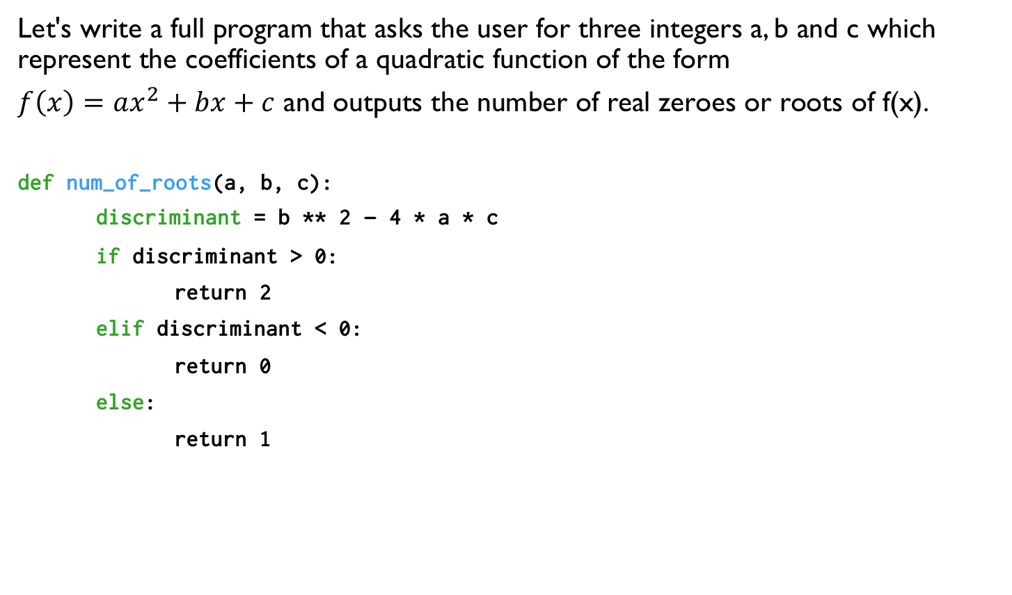
Writing a Simple Program
Let's write a full program that asks the user for three integers a, b and c which represent the coefficients of a quadratic function of the form
$f\left(x\right)=ax^{2}+bx+c$ and outputs the number of real zeroes or roots of f(x).
def num_of_roots(a, b, c):
discriminant = b ** 2 – 4 * a * c
if discriminant > 0:
return 2
elif discriminant < 0:
return 0
else:
return 1
a = float(input('Enter a:'))
b = float(input('Enter b:'))
c = float(input('Enter c:'))
numroots = num_of_roots(a, b, c)
print(numroots)

Slide 28
It is common for programmers to write a main controlling function that calls other functions to accomplish the task of the program.
def num_of_roots(a, b, c):
discriminant = b ** 2 – 4 * a * c
if discriminant > 0:
return 2
elif discriminant < 0:
return 0
else:
return 1
def get_int():
return int(input("Enter a number: "))
def main():
a = get_int()
b = get_int()
c = get_int()
print(num_of_roots(a, b, c))
main()
In other programming languages like Java
and C++, the main program is REQUIRED
to be called main().
the program starts running here.

Slide 29
def num_of_roots(a, b, c):
discriminant = b ** 2 – 4 * a * c
if discriminant > 0:
return 2
elif discriminant < 0:
return 0
else:
return 1
def get_int():
return int(input("Enter a number: "))
def main():
a = get_int()
b = get_int()
c = get_int()
print(num_of_roots(a, b, c))
if __name__ == 'main':
main()
You might also see this version of calling main().
It has to do with importing vs. running a script.
We won't worry too much about this for now.

Slide 30
Python Program Template
# declare and initialize global variables with file scope
…
# function definitions
def func1(…):
…
def func2(…):
…
# main() function calls above functions to accomplish task of application
def main():
…
main()
# OR
# if __name__ == 'main':
# main()
From now on, when we write a
program, we will use this template.

Slide 31
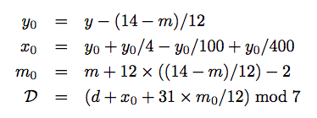
Lab 1: Day Of the Week
Create a new repl on replit. Write a program that outputs the day of the week for a given
date! You program must the program template discussed in this lecture. It should include
the main function and the day_off_week function below.
Given the month, m, day, d and year y, the day of the week(Sunday = 0, Monday = 1, …,
Saturday = 6) D is given by:
Note: the / operator from the above equations is floor division // in Python. The
mod operator is %.
Your program needs the following method and the main function.
def day_of_week(m, d, y):
# your code implementation
Notes:
// This program computes two people's body mass index (BMI) and
// compares them. The code uses parameters, returns, and Scanner.
import java.util.*; // so that I can use Scanner
public class BMI {
public static void main(String[] args) {
System.out.println("This program reads in data for two people and");
System.out.println("computes their body mass index (BMI)");
System.out.println();
// finish me!
}
}

Slide 32
Lab 1: Day Of the Week
Your program should have output similar to the following:
Enter month: 10
Enter day: 27
Enter year: 2020
Day of the week: Tuesday
And try entering your birthday and test your parents!
Notes:
// This program computes two people's body mass index (BMI) and
// compares them. The code uses parameters, returns, and Scanner.
import java.util.*; // so that I can use Scanner
public class BMI {
public static void main(String[] args) {
System.out.println("This program reads in data for two people and");
System.out.println("computes their body mass index (BMI)");
System.out.println();
// finish me!
}
}

Slide 33
References
Vanderplas, Jake, A Whirlwind Tour of Python, O’reilly Media.
Halterman, Richard, Fundamentals of Python Programming.

