Slide 1

Understanding Data Part 3
Extracting Information from Data

Slide 2
Information
Information is the collection of facts and patterns extracted from data. Data provide opportunities for identifying trends, making connections, and addressing problems.
The size of a data set affects the amount of information that can be extracted from it. A popular subfield of computer science is data science where large datasets are processed and analyzed.
Large data sets are difficult to process using a single computer and may require parallel or distributed systems. Scalability of systems is an important consideration when working with data sets, as the computational capacity of a system affects how data sets can be processed and stored.
Parallel computing uses a single computer with multiple processors. Distributed computing uses multiple computing devices to process those tasks.
Notes:
Crash Course: Cybersecurity

Slide 3
Information
Programs can be used to process data to acquire information.
Programs such as spreadsheets(for example, Excel) help efficiently organize and find trends in information. Excel can process tabular data or 2D data with mixed datatypes.
A powerful alternative is Python's pandas library. We will explore this library and see how it helps us:
gain insight and knowledge that are obtained from translating and transforming digitally represented information.
see patterns when data are transformed
filter, modify, combine and compare data
visualize data through charts, graphs, tables and other visualizations
We will use Jupyter Notebook(Lab) for all code in this lecture slides.
Data filtering systems are important tools for finding information and recognizing patterns in data.
Search tools are useful for efficiently finding information.
Tables, diagrams, text, and other visual tools can be used to communicate insight and knowledge gained from data.
Notes:
Crash Course: Cybersecurity

Slide 4


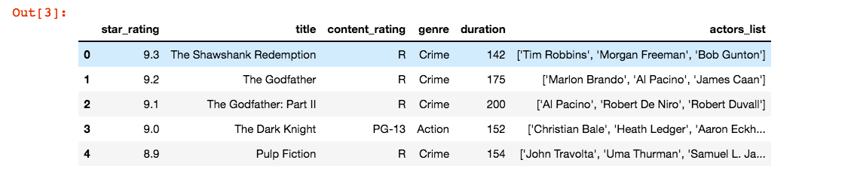
pandas
We'll explore pandas using Jupyter Lab by looking at a movies dataset: IMDB's Top 1000 movies.
In Jupyter Lab, instead of printing an object,
running a cell(SHIFT ENTER) on the object outputs
that object in the next "Out" cell.
Notes:
Crash Course: Cybersecurity

Slide 5
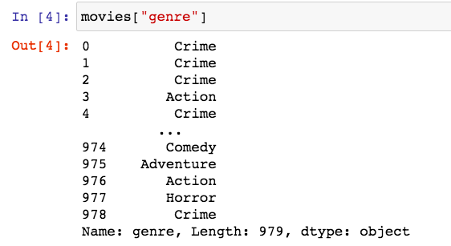
Dataframe
The movies data structure in the previous slides is a dataframe. A dataframe is an enhanced two-dimensional data structure. You can think of it as a dictionary where the keys are the column names and the values are column values. Each column is called a Series.
You can select a column by using [] notation and
specifying the column name as a string.
This displays the "genre" Series.
Notes:
Crash Course: Cybersecurity

Slide 6
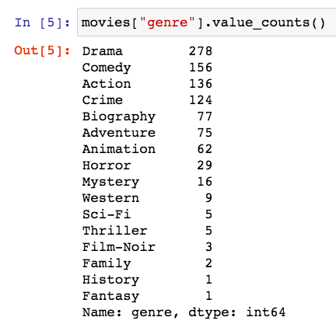
Analyzing Data
For categorical data like movies genre, the method value_counts() returns a columns(Series) containing counts of unique values.
For example, suppose I am interested
in investigating to see which of the
movies genre is most popular in the
top movies rated on IMDB.
Patterns can emerge when data are
transformed using programs.
# 1 genre is Drama!
Notes:
Crash Course: Cybersecurity

Slide 7
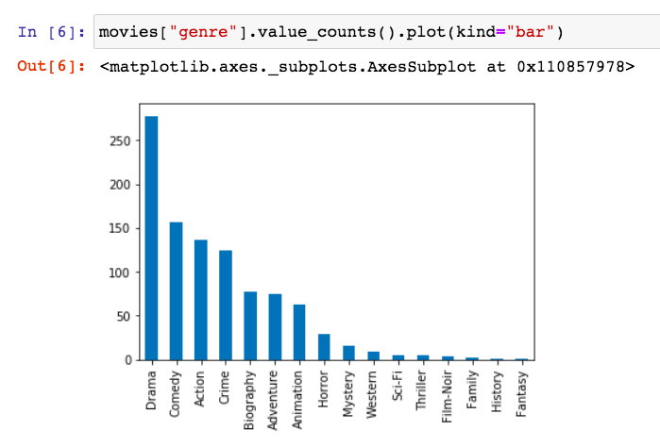
Plotting Data
Tables, charts, diagrams, text, and other visual tools can be used to communicate insight and knowledge gained from data.
The table of counts of unique values can be visually presented using pandas' plot function. We can specify the kind of graph with the "kind" optional parameter.
Notes:
Crash Course: Cybersecurity

Slide 8
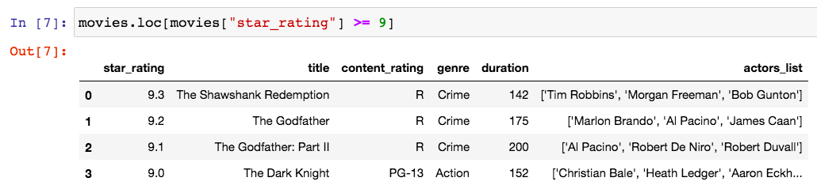
Filtering Data
Some processes can be used to extract information. For example, data filtering systems are important tools for finding information and recognizing patterns in data.
What if I want to filter my data and only want to look at movies with at least 9.0 rating? You can use the .loc[] notation and insert a filtering boolean condition.
Notes:
Crash Course: Cybersecurity

Slide 9
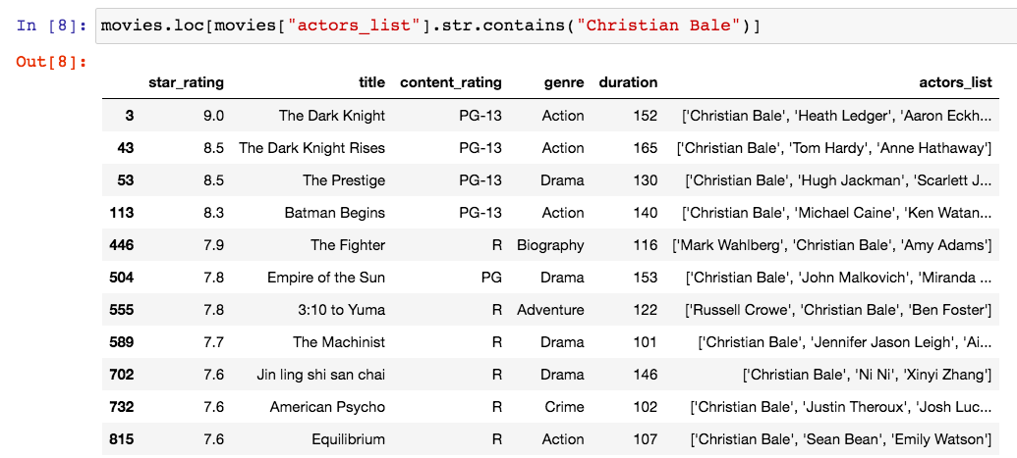
pandas
Search tools are useful for efficiently finding information.
For example, what if I want to watch a highly rated movies that starred Christian Bale? Series.str.contains("string") can be used here.
Notes:
Crash Course: Cybersecurity

Slide 10
Cleaning Data
Data sets pose challenges regardless of size, such as:
the need to clean data
incomplete data
invalid data
the need to combine data sources
Depending on how data were collected, they may not be uniform. For example, if users enter data into an open field, the way they choose to abbreviate, spell, or capitalize something may vary from user to user.
Cleaning data is a process that makes the data uniform without changing their meaning (e.g., replacing all equivalent abbreviations, spellings, and capitalizations with the same word).
Problems of bias are often created by the type or source of data being collected. Bias is not eliminated by simply collecting more data.
Notes:
Crash Course: Cybersecurity

Slide 11
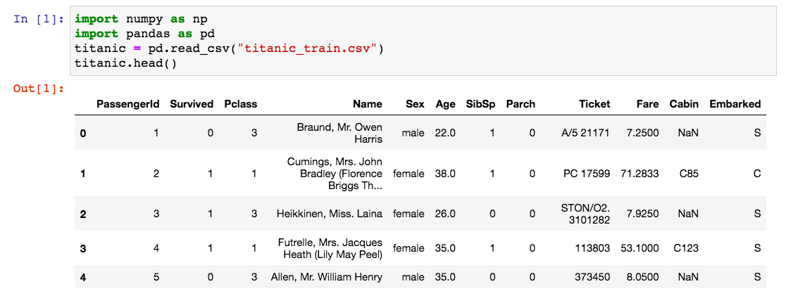
Titanic Dataset Example
On April 15, 1912, during her maiden voyage, the Titanic sank after colliding with an iceberg, killing 1502 out of 2224(32% survival rate) passengers and crew.
Notes:
Crash Course: Cybersecurity

Slide 12
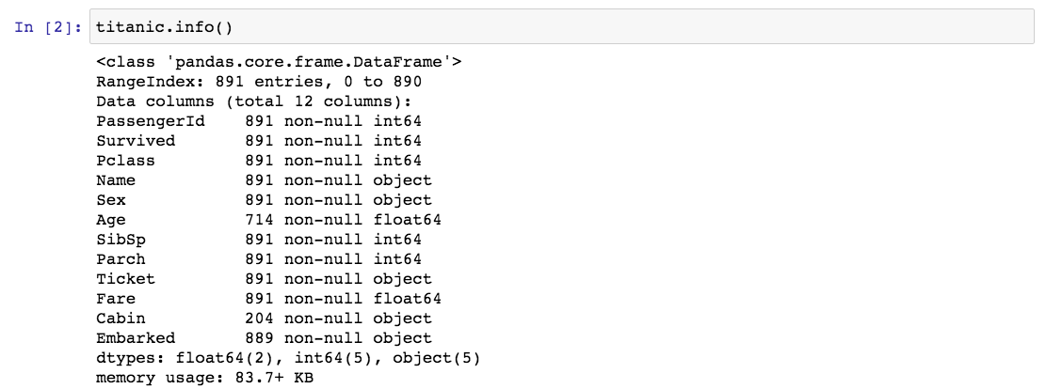
Titanic Dataset Example
Calling the info() method on the dataframe, we can see that this dataset contains incomplete data. For example, Age has only 714 entries(out of 891) and Cabin only has 204 entries(out of 891).
Notes:
Crash Course: Cybersecurity

Slide 13
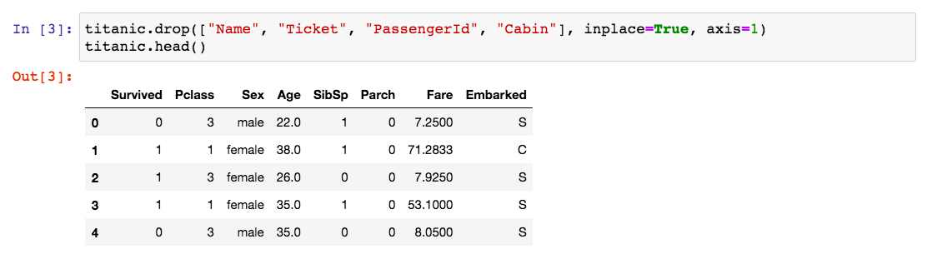
Cleaning Data
If we are trying to create a model that predicts which passengers survived the Titanic shipwreck. To get a good model, we may clean our data by:
dropping features that contain too many blank or null values(Cabin)
dropping features that may not have high correlation to our prediction(Name, PassengerId, Ticket)
Note: We down to 8 columns instead of 12.
Notes:
Crash Course: Cybersecurity

Slide 14
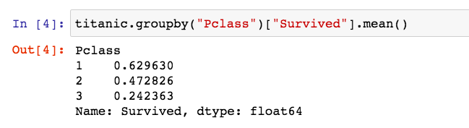
Extracting Information
One of the reasons that the shipwreck led to such loss of life was that there were not enough lifeboats for the passengers and crew.
Although there was some element of luck involved in surviving the sinking, some groups of people were more likely to survive than others, such as women, children, and the upper-class.
For example, we can call the groupby() method to group the passengers based on the column Pclass(1 = upper-class, 2 = middle-class, 3 = lower-class) and look at their survivor rate.
Notes:
Crash Course: Cybersecurity

Slide 15
Data
Digitally processed data may show correlation between variables. A correlation found in data does not necessarily indicate that a causal relationship exists.
Additional research is needed to understand the exact nature of the relationship.
Often, a single source does not contain the data needed to draw a conclusion. It may be necessary to combine data from a variety of sources to formulate a conclusion.
Combining data sources, clustering data, and classifying data are parts of the process of using programs to gain insight and knowledge from data.
Notes:
Crash Course: Cybersecurity

