Slide 1

Understanding Data
Introduction to Audio/Signal Processing with Python

Slide 2
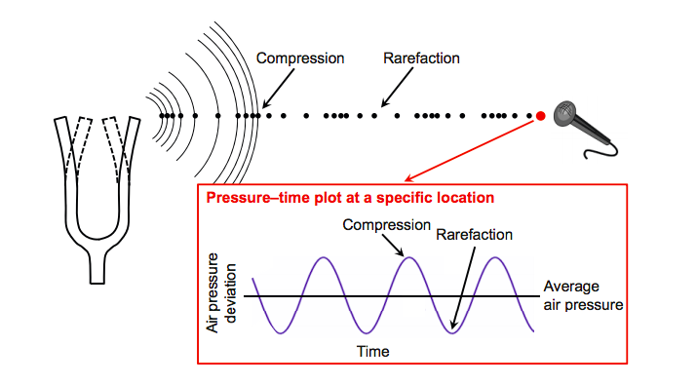
Sound
Figure taken from [Meinard Müller, Fundamentals of Music Processing, Figure 1.17, Springer 2015]

Slide 3
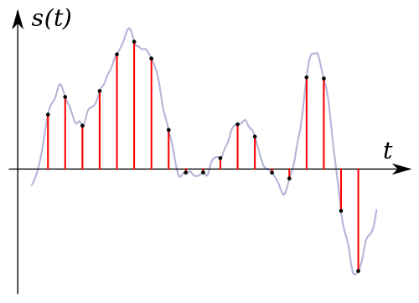
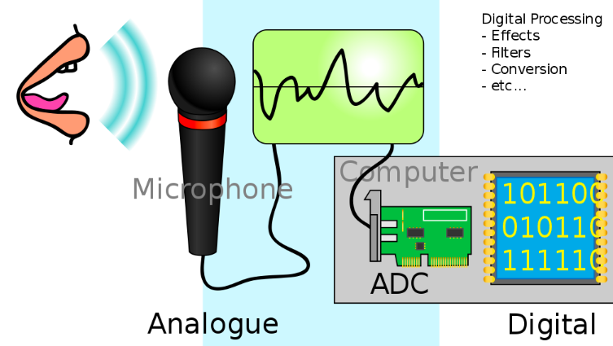
Analog to Digital Audio
Sampling the analog signal s(t)
The array of sampled values from the electrical signal is digital audio.
Electrical analog signal is sampled and convert to an array of numbers via ADC(Analog to Digital Converter).
The microphone converts acoustic energy to electrical energy.

Slide 4
Analog to Digital Audio
Sampling rate = 44,100 samples per second (CD quality)
analog signal s(t)
digital signal
{y0, y1, y2,…,yn}
array of 16-bit values(bit depth)
(1 bit for sign, 15 bits for value)
It is amazing that a digital sound file is simply an array or list of numbers!

Slide 5
Period, Amplitude and Frequency
A signal that exhibits the same repeated pattern(cycle) is periodic.
Notes:
\text{period} = \dfrac{1}{\text{frequency}}

Slide 6
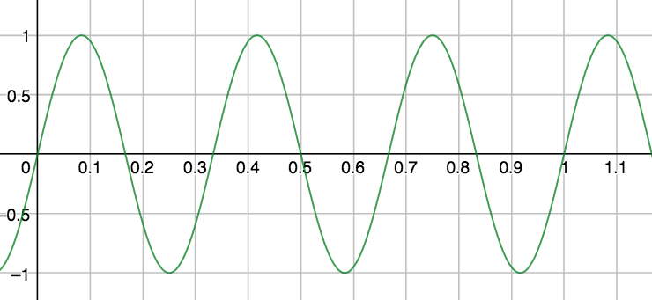
An Example
Period = 1/3 sec per cycle Frequency = 3 cycles per second

Slide 7
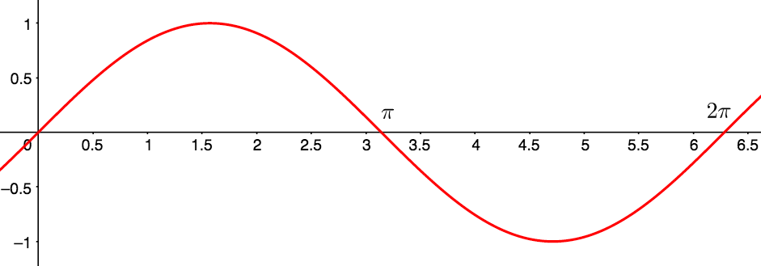
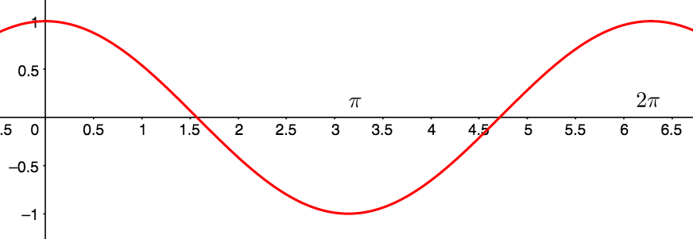
Sine and Cosine Wave

Slide 8
Sinusoids
Both the and completes one cycle in seconds:
Notes:
y=\sin(2\pi t), t\in[0,2\pi]\text{ (one cycle in } 2\pi \text{ seconds)}

Slide 9
Real Sinusoids
where
Notes:
y=a\sin(2\pi ft) \text{ and } y=a\cos(2\pi ft),
y = 3\sin(2\pi\cdot 4t)

Slide 10
An Example
Suppose you have the signal
Find the amplitude, frequency and period.
amplitude = 3; frequency = 4 Hz;
Notes:
y = 3\sin(2\pi\cdot 4t + \pi/2).

Slide 11
Middle C
Middle C (or C4) has the frequency 261.6 Hz.
Notes:
y=a\sin(2\pi ft) \text{ and } y=a\cos(2\pi ft),

Slide 12
C Major
The C major chord C-E-G has frequencies 261.6 Hz, 329.6 Hz, 392 Hz.
The analog signal for this chord is
Let’s simulate these sounds in Python.
Notes:
y(t)=\sin(2\pi\cdot 261.6\cdot t)+\sin(2\pi\cdot 329.6\cdot t)+\sin(2\pi\cdot 392\cdot t).

Slide 13
Loudness vs Pitch
Loudness is our brain’s perception of amplitude.
Pitch is our brain’s perception of frequency.
Our perception of pitch is based on the logarithm of frequency.
The interval between two notes is the perceived difference between the two pitches.
As a result, the interval we hear from two notes depends on the ratio of their frequencies, not the difference.
Notes:
y = 3\sin(2\pi\cdot 4t + \pi/2).

Slide 14
Fundamental Frequency and Overtones
pure tone = one frequency
Most sounds are more complex.
E4 piano note = supposition of many frequencies: 330 Hz, 660 Hz, 990 Hz, 1320 Hz and 1650 Hz.
Fundamental frequency = 330 Hz.
Overtones or Harmonics = 660 Hz, 990 Hz, 1320 Hz, 1650 Hz.
Notes:
y = 3\sin(2\pi\cdot 4t + \pi/2).

Slide 15
Time vs Frequency Domains
In the time domain, the voltage/current signal is a function of time.
In the frequency domain, the signal is represented as a function of frequencies that are present in the signal.
.
Notes:
y(t)=\sin(2\pi\cdot 261.6\cdot t)+\sin(2\pi\cdot 329.6\cdot t)+\sin(2\pi\cdot 392\cdot t).

Slide 16
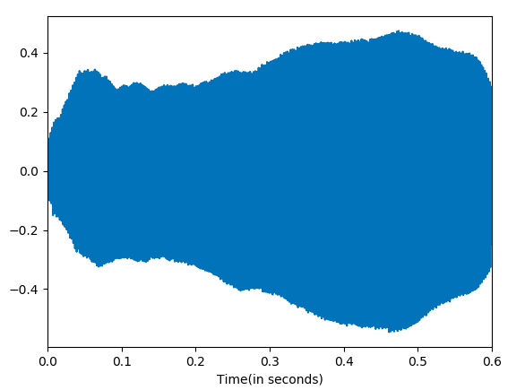
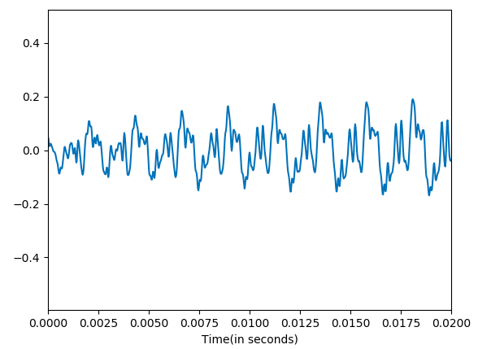
Time Domain
The signal in the time domain is very difficult to analyze.
Notes:
y(t)=\sin(2\pi\cdot 261.6\cdot t)+\sin(2\pi\cdot 329.6\cdot t)+\sin(2\pi\cdot 392\cdot t).

Slide 17
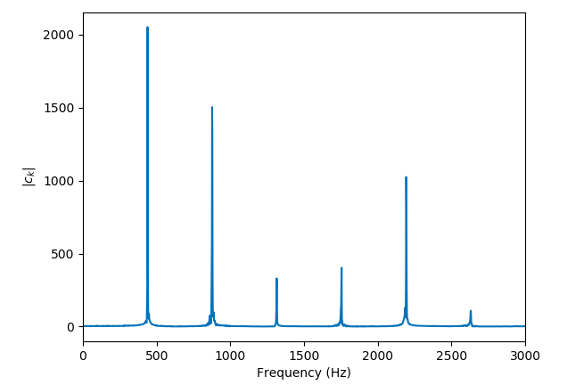
Frequency Domain
But converting the signal into
its frequency domain allows
us to understand its frequency
content.
What chord is this?
The set of frequencies in a signal and their magnitudes is called the spectrum of the signal.
Notes:
y(t)=\sin(2\pi\cdot 261.6\cdot t)+\sin(2\pi\cdot 329.6\cdot t)+\sin(2\pi\cdot 392\cdot t).

Slide 18
Discrete Fourier Transform (DFT)
DFT
IDFT
Time Domain
Frequency Domain
Notes:
y(t)=\sin(2\pi\cdot 261.6\cdot t)+\sin(2\pi\cdot 329.6\cdot t)+\sin(2\pi\cdot 392\cdot t).

Slide 19
What is the Discrete Fourier Transform?

Slide 20
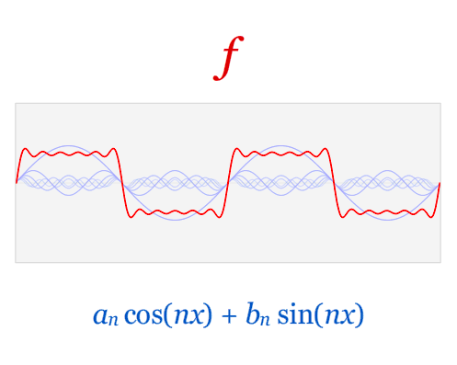
What is the Discrete Fourier Transform?

Slide 21
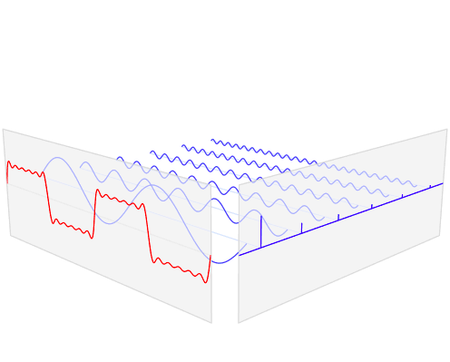
What is the Discrete Fourier Transform?

Slide 22
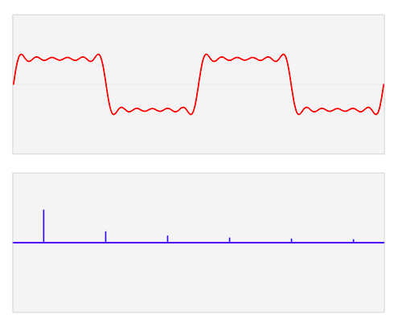
What is the Discrete Fourier Transform?

Slide 23
Spectrum Analyzers

Slide 24
Important Take Aways
Digital audio is simply sampling from a continuous, analog function at some sampling rate producing an array of numbers.
Sinusoids take on the form .
Pitch is our brain’s perception of frequency. (logarithm scale)
fundamental frequency vs harmonics
Time and Frequency domains are two equivalent representation of a signal.
The Discrete Fourier Transform and the Inverse Discrete Fourier Transform allows us to go back and forth between representations.
Notes:
y(t)=\sin(2\pi\cdot 261.6\cdot t)+\sin(2\pi\cdot 329.6\cdot t)+\sin(2\pi\cdot 392\cdot t).

Slide 25
References
1) Müller, Meinard, Fundamentals of Music Processing, Springer 2015.
2) Downey, Allen, ThinkDSP, Green Tea Press 2012.
3) Smith, Julius, The Mathematics of the Discrete Fourier Transform, W3K Publishing 2007.
4) Loy, Gareth, Musimathics, Volumes 1 and 2. The MIT Press 2011.
5) Newman, Mark, Computational Physics, Createspace Independent Publishing Platform 2012.
6) Soklaski, Ryan. MIT Lincoln Lab Researcher. Beaver Works Summer Institute.
Notes:
y(t)=\sin(2\pi\cdot 261.6\cdot t)+\sin(2\pi\cdot 329.6\cdot t)+\sin(2\pi\cdot 392\cdot t).

