Slide 1
Introduction to Python
Operations and Variables

Slide 2
Topics
Python interpreters
Python Scripts
repl.it
Printing with print()
Basic Built-In Number Types
Integers (division vs. floor division)
Floats
Booleans
NoneType

Slide 3
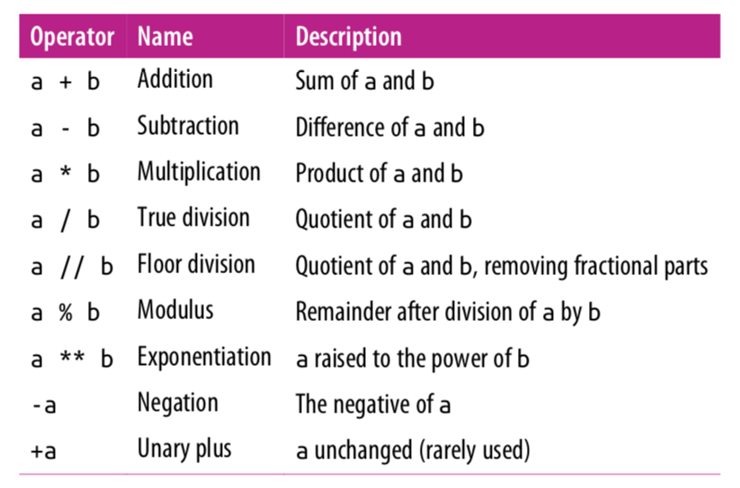
Arithmetic Operations

Slide 4
Mixing Types
Any expression that two floats produce a float.
x = 17.0 – 10.0
print(x) # 7.0
When an expression’s operands are an int and a float, Python automatically converts the int to a float.
x = 17.0 – 10
print(x) # 7.0
y = 17 – 10.0
print(y) # 7.0

Slide 5
True Division vs Floor Division
The operator / is true division and the operator // returns floor division(round down after true divide).
print(23 // 7) # 3
print(3 // 9) # 0
print(-4 // 3) # -2
print(6 / 5) # 1.2

Slide 6
Remainder with %
The % operator computes the remainder after floor division.
14 % 4 is 2
218 % 5 is 3 3 43 4 ) 14 5 ) 218 12 20 2 18 15 3
Applications of % operator:
Obtain last digit of a number: 230857 % 10 is 7
Obtain last 4 digits: 658236489 % 10000 is 6489
See whether a number is odd: 7 % 2 is 1, 42 % 2 is 0
Notes:
6
What is 8 % 20? It's 8, but students often say 0.

Slide 7
Modulo Operator
The operator % returns the modulus which is the remainder after floor division.
print(18 % 5) # 3
print(2 % 9) # 2
print(125 % 10) # 5
print(-17 % 10) # 3
print(17 % -10) # -3

Slide 8
Why floor/modulo division is useful
Floor division allows us to extract the integer part of the division while the modulo operator extracts the remainder part of the division. Consider the question:
How many weeks and days are there in 25 days?
Answer: 3 weeks plus 4 days.
num_weeks = 25 // 7 # extracting number of weeks
print(num_weeks) # 3
num_days = 25 % 7 # extracting number of days
print(num_days) # 4

Slide 9
Why the modulo operator is useful
If today is a Tuesday, which day is 43 days from today?
Answer: 43 divided by 7 is 6 with a remainder of 1. Thus, it will be Wednesday.
print(43 % 7) # 1
Even/odd: A number x is even if x % 2 is 0 and odd if x % 2 is 1.
num = int(input(‘Please enter an integer value: ’))
print(num, 'is even:', num%2==0)
Output 1:
Please enter an integer value: 4
4 is even: True
Output 2:
Please enter an integer value: 13
13 is even: False

Slide 10
Expressions
Find the exact change for 137 cents using quarters, dimes, nickels and cents. Use the least
number of coins.
How many quarters? 137 // 25 = 5 quarters (Floor Division!)
What’s leftover? 137 % 25 = 12 cents
How many dimes? 12 // 10 = 1 dime
What’s leftover? 12 % 10 = 2 cents
How many nickels? 2 // 5 = 0 nickels.
What’s leftover? 2 % 5 = 2 cents.
How many pennies? 2 // 1 = 2 pennies
What’s leftover? 2 % 1= 0 cents. Done!

Slide 11
Extracting Digits
Given a three-digit integer. Extract its the ones, tens and hundreds digits.
For example, if the integer is 352. Its ones digit is the 2, its tens digit is the 5 and
its hundreds digit is the 3.
number = 352
print("ones:", number % 10)
number = number // 10
print(number)
print("tens:", number % 10)
number = number // 10
print(number)
Note: Modulo 10 (% 10) extracts the last digit. Floor division (// 10) discards the
last digit. Later in another lecture, we will see how to generalize this to
any number of digits.
# ones: 2
# number = 35 (discards last digit)
# 35
# tens: 5
# number = 3 (discards last digit)
# 3

Slide 12
Extracting Digits
Alternatively:
number = 352
ones = number % 10
tens = (number // 10) % 10
hundreds = number // 100
print("ones:", ones, "tens", tens, "hundreds:", hundreds)
Output:
ones: 2 tens: 5 hundreds: 3

Slide 13
Exponentiation and Negation
x = 2 ** 3
print(x) # 8
Negation is a unary operator. It applies to only one operand. Other operations such as +, -, *, /, //, % are binary operators, they apply to two operands.
x = -5
y = --5
print(x) # -5
print(y) # 5

Slide 14
Operator Precedence
Precedence | Operator | Operation
highest | ** | exponentiation
 | - | negation
 | *, /, //, % | multiplication, division, floor division, modulus
lowest | +, - | adding, subtraction
Operators on the same row are applied left to right. Exponentiation, however, is
applied right to left. Expressions in parenthesis are evaluated first(PEMDAS).

Slide 15
Operator Precedence
x = -2 ** 4
print(x) # -16
y = 7 – 4 * 5 % (1 + 2)
print(y) # 5
7 - 4 * 5 % (1 + 2)
7 – 4 * 5 % 3
7 – 20 % 3
7 – 2
5

Slide 16
Augmented Assignment
An augmented assignment combines an assignment statement with an operator to make the statement more concise.
Shorthand Equivalent version
variable += value; variable = variable + value;
variable -= value; variable = variable - value;
variable *= value; variable = variable * value;
variable /= value; variable = variable / value;
variable %= value; variable = variable % value;
x = 4
x += 1 # equivalent to x = x + 1
print(x) # 5

Slide 17
Augmented Assignment
x = 3
x *= 2 + 5
print(x) # 21
number = 5
number *= number
print(number) # 25

Slide 18
Lab 1
Print some strings. Experiment with the “sep” and “end” parameters.
Try division vs floor division with integers. Try some which has negative dividends as well as negative divisors.
Initialize some floating point variables in both standard decimal notation and in exponential notation.
Experiment with the type() function.
Try to use int() and float() to cast.
Work with boolean expressions.

Slide 19
Lab 2
Create a new repl on repl.it.
Repeat some of the things you did from Lab 1 in the script main.py.
The IPython interpreter runs your code and display the outputs. In your script, you won’t have this feature. Instead, use the print() function to print out the values of your variables.

Slide 20
References
Vanderplas, Jake, A Whirlwind Tour of Python, O’reilly Media.
This book is completely free and can be downloaded online at O’reilly’s site.

