Slide 1
Introduction to Python
For Loops

Slide 2
Topics
For Loops

Slide 3
Iteration
Iteration is a repeating portion of an algorithm. Iteration repeats a specified number of times or until a given condition is met.
If we want to ask the user to enter 5 numbers and sum them, it is repetitive to do this:
sum = 0
x = int(input(“Enter number:”))
sum = sum + x
x = int(input(“Enter number:”))
sum = sum + x
x = int(input(“Enter number:”))
sum = sum + x
x = int(input(“Enter number:”))
sum = sum + x
x = int(input(“Enter number:”))
sum = sum + x
print(sum)

Slide 4
Iteration
Iteration is a repeating portion of an algorithm. Iteration repeats a specified number of times or until a given condition is met.
For example, if we want to print a message 5 times:
for i in range(5):
print("hi")
hi
hi
hi
hi
hi

Slide 5
Iteration
Iteration loops are frequently referred to as for loops because for is the keyword that is used to introduce them in nearly all programming languages, including Python.
Python’s for loop iterates over items of a sequence(e.g. a list of numbers or a string(sequence of characters)) and process them with some code.
for x in sequence: block

Slide 6
Lists
A list defines a sequence of ordered objects(integers, floats, strings, etc…). They can be defined with comma-separated values between square brackets.
We will discuss lists further in the next lecture.
# list of names(strings)
names = [“Mike”, “Sarah”, “Jack”, “Mia”]
# list of scores(ints)
scores = [92, 83, 77]
# list of gpas(ints)
gpas = [3.1, 3.4, 2.7, 2.1, 3.8]

Slide 7
For Loops
Python’s for loop iterates over items of a sequence(e.g. a list of numbers or a string(sequence of characters)) and process them with some code.
for x in sequence: block
for x in [2,3,5,7]: print(x, end=“ ”) # ends each print with a space
# print all on same line
2 3 5 7

Slide 8
For Loops
names = [“Mike”, “Sarah”, “Jack”, “Mia”]
for name in names: print(name, end=“ ”) # ends each print with a space
# print all on same line
Mike Sarah Jack Mia

Slide 9
For Each Loops
Since a string is a sequence of characters, a for loop can used to iterate over the characters.
for x in "hello": print(x)
h
e
l
l
o
Iterate through each character in the string.

Slide 10
range(stop)
range(stop): returns sequence of numbers from 0 (default) up to but not including stop. Increment by 1 (default).
range(5) generates [0, 1, 2, 3, 4]
range(100) generates [0, 1, 2, …, 98, 99]

Slide 11
range(stop)
A simple use of a for loop runs some code a specified number of times using the range() function.
for i in range(5):
print(i, end=" ")
0 1 2 3 4
The above code is equivalent to:
for i in [0, 1, 2, 3, 4]:
print(i, end=" ")
0 1 2 3 4
Think of range(5) as generating this
list: [0, 1, 2, 3, 4].

Slide 12
range(stop)
A simple use of a for loop runs some code a specified number of times using the range() function.
range(stop): returns sequence of numbers from 0 (default) up to but not including stop. Increment by 1 (default).
for i in range(5):
print(i, end=" ")
0 1 2 3 4
for i in range(10):
print("hi", end=" ")
hi hi hi hi hi hi hi hi hi hi
Think of range(5) as generating this
list: [0, 1, 2, 3, 4].

Slide 13
range(start, stop)
range(start, stop): from start up to but not including stop. Increment by 1(default).
for i in range(2, 8):
print(i, end=' ')
2 3 4 5 6 7

Slide 14
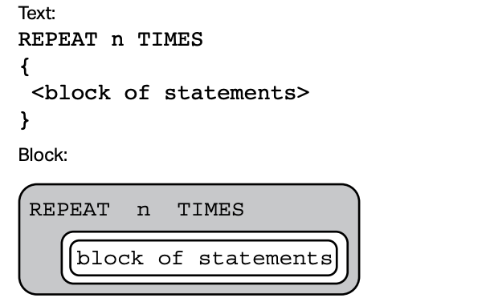
AP Exam
To perform a task n times, the AP exam use the following syntax.
Note: The above is equivalent to the following code in Python:
for i in range(n):
# block of statements
…

Slide 15
Definite Iteration
The for loop is an example of a definite iteration. We can determine ahead of time the number of times the loop repeats. Later, we will talk about indefinite iteration, a loop where we cannot predict the number of times a loop repeats.
for i in range(5): print("*", end="")
*****
The loop above prints five *'s. We can determine this ahead of time from the for loop statement.

Slide 16
Summing and Counting
There are two common tasks that uses for loops.
1) Summing
2) Counting

Slide 17
Summing Values
Write a segment of code that solve the problem
1 + 2 + 3 + … + 98 + 99 + 100.
We need a variable that accumulate the sum at each iteration of the loop. This variable should be initialized to 0.
sum = 0
for i in range(1, 101): sum = sum + i

Slide 18
Writing a function to sum
Now write a function that accepts a non-negative integer parameter n and returns the sum of integers from 1 to n(including).
def sum(n):
sum = 0
for i in range(1, n+1): sum = sum + i
return sum
print(sum(5)) # 1+2+3+4+5=15
a = sum(100) # a = 5050
print(a) # 5050 is printed on console

Slide 19
Conditional Summing
Write a segment of code that compute the sum of all numbers from 1 to 100 that are multiples of 3. Loop but only sum if a certain condition is true.
sum = 0
for i in range(1, 101): if i % 3 == 0:
sum += i
Using augmented assignment

Slide 20
Counting
Write a function that accepts an integer parameter n and returns the number of factors of n.
def count_factors(n):
count = 0
for i in range(1, n+1):
if n % i == 0: # i is a factor of n
count = count + 1
return count
print(count_factors(10)) # 4 (factors of 10 = {1,2,5,10})
print(count_factors(7)) # 2 (factors of 7 = {1,7})

Slide 21
Counting Letters
There is another way to loop through letters of a string. Here’s the second way to do the previous problem. Given a string, count the number of occurrences of the letter “A” or “a”.
def countA(str):
count = 0
for letter in str:
if letter == “a” or letter == “A”:
count = count + 1
return count
message = “abbA”
print(countA(message)) # 2

Slide 22
Iteration
Let’s use a for loop to rewrite the code at the beginning of this lecture.
If we want to ask the user to enter 5 numbers and sum them, it is repetitive to do this:
sum = 0
x = int(input(“Enter number:”))
sum = sum + x
x = int(input(“Enter number:”))
sum = sum + x
x = int(input(“Enter number:”))
sum = sum + x
x = int(input(“Enter number:”))
sum = sum + x
x = int(input(“Enter number:”))
sum = sum + x
print(“Sum:”, sum)
sum = 0
for in in range(5):
x = int(input(“Enter number:”))
sum = sum + x
print(“Sum:”, sum)
For loop

Slide 23
For Loop in Movies and TV-Shows
Movies:
Groundhog Day(1993); Bill Murray.
Looper(2010); Bruce Willis and Joseph Gordon-Levitt, Emily Blunt.
Edge of Tomorrow(2014); Tom Cruise, Emily Blunt.
Happy Death Day(2017).
TV-Show:
Russian Doll(Netflix, Emmy-Nominated)

Slide 24
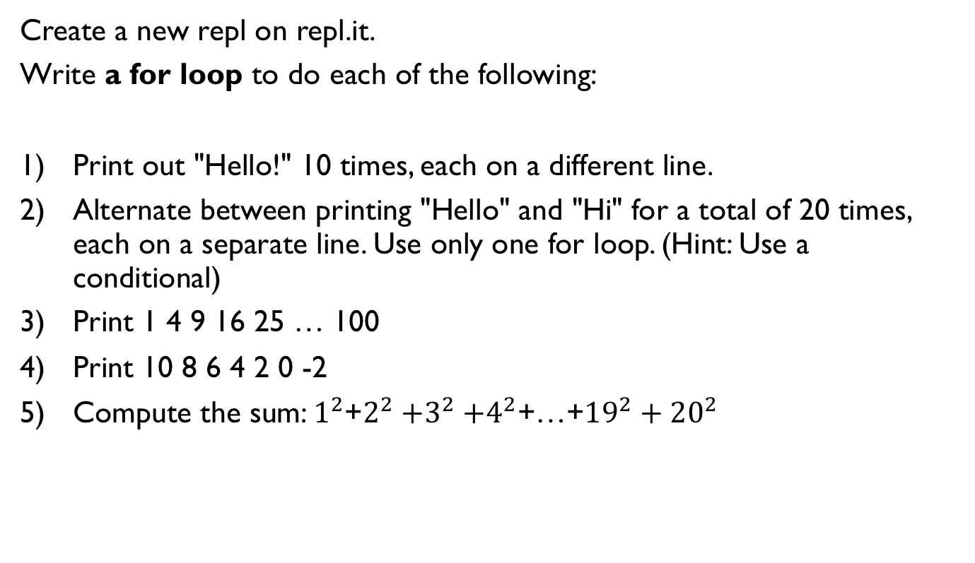
Lab 1
Create a new repl on repl.it.
Write a for loop to do each of the following:
Print out "Hello!" 10 times, each on a different line.
Alternate between printing "Hello" and "Hi" for a total of 20 times, each on a separate line. Use only one for loop. (Hint: Use a conditional)
Print 1 4 9 16 25 … 100
Print 10 8 6 4 2 0 -2
Compute the sum: $1^{2}$+$2^{2}{+3}^{2}+4^{2}$+…+${19}^{2}+{20}^{2}$

Slide 25
Lab 2: Counting Primes
Create a new repl.
1) Rewrite the function count_factors as explained in a previous slide.
2) A number n is prime if its only factors are 1 and n. Write the function is_prime which accepts an integer n and returns whether it is prime. Note that 1 is not prime. You must call the function count_factors in your implementation of is_prime.
is_prime(13) returns True
is_prime(1245) returns False
3) Write the function num_primes which accepts an integer n and and returns the number of primes up to and including n. You must call the function is_prime in your implementation.
num_prime(11) returns 5 since 2, 3, 5, 7, 11 are the 5 prime numbers less than or equal to 11.
Call the three above functions with different inputs and make sure that your functions work as expected.

Slide 26
References
Vanderplas, Jake, A Whirlwind Tour of Python, O’reilly Media.

