Slide 1
Introduction to Python
Lists

Slide 2
Topics
Lists
List indexing
Traversing and modifying a list
Summing a list
Maximum/Minimum of a list
List Methods

Slide 3
Containers
Python includes several built-in sequences: lists, tuples, strings. We will discuss these in the next few lectures. Here's a broad overview:
Lists and tuples are container sequences, which can hold items of different type.
String is a flat sequence which holds item of one type(characters).
Another way of grouping sequence types is by mutability. Lists are mutable(can be modified) sequences while strings and tuples are immutable sequences. We discuss lists in this lecture.

Slide 4
Lists
Lists are the basic ordered and mutable data collection type in Python. They define a sequence of ordered objects(integers, floats, strings, etc…). They can be defined with comma-separated values between square brackets.
L = [2, 3, 5, 7]
print(len(L)) # 4, len() also works with strings
L.append(11) # append to the end of the list
print(L) # [2, 3, 5, 7, 11]

Slide 5
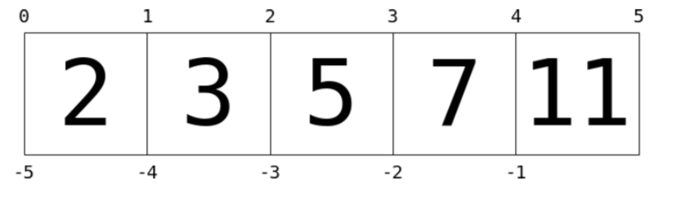
Indexing
Indexing is a means the fetching of a single value from the list. This is a 0-based indexing scheme.
L = [2, 3, 5, 7, 11] print(L[0]) # 2
print(L[1]) # 3
print(L[5]) # index out of bounds error.

Slide 6
Lists can contain different types of objects
List can contain different types and even other lists.
L = [1, 'two', 3.14, [-2, 3, 5]]
print(L[0]) # 1
print(L[1]) # two
print(L[3]) # [-2, 3, 5]
print(L[3][0]) # -2
print(L[3][1]) # 3
print(L[3][2]) # 5

Slide 7
Modifying a List
Indexing can be used to set elements as well as access them.
L = [2, 3, 5, 7, 11]
L[0] = 100
print(L) # [100, 3, 5, 7, 11]
L[2] = -4
print(L) # [100, 3, -4, 7, 11]

Slide 8
Slicing(same as for Strings)
We saw in the previous lecture that we can slice a string by specifying a start-index and stop-index, and the result is a subsequence of the items contained within the slice.
Slicing also works with lists!(As well as many important data structures in Python) Slicing can be done using the syntax:
my_list[start:stop:step]
where
start: index of beginning of the slice(included), default is 0
stop: index of the end of the slice(excluded), default is length of the list
step: increment size at each step, default is 1.

Slide 9
List Slicing
L = [10, -2, 1, 6, 2]
print(L[1:3]) # [-2, 1]
print(L[:3]) # [10, -2, 1]
print(L[1:]) # [-2, 1, 6, 2]
print(L[0:4:2]) # [10, 1]
print(L[:]) # [10, -2, 1, 6, 2]
print(L[::-1]) # [2, 6, 1, -2, 10]

Slide 10
Traversing a list
We can traverse through a list using a for loop. We have seen this before with strings! There are two options:
1) for each loop:
nums = [2, -1, 3, 4, -3]
for x in nums:
print(x, end=" ")
2 -1 3 4 -3
2) loop using indices
nums = [2, -1, 3, 4, -3]
for i in range(len(nums)):
print(nums[i], end=" ")
2 -1 3 4 -3
Looping through each value
Looping through each index
i takes on values: 0,1,2,3,4.

Slide 11
Modifying a list
Consider the following code that is intended to change all even numbers in a list to 0.
nums = [24, 3, 34, 6, -5, 4]
for x in nums:
if x % 2 == 0:
x = 0
print(nums)
Output:
[24, 3, 34, 6, -5, 4]
Note: The list is unchanged? Why? How can we fix it?

Slide 12
Modifying a list
Here's the correct code to change all even numbers in a list to 0. Compare the following code to the previous slide.
nums = [24, 3, 34, 6, -5, 4]
for i in range(len(nums)):
if nums[i] % 2 == 0:
nums[i] = 0
print(nums)
Output:
[0, 3, 0, 0, -5, 0]

Slide 13
Creating a list
If you want to create a list containing the first five perfect squares, then you can complete these steps in three lines of code:
squares = [] # create empty list
for i in range(5):
squares.append(i ** 2) # add each square to list
print(squares)
Output:
[0, 1, 4, 9, 16]
There is a much simpler way to create this list using list comprehensions.

Slide 14
String Indexing
Python allows you to retrieve individual members of a string by specifying the index of that member, which is the integer that uniquely identifies that member’s position in the string. The built-in len() function returns the number of characters in a string.
message = "hello"
length = len(message)
print(length) # 5
print(message[0]) # h
print(message[1]) # e
print(message[4]) # o
print(message[5]) # error! out of range!
Note: On the AP exam,
The first index of the first character of a string is 1 not 0.

Slide 15
String Indexing
Strings are immutable: once it is created, it cannot be changed!
message = "hello"
message[0] = "H" # ERROR! A string is immutable!
Negative indices can be used to access characters of a string. The last character is at index -1, the second to last at index -2, etc…
print(message[-1]) # o
print(message[-2]) # l

Slide 16
Looping Through Each Character
Since each character of a string has index, we can use a loop to traverse a string.
message = "hello"
for i in range(len(message)):
print(message[i])
Output:
h
e
l
l
o

Slide 17
Counting Letters(Version 1)
Write a function which accepts a string and returns the number of “A”, “a” in the string.
def countA(str):
count = 0
for i in range(len(str)):
if str[i] == “a” or str[i] == “A”:
count = count + 1
return count
message = “abbA”
print(countA(message)) # 2

Slide 18
Counting Letters(Version 2)
There is another way to loop through letters of a string. Here’s the second way to do the previous problem.
def countA(str):
count = 0
for letter in str:
if letter == “a” or letter == “A”:
count = count + 1
return count
message = “abbA”
print(countA(message)) # 2

Slide 19
Slicing
We can also “slice” a string, specifying a start-index and stop-index, and return a subsequence of the items contained within the slice.
Slicing is a very important indexing scheme that we will see many times in other data structures(lists, tuples, strings, Numpy's arrays, Panda's data frames, etc..). Slicing can be done using the syntax:
some_string[start:stop:step]
where
start: index of beginning of the slice(included), default is 0
stop: index of the end of the slice(excluded), default is length of string
step: increment size at each step, default is 1.

Slide 20
Slicing
language = "python"
print(language[0:4]) # pyth
# 0 up to but not including index 4
print(language[:4]) # pyth, default start index at 0
print(language[4:]) # on, default end index is length of string
print(language[:]) # python, 0 to end of string
print(language[0:5:2]) # pto, step size of 2
print(language[::-1]) # negative step size traverses backwards
# nohtyp

Slide 21
Functions on Strings
Functions we discussed so far are isolated, independent entities. Sometimes functions are associated with some object and operates on the data of that object. In this context, functions are called methods.
Strings is an example of a type of objects which contains methods. These methods can be accessed through the dot notation applied to a string variable or literal.
find(value) | returns the lowest index of a substring value in a string. If substring is not found, returns -1.
upper() and lower() | returns a copy of the string capitalizing(or lower casing) all characters in the string

Slide 22
String Methods
s = "Hi, Mike!"
index = s.find("Hi")
print(index) # 0, first letter’s index is 0.
print(s.find(" ")) # 3
print(s.find("Mike")) # 4
index2 = s.find("mike") # -1, not found
b = "python"
print(b.upper()) # PYTHON
print("JAVA".lower()) # java

Slide 23
String Methods
Note that upper(), lower() do not modify the original string but rather returns a new copy of the string.
s = "HI MIKE"
s.lower() # returned value "hi mike" is lost
print(s) # HI MIKE (s is unchanged)
s = s.lower() # store the modified, returned string back in s
print(s) # hi mike

Slide 24
f-Strings
f-Strings is the new way to format strings in Python. (v 3.6)
Also called “formatted string literals,” f-strings are string literals that have an f at the beginning and curly braces containing expressions that will be replaced with their values.
name = “Mike”
gpa = 3.2
f_str = f“I am {name} with a {gpa} gpa.”
print(f_str)
print("I am " + name + " with a " + str(gpa) " gpa.”)
Output:
I am Mike with a 3.2 gpa.
I am Mike with a 3.2 gpa.

Slide 25
f-Strings
An f-string is special because it permits us to write Python code within a string; any expression within curly brackets, {}, will be executed as Python code, and the resulting value will be converted to a string and inserted into the f-string at that position.
grade1 = 1.5
grade2 = 2.5
ave = f“average is {(grade1+grade2)/2}”
print(ave) # average is 2.0
This is equivalent but it is preferable to use an f-string.
average = “average is " + str((grade1+grade2)/2)

Slide 26
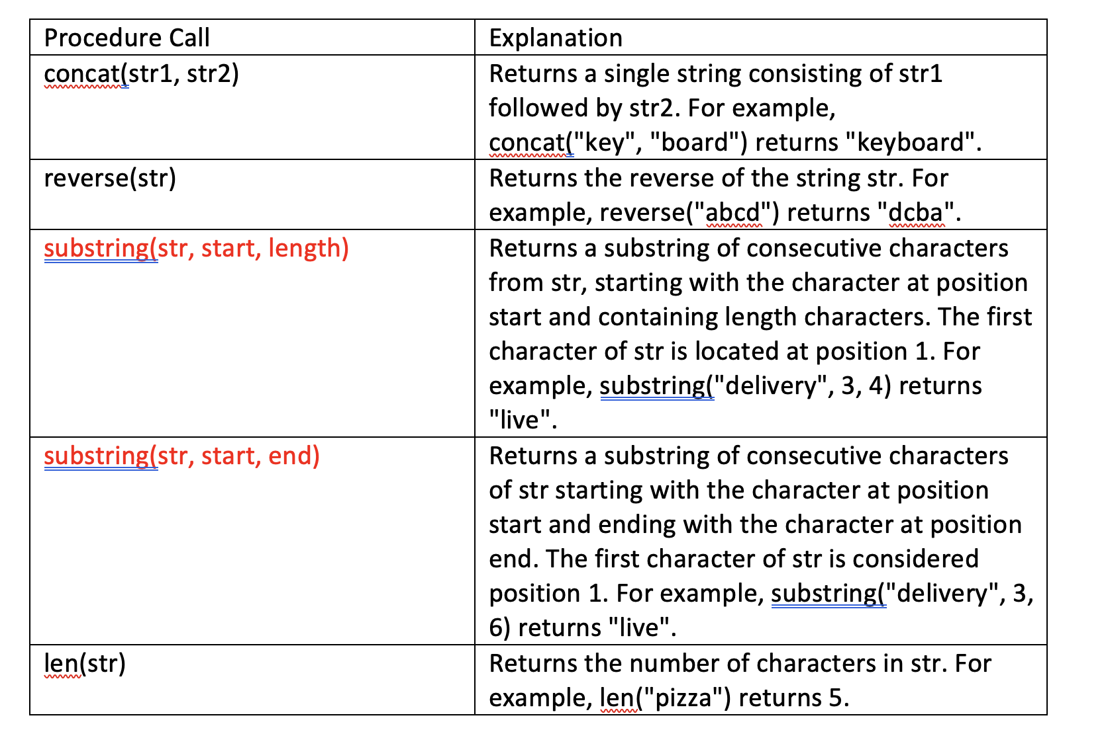
AP Exam
There will be questions on the AP exam which requires students to manipulate strings.
The exam will provide an API(application programming interface) for string
manipulation. A sample API below was given in previous exams.
The substring function may
take on different arguments
on the exam. Read
the API carefully as this
may vary year to year.

Slide 27
Creating a list with list comprehensions
List comprehensions is a way to create a list in Python that is concise and elegant. Its main use is to create a new list from a given list.
Instead of:
squares = [] # create empty list
for i in range(5):
squares.append(i ** 2) # add each square to list
Do this:
squares = [i ** 2 for i in range(5)] # one line!
List comprehensions allow you to use a conditional.
even_squares = [i ** 2 for i in range(5) if i % 2 == 0]
print(even_squares) # [0, 4, 16]

Slide 28
Algorithms to know
The following algorithms are useful. Know how to implement these algorithms!
Find sum of a list of numbers.
Find the average of a list of numbers.
Find the maximum/minimum of a list of numbers.

Slide 29
Sum of a list
Given a list, find the sum of its elements. We can do this by traversing through the list using a for loop.
nums = [2, -1, 3, 4, -3]
s = 0
for x in nums:
s += x
print(s)
Whenever we have a piece of code that accomplish a useful task, we should put it in a function.

Slide 30
Sum Function
Write a function that accepts a list of numbers as a parameter and returns its sum.
def sum(nums):
s = 0
for x in nums:
s += x
return s
lst = [2, -1, 3, 4, -3]
print(sum(lst)) # 5
lst2 = [1, 5, 4, 2]
a = sum(lst2)
print(a) # 12

Slide 31
Average Function
Write a function that accepts a list of numbers as a parameter and returns its average.
def average(nums):
s = 0
for x in nums:
s += x
return s/len(nums)
lst = [2, 5, 4, 3]
a = average(lst)
print(a) # 3.5

Slide 32
Conditional Summing
Write a function that accepts a list of numbers as a parameter and returns the sum of all even numbers in the list.
def sum_even(nums):
s = 0
for x in nums:
if x % 2 == 0:
s += x
return s

Slide 33
Find Maximum Function
Write a function that accepts a nonempty list of numbers as a parameter and returns its maximum value. Does the code below work?
def maximum(nums):
current_max = 0
for x in nums: if x > current_max:
current_max = x
return current_max
lst = [-2, -5, -12, -3]
a = maximum(lst)
print(a) # 0 INCORRECT!
Incorrect!
No! What if the list contains
only negative numbers?This function
returns 0 which is not even in the list!

Slide 34
Find Maximum Function(Correct)
Here's the correct implementation of maximum. The minimum function is similar.
def maximum(nums):
current_max = nums[0] # the first value is maximum
for x in nums: # until a bigger value shows up if x > current_max:
current_max = x
return current_max
lst = [2, 5, 12, 3, 4, 11]
a = maximum(lst)
print(a) # 12

Slide 35
List Methods
The following is a short list of useful list methods.
append(value) | appends value to the end of the list
insert(index, value) | inserts value at position given by index, shifts elements to the right.
pop(index) | removes object at index from list, shifts elements left and returns removed object. Returns last element if index is omitted. The index parameter is optional(default to last element).
split() | splits a string into a list. A separator can be specified. The default separator is any whitespace. Note that this is a string method not a list method.

Slide 36
List Methods
L = [3, "hi", -4, 6]
L.append(2) # L = [3,"hi",-4, 6, 2]
L.insert(1, "hello") # L = [3,"hello","hi",-4, 6, 2]
a = L.pop(3) # L = [3,"hello","hi",6, 2]
print(a) # -4
L.pop() # ok to not store popped value
print(L) # [3,"hello","hi",6]

Slide 37
split()
The split() method splits a string into a list. A separator can be specified. The default separator is any whitespace.
fruits = "apple mango banana grape"
fruits_lst = fruits.split()
print(list_fruits) # [‘apple’, ‘mango’, ‘banana’, ‘grape’]
greeting = “hi,I am Mike,I just graduate.”
greet_lst = greeting.split(",")
print(greet_lst) # [‘hi’, ‘I am Mike’, ‘I just graduate.’]
nums = “4 24 12”
nums_lst = nums.split()
print(nums_lst) # [‘4’, ‘24’, ‘12’], these are still strings

Slide 38
Create a list from user inputs
Ask the user to enter a list of numbers of any length separated by spaces. Generate a list containing those numbers. The split() function can be used here.
nums = input("Enter list of numbers separated by spaces: ").split()
print(nums)
Sample output:
Enter list of numbers separated by spaces: 4 6 1 23
['4', '6', '1', '23']
Note that the list above is a list of strings! We like this to be a list of integers.

Slide 39
Create a list from user inputs
From the previous example, we can change each string in the list by manually casting it to an integer.
nums = input().split()
for i in range(len(nums)):
nums[i] = int(num[i]) # cast string to integer
print(nums)
Sample output:
4 6 1 23
[4, 6, 1, 23]
We can further simplify the code above using list comprehensions! This code below can used in many of the replit Teams problems for this lecture.
nums = [int(x) for x in input().split()]

Slide 40
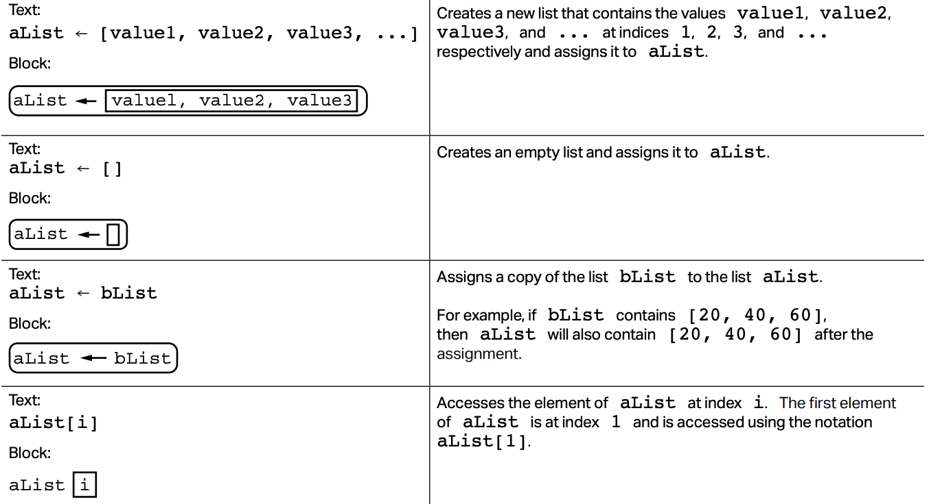
AP Exam: Lists API

Slide 41
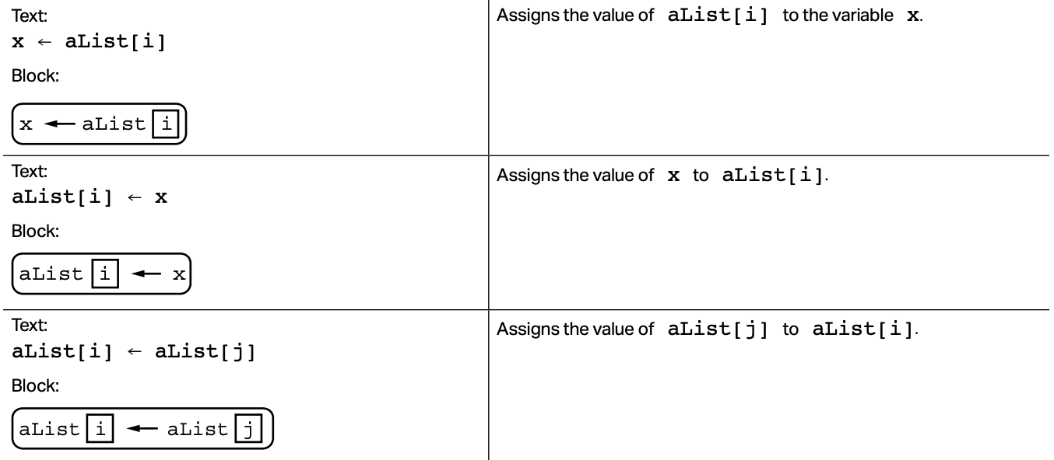
AP Exam: Lists API

Slide 42
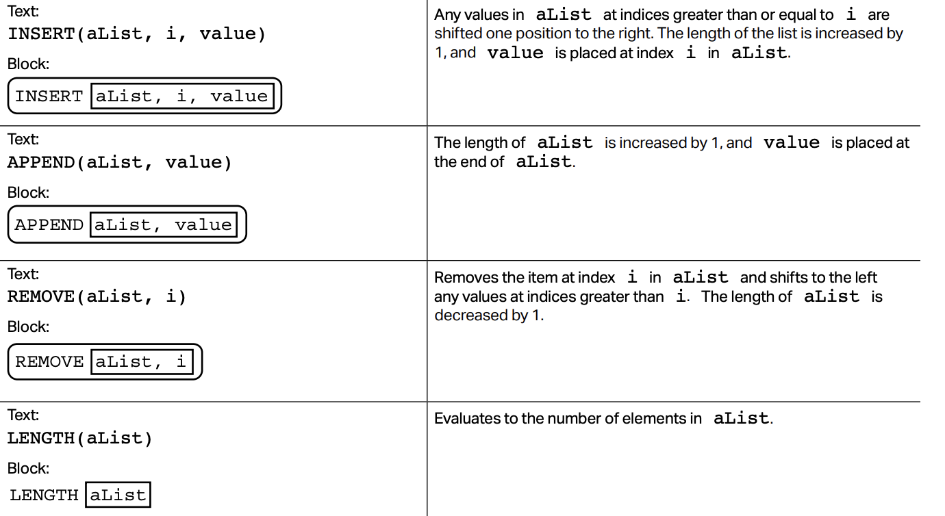
AP Exam: Lists API

Slide 43
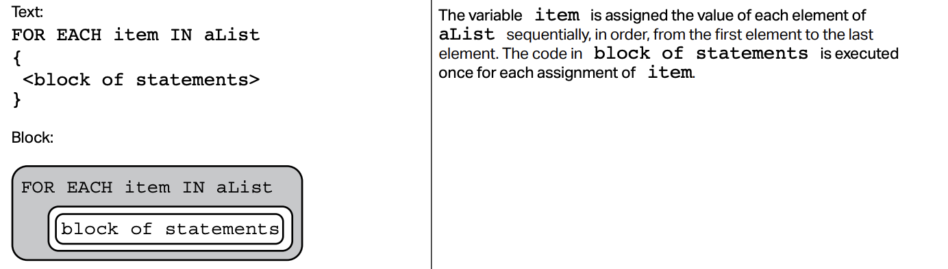
AP Exam: Lists API

Slide 44
Lab 1
Create a new repl on repl.it
Create this list and assign it to a variable [3,41,62,87,101, 88]. Use a for loop to compute the sum. Print out the sum.
Use a for loop to compute the sum of odd numbers from the list above.
Use a for loop to compute the sum of values located at even indices.(Use the len() function).

Slide 45
References
Vanderplas, Jake, A Whirlwind Tour of Python, O’reilly Media.
Luciano, Ramalho, Fluent Python, O'reilly Media.

