Slide 1
Unit 1: Primitive Types Arithmetic Operations
Adapted from:
1) Building Java Programs: A Back to Basics Approach
by Stuart Reges and Marty Stepp
2) Runestone CSAwesome Curriculum
This work is licensed under the
Creative Commons Attribution-NonCommercial-ShareAlike 4.0 International License.
https://longbaonguyen.github.io

Slide 2
Expressions
expression: A value or operation that computes a value.
  Examples: 1 + 4 * 5
  (7 + 2) * 6 / 3
  42
  The simplest expression is a literal value.
  A complex expression can use operators and parentheses.

Slide 3
Arithmetic operators
operator: Combines multiple values or expressions.
  + addition
  - subtraction (or negation)
  * multiplication
  / division
  % modulus (a.k.a. remainder)
As a program runs, its expressions are evaluated.
  1 + 1 evaluates to 2
  System.out.println(3 * 4); prints 12
    How would we print the text 3 * 4 ?

Slide 4
Integer division with /
When we divide integers, the quotient is also an integer.
  14 / 4 is 3, not 3.5
3 4 52
4 ) 14 10 ) 45 27 ) 1425
12 40 135
2 5 75
54
21
More examples:
  32 / 5 is 6
  84 / 10 is 8
  156 / 100 is 1
  Dividing by 0 causes an error when your program runs. This error is also called an ArithmeticException.

Slide 5
Integer remainder with %
The % operator computes the remainder from integer division.
  14 % 4 is 2
  218 % 5 is 3
  3 43
  4 ) 14 5 ) 218
  12 20
  2 18
  15
  3
Applications of % operator:
  Obtain last digit of a number: 230857 % 10 is 7
  Obtain last 4 digits: 658236489 % 10000 is 6489
  See whether a number is odd: 7 % 2 is 1, 42 % 2 is 0
Notes:
What is 8 % 20? It's 8, but students often say 0.

Slide 6
% Example
public static void main(String[] args){
System.out.println(14 / 5 + " " -3 / 2);
System.out.println(45 % 6 + " " 2 % 2);
System.out.println(0 % 10 + " " 11 % 0);
System.out.println(8 % 10);
}
Output:
2 -1
3 0
0 ArithmeticException
8

Slide 7
Expressions
  Find the exact change for 137 cents using quarters, dimes,
  nickels and cents. Use the least number of coins.
  How many quarters? 137 / 25 = 5 quarters (Integer Division!)
  What’s leftover? 137 % 25 = 12 cents
  How many dimes? 12 / 10 = 1 dime
  What’s leftover? 12 % 10 = 2 cents
  How many nickels? 2 / 5 = 0 nickels.
  What’s leftover? 2 % 5 = 2 cents.
  How many pennies? 2 / 1 = 2 pennies

Slide 8
Even or Odd
An important use of the % operator is to test for divisibility. For example, is a number even or odd? Is a number a multiple of 3?
// a number is even if it has no remainder
// when divided by 2.
if(number % 2 == 0){
…
}
// multiple of 3
if(number % 3 == 0){
…
}

Slide 9
Precedence
precedence: Order in which operators are evaluated.
  Generally operators evaluate left-to-right.
  1 - 2 - 3 is (1 - 2) - 3 which is -4
  But * / % have a higher level of precedence than + -
  1 + 3 * 4 is 13
  6 + 8 / 2 * 3
  6 + 4 * 3
  6 + 12 is 18
  Parentheses can force a certain order of evaluation:
  (1 + 3) * 4 is 16
  Spacing does not affect order of evaluation
  1+3 * 4-2 is 11

Slide 10
Precedence examples
1 * 2 + 3 * 5 % 4
\_/
|
2 + 3 * 5 % 4
\_/
|
2 + 15 % 4
\___/
|
2 + 3
\________/
|
5
1 + 8 % 3 * 2 - 9
\_/
|
1 + 2 * 2 - 9
\___/
|
1 + 4 - 9
\______/
|
5 - 9
\_________/
|
-4
Notes:
Ask the students what 15 / 4 and 2 / 3 are, since the answers are non-obvious.

Slide 11
Real numbers (type double)
Examples: 6.022 , -42.0 , 2.143
  Placing .0 or . after an integer makes it a double.
The operators + - * / % () all still work with double.
  / produces an exact answer: 15.0 / 2.0 is 7.5
  Precedence is the same: () before * / % before + -
Notes:
Point out that it's odd for 42.0 to be considered a real number, but it is.

Slide 12
Real number example
2.0 * 2.4 + 2.25 * 4.0 / 2.0
\___/
|
4.8 + 2.25 * 4.0 / 2.0
\___/
|
4.8 + 9.0 / 2.0
\_____/
|
4.8 + 4.5
\____________/
|
9.3

Slide 13
Mixing types
When int and double are mixed, the result is a double.
  4.2 * 3 is 12.6
The conversion is per-operator, affecting only its operands.
  7 / 3 * 1.2 + 3 / 2
  \_/
  |
  2 * 1.2 + 3 / 2
  \___/
  |
  2.4 + 3 / 2
  \_/
  |
  2.4 + 1
  \________/
  |
  3.4
  3 / 2 is 1 above, not 1.5.
2.0 + 10 / 3 * 2.5 - 6 / 4
\___/
|
2.0 + 3 * 2.5 - 6 / 4
\_____/
|
2.0 + 7.5 - 6 / 4
\_/
|
2.0 + 7.5 - 1
\_________/
|
9.5 - 1
\______________/
|
8.5
Notes:
I don't usually go through the expression on the right; I just show it very quickly and move on.

Slide 14
Type casting
type cast: A conversion from one type to another.
  To promote an int into a double to get exact division from /
  To truncate a double from a real number to an integer
Syntax:
  (type) expression
  Examples:
  double result = (double) 19 / 5; // 3.8
  int result2 = (int) result; // 3
  int x = (int) Math.pow(10, 3); // 1000

Slide 15
More about type casting
Type casting has high precedence and only casts the item immediately next to it.
  double x = (double) 1 + 1 / 2; // 1.0
  double y = 1 + (double) 1 / 2; // 1.5
You can use parentheses to force evaluation order.
  double average = (double) (a + b + c) / 3;
  The code above cast the sum (a + b + c) into a double.
A conversion to double can be achieved in other ways.
  double average = 1.0 * (a + b + c) / 3;

Slide 16
Casting
public class Test{
public static void main(String[] args){
System.out.println(1 / 3);
System.out.println(1.0 / 3);
System.out.println(1 / 3.0);
System.out.println((double) 1 / 3);
}
}
0
0.3333333333333333
0.3333333333333333
0.3333333333333333
Notes:
I don't usually go through the expression on the right; I just show it very quickly and move on.

Slide 17
Casting Example
public static void main(String[] args){
double x = 4 / 3;
double y = (double)(125/10);
double z = (double) 28 / 5;
System.out.println(x + “ ” + y + “ ” + z);
}
Output:
1.0 12.0 5.6

Slide 18
Round to the nearest integer
casting can be used to round a number to its nearest integer .
  double number = 7.0 / 3;
  // round a positive number to its nearest integer
  int nearestInt = (int)(number + 0.5);
  double negNumber = -20.0 / 3;
  // round a negative number to its nearest integer
  int nearestNegInt = (int)(negNumber – 0.5);
What is the value of nearestInt and nearestNegInt?
Answer: 2 and -7

Slide 19
Increment and decrement
shortcuts to increase or decrease a variable's value by 1
  Shorthand Equivalent longer version
  variable++; variable = variable + 1;
  variable--; variable = variable - 1;
  int x = 2;
  x++; // x = x + 1;
  // x now stores 3
  double gpa = 2.5;
  gpa--; // gpa = gpa - 1;
  // gpa now stores 1.5

Slide 20
Modify-and-assign
shortcuts to modify a variable's value
  Shorthand Equivalent longer version
  variable += value; variable = variable + value;
  variable -= value; variable = variable - value;
  variable *= value; variable = variable * value;
  variable /= value; variable = variable / value;
  variable %= value; variable = variable % value;
  x += 3; // x = x + 3;
  gpa -= 0.5; // gpa = gpa - 0.5;
  number *= 2; // number = number * 2;

Slide 21
Code Tracing
  What are the values of x, y and z after tracing through the
  following code?
  int x = 0;
  int y = 5;
  int z = 1;
  x++;
  y -= 3;
  z = x + z;
  x = y * z;
  y %= 2;
  z--;
  Answer: x = 4, y = 0, z = 1

Slide 22
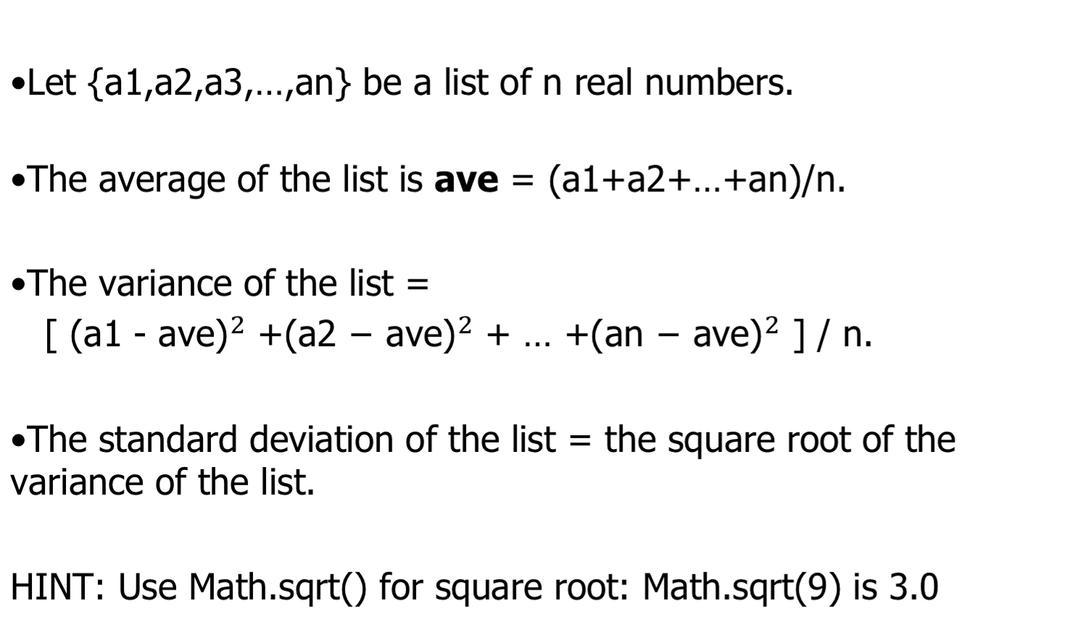
Lab 1

Slide 23
Lab 1
For example, if the list is {78,80,77}.
Average =78.33333333333333
Variance = 1.5555555555555556
Standard deviation = 1.247219128924647

Slide 24
Lab 1
Create a new repl on repl.it and follow the comments below to write a program that compute some statistics.
public class Statistics
{
public static void main(String[] args)
{
/* 1. Declare 3 int variables for grades and initialize them to 3 values
2. Declare an int variable for the sum of the grades
3. Declare a double variable for the average of the grades
4. Write a formula to calculate the sum of the 3 grades
5. Write a formula to calculate the average of the 3 grades from the
sum using division and type casting.
6. Print out the average
7. Declare a double variable and calculate the variance
8. Declare a double variable to compute the standard deviation.
9. Print out the variance and standard deviation.
*/
}
}

Slide 25
Lab 2
Use the following template(or something similar) to write a program that gives exact change with the least number of coins for a given number of cents.
import java.util.*;
public static void main(String[] args){
Scanner console = new Scanner(System.in);
int totalCents = console.nextInt();
int quarters, dimes, nickels, pennies;
…..
// your code here.
}
Suppose that the input above is 137. Then the output would be:
Output: 5 quarters, 1 dimes, 0 nickels, 2 pennies.

Slide 26
References
For more tutorials/lecture notes in Java, Python, game programming, artificial intelligence with neural networks:
https://longbaonguyen.github.io
Building Java Programs: A Back to Basics Approach by Stuart Reges and Marty Stepp
2) Runestone CSAwesome Curriculum: https://runestone.academy/runestone/books/published/csawesome/index.html

