Slide 1
Introduction to Processing
The Basics

Slide 2
Processing
Processing started by Ben Fry and Casey Reas while both were graduate students at MIT Media Lab in 2001.
Processing is Java.
Designed for visual artists with limited programming experience who want to create art without knowing complicated Java syntax.
In its current version, hundred of libraries have been written for computer vision, data visualization, music composition, networking, 3D drawings and programming electronics.

Slide 3
Structure of a Sketch
A sketch or program in processing only needs two methods: setup and draw.
setup() is similar to a constructor, it initializes variables.
draw() is similar to the main method.
void setup(){
…
}
void draw(){
…
}

Slide 4
setup()
//declare global variables on top
//setup() is called automatically to initialize variables, runs ONCE.
// it is good practice to initialize variables here, calling it explicitly later, for
// example, can reset your game.
void setup(){
…
}
void draw(){
…
}

Slide 5
draw()
void setup(){
…
}
// draw is called automatically 60 times a second(similar to an infinite
// while loop). If you draw an object then update it, draw will
// animate the object.
void draw(){
…
}

Slide 6
File System
When a sketch is saved, Processing will create new folder whose name matches the name of the sketch(without the .pde extension).
For example, if I save the sketch below as Game.pde, then Game.pde is in a folder called Game.
void setup(){
…
}
void draw(){
…
}

Slide 7
Example
int x, y; //declare global variables
//initialize them in setup().
void setup(){
x = 5;
y = 10;
}
// modify and update them in draw().
void draw(){
x += 1; //x increases by 1, 60 times per second.
}

Slide 8
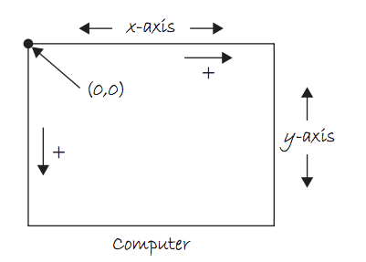
The Coordinate System

Slide 9
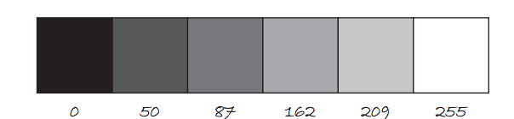
Color
Color is defined by a range of numbers.
In grayscale, 0 is black, 255 is white and any color in between is a shade of gray ranging from black to white.

Slide 10
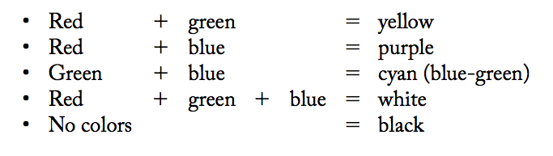
Color
RGB Color is determined by three parameters. Each parameter is in the range 0-255. The first indicates the degree of red(R), the second the degree of green(G) and the last the degree of blue(B).

Slide 11
Some Methods
size(int width, int height): Set the size of the window. This should go in setup(). width and height are reserved words referring to the size of the screen.
background(int range): range can be any integer from 0=black to 255=white. This should go in draw().
background(int r, int g, int b): Background with RGB values. This should go in draw().

Slide 12
Some Methods
fill(int r, int g, int b):By calling fill BEFORE a shape will set the color of the shape. Call it again before drawing another shape to change color.
strokeWeight(int pixel): Call BEFORE drawing a shape will set thickness of the boundary.
line(int x1, int y1, int x2, int y2):
ellipse(int x, int y, int width, int height): center of ellipse is (x, y); width and height are the lengths of the axes.
rect(int x, int y, int width, int height): position is top left corner by default.

Slide 13
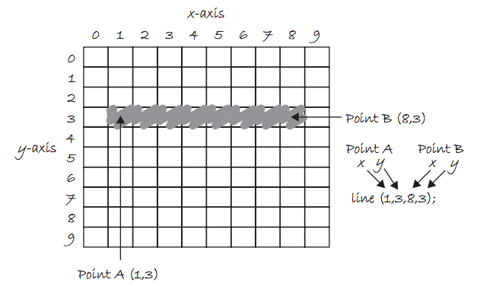
Draw a Line

Slide 14
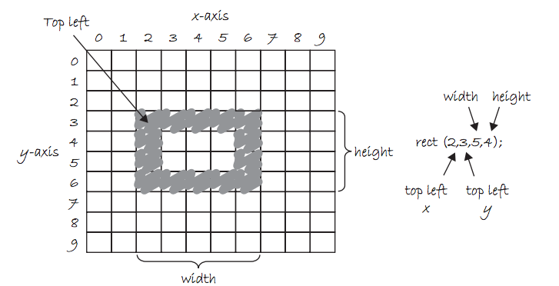
Draw a Rectangle

Slide 15
Adding Text
The text(String, int x, int y) function draws text on the screen.You can set the text size and color by using textSize(int s) and fill(int r, int g, int b) before drawing the text.
textSize(32);
fill(255, 0, 0);
text("Hello, World!", 100, 200);

Slide 16
Example 1
int x,y;
void setup(){
size(800,600); // 800 pixels by 600 pixels
x = width / 2;
//width=800, height=600, these variables are reserved.
y = height / 2; }
void draw(){
background(255);//white background
fill(255, 0, 0);//red fill
ellipse(x, y, 80, 80);//red-filled circle radius 40
//continued on the next slide…

Slide 17
Example 1 Continued..
fill(0, 255, 0);//green fill
ellipse(x, y, 80, 80);//green-filled circle radius 40
fill(0, 0, 255); //blue fill
//blue filled rectangle at (40,50) width=60,height=70
rect(40, 50, 60, 70);
}

Slide 18
Example 2:Make it move.
int x, y, xspeed = 5;
void setup(){
size(600,400);
x = width/2;
y = height/2;}
// make a red circle moves horizontally
// across the screen
void draw(){
background(255);//white background
fill(255,0,0); //fill red
ellipse(x,y,80,80);
x += xspeed; //moves 5*60=300 pixels per sec.
}

Slide 19
Processing (keyPressed)
The draw() loop runs continuously until it is interrupted by an event, for example, a keyboard or mouse event.
If a key is pressed, draw() temporarily halts, Processing then jump execution to the keyPressed() function, runs the function’s code then return control to the draw() loop. The key that is pressed is store in the key variable.(or keyCode if it is a special character, e.g. UP, DOWN, LEFT, RIGHT).
Similarly, if a key is released, keyReleased() is called.
Notes:
19

Slide 20
Processing (keyPressed)
void setup(){…}
void draw(){…}
// call automaticaly IF a key is pressed.
void keyPressed(){
if(key == 'a'){
//for letter keys
//code to run if ‘a’ is pressed.
}
if(keyCode == UP) {
//for arrow keys: UP,DOWN, LEFT, RIGHT
//code to run if UP is pressed.
}
}
Notes:
20

Slide 21
Processing: Mouse Events
Processing keeps track of the position of the mouse at any given time through the variables mouseX, mouseY.
Similar to keyPressed, which responds to keyboard inputs, mouseClicked is a function that can be implemented to respond to the mouse being clicked. IF the mouse is clicked, mouseClicked is called and code can be implemented to respond to the click.
Notes:
21

Slide 22
What does it do?
int blue = 0;
void setup(){
size(600, 600);
}
void draw(){
background(255);
fill(255, 0, blue);
ellipse(mouseX, mouseY, 100, 100);
}
void mouseClicked(){
if (blue == 0)
blue = 255;
else
blue = 0;
}
Notes:
22

Slide 23
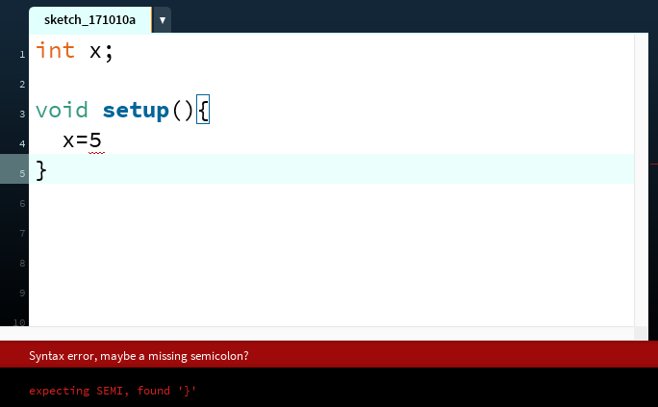
The Console
The console refers to the box at the bottom of Processing. It is generally used to print error messages in the code.
Notes:
ask them, how might the computer store "hi" using binary digits? (some kind of mapping; ASCII)

Slide 24
The Console
Messages can be printed on the console(for error-checking purposes, etc..) by using the command println() or print().
println(4);
println(4 + 3/2);
println(“Hello, world”);
Notes:
ask them, how might the computer store "hi" using binary digits? (some kind of mapping; ASCII)

Slide 25
float vs double
float: 32-bit data type representing real numbers to about 7 decimal places.(Not on AP Exam)
double: 64-bit data type representing real numbers to about 16 decimal places.

Slide 26
float vs double
Since Processing is graphics intensive, it is recommended that
floats are used instead of doubles. In fact, float is the default type
for decimal numbers in Processing. All of the built-in math functions in
Processing returns floats. The math functions from the standard Math
library in Java returns doubles.
//sqrt() is Processing’s version of Math.sqrt(). Both are available in Processing
print(Math.sqrt(9)); // 3.0 but is a double
print(sqrt(9)); // 3.0 but is a float

Slide 27
Download Processing
Download Processing in your computer at home!
Your computer is probably a 64-bit computer if it’s fairly recently. Use the 64-bit version.
http://www.processing.org

Slide 28
Things to Try
Lab 1: Make the ball move horizontally back and forth in the middle of the screen, bouncing each time it hits the left or right side of the screen.
Modify your code so that it is moving in a diagonal direction and bouncing when it hits any side of the screen.

Slide 29
Things to Try
Lab 2: Use mouseX and mouseY to write a program that draw a red ball which follows your mouse.

Slide 30
Things to Try
Lab 3: Create a window of size 800p by 600p. Use for loops to draw horizontal and vertical lines every 100 pixels. You can use strokeWeight(int p) to adjust the thickness of the lines.

Slide 31
Things to Try
Lab 4: Draw a blue rectangle at the center of the screen. Let the user move the rectangle up, down, left, right using the keyboard arrow keys. Hint: It is better(more smooth) if you use both keyPressed and keyReleased.

Slide 32
References
For more tutorials/lecture notes in Java, Python, game programming, artificial intelligence with neural networks:
https://longbaonguyen.github.io
Processing’s website: www.processing.org
https://processing.org/tutorials/

